Slide 1
Digital Accessibility for CMS Users
Suzy Shipman
Web Services, IS

Slide 2
What is Accessibility?
Making sure the website can be used by as many people as possible including people with impairments to their:
Vision
Hearing
Mobility
Thinking and understanding
Notes:
Let’s start off by thinking about what we really mean by accessibility.
It’s actually quite a simple definition
‘Making sure the website can be used by as many people as possible’
So that people with impairments can use it just as well as anyone else
Vision – might be blind, partially-sighted or colour blind
Hearing – deaf or hard of hearing
Mobility – might find it difficult to use a mouse or a keyboard
Thinking and understanding – people with dyslexia, autism, learning difficulties

Slide 3
Why is Accessibility important?
Equality!
At least 1 in 5 people in the UK have a long-term illness, impairment or disability
New accessibility legislation
Notes:
Why is it important?
Well the main thing is equality. With the web being so important these days it’s vital that everyone can access the information there.
A lot of services rely on web pages, and if they’re not accessible, people can’t do those important, everyday tasks
And there are a lot of people who need this. 1 in 5 people in the UK have a long-term illness, impairment or disability.
So there’s a big chunk of our audience out there who might need to use assistive technology or view our pages in a different way
And of course the real push for us to be trying to improve accessibility is the new legislation.
We have to improve our site, and make sure users are aware of how they can use the site and what we’re working on

Slide 4
Remember
This is about people not just about compliance!
All of the improvements we need to make are going to make life easier for people.
You may be disabled, or may become disabled in future. Our improvements will help you.
Making a website more accessible helps everyone
Notes:
While the legislation is the big push here, we need to remember it’s not just about that.
It’s about people!
All the changes we’ll make are going to make life easier for people, lots of people.
You might be disabled or might become disabled, and these improvements could help you.
And of course, making a website more accessible helps everyone – not just those with disabilities and impairments.

Slide 5
Our Responsibilities (IS)
We are responsible for the website as a whole, for example we make sure that:
  People can move around pages without a mouse
  People can enlarge text
  Images used in the site design have alternative text
  Everyone can use our forms
  Colours used have sufficient contrast
Notes:
Now this may seem a bit daunting, but it’s not all down to you to fix everything!
My team is responsible for the site as a whole so it’s going to be our job to make many of the changes so that everyone can use our site.
Eg.
Mouse – making sure people can move around and use our site with a keyboard alone
Text – making sure people can enlarge the text if they need to without the page getting into a mess
Images – making sure that images we use in the site design, like logos and awards have alt text
Forms – making sure our forms work well, like making sure it’s clear what a box is for, and making sure errors are clear if people don’t fill out a box or put something in that is not accepted
Colours – making sure the text colour and background colour work ok together and aren’t hard to read

Slide 6
Your responsibilities (CMS Users)
You are responsible for your content, for example:
  Language
  Page structure
  Layout
  Links
  Tables
  Images
  Media (e.g. documents and videos)
Notes:
From your side of things it’s the content within the page that you need to focus on.
There are 7 main areas that you need to think about when using the CMS
Language – does what we’re saying make sense?
Page structure – is our content structured in a way to make it easy to navigate and understand?
Layout – are we laying out our content in a way that makes it easy to read and understand?
Links – are we letting people know where they’re going when they click on a link?
Tables – are we making sure people can understand what our table contains?
Images – are we providing alternatives for people who can’t see our images?
Media – are we providing documents and videos (etc) in a format where everyone can use them?

Slide 7
Language
People need to understand what we are saying
  Use plain English (or Welsh)
  Use the simplest words possible
  Don’t use jargon
  Give clear direction
  Check spelling and grammar
Notes:
So we’re going to work through these areas.
First off language

Slide 8
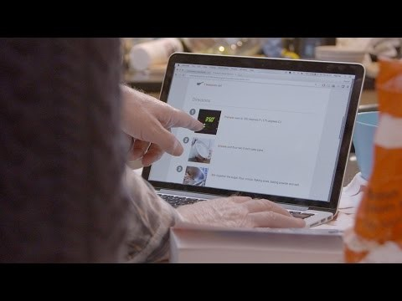
User Perspectives (language)
Notes:
We’ll have a look now at what a difference language can make for everyone

Slide 9
Page structure
People use the site in different ways which rely on well-structured content
They may use a screen reader, and move about using their keyboard
It’s important that they know where they are on the page
Do:
  Use appropriate headings
Don’t:
  Use bold or underlining to mark text as a heading
Notes:
Structure
Some people will be accessing our site using different tools.
These tools will look for headings so that the user can skip to a different topic
If we don’t use proper headings this won’t work and they’ll need to view/have read the whole page
We might just make text bold or underlined and that would show it’s a heading to a sighted user, but nobody else would know they’re headings

Slide 10
Why is page structure important?
Let’s try it out…
https://www.aber.ac.uk/en/training/digital-accessibility/try-it-out
Notes:
Let’s have a look at what kind of experience a person using a screen reader might have.
Open the link and click on SilkTide Screen reader simulator
Use H to jump from heading to heading

Slide 11
How to set a heading in the CMS
Type your text
Select it
Click on the Format menu
Choose Formats
Choose Headings
Click on the heading you
want to use
How the CMS helps you
The CMS only allows you to create a Heading 2 or below in the content editor.
You can check whether text is a heading by selecting it and checking what is shown at the bottom of the editor window.
Notes:
We should create headings as we create content
CMS only allows the right heading level
But if you copied text in, you might need to fix it up
Check if text is a heading and fix it if it’s not

Slide 12
Layout
Large paragraphs of text can be hard to read.
  Keep sentences short
  Keep paragraphs short
  Split your content with relevant headings
  Keep your text aligned to the left
  Use bullet points
Notes:
The layout of the page can be very important for understanding the page.
People with dyslexia or other cognitive difficulties can find it hard to read a lot of text at once.
If someone is magnifying their screen, long sentences and paragraphs can be hard to take in

Slide 13
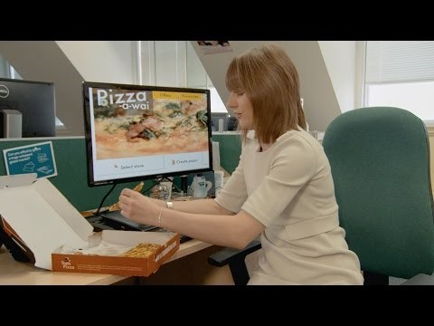
User perspectives (layout)
Notes:
Here’s a user perspective of web layout
This is more about the overall layout which you can’t really change, but it does illustrate what a difference it can make to lay out your page well

Slide 14
Links
What is a friendly link?
Does the link text tell the person where the link goes without needing to read the text around it?
If it does, it’s friendly!
People need to know where links
are taking them.
Do:
  Use friendly links
Don’t:
  Use the same text for links that are going to different places
  Use ‘click here’ as your link text
Notes:
You probably remember me talking about friendly links in CMS training
These are important for everyone, but especially people using screen readers.
The links are read out and you can just have it read them and not the text around them.
Don’t use repeated text for different links
Make sure links are friendly

Slide 15
Why are friendly links important?
Let’s try it out…
https://www.aber.ac.uk/en/training/digital-accessibility/try-it-out
Notes:
Let’s take a look at how users can skip through the links on a screenreader
Open the link and click on SilkTide Screen reader simulator
Use K to jump from link to link

Slide 16
Tables
What is a data?
Data is a list of items that can be placed under a number of headings. E.g. a list of staff names, phone numbers and email addresses.
People accessing the website in
different ways need to understand
what a table contains
  Only use a table when you need to
  display data
  Always use headers to explain
  what’s inside the table
  Don’t resize the table
Notes:
Tables are another area I talk about in CMS training
We need to make sure we only use them for data
Must use headings
And don’t resize

Slide 17
How to add headings to a table
Add a new row at the top of
the table
Type the header text into the
row
Select all the cells in the row
Right click and choose Cell
Choose Cell properties
Set Cell type to Header cell and Scope to Row
Click OK to finish
How the CMS helps you
The CMS only allows you to create a table with headers.
You should only need to add headers if you’ve pasted the table in from elsewhere and it doesn’t already have headers.
Notes:
If you have a table without headings you can add them.
Creating a table within the CMS only allows you to have headers (row, or both row and column)

Slide 18
Images
We need to provide alternatives if people using our site can’t see our images
  Decorative images
  Images with purpose
    Images that don’t contain text
    Images containing text
    Images containing charts, graphs or diagrams
Notes:
Now images are a big topic.
We need to provide alternatives to images, but what we do depends on the type of image

Slide 19
Decorative Images
How the CMS helps you
You can easily add alternative text to an image by double clicking on it in the editor and typing the text into the Alt box
If an image is purely decorative
it doesn’t have to have alternative
text
But, is it really just decorative?
Most images have a purpose
of some sort
If in doubt…
add alternative text!
Notes:
Starting off with decorative images
If it’s purely decorative don’t need alt text
But how do you decide?
E.G signpost mentoring – picture of students talking over coffee, in a nice environment, gives a warm, friendly, supportive feel
So is that decorative?

Slide 20
Is this a decorative image?
https://www.aber.ac.uk/en/student-support/current-students/peer-support/

Slide 21
Images with purpose
Is the image:
  Used to contribute to the ‘feel’ of the page?
  Used to convey information?
  Referred to in the text?
  Used for navigation?
If the answer to any of these questions is yes then the image does have purpose and needs alternative text
Notes:
Some images have a much clearer purpose
Easy – we need to give them some kind of alternative text

Slide 22
Images that don’t contain text
What should we put in the alternative text?
Do:
  Briefly describe the image
  Bear in mind the context of the page
  If the image is clicked on to carry out an action, describe the action, not the image
Don’t:
  Use ‘photo of...’ or ‘image of…’
  Describe the image in lengthy detail
Notes:
So – image with purpose
Without text
What should we put in the alt text?

Slide 23
Why is alternative text important?
Let’s try it out…
https://www.aber.ac.uk/en/training/digital-accessibility/try-it-out
Notes:
Lets demonstrate what a screen reader would do
Open the link and click on SilkTide Screen reader simulator
Prev/Next buttons to have it read out the Image alt text

Slide 24
Images containing text
For images containing text we must provide an alternative way to view the text
Small amount of text (e.g. logo or award badge):
  Put the exact text in the alternative text
Large amount of text
(e.g. an infographic)
  Create a new CMS page containing
  the text from the image
  Link up the image to the new page
Note:
Check the text in the image has sufficient contrast with the image background
Notes:
What about if the image contains text?
Small amount – alt
Large amount – new page
Make sure the contrast in the image is good enough

Slide 25
Images containing charts, graphs or diagrams
These images must have a description or an alternative way to view the information
  Alternative text describing what the
  image conveys
  Table of data used in the chart or graph in
  the image
  Link to a new page giving a detailed
  description of the image
Note:
Make sure that the chart, graph or diagram can still be understood if it is displayed in black & white rather than colour
Notes:
These are special and we need to make sure that we can convey the message shown in the chart/graph/diagram in another way
Alt
Table of data
Link to page
Remember don’t use only colour in a chart to distinguish between lines or bars – see if you can still understand it if it’s in black and white. If not you need to make changes

Slide 26
Video
Think about:
  People who can hear the video but can’t see it
  People who can see the video but can’t hear it
You need to provide:
  Captions and/or transcript
You may also need to provide
  Descriptive text transcript
  Audio description
Notes:
Video.
For this you’re thinking about 2 main groups of people
People who can hear it but not see it
People who can see it but not hear it
Need captions and/or transcript
If there is something going on visually in the video but it’s not described in the narration or nobody is speaking, you may need to add a descriptive text transcript or an audio description so a person who can’t see the video still understands what is happening.
If there is something going on in the audio, but there’s nothing on the screen to say what is happening, you may need to add a descriptive text transcript to explain.

Slide 27
But we don’t make our own videos!
In that situation you need to:
  Make sure that the person/company making your video knows it needs to be accessible
  Don’t accept the video unless it is accessible
Notes:
We no longer have a video team
So we’re more likely to be going external
Put accessibility into your spec /requirements

Slide 28
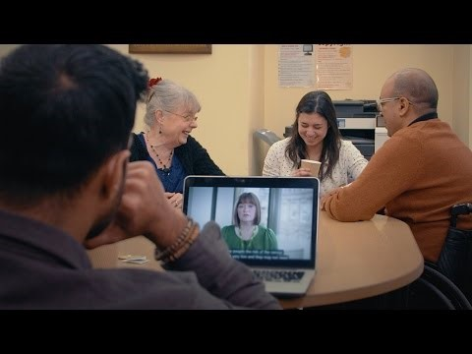
User perspectives (video)
Notes:
User perspective
It’s not just people with impairments we’re helping – also people in loud places, or quiet places

Slide 29
Documents
  Use clear, simple language
  Keep sentences and paragraphs short
  Use bullet points
  Use page heading styles (rather than bold or underline)
  Add alternative text to images, tables and diagrams
  Avoid using colour alone to communicate an idea

Slide 30
Documents continued
  Ensure sufficient colour contrast
  Use a sans-serif font, avoid italics, underlining and all caps
  Use 1.5 line spacing
  Use friendly links
  Keep text aligned left

Slide 31
Word or PDF?
Both!
Some people with particular impairments will prefer one or the other
Don’t Panic!
Document accessibility is covered in more detail in the LTEU training session ‘Creating Accessible Learning Materials’

Slide 32
Putting it into practice
We’ll look at a page and ask ourselves:
  What can you see that’s wrong with this page?
  What about the things you can’t see?
Notes:
So now you’ve been sat there listening to me for ages, let’s see if we’ve learnt anything! ☺

Slide 33
What can you see?
Discuss with your neighbour any visible problems with this page
I’ll then ask each pair to tell me one thing they’ve spotted

Slide 34
What’s wrong with this page?
www.aber.ac.uk/dat
Notes:
Here’s the page to look at

Slide 35

Did you spot these?
  Spelling mistake in the main heading
  Justified text in the first paragraph
  Long first paragraph with unnecessarily complex words
  Table not filling the full width of the page
  No table headers
  Doubled words in SharePoint row of table
  Graph relies on colour to convey information
  Link text that just says ‘here’
  Heading 1 down the bottom of the page
  Image with poor contrast at the bottom of the page
Notes:
Go through the items on the list and see if we spotted them all
If any were missed, return to the webpage and point them out

Slide 36
What about the things you can’t see?
Some issues can’t be seen by just looking at the page!
You can choose to inspect areas of the page in the browser (Chrome):
  Right click on an image and choose Inspect, look at the highlighted code and see if there is anything after ‘alt’.
  Right click on text that acts as a heading and choose Inspect. You’ll see the HTML code for the page with the text you clicked on highlighted. Look for tags like <h1> or <h2>.
Or you can use the CMS editor:
  Double click on an image to see if it has alt text
  Select text that acts as a heading and the formatting used will show in the bottom of the editor window
Notes:
Show on screen how to inspect image and heading
Show in CMS too

Slide 37
The future
We’re hoping to get an audit tool which can warn us when things aren’t quite right, including:
  Spelling errors
  No alternative text
  Broken links
  Repeated links using the same text
  Incorrect headings
Notes:
Not everything can be picked up by an audit tool, but it will make it easier for us to see what our main issues are so we can get them fixed up.
Start of the process = audit
For future we’d get regular updates of how the site is doing and if there are new problems to fix.

Slide 38
Summary
Accessibility is important
Accessibility is required
You are responsible for your content
It’s not hard if you consider it as part of preparing your page ☺

Slide 39
Help and Support
Of course, that’s not the end of the story…
We’re here to help
Contacts
  IS Helpdesk: is@aber.ac.uk ,2400
  Suzy Shipman: sfs@aber.ac.uk, 8785
  digital-accessibility@aber.ac.uk
Digital Accessibility web pages:
  General guidance for staff
  https://www.aber.ac.uk/en/accessibility/guidance-staff/
  Information for CMS users
  https://www.aber.ac.uk/en/is/it-services/web/compliance/accessibility/
Looking for the accessibility web pages?
Scroll to the bottom of any of our webpages and click on Accessibility.

