Slide 1
Learning analytics: How can evidence from Aspire reading list management system enhance the learner experience?
By
Sahm Nikoi (skn@aber.ac.uk) & Sarah Gwenlan (ssg@aber.ac.uk)
(Information Services : Academic Engagement Group)

Slide 2
What is learning analytics?
“Learning analytics uses data about students and their activities to help institutions understand and improve educational processes, and provide better support to learners”. (JISC)
Learning analytics is the measurement, collection, analysis and reporting of data about learners and their context for purposes of understanding and optimising learning and the environments in which it occurs (Society for Learning Analytics)

Slide 3
Learning analytics and the HE context
Virtual learning environments (e.g. Blackboard) allow managers, teachers and researchers to easily gather an immense quantity of data regarding students’ behaviour, interactions, preferences and opinions. When properly analysed, all these data might provide useful insight on how to make learning processes more adaptive, attractive and efficient.
(Source: http://openthoughts-analytics.blogs.uoc.edu/about-the-question/)

Slide 4
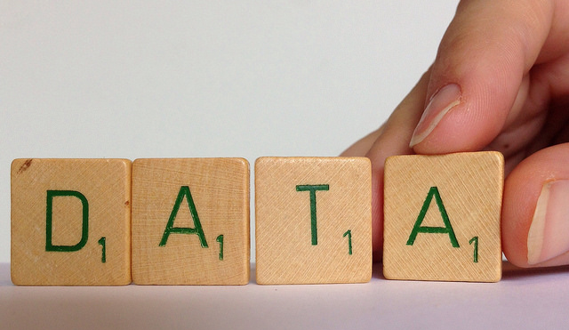
Big data bring big questions
How can we use learning analytics techniques to provide better support to our students?
How can we take advantage of big data and analytics to help shape the learner experience?
How can we integrate data mining into pedagogical theory? Example use data about students to provide better feedback.
Notes:
Learning analytics is about “Thinking with broken images versus thinking with clear images”

Slide 5
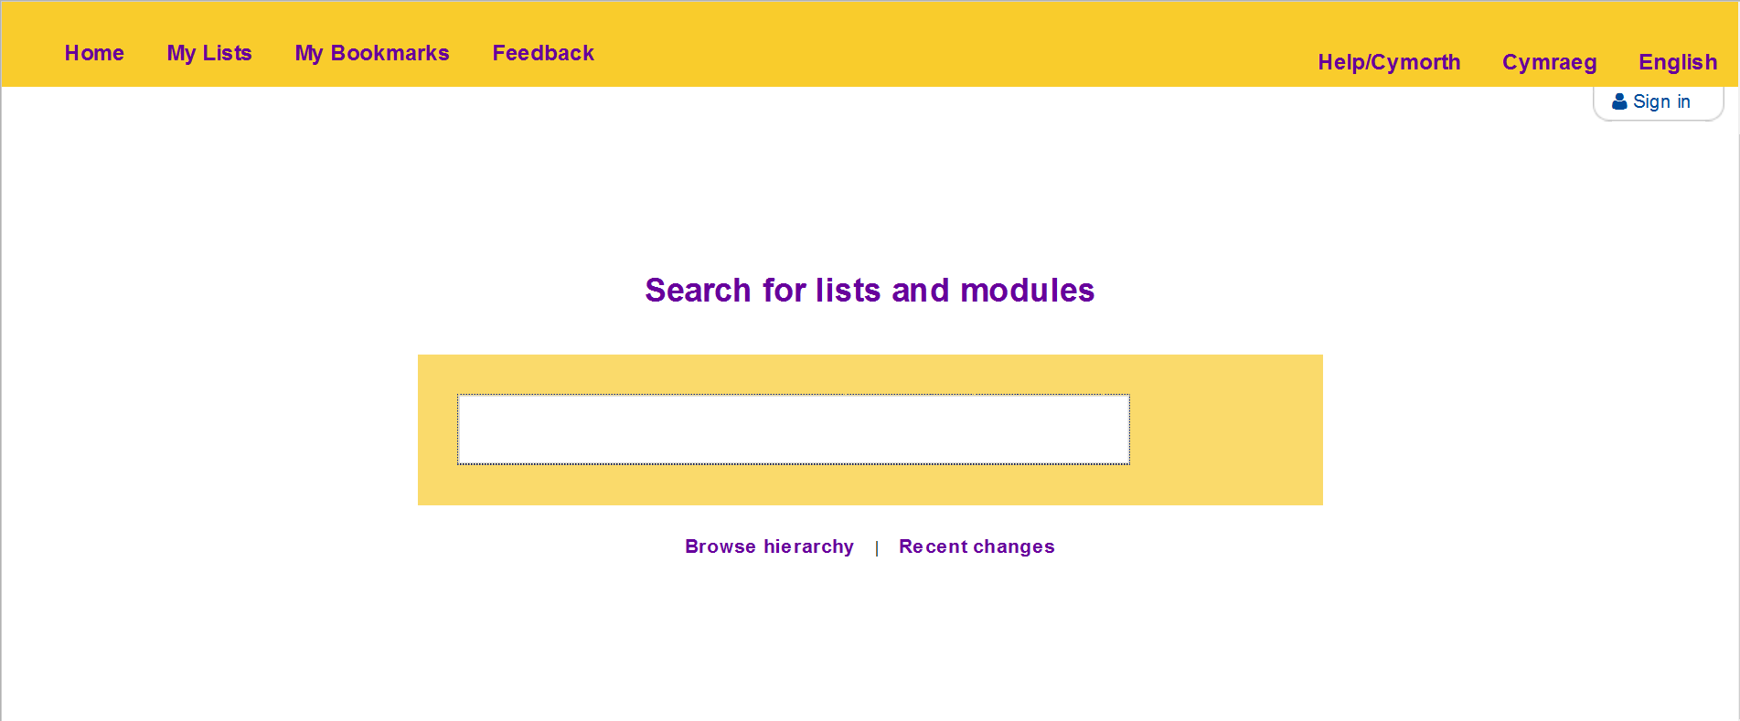
Talis Aspire
http://aspire.aber.ac.uk/

Slide 6
The Information Services context
Assess resource health and create the right level of stock
Improve allocation and utilisation of resources
Improve purchasing decisions based on data availability
Improve workflow efficiencies
Improve information skills training

Slide 7
The Academic context
Useful for updating module reading list
Increased student engagement and feedback
Support at risk and underperforming students
Resource recommender (different editions)
Learn about study reading habits

Slide 8
The learner context
Evidence of personal reading intentions / records
Popular resources
Engagement with content based on study notes
Customise citation styles, hence improved referencing

Slide 9
Examples from Aspire dashboard
Student annotations
Library availability
Item clicks
Improving the item
Metadata quality
Citations

Slide 10
Where do we go from here
POSITIONING
IMPACT MEASURES | Present (What is happening) | Future (Trends)
Information (fact based) | Reports/Descriptions | Extrapolation
Insight (understanding) | Recommendations | Predictions (dispositional, activity & performance)
Adapted from: Davenport, T. H., Harris, J. G., & Morison, R. Analytics at work : Smarter decisions, better results. Harvard Business Press, 2010.
Notes:
Generating insight: 1. How and why did something happen? (explanation). 2. What is the next action (recommendations) 3. What is likely to happen (alternative and optimal course of action).

Slide 11
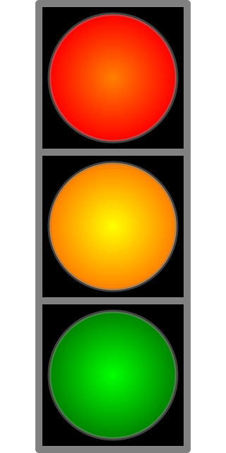
Maximising benefits of learning analytics
Integrated learning analytics
Student learning success
Aspire
Blackboard
Primo
High risk
Moderate risk
Low risk
Resources learning Student performance
PREDICTION

Slide 12
Key issues & challenges: IS perspective
The danger of data driven acquisition i.e. of buying only what has been used
Reading list policy and collection development
Information glut and obesity

Slide 13
Key issues & challenges : Academic perspective
The danger of false positives / negatives
Danger of being data driven (Non quantitative aspects of the learner experience ignored and not measured)
Is this a good measure of learner behaviour?
Interpretation accuracy and validity of the data
Implications for adaptive teaching

Slide 14
Key issues & challenges – learner perspective
What implications for information skills training
Big brother is watching syndrome (Ethics & privacy)

Slide 15
THANK
YOU

Slide 16
Further information
Buckingham Shum, Simon (2012). Learning Analytics Policy Brief UNESCO.
Cooper, Adam. A Brief History of Analytics A Briefing Paper. CETIS Analytics Series. JISC CETIS, November 2012. http://publications.cetis.ac.uk/wp-content/uploads/2012/12/Analytics-Brief-History-Vol-1-No9.pdf
EducationalDataMining.org".
Eli (2011). "Seven Things You Should Know About First Generation Learning Analytics.". EDUCAUSE Learning Initiative Briefing.
Ferguson, Rebecca. The State of Learning Analytics in 2012: A Review and Future Challenges. Technical Report. Knowledge Media Institute: The Open University, UK, 2012. http://kmi.open.ac.uk/publications/pdf/kmi-12-01.pdf
Gašević, D.; Dawson, S.; Siemens, G. (2015). "Let's not forget: Learning analytics are about learning" (PDF). TechTrends 59 (1): 64–71
Greller, Wolfgang; Drachsler, Hendrik (2012). "Translating Learning into Numbers: Toward a Generic Framework for Learning Analytics." . Educational Technology and Society 15 (3): 42–57.
Kay, David, Naomi Kom, and Charles Oppenheim. Legal, Risk and Ethical Aspects of Analytics in Higher Education. CETIS Analytics Series. Vol.1 No.6. November 2012.
Long, P. and Siemens, G., (2011). "Penetrating the fog: analytics in learning and education.". Educause Review Online 46 (5): 31–40.
Powell, Stephen, and Sheila MacNeil. Institutional Readiness for Analytics A Briefing Paper. CETIS Analytics Series. JISC CETIS, December 2012. http://publications.cetis.ac.uk/wp-content/uploads/2012/12/Institutional-Readiness-for-Analytics-Vol1-No8.pdf
U.S. Department of Education, Office of Educational Technology. "Enhancing Teaching and Learning Through Educational Data Mining and Learning Analytics: An Issue Brief“

Slide 17
Photo credits
Data: https://www.flickr.com/photos/jannekestaaks/14391223825/in/photolist-nVGMsH-pqEnLW-8HWjHJ-9HnLop-iimFDf-6V2MkR-qntpoT-faq2B4-dHo3mh-ap9rFX-kwvSLc-f1L5Rk-avnpd5-a9GV9e-imfDLH-q8ZhdE-q8Zh6A-q8ZgEq-q8ZgpL-qb6knr-fh7UPq-e1pJM8-6UZFV4-b66o1x-eWMecV-7cDQve-6UKMs7-aZCin8-aYNPqD-8yyKdK-aZhu44-pTGtd5-82ogTi-kwxwoA-qbdmhQ-pevGq2-qbdkWE-qbdkDL-pTQfMt-qbgxqP-9jNjtj-9w3DwZ-bUY1mb-rRVNZj-o95xT7-nv3C61-enHZuK-ddn7sf-7n3F19-ci6cjo/
Book spiral: https://pixabay.com/en/book-books-bookshelf-read-774837/
Cap & gown: https://pixabay.com/en/graduation-man-cap-gown-education-879941/
Dashboard: https://pixabay.com/en/auto-steering-wheel-interior-466111/

