Slide 1
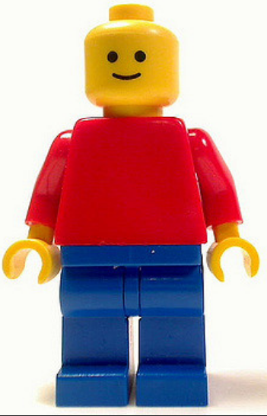
Learning with Lego
Sarah Higgins – Information Studies
sjh@aber.ac.uk

Slide 2
ILM1620: Management of Archive Services
20 credit core module for MA Archive Administration
Archive buildings have very specific design criteria to ensure:
Long-term preservation of materials
Efficient customer services
One learning outcome is:
‘List the major considerations to be taken into account in planning, designing and managing an archive building’
Originally covered in a 2 hour lecture

Slide 3
ILM1620: Management of Archive Services
Core text is:
PD 5454:2012: Guide for the storage and exhibition of archival materials
Contents:
The storage environment for archival materials
Storage repository site
Repository construction
Fire protection and prevention

Slide 4
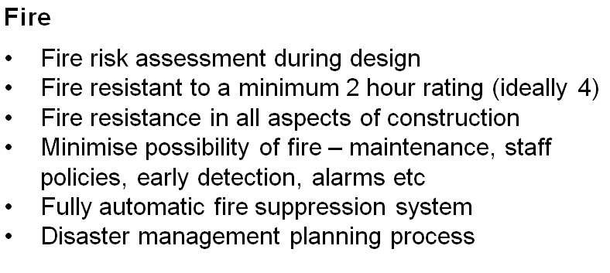
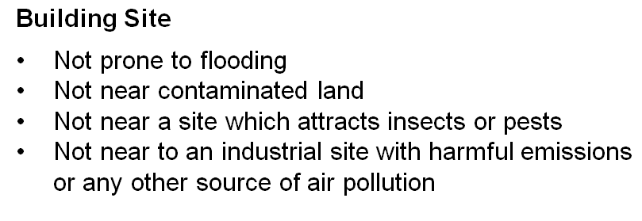
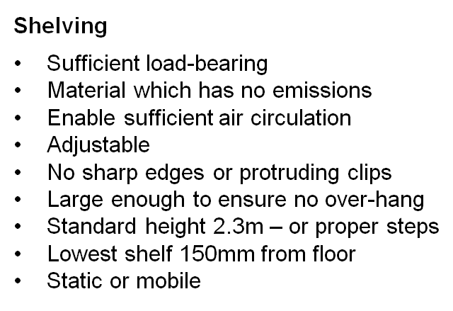
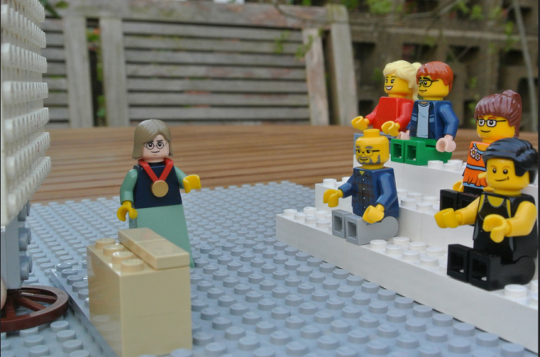
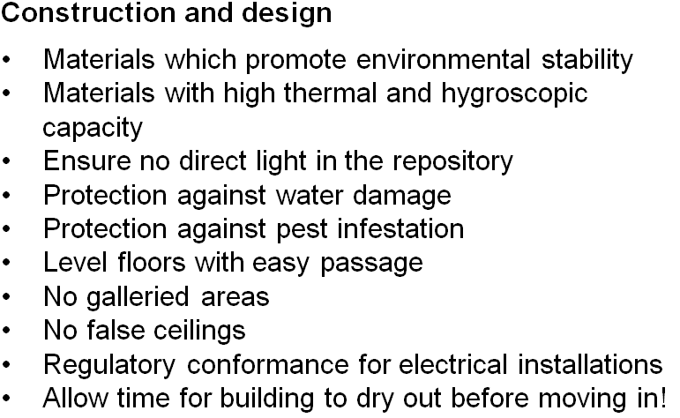

Slide 5
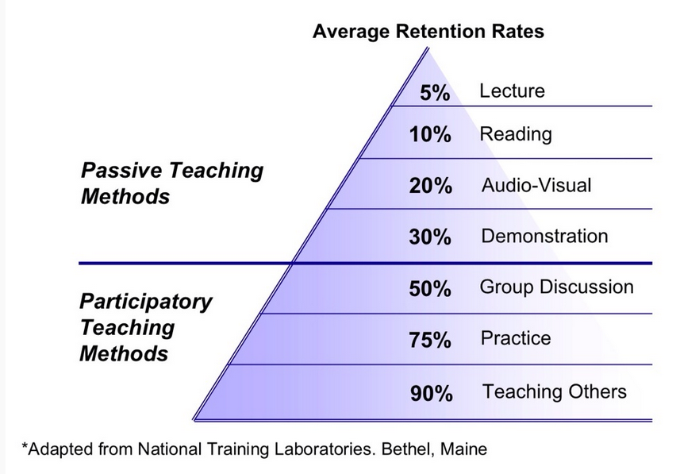
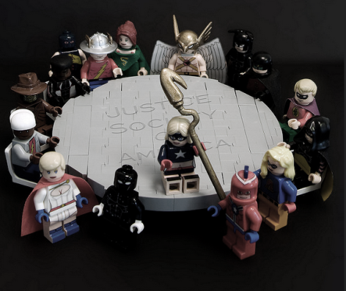
Participatory learning
/
Aitoff: https://pixabay.com/en/stormtrooper-egg-lego-storm-1351022/
Julian Fong:
https://www.flickr.com/photos/levork/3990253363
http://classroom-aid.com/2014/03/10/good-practice-guide-and-use-case-studies-of-mobile-learning-mlearning

Slide 6
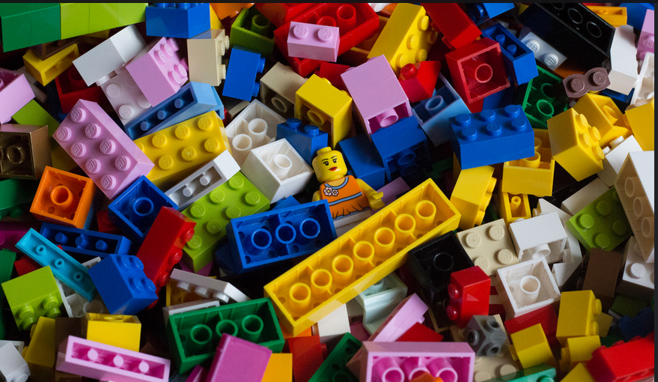
Lego
Manufactured since 1949
600 billion Lego parts manufactured to July 2015
Described as ‘the world’s most powerful brand’
All pieces compatible and will interlock with other pieces
https://en.wikipedia.org/wiki/Lego
Curtis McHale: https://www.flickr.com/photos/curtismchale/16306436574

Slide 7
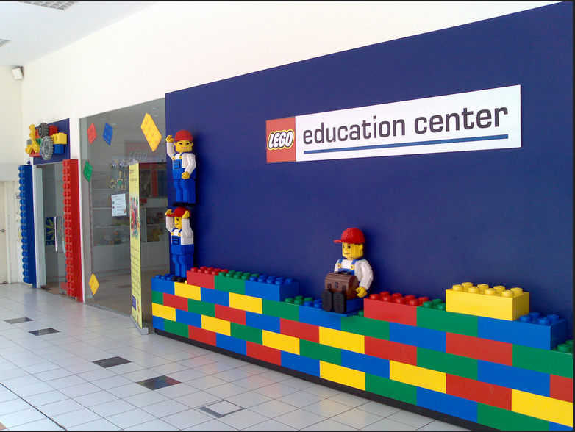
Lego and education
‘getting hands-on inspires pupils to actively enquire and explore a particular topic, allowing them to understand the real-world application of the theories being taught’
‘builds up teamwork, communication abilities and strong collaboration’
‘pupils are enthusiastic and eager to learn’
‘builds critical thinking and creativity’
https://education.lego.com/
Kokeshi:
https://www.flickr.com/photos/kokeshi/234790558

Slide 8
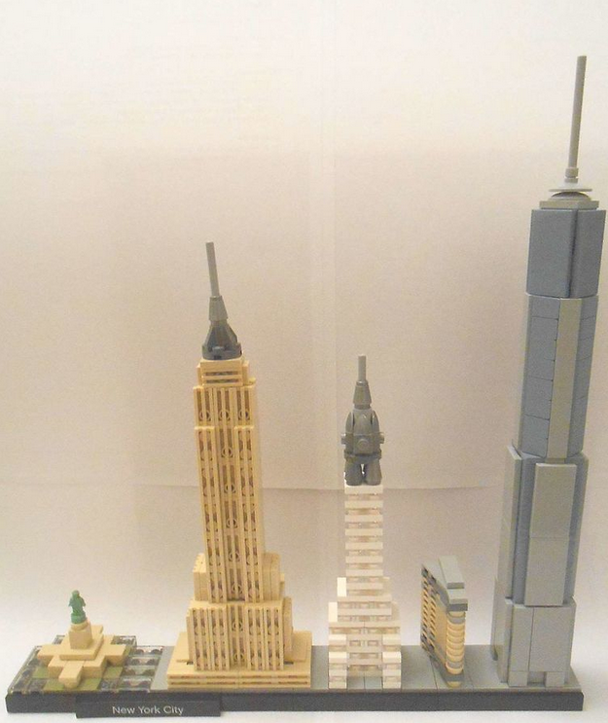
Lego architecture
First produced in around the 1970s for the professional architecture market
Micro-bricks
Reintroduced in 2008
Models of famous landmarks
Information Studies owns large sets used by a library design researcher in the past
Lying unused in Thomas Parry Library
https://commons.wikimedia.org/wiki/File:Skyline_new_york_lego_architecture.JPG

Slide 9
Redesigning the lesson
Booked room with group work tables
Moved class to last one before Christmas
Assigned reading a week in advance
Reduced ‘lecture’ to an introductory 10 minutes
Divided class into groups of 3-5 (depending on class size)
Kept the Lego hidden until given out
Provided pens, paper
Asked each group to explain their design to the others
Offered prizes for the best design

Slide 10
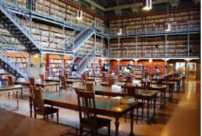
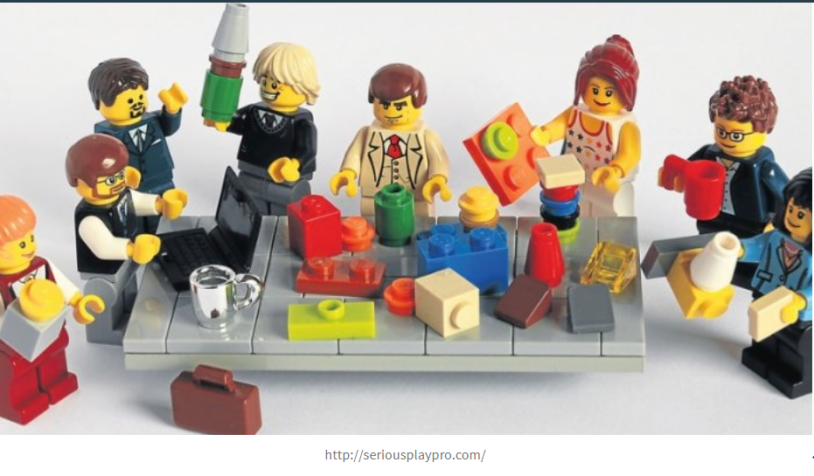
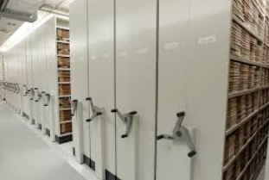
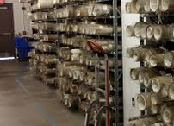
Lego architecture

Slide 11
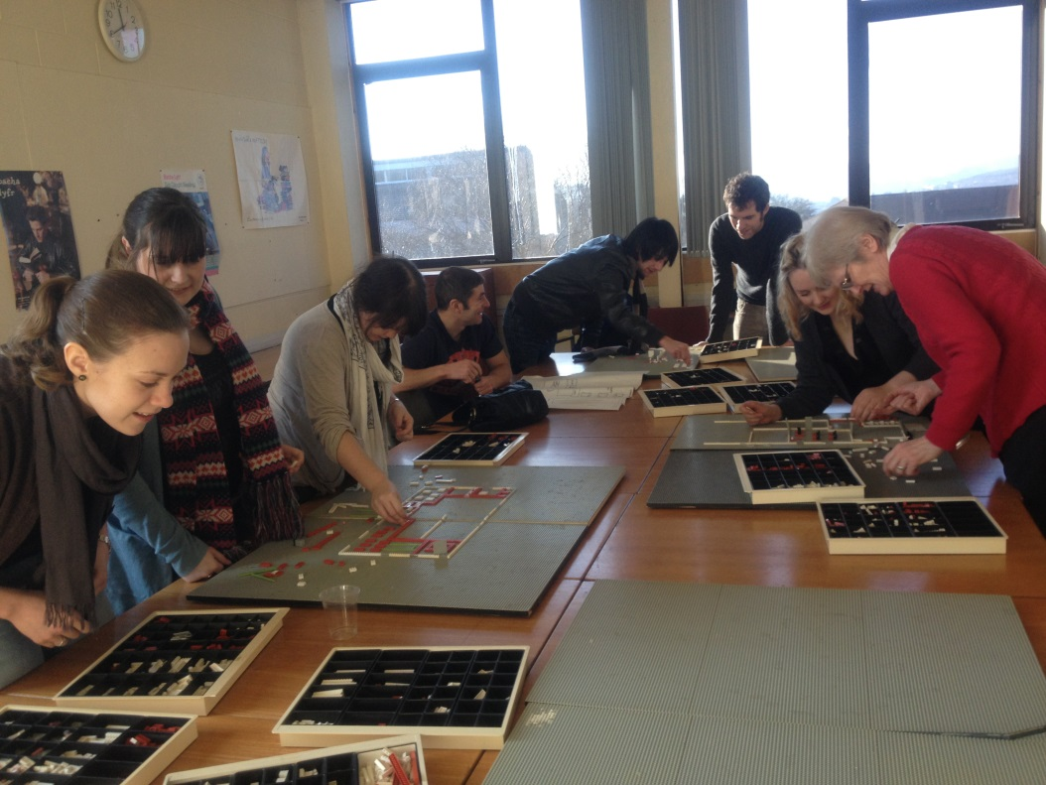
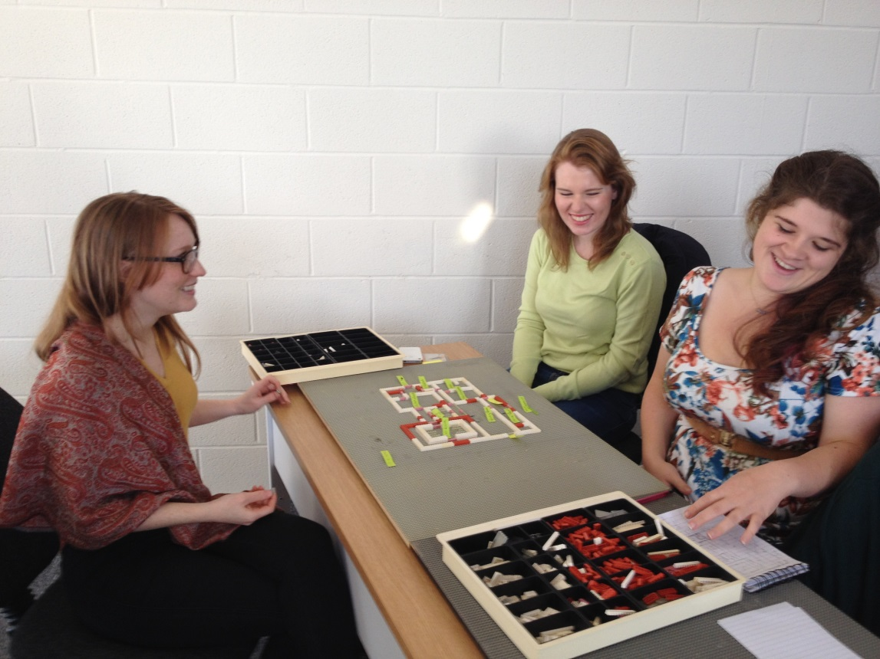
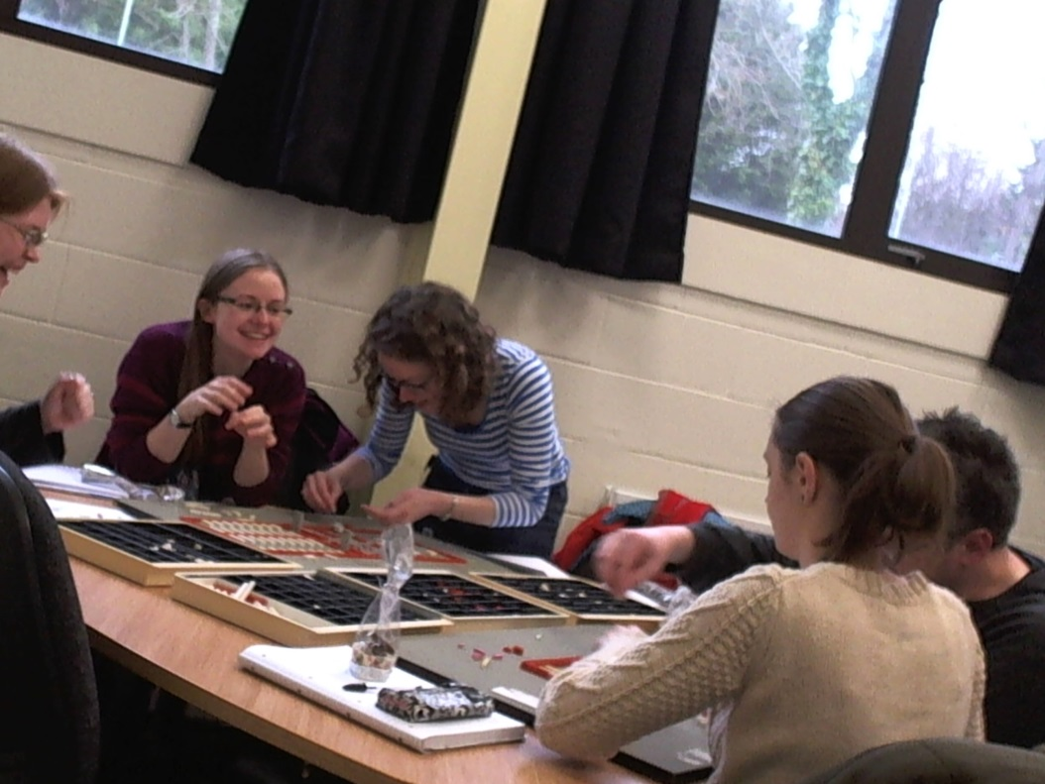
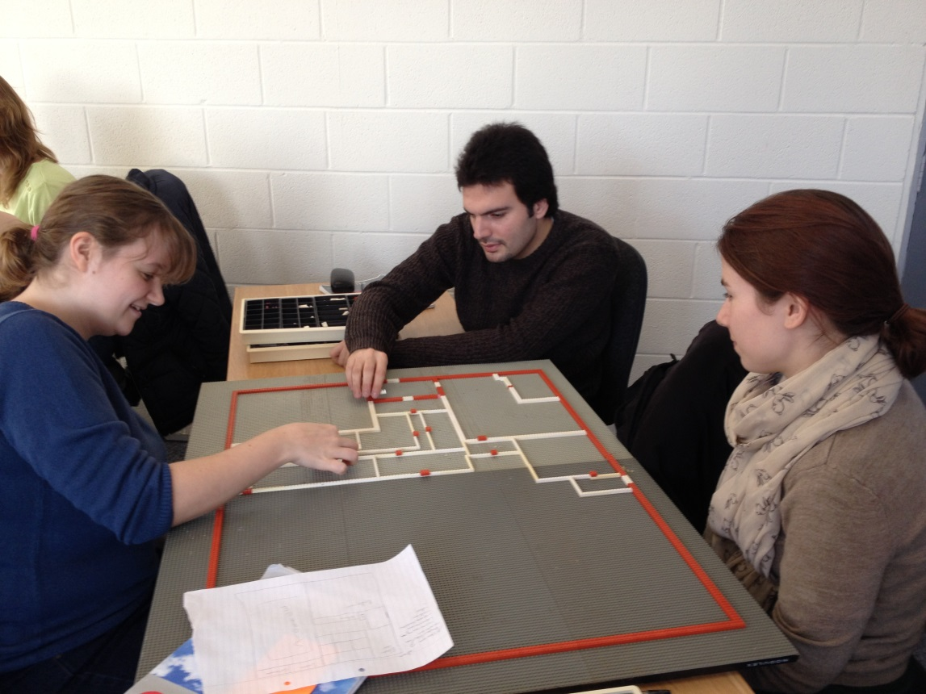

Slide 13
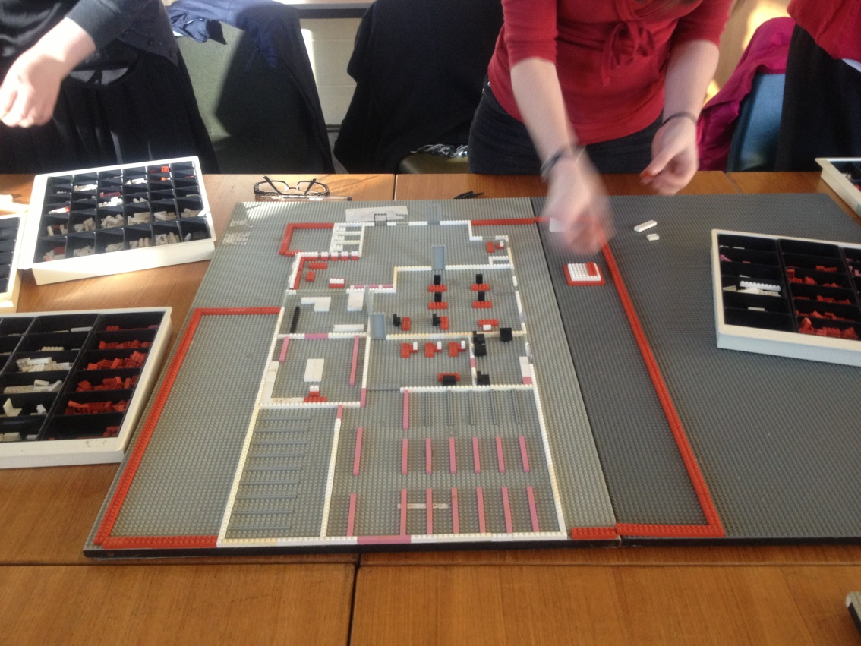
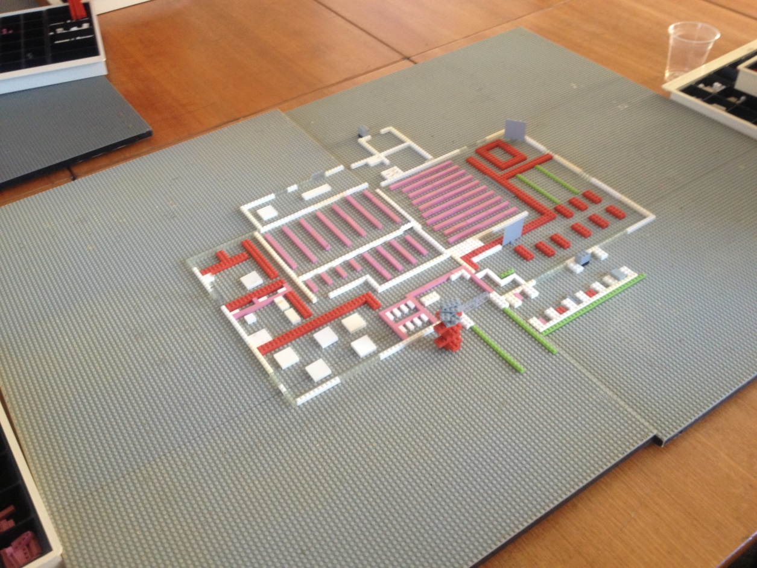
Remember list of considerations for archives building design
Understand why the criteria are important
Apply spatial analysis to their design
Analyse requirements as they design
Evaluate the design as it progresses
Create their own vision.
Had fun!

Slide 14
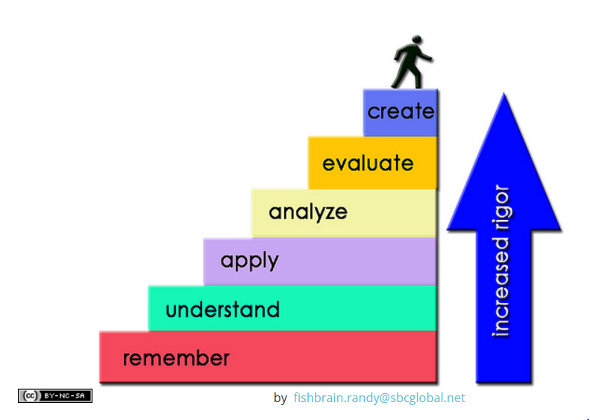

Slide 15
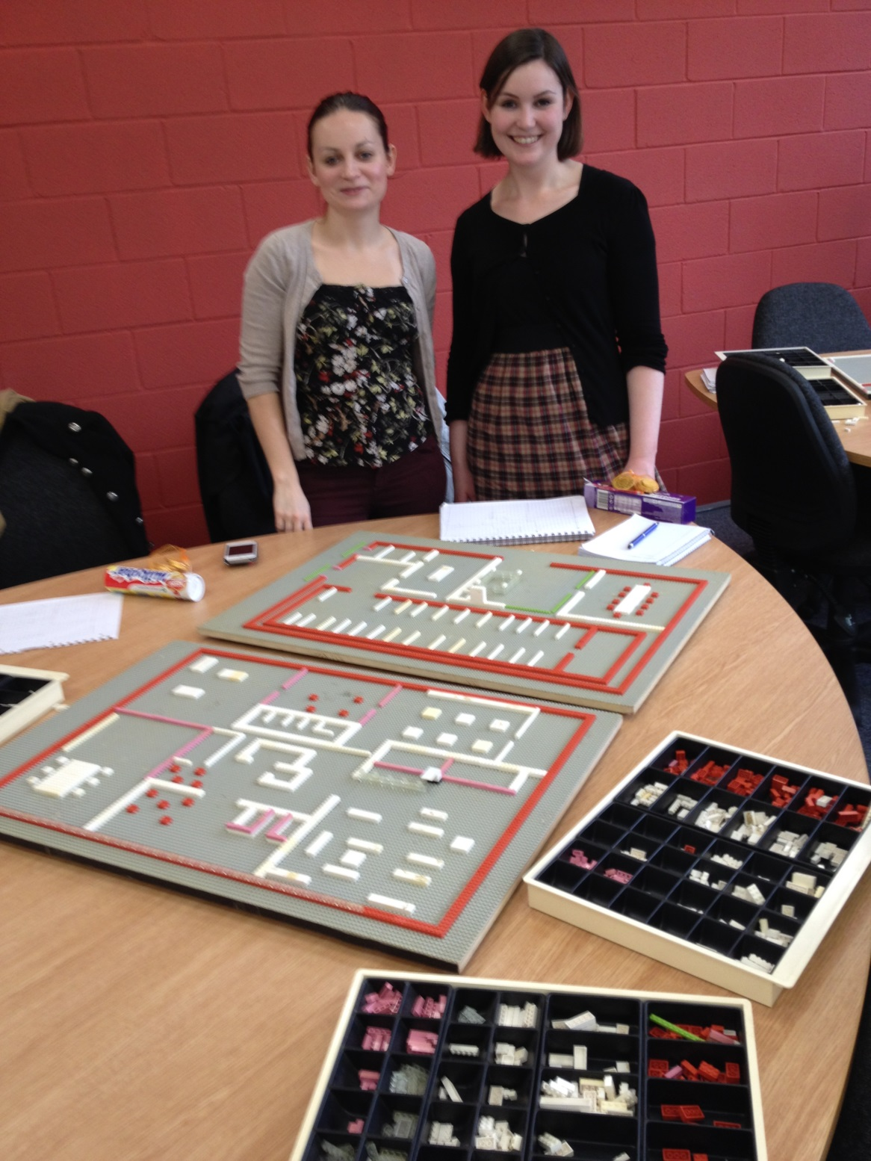
Sarah Higgins
Information Studies
sjh@aber.ac.uk

