Slide 1
FROM attendance concerns
to learning analytics
Chris Price & Kate Wright

Slide 2
Attendance Monitoring
The questions I started from:
Why do we get to week 7, and I am the first person finding out the problems of a fresher who has only been to 10% of his lectures?…
And what can we do to change that?
Better question:
In an age of large classes, how do we keep an eye on all students and know which ones are not “alright”?

Slide 3
Emphasis is pastoral

Slide 4
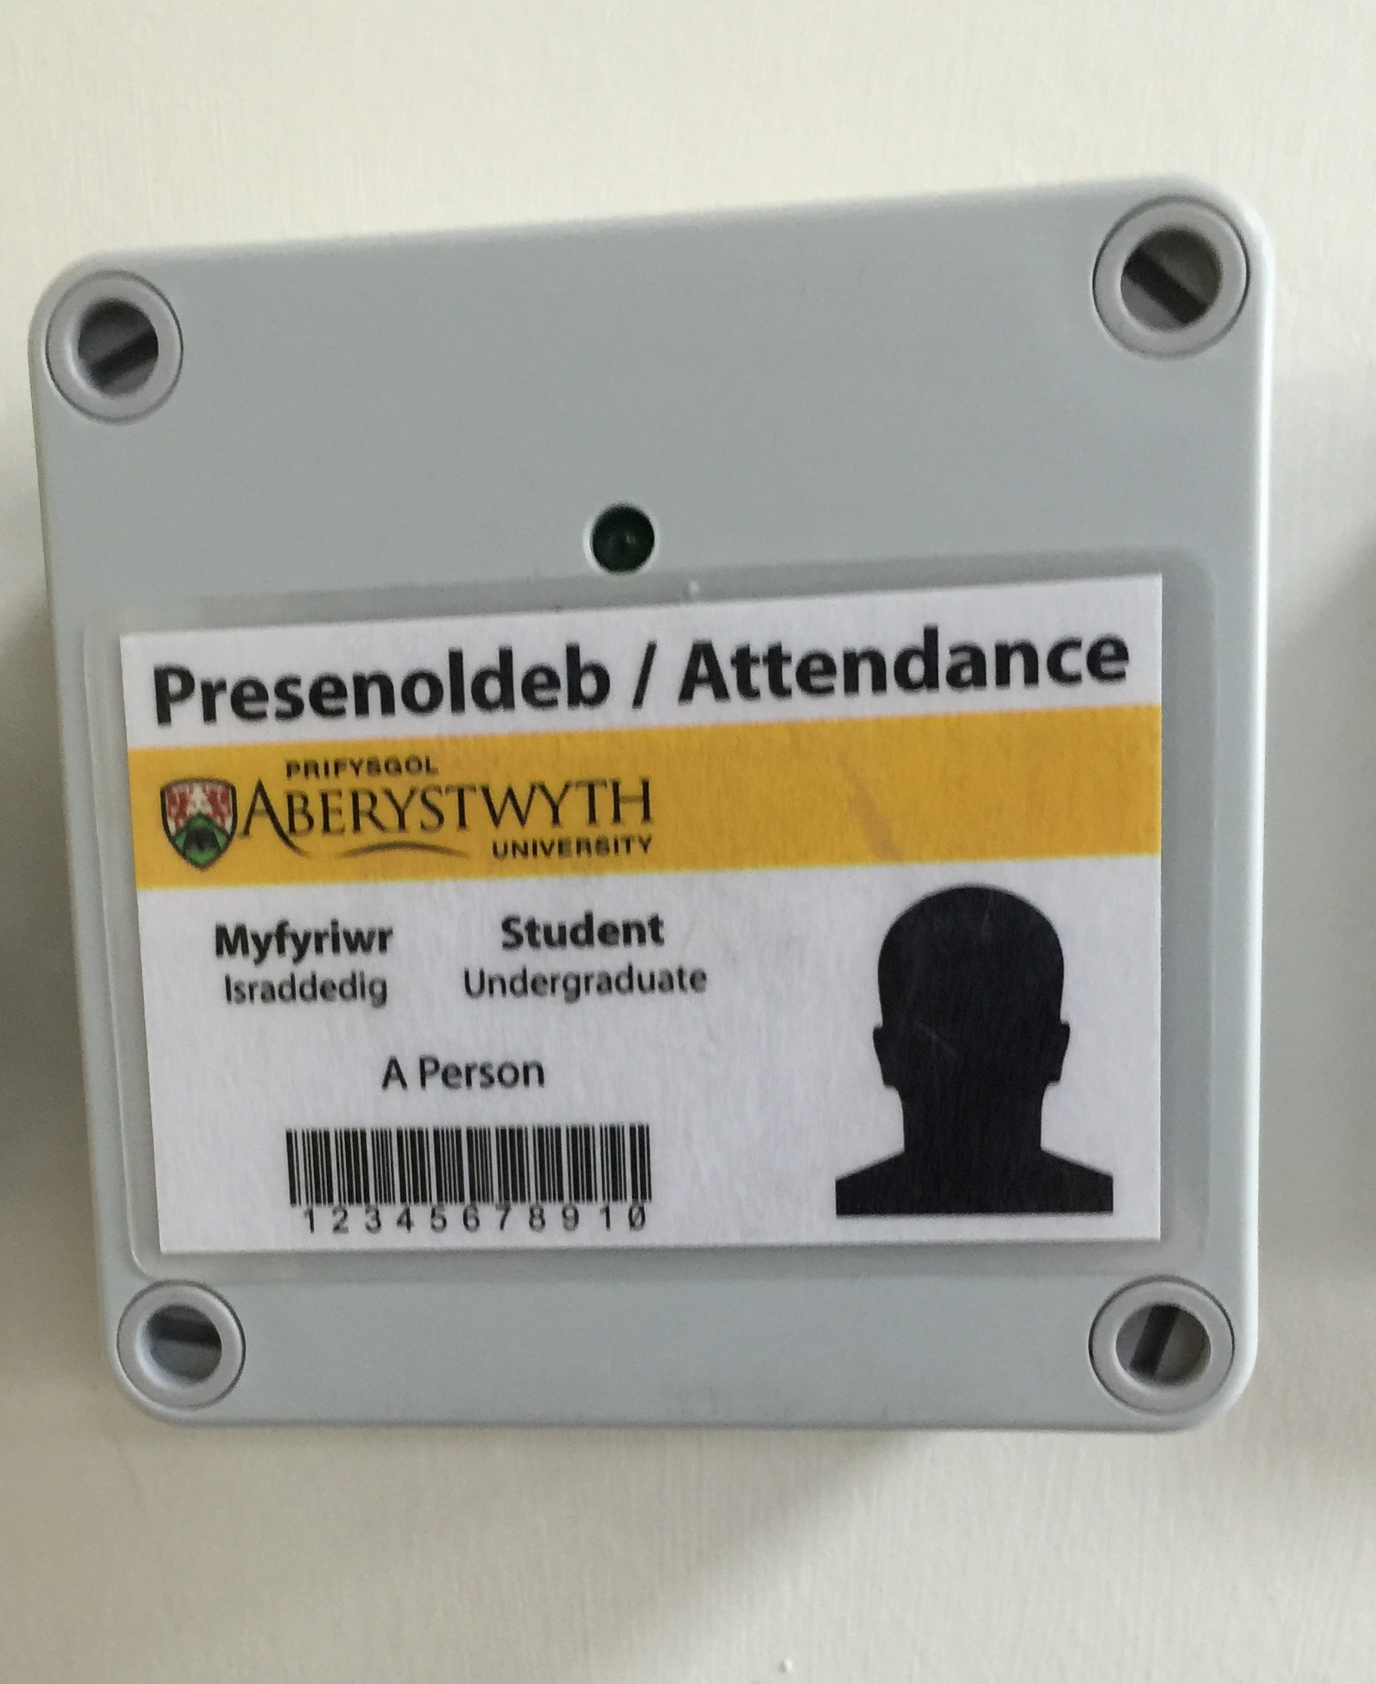
What can we do to improve problem detection?
Automate the recording process
Automate the monitoring
Flagging of students whose attendance falls below thresholds
Rapid response and gradual increase in level of response commensurate with severity and duration
Clear picture of attendance and response

Slide 5
Levels of Action basED on Attendance and history
Level of concern | Action
Attendance should be better | Email student a warning
Attendance will cause problems or not responded to above | Email to see personal tutor
Absence is causing problems for student | Email to see year / course tutor
Student is not responding to our efforts | Letters to see DUGS

Slide 6
Problems with this aPPROACH
Students cheat attendance - not a big problem in practice
Students lie - to themselves and us
Staff don’t do their pastoral jobs
Suddenly we need a better way of recording absences (we always did need it, but we didn’t know it)

Slide 7
THE GOOD THINGS this does for us
Lets us respond VERY quickly to drop in attendance
(Mostly) keeps our eye on the ball - we don’t “fire and forget” at students as much as we did
Helps us to monitor students that are in high risk groups more closely
Makes Tier 4 monitoring much easier - it is similar to what we do for other students
All info is in one place, not separate bits of paper
It gives a clear history of what has been done if we need to recommend exclusion
It comes in handy for special circumstances cases

Slide 8
Where it needs improvement
Better information on student participation and academic achievement
Have they been handing in assignments?
What do results so far look like?
Are they using the on-line material?
Making information on their attendance / performance available to students
AND THAT LEADS US INTO LEARNING ANALYTICS

Slide 9
Learning Analytics at AU

Slide 10
What is Learning Analytics?
“ the application of analytic techniques to analyze educational data, including data about learner and teacher activities, to identify patterns of behavior and provide (frequent) actionable information to improve learning and learning related activities” Davenport et al,(2010).
MOPS is a good example
Attendance data – when students go and don’t go
Information reviewed by staff
Concrete actions initiated by staff

Slide 11
Learning Analytics: JISC
An analytics ‘solution’
Advice and guidance
www.jisc.ac.uk/rd/projects/effective-learning-analytics

Slide 12
Learning Analytics: JISC & AU
Can we look at a wider range of data?
Are you ready for learning analytics?
Readiness report
Interviews, focus groups and workshops
Recommendations
Next steps
Exploring data sources: e.g. Blackboard usage
Engaging stakeholders

