Slide 1
Students as collaborators: using Problem-Based Learning to inform University Practice
Dr Rachel Rahman
Psychology Department

Slide 2
Overview of presentation
Set the scene of the module
Background pedagogical approach
Overview of the practical approach
Evaluation
Reflection

Slide 3
Overview of the module
PS31220 Health psychology is a third year option module
Typically 50-70 students registered each year
Topics:
Determinants of health risk behaviour
Health perception
Measuring health
Behaviour change
Intervention design
Health communication and promotion
Coping and chronic disease
Assessments include:
Health promotion poster and outline (40%)
Exam (60%)

Slide 4
What I wanted to achieve
Learning
Engage students with research literature
Become more adept at applying psychological theory
Critical thinking
Employability
Better understand the complexities of health psychology
Have an opportunity to include an interesting approach to health psychology on their CVs
As an academic
Opportunity to better integrate my teaching with University policy and practice

Slide 5
Background
The pedagogical approach
"Tell me and I forget, show me and I remember, involve me and I understand."
Problem based learning
(Project pathway)
Co-operative inquiry

Slide 6
Problem based learning
PBL involves developing knowledge by setting problems or challenges that require students to research the area in order to solve the problem
(Barron & Darling-Hammond, 2008).
Project pathway involves working on a set project or task with an objective to develop a product as an outcome
Evidence that students using PBL and project pathways show better:
Critical thinking and reasoning
Transferability of information to novel situations
Confidence in their learning
Project planning
(Penuel, Means, & Simkins, 2000)
Savery (2015)

Slide 7
Co-operative Inquiry
A way of working with other people who have similar concerns and interests in order to:
Understand your world,
Develop new and creative ways of looking at things.
Learn how to act to change things you may want to change and find out how to do things better
(Heron & Reason, 2000)
In co-operative inquiry all those involved in the endeavour are
co-researchers, and
co-subjects,
(Reason, 2002)
Evidence that students using Co-operative inquiry show better
Problem solving
Transferability of information to novel situations
Team working skills
(Barron & Darling-Hammond, 2008)

Slide 8
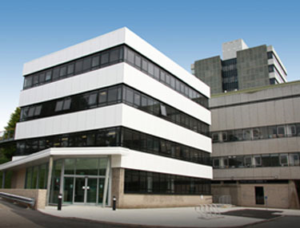
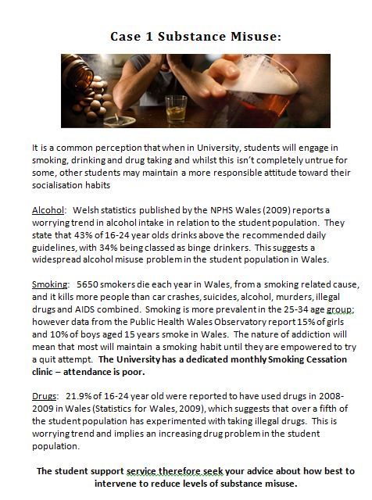
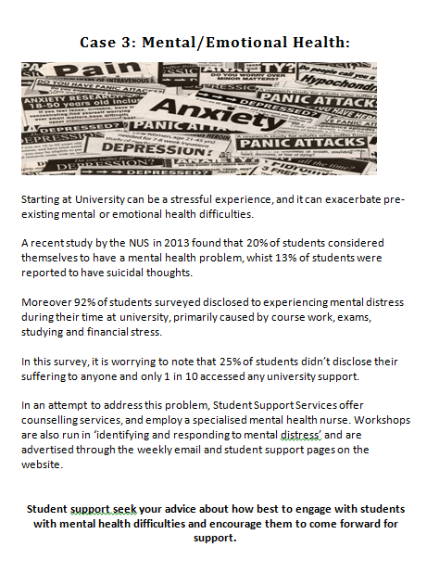
How it worked
Co-operative inquiry between University's Student Support Services and health psychology students
Student support identified 3 ‘problem based case studies’

Slide 9
seminars
Worked in self-selected groups of 4-8 on a chosen case
4 seminars designed around concept of intervention mapping
Introduced to an ecological model and asked to consider determinants of their chosen behaviour
Researched promotional material and health communication on campus, websites, GPs
Considered an appropriate behaviour change theory to underpin an intervention
Completion of the intervention and development of a pitch
Research and reading expected in-between sessions to support ideas and suggestions

Slide 10
How it worked in assessment
Final lecture of the module each group pitched their idea in 8 minutes to a member of student support staff
Presentation not assessed but opportunity for formative feedback
From this point students were required to work individually to prepare for an exam question on this topic area.
Exam:
Section A: Choice of 3 essay questions-answer 1
Section B: Question based on the portfolio development

Slide 11
Exam question
Using an example of your choice, outline a health intervention suitable for targeting a student population. Your answer should consider theoretical underpinnings, and research evidence to justify the approach and specifically address:
the behaviour in question
the determinants of the behaviour to be addressed
the intervention approach with justification

Slide 12
Exam performance

Slide 13
Evaluation of the approach
Caryl Davies Student Support
“ The initiative to involve Student Support Services in a third year Health Psychology module has provided a novel and valuable opportunity to involve students in the way that the university deliver health promotion interventions and to enable us to focus health promotion activities in a format students are more likely to engage with... we are now seeking further ways to collaborate for example, to engage psychology students in evaluating our wellbeing service”
Angharad Jones, Student Nurse
“I thought it was really valuable to have students perspective and proposals on real problems that we (as an university) are facing. It was good for students to see that we work together as well. The balloon challenge about smoking is a great idea, and something I want to pursue at some point. My suggestion for the future would be, that as some of the projects involved the SU taking the lead, it would be good to invite the SU Welfare Officer for this year.

Slide 14
Quantitative feedback
The portfolio helped me to…

Slide 15
Qualitative feedback
I found the process very helpful in coming up with an intervention. I noticed we all had the tendency to rush to an intervention before thinking of other stages in the process and so the seminars and actual piece of work was helpful for guidance and of course helpful not only in the exam, but in understanding fundamental processes in health psychology.
On-going feedback during the sessions was invaluable to ensure that the group were on the right track...Doing the ‘pitch’ to Student Support was particularly valuable as it meant that we could see how realistic our suggestions would be.
I enjoyed working as a group to produce the work, preferred that to working on my own! I also liked that it helped us to know what was coming up in the exam

Slide 16
Quantitative feedback

Slide 17
Qualitative feedback
The only (small) gripe is that, because the presentations were not marked, a small number of people did not attend them. However, I think that things should stay the same as it is up to the individual to take responsibility for their own learning in year 3 and I am sure that those who attended gained a lot which they could use in their exams.
I found hearing feedback for others stressful because some got more positive feedback than others so those with more negative feedback had more work to sort it for the exam.
Overall I liked it but would prefer it to be assessed differently within the exam (maybe worth less percent? Or combined with MCQs or short answer questions on a wider range of lecture material to make it more worthwhile revising

Slide 18
Reflections
Collaborating with service departments was beneficial
Developed onto future collaborations
Collaboration provides understanding from all parties about perspectives to the problem.
Students didn’t engage with the literature as well as I had hoped
Pitch needs careful management

Slide 19
Questions
Thank you
Diolch

Slide 20
References
Barron, B. & Darling-Hammond,L. (2008). Powerful learning: Studies show Deep understanding derives from collaborative methods. Accessed on September 5th via http://www.edutopia.org/inquiry-project-learning-research
Heron,J. & Reason, P. (2001). The practice of co-operative inquiry: Research with rather than on people. P. Reason & H. Bradbury (Eds.), Handbook of Action Research: Participative Inquiry and Practice (pp. 179-188). London: Sage
Penuel, W.R., Means, B., & Simkins, M. (2000) The Multimedia challenge. Educational Leadership, 58, 34-38.
Reason, P. (2002). The Practice of Co-operative Inquiry. Systematic Practice and Action Research, 15, 169-176.
Savery, J.R. (2015). Overview of problem based learning; definitions and distinctions. In P.A. Ertmer (Ed.) Essential readings in Problem Based Learning. Purdue University Press.

