Slide 1
The Final Chapter: Thesis Submission, Examination and Results
Dr Alan Macmillan
Academic Registry
grastaff@aber.ac.uk
pgsstaff@aber.ac.uk

Slide 2
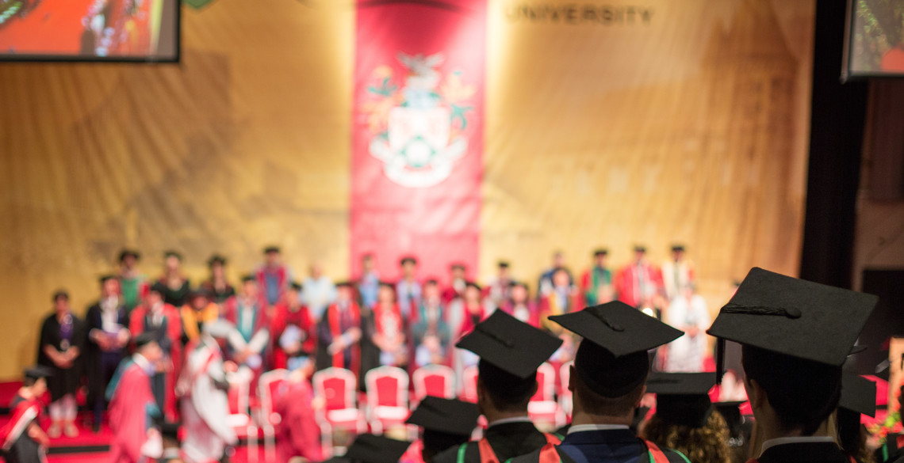

Slide 3
Thesis submission process
Intention to submit form to notify us of imminent submission and nominate examiners
Ideally at least 3 months before expected submission
This doesn’t commit you to a different submission date, your final deadline does not change
The nominated examiners and chair are approved by the HoGS/Grad School then we make a formal offer to the external(s) before the thesis can be sent.
You don’t choose examiners but will be involved, could be well before the ITS is completed
Notify us of any factors affecting viva
Indicate / discuss supervisor attendance at viva

Slide 4
The Examination Process
Independent chair to oversee fairness and integrity of the process and that the student is respected
One internal and one external examiner unless you are staff; they are equal
Examiners must meet experience criteria
The HoGS is looking for a balanced examination board
No recording is made
Result will normally be issued on the day (not at the beginning!)
Can be an arbitrating examiner if required

Slide 5
Submission Documents/Theses
Forms:
Abstract
Electronic agreement for POST VIVA copy of thesis
Covid impact form may be included
Theses:
Currently we are taking e-theses via Blackboard, no hard copies
Declarations and statements bound into each copy

Slide 6
Submission Information
No required referencing style
No minimum word length but maximum is 100,000 for PhD
Give time for supervisor feedback and preparation of the whole submission
Don’t send anything directly to examiners
You can’t amend once you have formally submitted

Slide 7
EMBARGO / BAR ON ACCESS
Aberystwyth Research Portal
Bar on Access
Research repository of University
Forms are in submission documents
Presumption of OPT IN but mechanism to OPT OUT
Under the remit of Information Services
OPT OUT hard copy is still available in Hugh Owen and National Libraries
Formal Bar on Access of hard and electronic copies for a specified period
Higher standard than electronic OPT OUT
Examples: IP or Commercial Sensitivity
If your supervisor thinks this may apply they should contact Academic Registry well in advance of your submission.
There is a process for a formal bar on access but these applications must be approved by the Research Degrees Committee which meets periodically through the year

Slide 8
Timeline for the viva
Once the thesis is sent we will send you an email confirming this and inviting you to contact your departmental pg co-coordinator to discuss the viva date
The viva is usually within 12 weeks of despatch to examiners
You are expected to be available to attend a viva in person held at Aberystwyth University – but in current circumstances we are being flexible with electronic vivas.

Slide 9
Possible viva outcomes PhD / DProf
Pass SUBJECT to corrections 4 weeks
Pass SUBJECT to corrections/amendments 6 months.
Not approved for PhD. Single opportunity to modify and re-submit for PhD within 12 months
Not approved for PhD but approved for MPhil, 4 weeks corrections*
Not approved for PhD. Single opportunity to modify and re-submit for MPhil within 12 months (not for resubmissions)*
Not approved for degree/no award
*Not available for DProf

Slide 10
Possible viva outcomes MPhil
a) Pass SUBJECT to corrections 4 weeks
b) Pass SUBJECT to corrections/amendments 12 weeks
c) Not approved for MPhil. Single opportunity to
modify and resubmit 12 months (not for resubmissions)
d) Not approved for degree/no award

Slide 11
What is the Viva
Rite of passage you have to endure?
Should be respectful and a conversation between peers, robust but not a grilling
Chance for you to talk in detail with people who have read the entire thesis
Look at strengths as well as any deficiencies
But it is an examination to test knowledge and understanding, check work is student’s own and ensure the process is (seen to be) rigorous and fair – not a formality
It will be intense
Chance for you to show you can make any revisions needed
Initial presentation/question to get you started
No set time but many are 1.5 to 2 hours; longer or shorter does not mean negative or positive

Slide 12
Electronic Viva
Guidance on AU website
Normally by Teams but can be Zoom if Teams is not suitable
You can use a room in the university if you don’t have a reliable connection or suitable space
Do a test run, and ask about arrangements if there are technical problems
If the format is tiring then you may want to ask for more regular breaks
Think about having someone available pre-viva, when the result is being decided, and afterwards – whatever the outcome, it will be good to have someone to talk to and have a debrief with, maybe a celebration

Slide 13
Preparation 1
Re-read thesis and mark up copy to take
But don’t overdo re-reading
Request mock viva or Q & A with colleagues (but two sets of examiners would not ask the same questions)
Talk about your research as much as possible – non-experts ask challenging questions!
Prepare for the obvious questions – why this method? What interested you in this topic?

Slide 14
Preparation 2
Try to identify strengths and weaknesses and for the latter, what you could do to address them; viva is a chance for you to show you can fix problems
Prepare for the unexpected – what will you do if you are stumped? I don’t know; I will try to incorporate this in future research; can I think about that for a minute?
Consider the research interests of the examiners, where are they particularly expert?
If you are still writing up, try to think as you write how you might be questioned on what you are writing

Slide 15
In the viva
Show confidence in your work, don’t be too self-effacing
Be robust in defending and explaining work – you are the expert and they are testing your expertise
Don’t filibuster but do give full answers
No-one’s work is perfect and where it is not, acknowledge limitations rather than defend the indefensible
You will usually be able to make corrections and the examiners will help with that; use the viva to show you can make changes if needed
Ask for clarification if question is unclear or contains several different questions; be assertive
Write questions down
Go back to things if you think of something significant later
Request a break if you need one

Slide 16
Put yourself in the examiners’ shoes…
They would love you to pass with minimal corrections
They appreciate how students may be feeling
They have to check it is your work by asking quite simple questions – don’t overthink those
They are checking you meet a threshold standard comparable to other universities
They will be interested and want to know more about some aspects
They need to provide you with detailed, constructive corrections so they do need to probe areas that need further work
They may identify areas for development for publication

Slide 17
External Examiner Viva Comment
The student ‘confidently addressed the questions we posed and was receptive to our different views, particularly regarding the structure (rather than the content) of the thesis. He stood his ground, however, when dealing with more technical and scientific questions and answered them in detail and convinced us of the appropriateness of his decision making’.

Slide 18
External Examiner Comment in a Viva
After a slightly reticent start, the candidate engaged fully with the questioning and gave full, detailed and reassuring answers. Overall, they displayed a wide awareness of key issues … and a very real and engaging commitment to, and passion for, their topic. They did acknowledge some of the weaknesses in the thesis.

Slide 19
Interim confirmation form - on the day of the viva
After the viva you will receive an Interim confirmation of result form from the examination board (paper based if possible)
To clarify the process for corrections and outcome for all parties

Slide 20
Resubmission
Not uncommon result and it does mean that potentially quite a lot of work needs to be done. But it is retrievable
Academic Registry will write to you confirming the result of the viva and inform you of your official resubmission deadline
The procedures and submission process is exactly the same as for the first submission
Make sure you have had full and comprehensive written feedback on the required changes from the examiners
Make the changes you are asked to make and no more, don’t introduce significant new material on your own initiative
Show your supervisor your work for review before you resubmit
Right of appeal: deadline of 20 working days from date of result letter
Be prepared for another viva

Slide 21
Corrections following the Viva
Make sure you understand what changes are required of you and when they are due – department can confirm
Submit the corrections on time – you haven’t passed until these are signed off and we have a final, approved thesis
Keep in contact with supervisor for advice
You can’t go back and forward to the examiners on the corrections
Submit your POST VIVA e-version with declarations to your department, to go to the University Research Portal

Slide 22
Informing you of a successful result
AR will write to you once the department confirms that all corrections have been completed and approved AND you have handed in the final hard and e-copies
The result letter will include the email and postal address we hold for you. If there are any changes to these addresses let us know right away
Certificate can be posted to you or will be available at graduation ceremony
You must register to attend the ceremonies and have all information complete early in June - note next ceremonies currently scheduled for July 2024

Slide 23
Skillsforge PGR management software
We are currently implementing a new software package which will replace our manual processes
This will give an online interface where you can initiate a range of processes – extensions, intention to submit forms, changes to thesis title, monitoring
Examination is a later phase as it is a more complicated workflow
This is quite an intuitive system used by many universities

Slide 24
Relevant Links
External viva prep resources: https://gradschool.southwales.ac.uk/current-postgraduate-research-students/preparing-viva-materials/
FAQS : https://www.aber.ac.uk/en/student/pg-issues/research/faq/
Extensions : https://www.aber.ac.uk/en/aqro/handbook/res-degrees/
Criteria for degrees – section 9.2 of https://www.aber.ac.uk/en/academic-registry/handbook/learning/
Research degree appeals: https://www.aber.ac.uk/en/aqro/handbook/appeals/
Certification : aocstaff@aber.ac.uk (processing times normally 3 working days)
Submission Docs : http://www.aber.ac.uk/en/student/pg-issues/research/
Regulations for PhD, MPhil, and Submission and Examination of Research Degrees: https://www.aber.ac.uk/en/aqro/handbook/regulations/#regulations
E-Viva Guidance: https://www.aber.ac.uk/en/academic-registry/handbook/regulations/viva-voce/

