Slide 1
Open Access Theses: Aberystwyth Research Portal and Beyond
Resource Discovery Team
Amy Staniforth, Jonathan Davies & Lorna Clark

Slide 2
Outline…
A quick introduction to the world of online theses
Guide to submitting your thesis to the Aberystwyth Research Portal – forms & embargoes
OA is the direction of travel for most current research outputs across all disciplines, and particularly for projects reliant on public funding
“Open Access is the immediate, online, free availability of research outputs…”
Open Access definitions from Open Access Scholarly Information Sourcebook http://www.openoasis.org/ accessed 25th November 2013 (my emphasis)

Slide 3
In brief …….
You supply a final electronic version to Information Services (via the Grad School). We upload it to PURE/Research Portal where it’s either made fully accessible, partly accessible or embargoed (based on specific criteria which you can outline in the accompanying form).
It is then harvested by the British Library who also make it accessible (or not, depending on above) via their EThOS service. This service also harvests from all other UK HEIs too.
i.e. ideally, therefore it will be fully accessible via the web, in 2 places.

Slide 4
BL’s Electronic Thesis Online Service (EThoS) http://ethos.bl.uk/
Access to 600,000+ records – most being PhD theses
At least monthly harvesting of institutional repositories
In her 2006 article in Serials (also available in University of Birmingham’s Repository), Jill Russell presented the context for the British Library thesis online service:
“PhD and other research theses produced in UK universities have long been recognised as a rich source of research findings, yet for anyone wishing to read them, they are often the hardest material to obtain in full text”

Slide 5
Benefits to deposit with EThOS:
Raised profile for individuals, universities and funders from wider circulation and citations of their work.
A more visible virtual community of researchers.
Metadata visible to search engines (in addition to thesis databases).
Greatly reduced delivery time for theses, and time saved by eliminating extra visits to library to consult restricted volumes or use microfilms.
Other benefits…
Accessed, read and built upon by people outside of traditional UK Higher Education (HE) circles
To preserve it for the future – live permanently
Easy for you to direct people to it

Slide 6
ALL UKRI funding has OA expectations built in e.g. AHRC Student Funding Guide 2013-2014 (still applicable):
121.
In the case of Ph.D. theses funded by the AHRC, metadata describing the thesis should be lodged in the institution's repository as soon as possible after award and a full text version should be available within a maximum of 12 months following award. It is expected that metadata in institutional repositories will be compatible with the metadata core set recommended by the ETHOS e-thesis online service.

Slide 7
Not just us…
University of Liege http://orbi.ulg.ac.be/
Catalan theses https://www.tdx.cat/
South African theses and dissertations: http://www.netd.ac.za/

Slide 8
Your Submission
Currently via Blackboard due to modifications in the workflow resulting from covid-19 restrictions
Introduction of new Skills Forge thesis management system (MyPGR) which will increasingly manage different PG processes

Slide 9
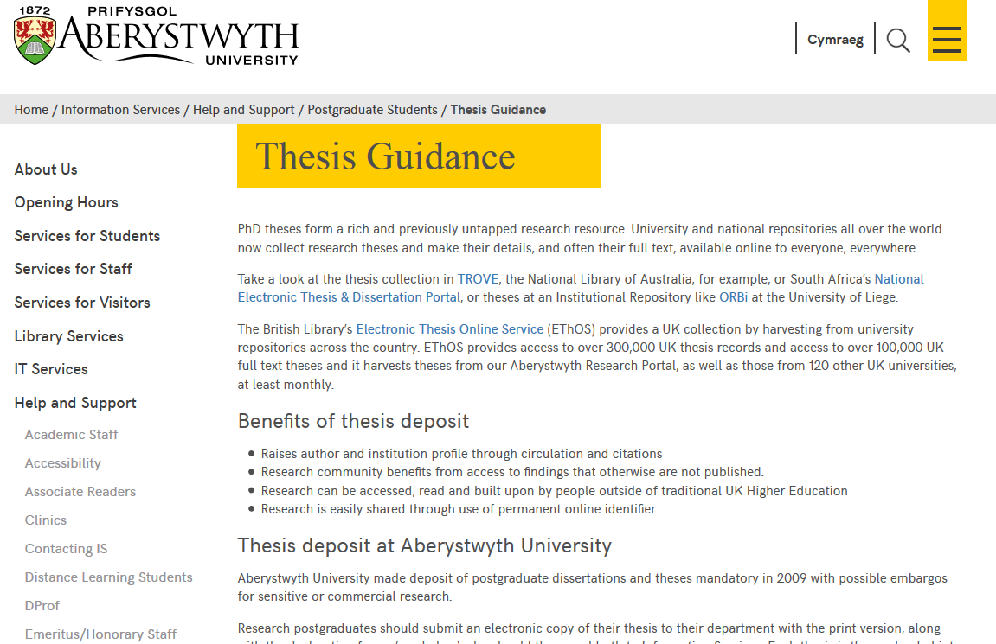
https://www.aber.ac.uk/en/is/help/postgrads/theses-guidance/

Slide 12
Things to bear in mind when planning, writing up and also as you come to submission:
Have you used significant amounts of third party copyright material without explicit permission? (e.g. maps, quotes, diagrams, images, other graphics). Usually only a problem with lots of items from the same source, or very identifiable quotes, or images.
Have you effectively anonymised any personal identifiers and followed appropriate ethical procedures?
Are there any commercial sensitivities involved in making the thesis public?
If there are any problems with the above we may not be able to make electronic versions publicly accessible.

Slide 13
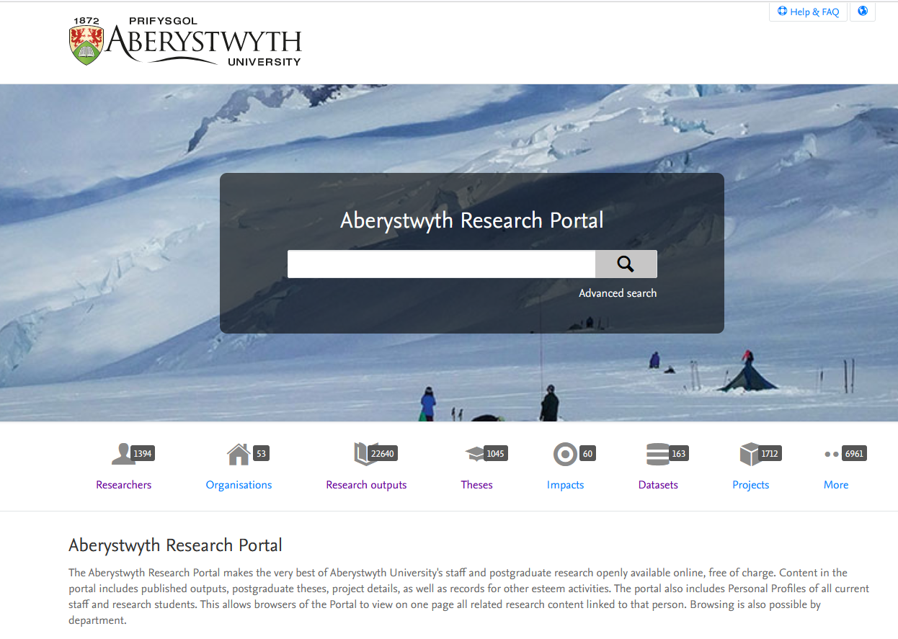
Aberystwyth Research Portal: over 600 PhD theses

Slide 14
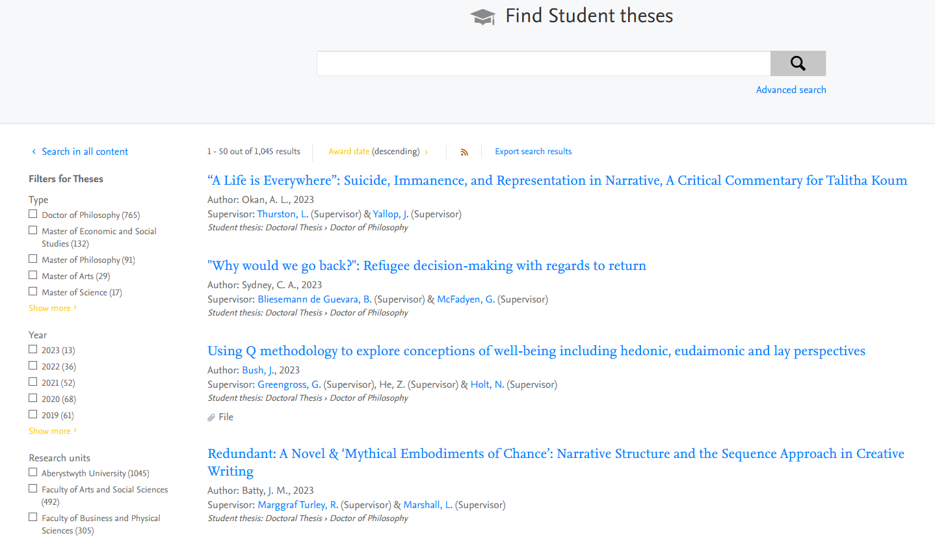

Slide 15
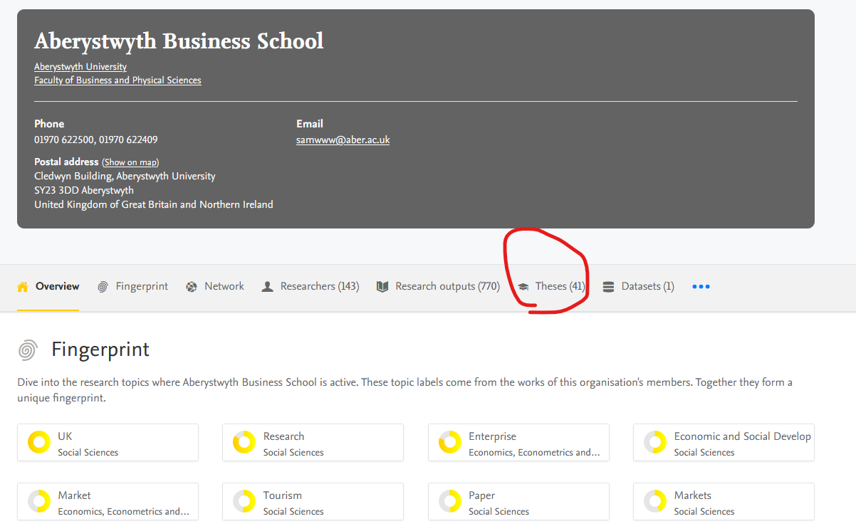

Slide 16
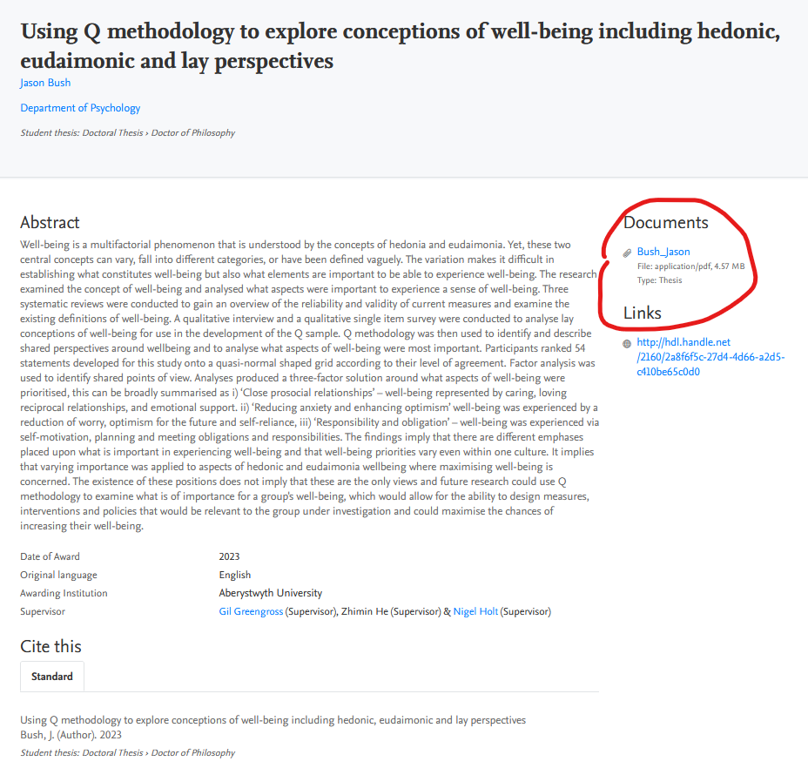

Slide 17
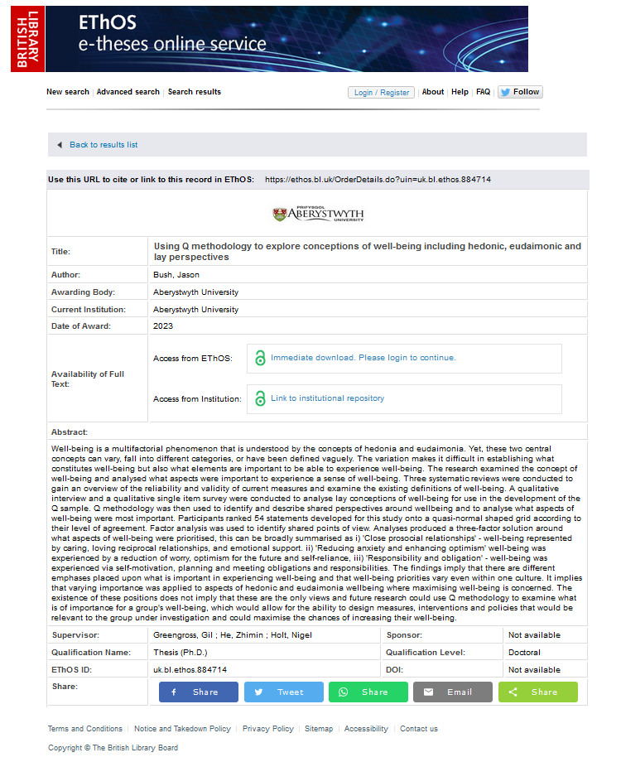

Slide 18
Good luck with your writing and get in touch with us at any point in the process…
For further information contact: is@aber.ac.uk
Or Amy, Jon or Lorna: resourcediscovery@aber.ac.uk

