Slide 1


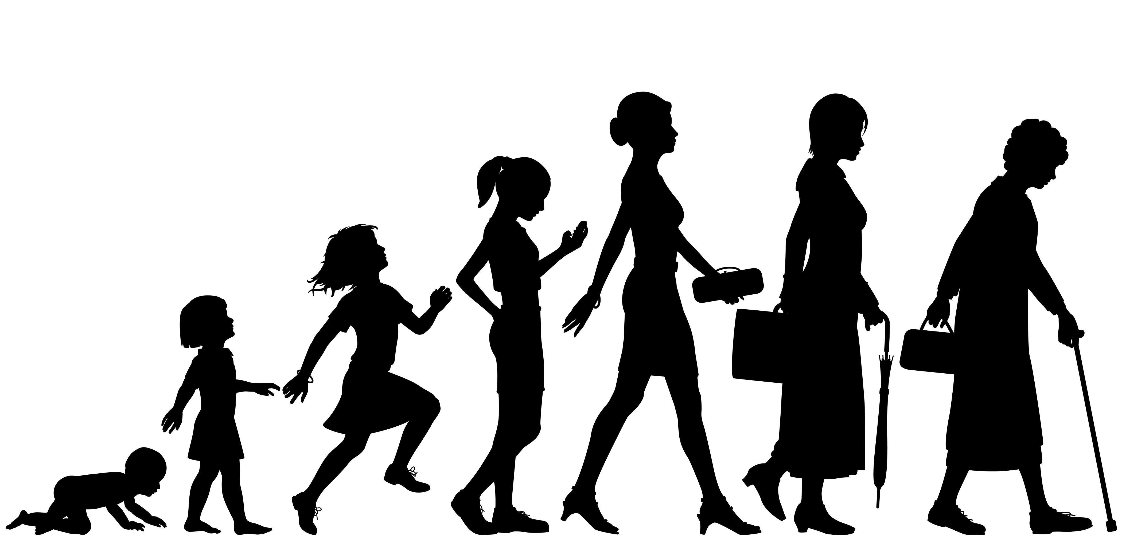
Welcome
Staff Health & Wellbeing Event
Women’s Health
Liz Merriman
Human Resources Manager
Notes:
Title page

Slide 2

General housekeeping
No fire alarm expected;
Mobile phones on silent;
Respect to participants and trainer;
Chatham House rules - Confidentiality.
Notes:
Bullet point list (animated)

Slide 3
Learning Objectives
“Women’s health” – what does that mean?
Why it matters for all of us
Understanding the impact within the workplace
Understanding what we can do to support each other
Notes:
Bullet point list (animated)

Slide 4
“Women’s health” – what are we talking about?
Who’s heard of the phrase “women’s troubles?”
Menstruation
Menopause
Fertility treatment
Pregnancy
Gynaecological related health issues including breast cancer and ovarian cancer
Polycystic ovary syndrome
endometriosis
Osteoporosis
Autoimmune Diseases (including Diabetes, thyroid issues etc)
Cardiovascular diseases
Gallstones
Migraines
IBS
Urinary tract infections
Hypertension
Notes:
What can this include?
There are some issues that relate only to women such as;
However there are other health issues that don’t simply relate to women but which women have a greater likelihood of suffering from, such as:
Some studies have reported that as many as one of every two women over 50 will suffer a fracture related to osteoporosis in her lifetime. By age 65, some women have lost half of their skeletal mass
Women tend to suffer their first heart attack 10 years later than men. he likelihood for a younger woman dying from a heart attack is significantly greater than that of a man. the symptoms of an impending heart attack may be somewhat different in a woman than in a man. A woman may more often ignore the symptoms and fail to seek medical attention.
bout 18% of women in the U.S. suffer migraine headaches compared with only 6% of men
According to the American Autoimmune Related Diseases Association (AARDA), about 75% of autoimmune diseases occur in women. By themselves, each disease appears to be uncommon -- except for diabetes, thyroid disease, and lupus -- but as a group, the disorders make up the fourth-largest cause of disability among American women.

Slide 5
Why it matters for all of us…
There are 32.39 million people in work in the UK in August 2018*
Women make up 47% of the UK workforce**
45% of the workforce over 50 are women - this equates to almost 4.4 million women over the age of 50 in employment.
On average menopause starts from 51 years old however typically occurs between 45 and 58
Periods start from age 12 on average
* Office for National Statistics August 2018
** The Prince’s responsible Business Network

Slide 6
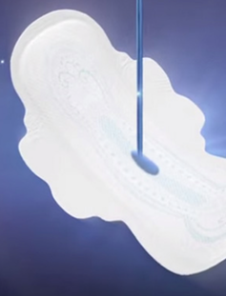

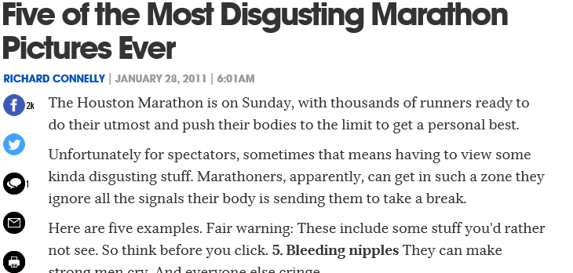
Menstruation ….
https://www.youtube.com/watch?v=zebXDyYuYK0 - then
CEO telling a male Facebook commenter - now
Notes:
Bullet point list (animated)
Who can recall recent press coverage of the long-distance runner who ran during her period and chose not to wear a pad or a tampon? Does anyone recall the general tone of the coverage?

Slide 7
Menstruation – how can this effect women’s health?
Premenstrual syndrome(PMS )
Premenstrual dysphoric disorder (PMDD )
Symptoms include:
Swollen or tender breasts
Spotty skin or greasy hair
Constipation or diarrhoea
Bloating or a gassy feeling
Cramping
Headache or backache
Clumsiness
Lower tolerance for noise or light
Irritability or hostile behaviour
Feeling tired
Sleep problems (sleeping too much or too little)
Appetite changes or food cravings
Trouble with concentration or memory
Tension or anxiety
Depression, feelings of sadness, or crying spells
Mood swings
Less interest in sex
Symptoms include:
Lasting irritability or anger that may affect other people
Feelings of sadness or despair, or even thoughts of suicide
Feelings of tension or anxiety
Panic attacks
Mood swings or crying often
Lack of interest in daily activities and relationships
Trouble thinking or focusing
Tiredness or low energy
Food cravings or binge eating
Trouble sleeping
Feeling out of control
Physical symptoms, such as cramps, bloating, breast tenderness, headaches, and joint or muscle pain
Notes:
PMS is a combination of physical and emotional symptoms that many women get after ovulation and before the start of their menstrual period. Researchers think that PMS happens in the days after ovulation because oestrogen and progesterone levels begin falling dramatically if you are not pregnant. PMS symptoms go away within a few days after a woman’s period starts as hormone levels begin rising again.
As many as three in four women say they get PMS symptoms at some point in their lifetime. For most women, PMS symptoms are mild.
PMS symptoms may get worse as you reach your late 30s or 40s and approach menopause and are in the transition to menopause, called perimenopause.
This is especially true for women whose moods are sensitive to changing hormone levels during the menstrual cycle. In the years leading up to menopause, your hormone levels also go up and down in an unpredictable way as your body slowly transitions to menopause. You may get the same mood changes, or they may get worse
About half of women who need relief from PMS also have another health problem, which may get worse in the time before their menstrual period.¹² These health problems share many symptoms with PMS and include:
Depression and anxiety disorders.These are the most common conditions that overlap with PMS. Depression and anxiety symptoms are similar to PMS and may get worse before or during your period.
ME/chronic fatigue syndrome Some women report that their symptoms often get worse right before their period.
Irritable bowel syndrome (IBS). IBS causes cramping, bloating, and gas. Your IBS symptoms may get worse right before your period.
Bladder pain syndrome. Women with bladder pain syndrome are more likely to have painful cramps during PMS.
PMS may also worsen some health problems, such as asthma, allergies, and migraines.
Most women do not have difficulties during the first half of their menstrual cycle, but once the egg has been released, there may be problems such as pelvic pain. During the second half of the cycle, a woman may experience premenstrual syndrome(PMS) and she may have menstrual cramps at the onset of her menstrual flow.
Approximately 70%-90% of women suffer from PMS
A particularly severe condition, PMDD is even more troublesome than PMS and approximately 5% of women of childbearing age suffer with it- is a condition similar to PMS that also happens in the week or two before your period starts as hormone levels begin to fall after ovulation. PMDD causes more severe symptoms than PMS, including severe depression, irritability, and tension.

Slide 8
Menstruation – how can this effect women’s health?
What helps?
Getting regular aerobic physical activity throughout the month. Exercise can help with symptoms such as depression, difficulty concentrating, and fatigue.
Choose healthy foods most of the time. Avoiding foods and drinks with caffeine, salt, and sugar in the two weeks before your period may lessen many PMS symptoms.
Get enough sleep. Try to get about eight hours of sleep each night. Lack of sleep is linked to depression and anxiety and can make PMS symptoms such as moodiness worse.
Find healthy ways to cope with stress. Talk to your friends or write in a journal. Some women also find yoga, massage, or meditation helpful.
Consult your GP – if the above aren't working keep a diary of your symptoms and speak with your GP who may prescribe antidepressants
Don’t smoke.
Don’t drink too much alcohol

Slide 9
Menstruation - how can this effect women’s health?
Endometriosis
On average it takes up to 7 years to diagnose from the onset of symptoms
Women with endometriosis can suffer a 38% greater loss of work productivity than those without endometriosis – this difference was mainly explained by a greater severity of pain symptoms among women with endometriosis
Symptoms:
pain in your lower tummy or back (pelvic pain) – usually worse during your period
period pain that stops you doing your normal activities
pain during or after sex
pain when peeing or pooing during your period
feeling sick, constipation, diarrhoea, or blood in your pee during your period
difficulty getting pregnant
You may also have heavy periods – you might use lots of pads or tampons, or you may bleed through your clothes
What to do:
Keep a diary / log of your symptoms
Arrange to see your GP to get a diagnosis
See support from Endometriosis UK (details on final slide)
Treatments can include:
Painkillers such as ibuprofen or paracetamol
Hormone medicine or contraceptives
surgery
Notes:
where cells that normally line the womb start to grow in other places, such as in the fallopian tubes and ovaries; these cells can cause intense pain when they shed and fall away

Slide 10
Menstruation – what can be done to support women in the workplace and why it matters
Why it matters…
A YouGov survey of 1,000 women carried out for BBC Radio 5 Live found:
52% had found it difficult to work because of the pain,
while almost a third had taken time off work.
Only 27% of women had told their bosses period pain was responsible
What can we do?
Talk about it! We should all encourage a culture of greater openness about our health, regardless of our gender.
Encourage people to take exercise during the working day – even a walk around campus can reduce pain and discomfort
Relaxation techniques – providing space and time for individuals to practice mindfulness during the day can be helpful or time to attend a yoga or Pilates class
Encouraging staff to consult their GP if the pain is greater than mere discomfort
Discuss opportunities to work more flexibly or working from home
Be sensitive to those around you
Notes:
Talk about Menstrual leave and why people in Japan and other countries don’t use it
How women’s pain is dealt with – according to the guardian - A paper called The Girl Who Cried Pain found extensive evidence that women’s pain is treated as less important than men’s by healthcare workers. One study found that boys with post-operative pain were given codeine while girls were given paracetamol. Men who had had a coronary artery bypass graft got narcotics; women after the same procedure were given sedatives, “suggesting that female patients were more often perceived as anxious rather than in pain”. When researchers reviewed evidence from the American Medical Association’s Task Force on Gender Disparities in Clinical Decision Making, “physicians were found to consistently view women’s (but not men’s) symptom reports as caused by emotional factors, even in the presence of positive clinical tests”. Why does this continue? Partly because we let it.
So let’s just put this into context - if there are 32.39 million workers in the uk and 47% of them are women, lets just say that 50% of them are currently menstruating – that statistic means at a rough guess 2.5 million women have taken time off work because of the pain periods can cause yet only 27% actually told their bosses why…

Slide 11
The Menopause – what is it?…
The menopause affects individual women’s emotional and physical health differently. Being aware of the basic needs is necessary to support women going through this transition. The menopause can last from four to eight years and the symptoms may include:
Hot flushes
Palpitations
Fatigue
Sleep disturbance
Night sweats
Skin irritation
Irritability
Mood disturbances
Poor concentration
The need for more toilet breaks
Heavier and more irregular periods
Headaches
Notes:
Bullet point li
The menopause is not an illness. But it most certainly poses many workplace health and safety issues
st (animated)

Slide 12
What impact can the Menopause have in the workplace?
50% of the respondents in a recently conducted survey found it ‘somewhat difficult’ to work during menopausal transition. *
Nearly 20% of respondents surveyed said that the menopause had a negative impact on their manager’s perceptions of their competence at work.
Only 50% of woman who took time off from work to deal with their symptoms told their line-manager the real reason for their absence
The symptoms most likely to be made worse by work are hot flushes, headaches, tiredness and lack of energy. These were closely followed by sweating, anxiety attacks, aches and pains, dry skin and eyes and short-term memory loss.
*Survey of Female Workers experiencing menopause – University of Nottingham & the British Occupational Health Research Foundation
** TUC report based on a survey of union safety representatives published in 2003, Working through the Change
Notes:
*** According to a survey of female workers experiencing menopause conducted by the University of Nottingham and The British Occupational Health Research Foundation,

Slide 13
What can we do to support ourselves and colleagues?
Talk about it! Learn more about it and raise awareness with others
Be sensitive to others – some may feel comfortable talking about this, other won’t – be respectful
Ensure colleagues have control over their working environment wherever possible to include the temperature and flexible breaks
Ensure toilet and sanitary access is good at all times
Provide access to fans and good ventilation
Encourage all staff to take exercise during breaks to access fresh air and sunlight
Uniforms – where these are required are they made of natural fibres and sufficiently loose fitting?
Workstation design – avoid restricted positions
Be mindful of workplace temperatures – a woman’s body temperature can rise by up to 5 degrees during a hot flush
Encourage colleagues to contact HR for referral to Occupational Health if they are struggling with some of the symptoms in the workplace

Slide 14
Other helpful sources of information…
Learn more about healthy eating for women
https://www.bbcgoodfood.com/howto/guide/balanced-diet-women
https://www.nhs.uk/live-well/eat-well/eight-tips-for-healthy-eating/
Mindfulness techniques in the workplace:
https://www.personneltoday.com/hr/how-practising-mindfulness-in-the-workplace-can-boost-productivity/
https://www.mindful.org/10-ways-mindful-work/
More info on Menopause, PMS, PMDD and Endometriosis
PMS: https://www.nhs.uk/conditions/pre-menstrual-syndrome/
PMDD: https://www.mind.org.uk/information-support/types-of-mental-health-problems/premenstrual-dysphoric-disorder-pmdd/#.W5d64uSWy71
Endometriosis UK: https://www.endometriosis-uk.org/
Endometriosis Helpline: 0808 808 2227

