Slide 1

Experiential Learning on Leadership for Final Year Undergrads
Andrew Henley
School of Management and Business

Slide 2

Objective
  To describe and evaluate a 2 day extra-curricular activity for final year UGs
  Drawing on prior experience with small business leaders

Slide 3
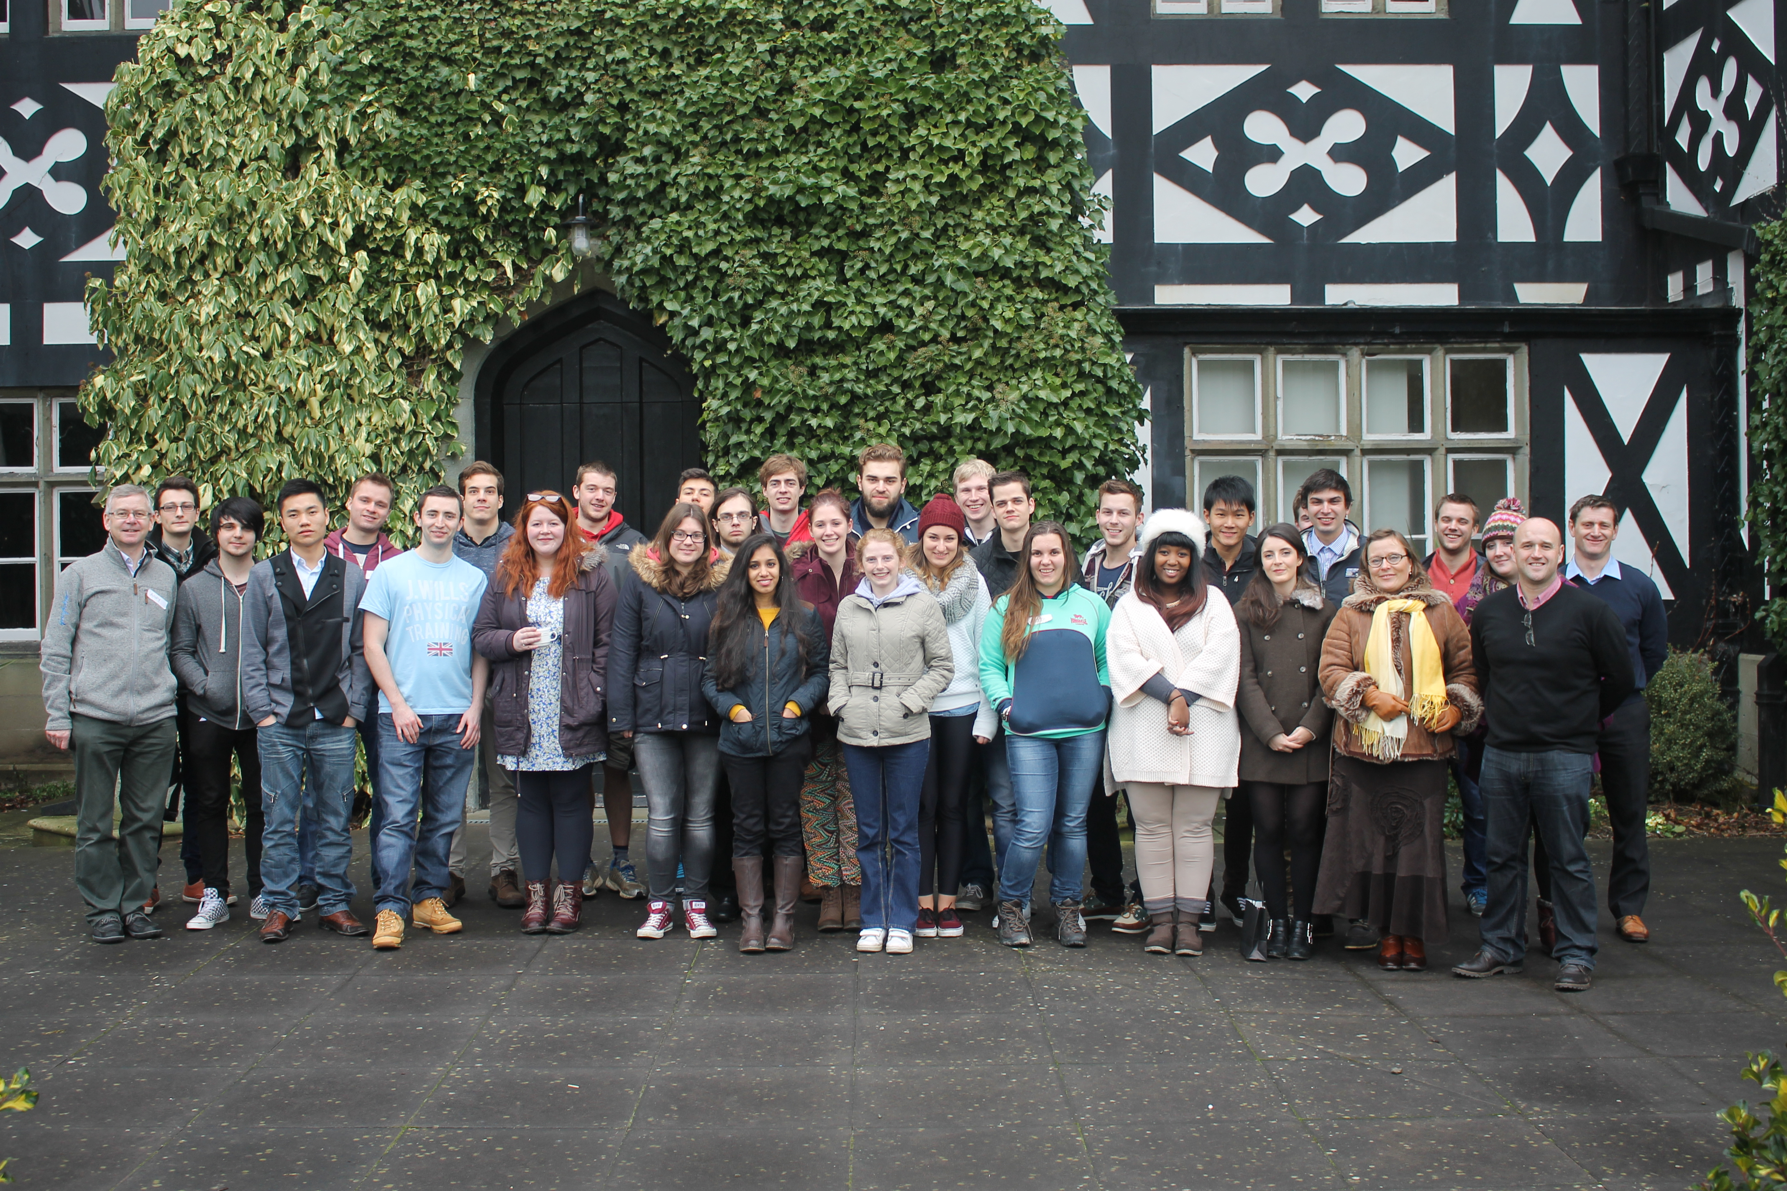

Slide 4
Challenge of “teaching” leadership
  “For some people leadership is a trait or an ability, for others it is a skill or a behavior, and for still others it is a relationship or a process. In reality, leadership probably includes components in all these dimensions.” P.G. Northouse, Introduction to Leadership, 3rd Ed. 2015

Slide 5
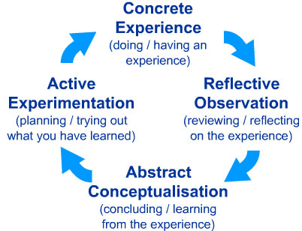
Kolb experiential learning cycle
Notes:
David A. Kolb (with Roger Fry) created his famous model out of four elements: concrete experience, observation and reflection, the formation of abstract concepts and testing in new situations. He represented these in the famous experiential learning circle that involves (1) concrete experience followed by (2) observation and experience followed by (3) forming abstract concepts followed by (4) testing in new situations (after Kurt Lewin). It is a model that appears time and again.
David Kolb and Roger Fry (1975: 35-6) argue that effective learning entails the possession of four different abilities (as indicated on each pole of their model): concrete experience abilities, reflective observation abilities, abstract conceptualization abilities and active experimentation abilities.
Kolb and Fry (1975) argue that the learning cycle can begin at any one of the four points – and that it should really be approached as a continuous spiral. However, it is suggested that the learning process often begins with a person carrying out a particular action and then seeing the effect of the action in this situation. Following this, the second step is to understand these effects in the particular instance so that if the same action was taken in the same circumstances it would be possible to anticipate what would follow from the action. In this pattern the third step would be understanding the general principle under which the particular instance falls.

Slide 6
The LEAD programme (Lancaster University and NWRDA 2004-2012),
adapted from Smith (2011, p 18)

Slide 7
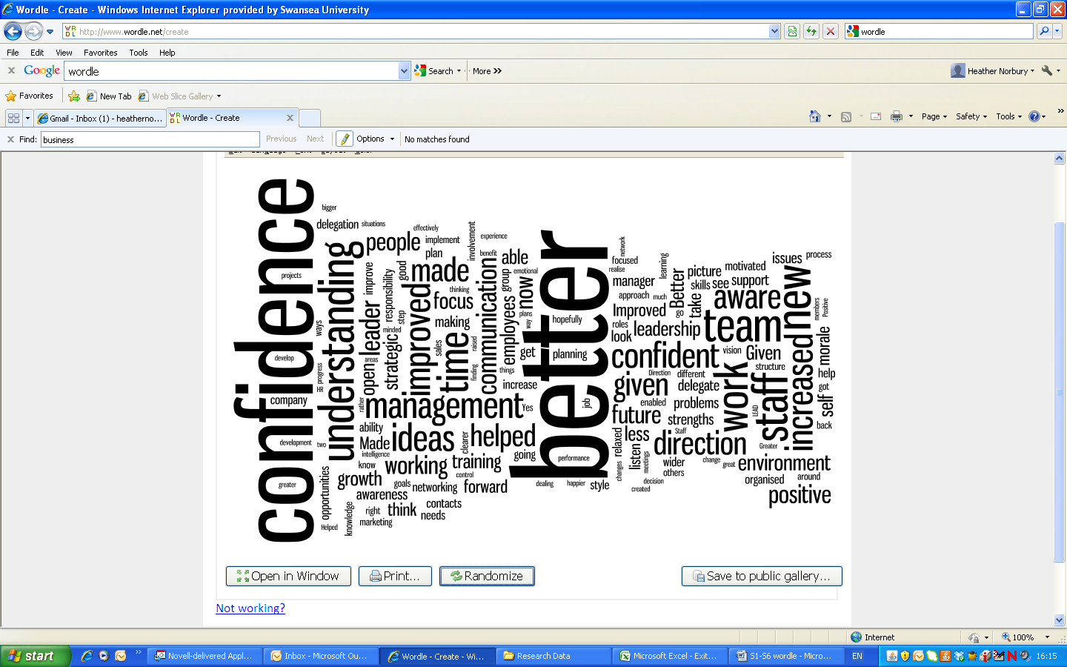

Slide 8
Experiential learning (Kolb, 1984)

Slide 9
Ingredients
  Experiential learning “games”, in some cases designed to elicit particular leader/follower behaviours
  Opportunity for group and individual reflection
  Embedded communication skills development
  Emergent leadership and explicit leadership
  High pressure, competitive, fun environment

Slide 10
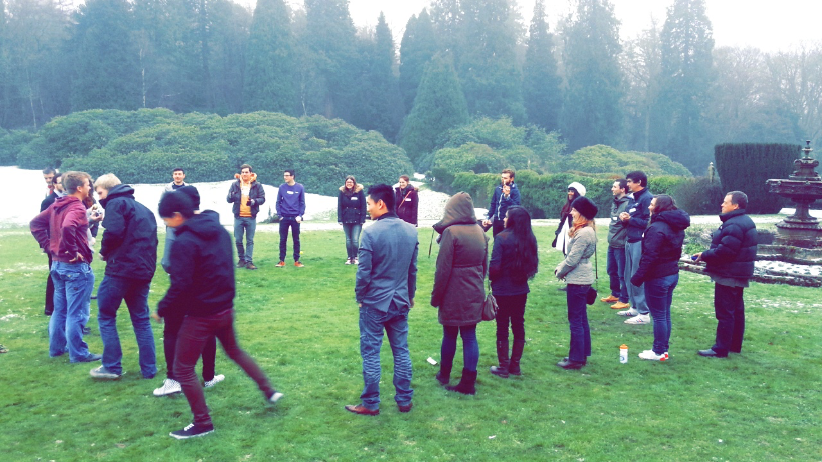

Slide 11
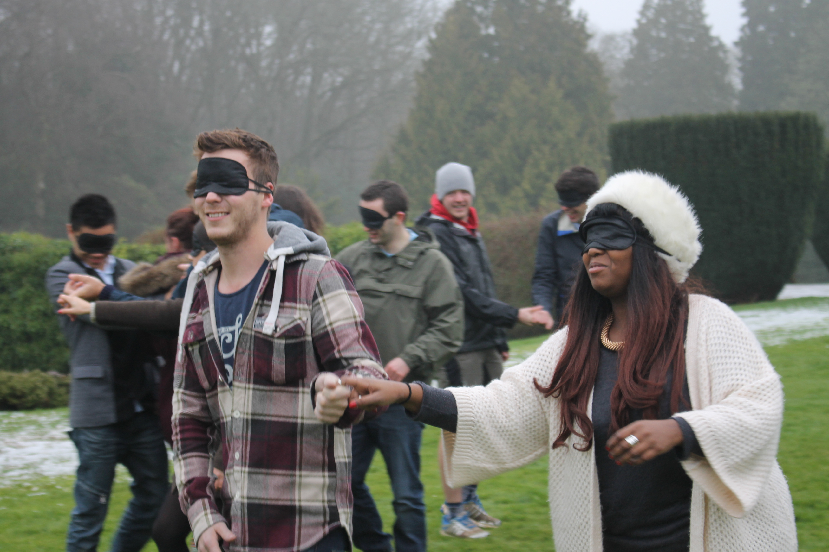

Slide 12
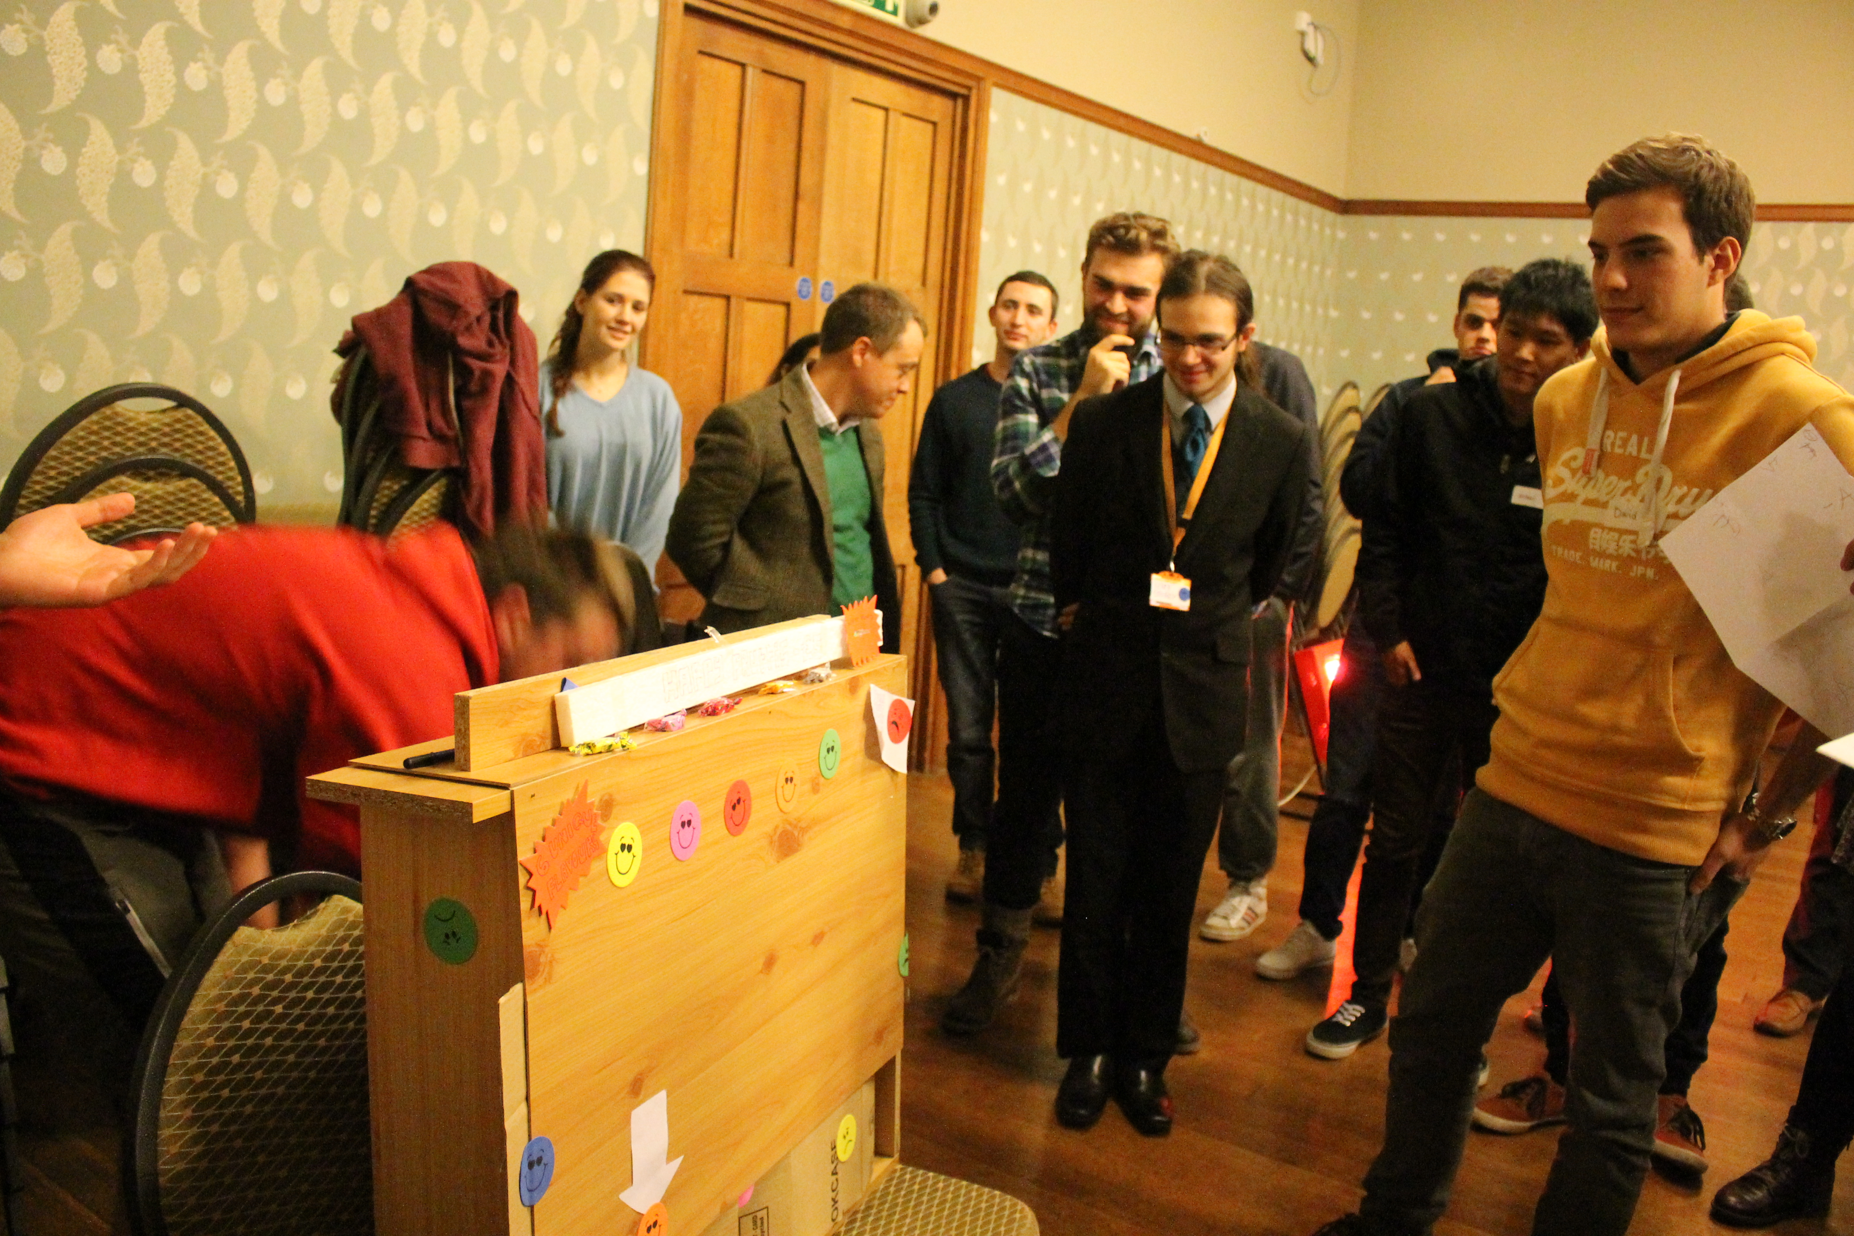

Slide 13
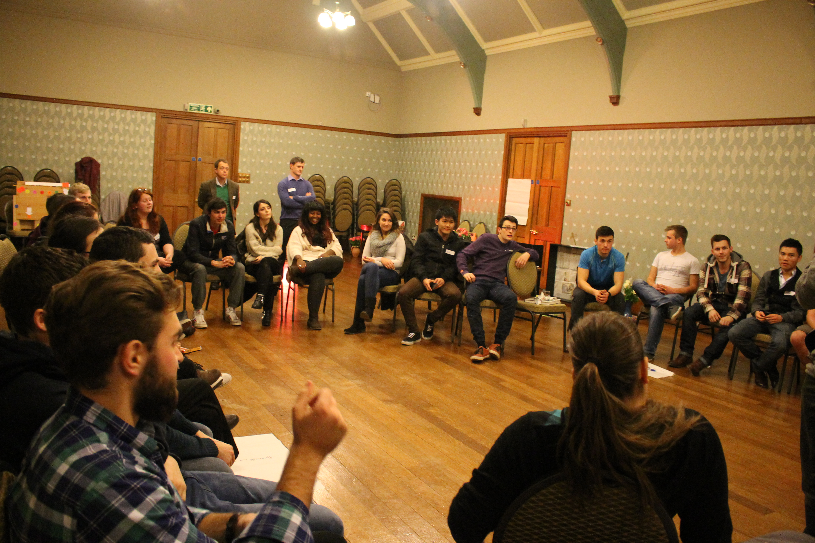

Slide 14
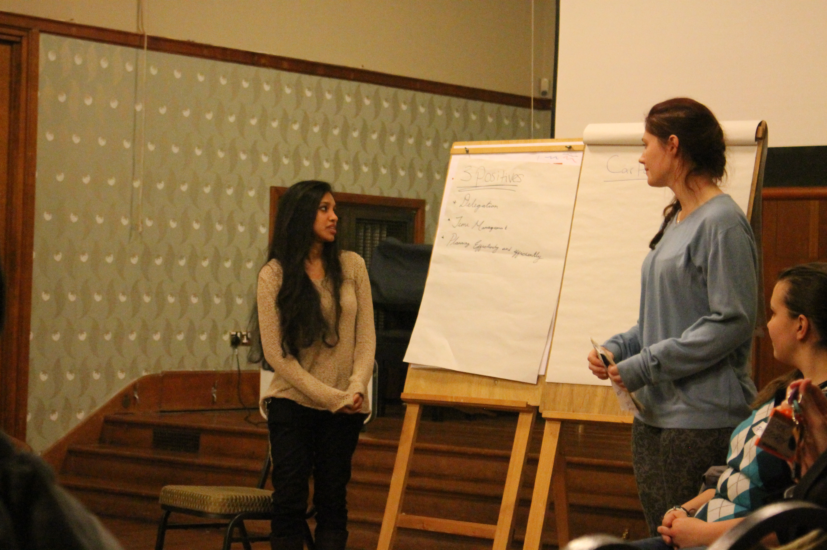

Slide 15
Activities
  “balls in the air”
  team-based problem solving, emergent leadership
  “self assembly”, team/leadership/delegation
  guest speaker
  personal “timeline” activity
  leadership trust activities
  “newflash”

Slide 16
Issues
  Timing (from employability point of view)
  How much experience would final years have available to reflect on?
  Would they see past the “fun and games”?
  How is this kind of activity/experience fed forward into formal curriculum?

Slide 17
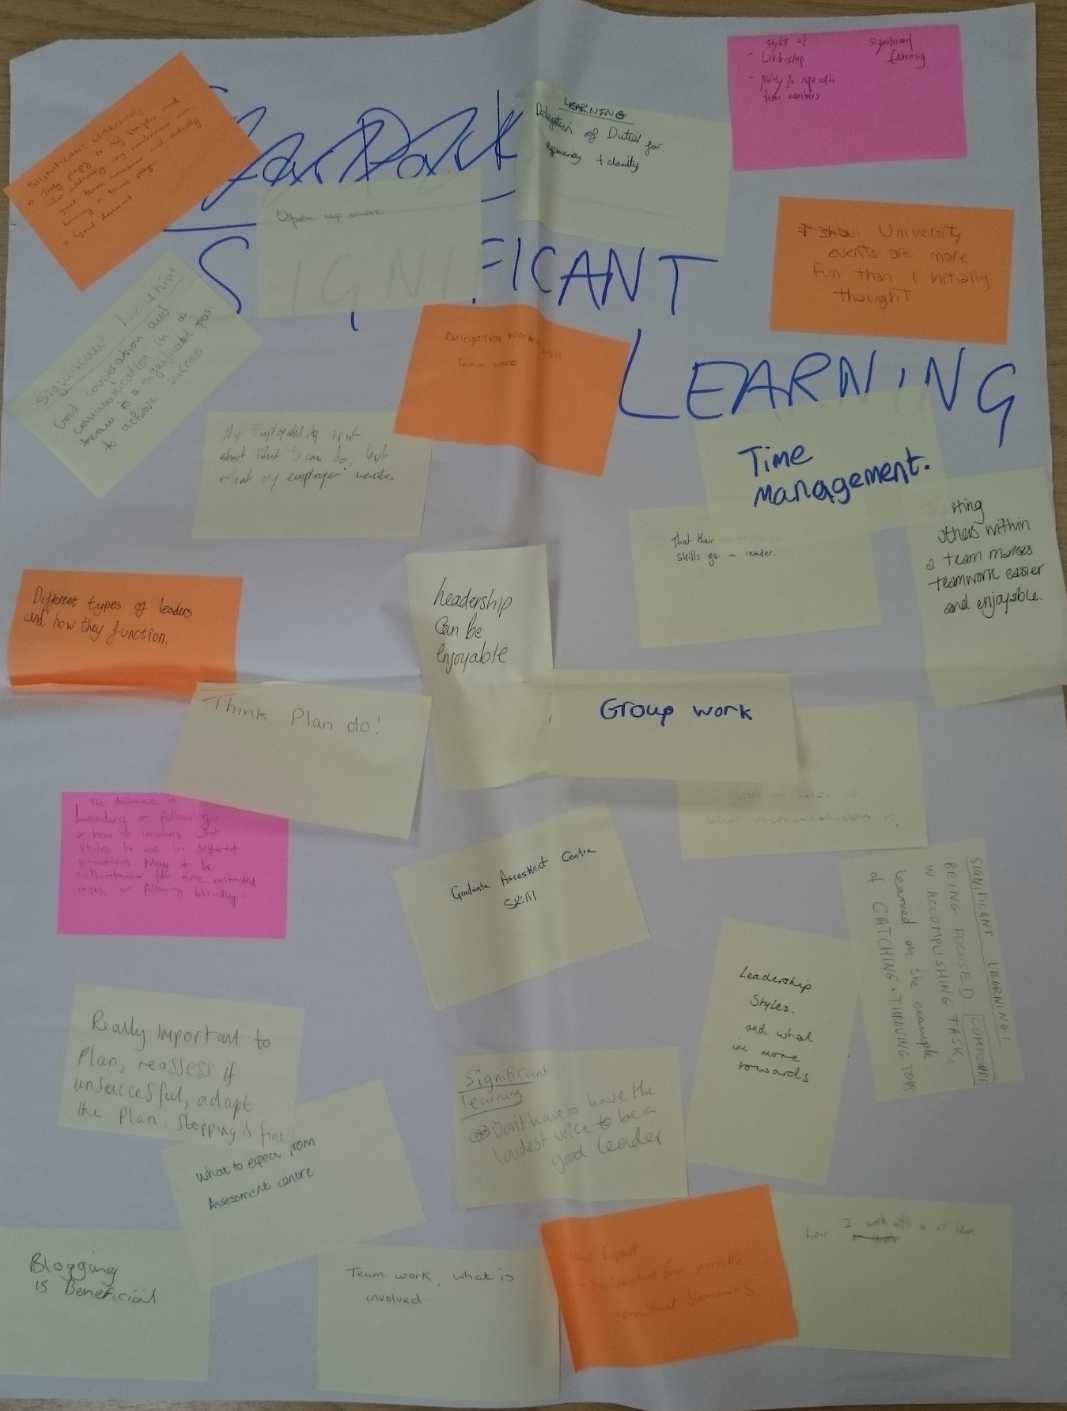
“soft” evaluation:

Slide 18
With grateful thanks to:
  Adrian Harvey
  Nel Jenkins
  Dominika Komeniecka
  Rafal Leja
  Dafydd Llywelyn
  Wyn Morris

