Slide 1
Student as Producer: Using research engaged teaching to enhance the learning experience of biomechanics students
Dr Daniel Low
Institute of Biological, Environmental and Rural Sciences
Aberystwyth University

Slide 2
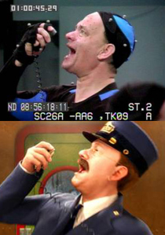
Biomechanics
Biomechanics is taught at all levels of the SES degree at AU.
Looks at the mechanics of movement.
Is used to look at performance and injury causation.
Links therefore to health and clinical assessments.
Used in animation

Slide 3
Needs analysis
Conversations with undergraduate Sport and Exercise Science students that they lacked some of the practical skills working with real clients.
Some difficulty to apply theoretical concepts to real world importance.
Maximise engagement and performance in the subject matter.
We were also being approached by local Health Care Professionals to help their assessment.

Slide 4

How can this be achieved?

Slide 5
Social learning
Theorists such as Bandura have advocated social interaction as a key consideration required for learning to take place.
Student as producer is model of learning where students create knowledge through social learning (Neary, 2010; Neary & Winn, 2012).

Slide 6
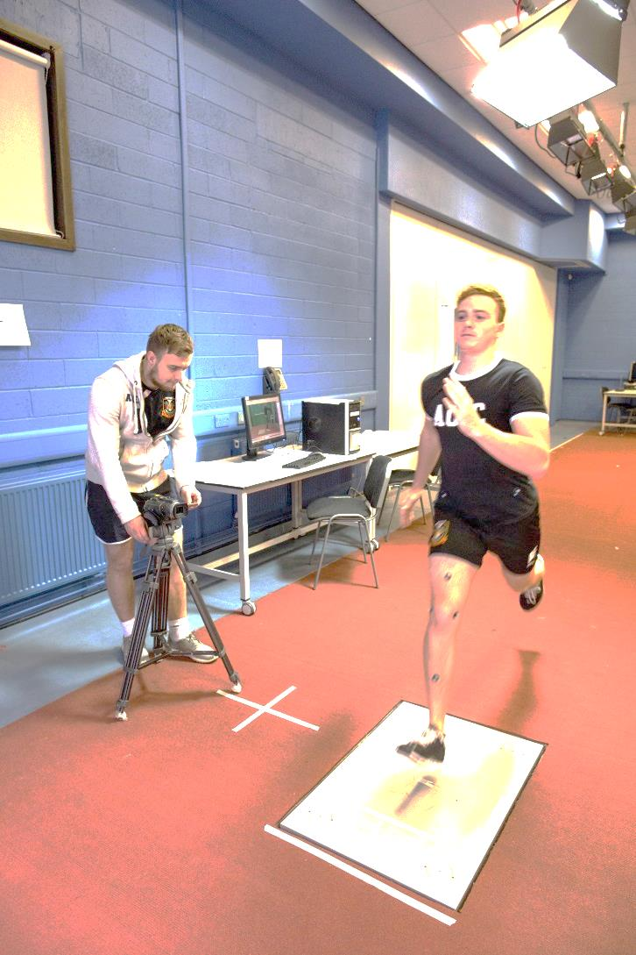
Student as Producer
Fundamentally it relates to the core activity of university, research and teaching, and how these concepts interlink (Neary & Winn, 2012).
Encourages the transformation of research-informed teaching into research-engaged teaching (Student as Producer, 2012).
It is more than the merely the individual learning in a social context, but is where the student works in partnership with the academic and also includes the way in which the social context of the university itself is transformed through progressive pedagogic practice (Neary, 2010).

Slide 7
How does it develop the student?
It appeared that the approach did develop:
  Discussion lead deep learning.
  Ownership in the learning process.
  Motivation and autonomy.
  Reflective practice.
  Critical thinking.

Slide 8
Partnership and the HEA
SAP is in line with the framework for partnership in learning and teaching put forward by the HEA (2014).
Partnership is defined as
  ‘relationship in which all involved are actively engaged in and stand to gain from the process of learning and working together to foster engaged student learning and engaging learning and teaching enhancement. Partnership is essentially a way of doing things, rather than an outcome in itself.’
  ‘All partnership is student engagement, but not all student engagement is partnership’ (HEA, 2014 p. 2).
Student engagement correlates with positive learning experiences and outcomes for students (Levy, 2014).

Slide 9
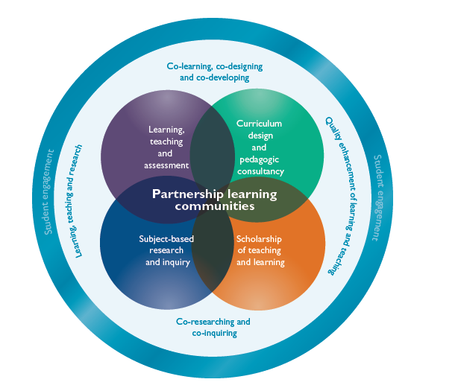
Student as Producer

Slide 10
Employability
‘Employability is more than about developing attributes, techniques or experience just to enable a student to get a job, or to progress within a current career.
It is about learning and the emphasis is less on ‘employ’ and more on ‘ability’.
In essence, the emphasis is on developing critical, reflective abilities, with a view to empowering and enhancing the learner’. (Harvey 2003).

Slide 11
Employability
Preparing students to match the changes in society cannot be achieved by direct teaching (Hattie et al., 1996, cited in Black and Wiliam, 1998b).
Students learn these things through reflection and metacognitive development (Hattie et al., 1996, cited in Black and Wiliam, 1998b).
‘Requires a relationship between teachers and students in which students are helped to take responsibility for their learning and a view of learning which places learners at the centre of the process’ (Deakin-Crick et al., 2005).

Slide 12
Therefore….
By applying SAP and learning in social setting to a real world experience, knowledge and understanding can be improved.
It also allows the development of additional practical skills required for ‘real world’ practice leading to improved employability of the student as well as maximising the students’ degree classification.
It also encourages critical and reflective practice.
The ability for this approach to learning to work with biomechanical students was not known.

Slide 13
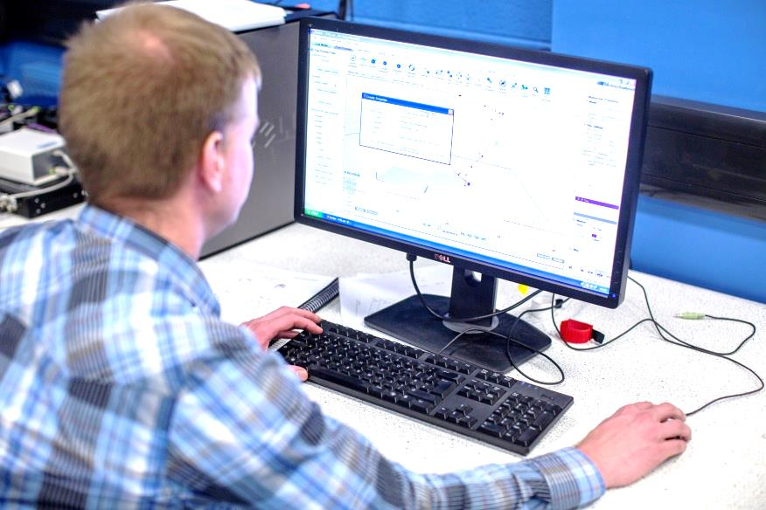
Aims
The aims of the project were to use SAP to develop:
  An interactive work between student, academic, health care professional and client.
  Apply theoretical concepts to real world settings.
  Development of an autonomous deep learner.
  Develop work related and
  professional skills.
  Improve perception of
  Employability.

Slide 14
The students
Ten 2nd and 3rd year students.
AU Sport and Exercise Science degree.
Mixed grade averages across the group.
Voluntary involvement (extra-curricular).
Analysed the movements of clients with injury identified by a Sports Therapist.

Slide 15
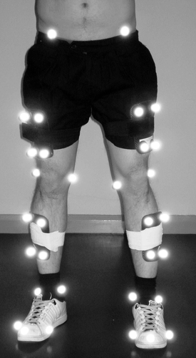
The work
Week 1:
  Mostly observed the procedures, but did gain practical experience on how to work the motion analysis system and also how communicate with the client.
  Practice the testing procedure observed in session one.
Week 2:
  Prepared the clients with the markers needed for the analysis and also supported the measurement of static flexibility measurements.
  Learnt how to process the data thorough discussion and observation with myself.
Notes:
Throughout the process, the students were given individual feedback on their performance as well as afterwards regarding how well they worked with each other and the client and professional.
Include images

Slide 16
The work
Week 3
  More autonomous; set up the equipment and prepared the client before I collected the data.
  Explained the details behind the set up.
  Performed the processing of data.
Week 4
  Applied their understanding to collect and process all data and used a predefined template .
  Created some clinical meaning of the data in relation to the injury.

Slide 17
The results- Collaboration
Students were able to learn from myself as well as from each other when they were able to discuss the protocol and set up.
It was evident that students were more confident as the sessions passed due to the successful application and analysis.
Students took ownership in the learning applying their knowledge to something that interested them.
Some more basic understanding was needed for the critique of the testing procedures used.

Slide 18
Results
On a scale of 1 (completely not ) to 5 (completely so):
Students agreed or completely agreed that by the end they felt like a partner in the process and not a student following the lead of the lecturer (average of 4 out of 5).
Confidence in performing the assessment on their own (average of 3.75).
Interpreting the data with some help (average of 4 out of 5) also scored well.

Slide 19
Results - employability
Students felt that it enhanced employment skills, which will be added to their CV (4.75 out of 5).
That they felt that it was valuable to get a job (4 out of 5).
That it provided practical skills in a real life setting (4.5 out of 5).

Slide 20
Results - Knowledge and understanding
Students were able to perform the assessment with confidence and could apply the principles.
Students felt that they had improved understanding the procedures for collecting biomechanical data (4 out of 5).
That they could interpret the data with some help (4 out of 5).

Slide 21
Results – Information generated
Health care professionals said that the data was extremely useful in their assessment utilising this for their subsequent intervention.
Provided different case example that can now be how used in the formal curriculum (research informed).
Learning through fellow students work will motivate these students.
Need to continue to develop research engaged opportunity.

Slide 22
Incorporation with curriculum
Students were able to show their peers the use of the equipment within formal dissertation and biomechanics practical seminars.
  Demonstrating deep learning.
I hope to transform the formally curriculum through the development of an assessed module.
Also development of informal curriculum through the greater similar opportunities.

Slide 23
Results - Opportunities
A desire for similar opportunity in other disciplines (average of 4.75 out of 5.
Qualitative student feedback showed that students felt that the approach should be.
  ‘a module alongside the Biomechanical Analysis [SS21120]’.
  ‘teach it as a module’.
  ‘very good’.
  ‘would be nice to have some more sessions like this in other modules because it was a great way to learn’.
  ‘really helpful and [a] positive experience’ and that they would ‘definitely do it again’.

Slide 24
How does it develop the student?
It appeared that the approach did develop:
  Discussion lead deep learning.
  Ownership in the learning process.
  Motivation and autonomy.
  Reflective practice.
  Critical thinking – however this could have been developed further and needed some more basic understanding.

Slide 25
My reflections
Worked really well to develop student understanding of the application of the theoretical concepts .
Developed excellent communication skills with lecturer and client.
Interpreting meaning from the data required more explanation than initially thought.
Would benefit from formal lectures or detailed explanation.

Slide 26
Future tasks
Continue to set up activities for ownership.
Different disciplines.
Incorporate findings of the pedagogical approach and of the assessment in the formal curriculum.

Slide 27
Wider influence
University strategic plan:
  Working in partnership.
  Creating opportunity.
  Teaching that inspires.
Transformation of the formal and informal curriculum by incorporation into a new module and through development of new opportunities.

Slide 28

Aims
The progressive approach developed learning and employability as well as the aims set:
  Interactive work between student, academic, health care professional and client
  Apply theoretical concepts to real world settings
  Development of an autonomous deep learner
  Develop work related
  and professional skills
  Improve perception of
  employability

Slide 29
Any questions

