Slide 1
Improving Engagement with Games as a Form of Feedback
Heather Norris
Law and Criminology Department

Slide 2
Main Question
How to improve student engagement-especially in areas that are perceived as tedious?

Slide 3
Additional Questions
Are games/challenges a suitable form of formative assessment and feedback in higher education?
Are these more appropriate for first years?
Do students find a more interactive learning/teaching approach useful?

Slide 4
“Engagement is the direct (and only) pathway to cumulative learning, long-term achievement, and eventual academic success”
(Skinner and Pizer, 2013, pg. 23)

Slide 5
Engagement and Learning
8 strategies to improve engagement and prevent lurking (Klemm, 1988, pg. 64)
Require participation
Form Teams
Make activities interesting
Don’t settle for opinions
Structure the activity
Do something/include active participation
Involve yourself as the teacher
Peer grading
Formative feedback increasing uncommon in higher education
Strong emphasis on summative assessment and feedback
York (2003)-Universities need a radical restructure to increase time for formalised formative practices

Slide 6
In Previous Years…
Referencing standards not as consistent as we would like
To improve standards we provided referencing seminars for 1st years & 2nd years, however...
Referencing seminar not well attended
Lack of engagement in these seminar (lurking)
No real improvement overall

Slide 7
 | Workshop Plan
1. | Rename ‘Seminar’ to ‘Workshop’ in module handbook.
2. | Initial referencing assessment (a challenge) at the start of the workshop
3. | Set a number of group tasks-referred as games and challenges
4. | Reviewed as a group and corrections made and discussed (Key step-formative feedback provided)
5. | Final summative assessment-peer marked (referred to as a challenge with a chocolate bar for the highest score)
6. | Student Feedback

Slide 8
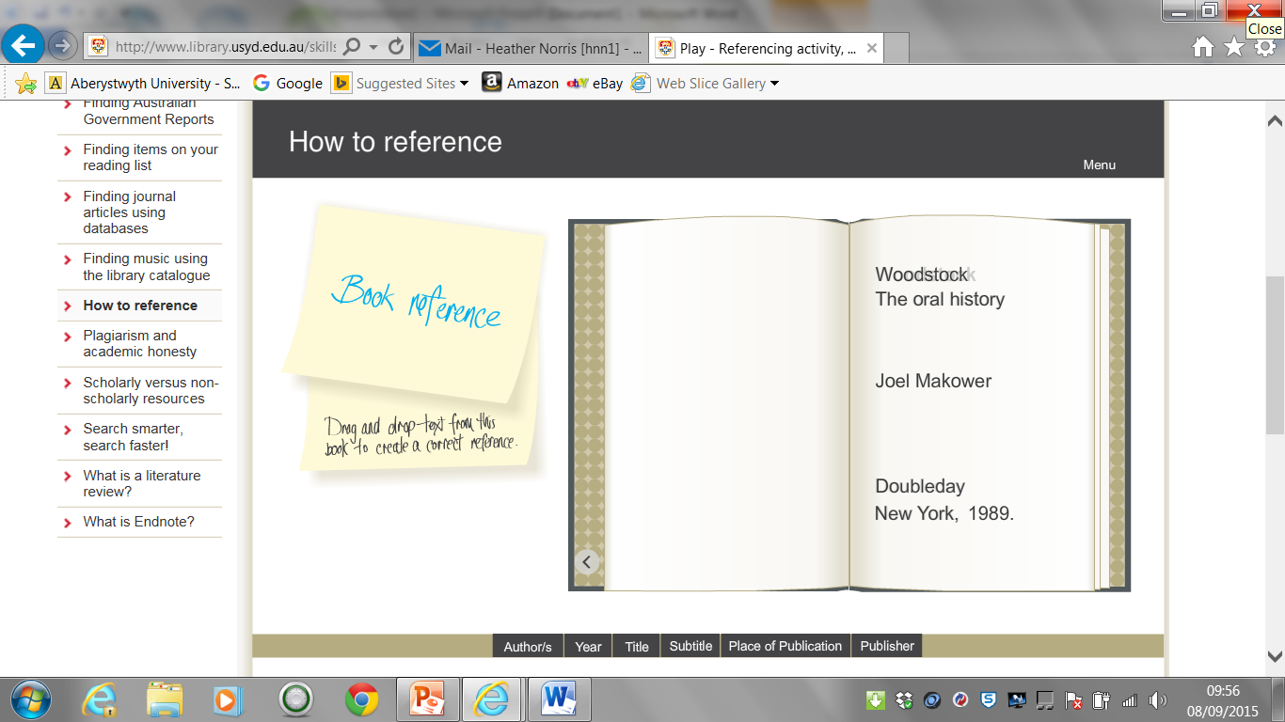
Examples
http://www.library.usyd.edu.au/skills/elearning/learn/referencing/activities/index.php
Online based games-in teams and as a class

Slide 9
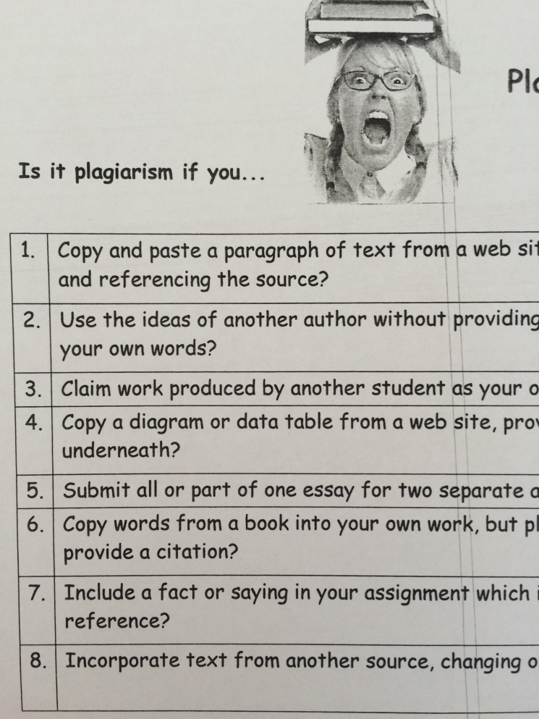
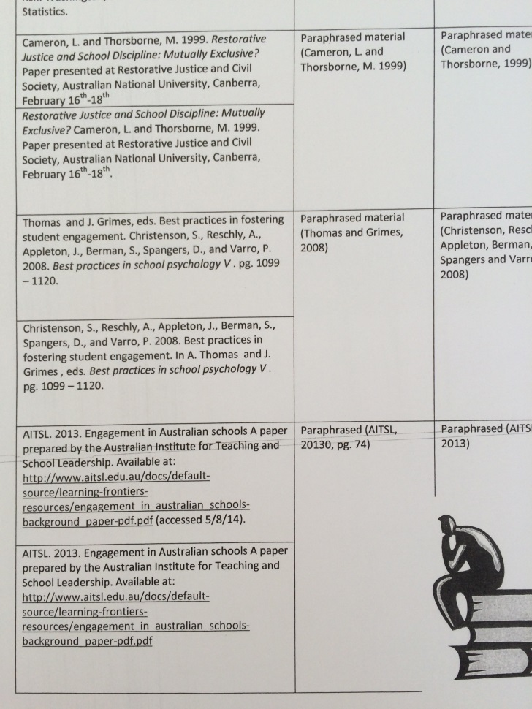
Examples
Simple paper based challenges

Slide 10
Sample & Results
Sample
Results
Useful?
Recognise Referencing Problems?
18 1st Years
61 2nd Years
Year | Yes | No
1 | 18 | 0
2 | 59 | 2
Year | Yes | No
1 | 18 | 0
2 | 57 | 4

Slide 11
Results continued
Year group differences and preferred teaching styles
Year | Presentation/Lecture Only | Interactive Workshop
1 | 0 | 18
2 | 2 | 59

Slide 12
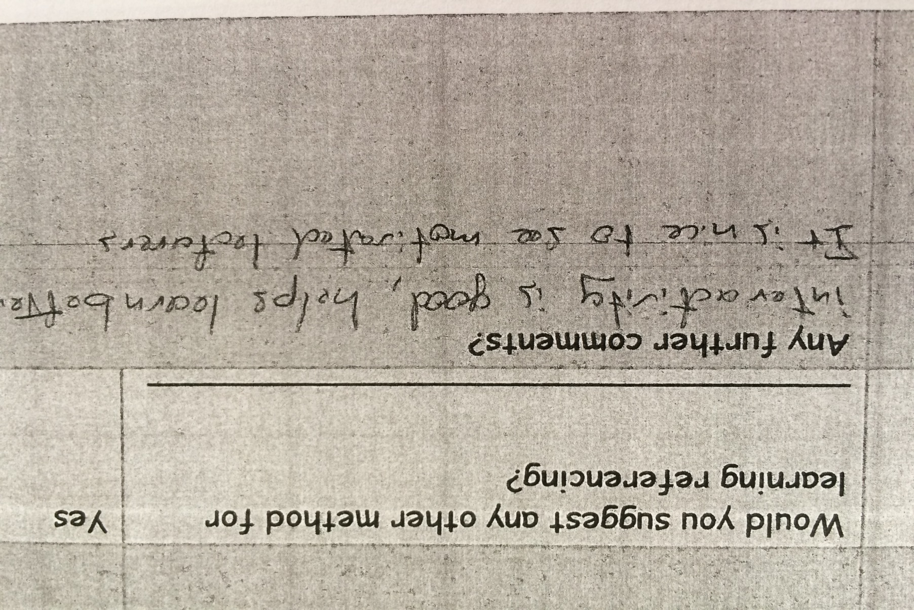
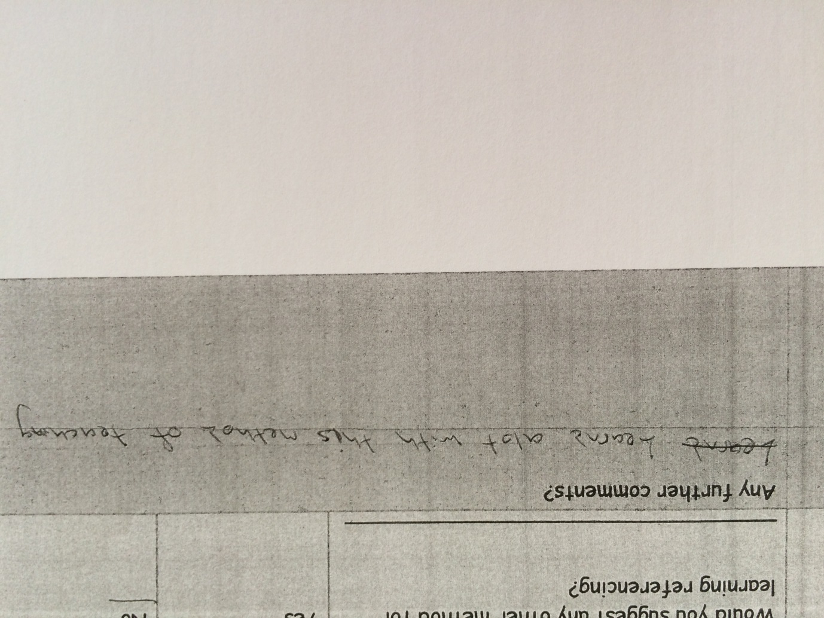
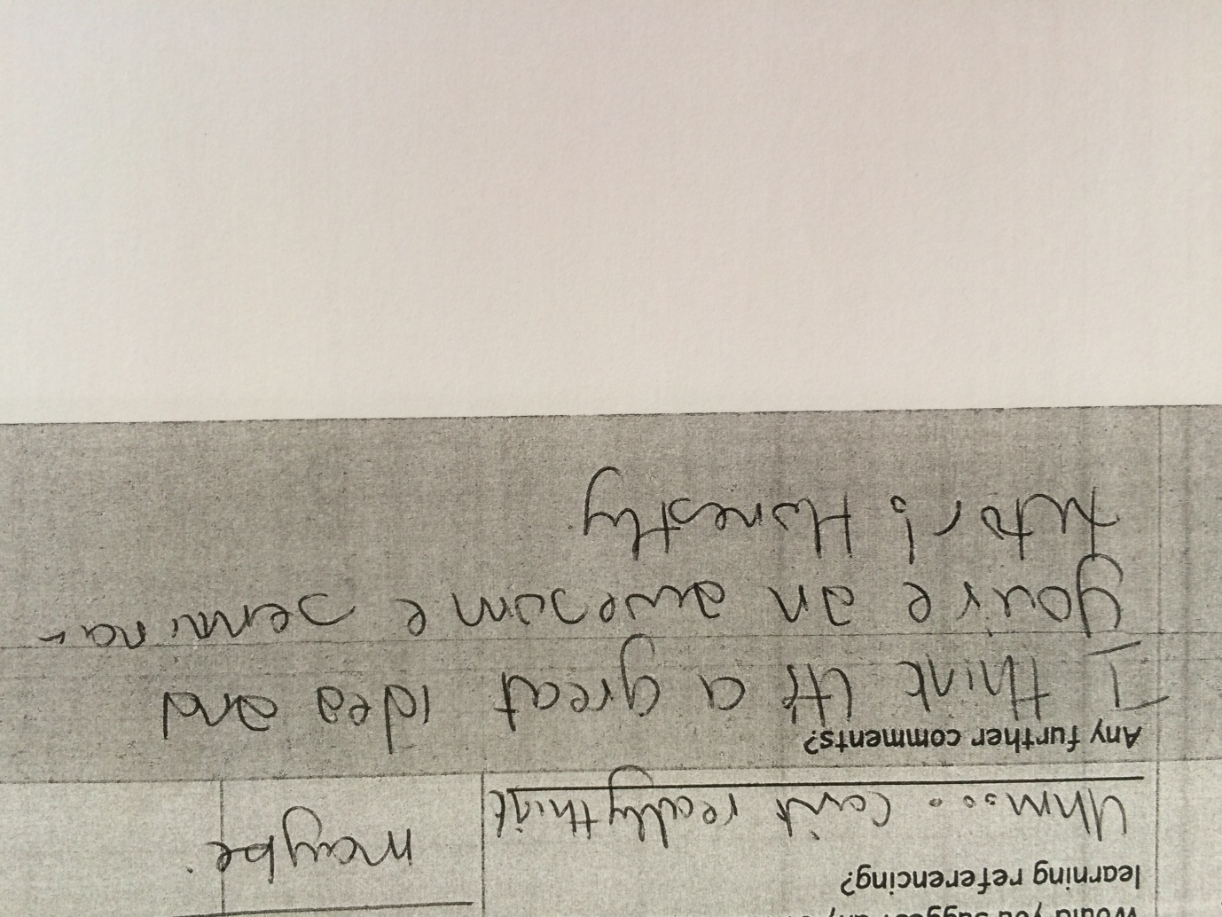
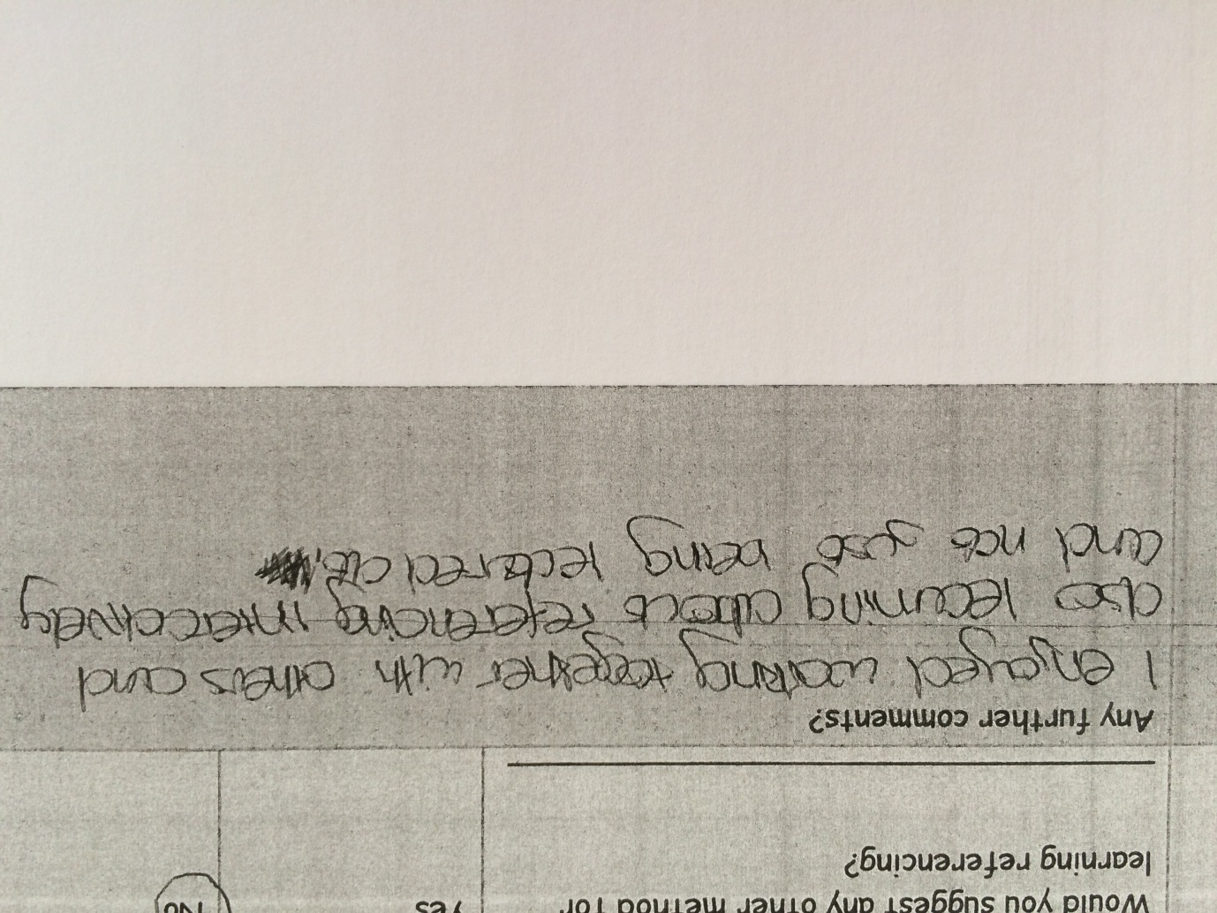
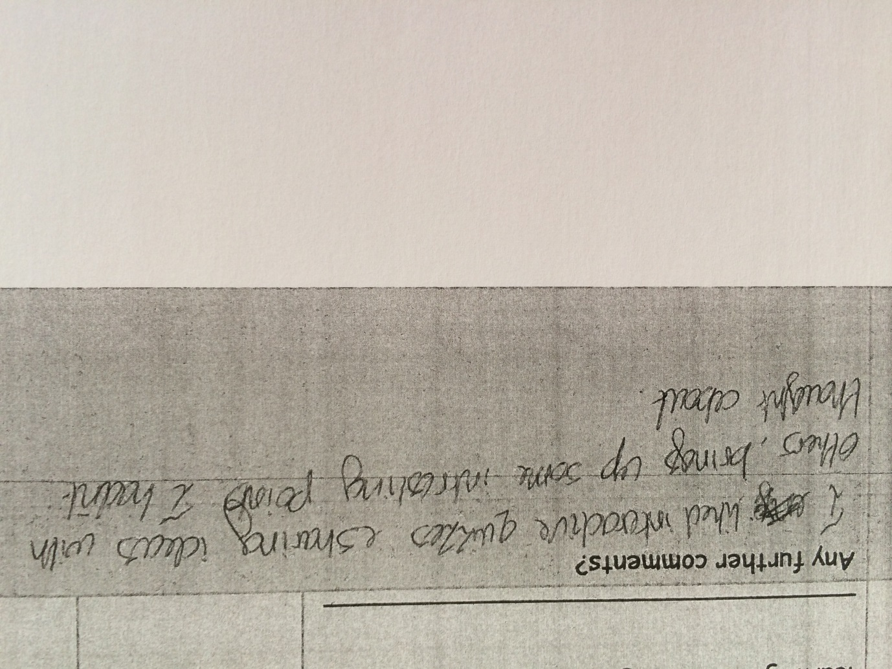
Student Feedback

Slide 13
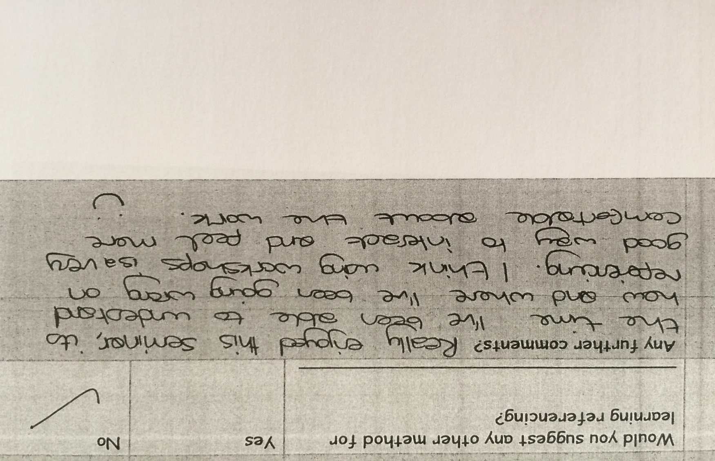
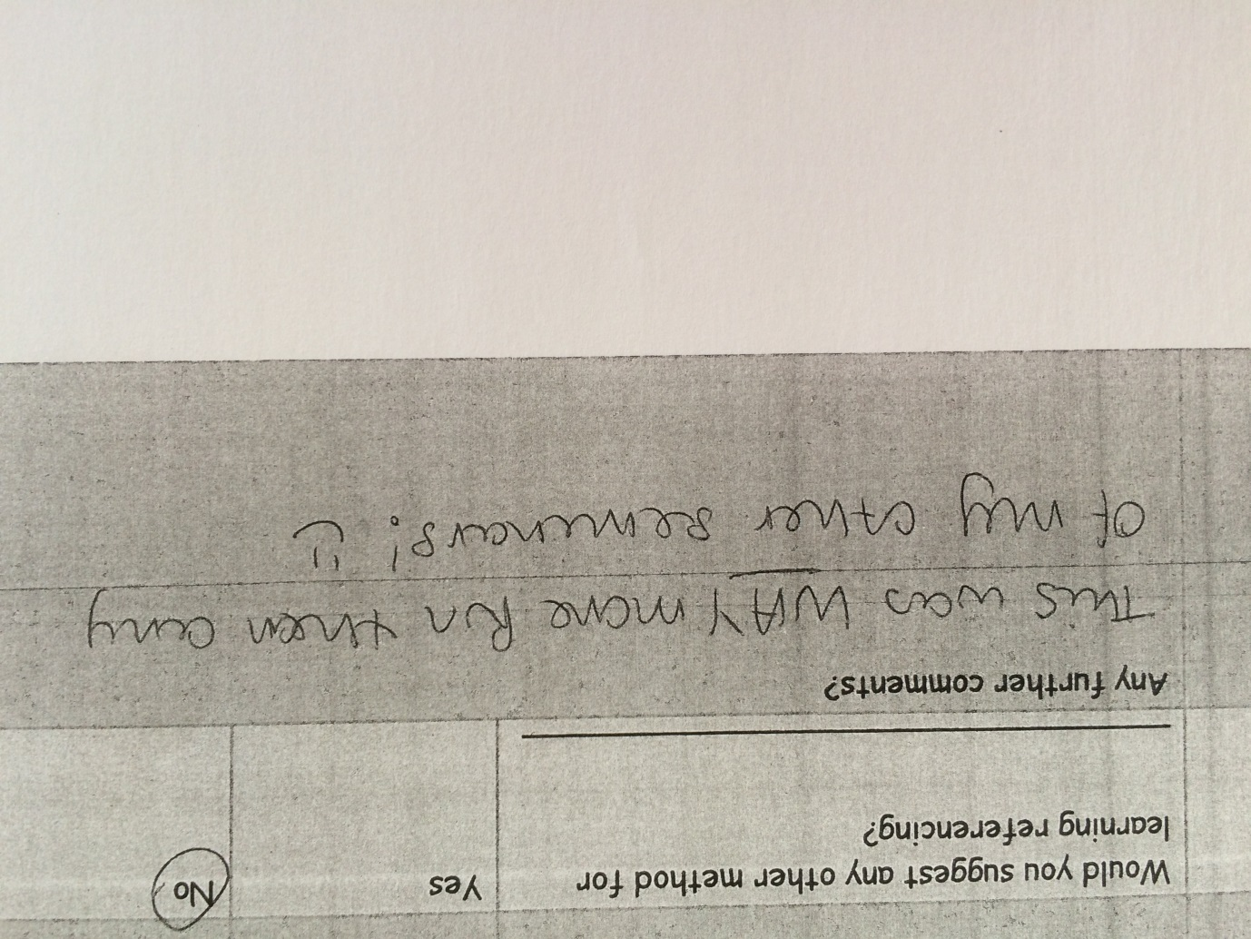
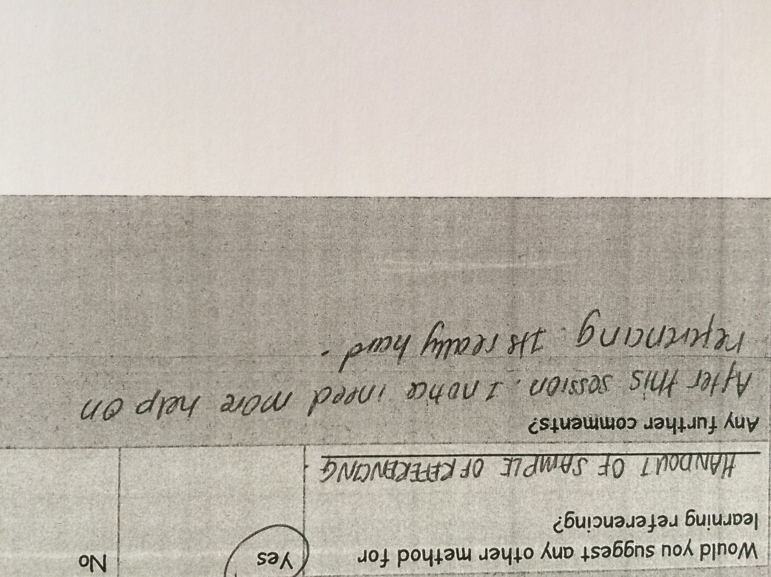
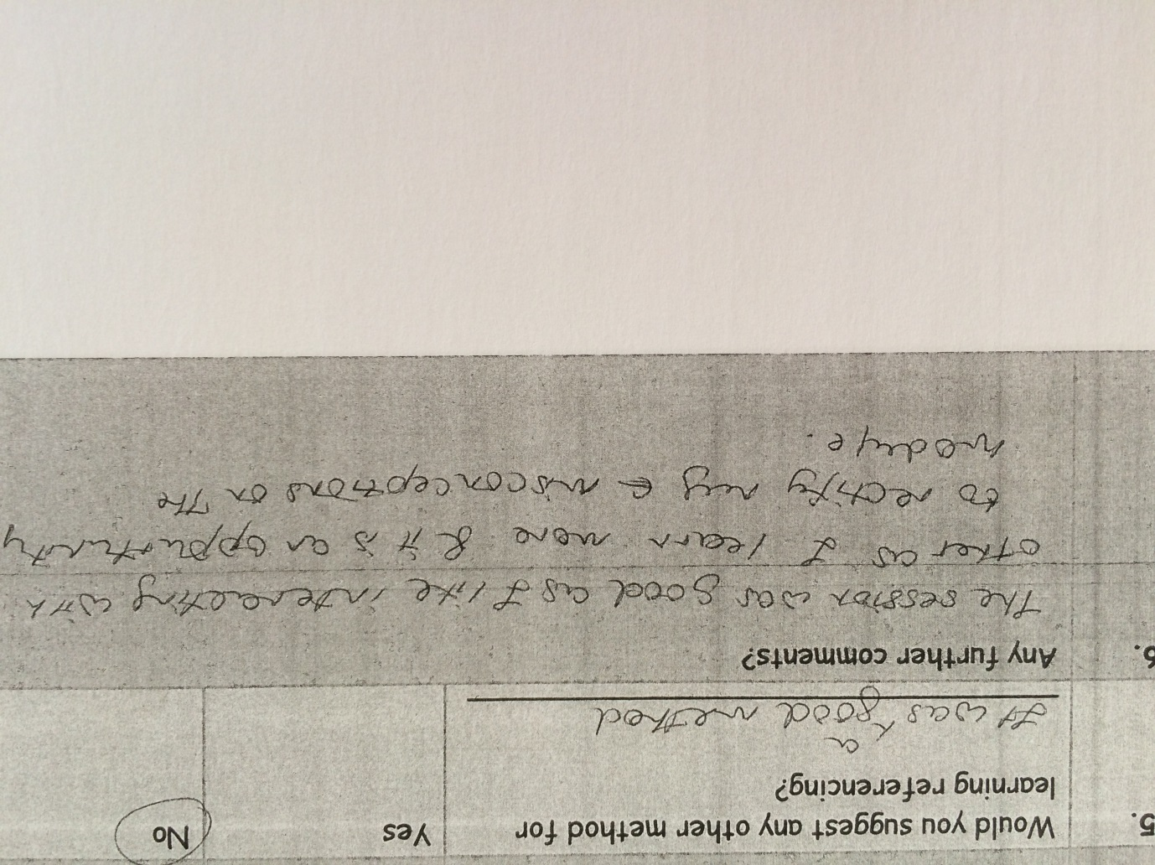

Slide 14
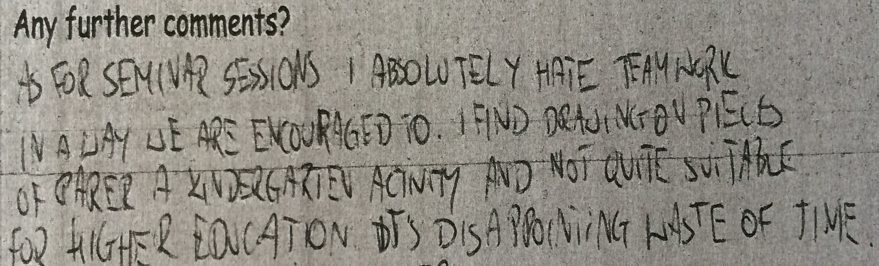
Not all positive…

Slide 15
Key Points
Very little ‘traditional’ lecturing
Make perceived tedious tasks into games and challenges
Include a variety of methods-individual, team and whole class work
Informal and ‘fun’ atmosphere
All 1st years and nearly all 2nd years found the activities a useful method of learning

