Slide 1
The use of tablets for Educational Purposes
Steve Atherton & Antonio Barriga Rubio, School of Education and Lifelong Learning

Slide 2

Intervention Objectives
To collect clear data on the impact of technology on students’ engagement with the feedback provided on assignment scripts. Prysor Davies Dr Stephen Atherton Dr Andrew Davies

Slide 3
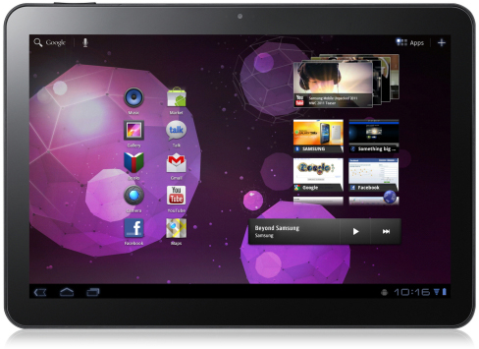
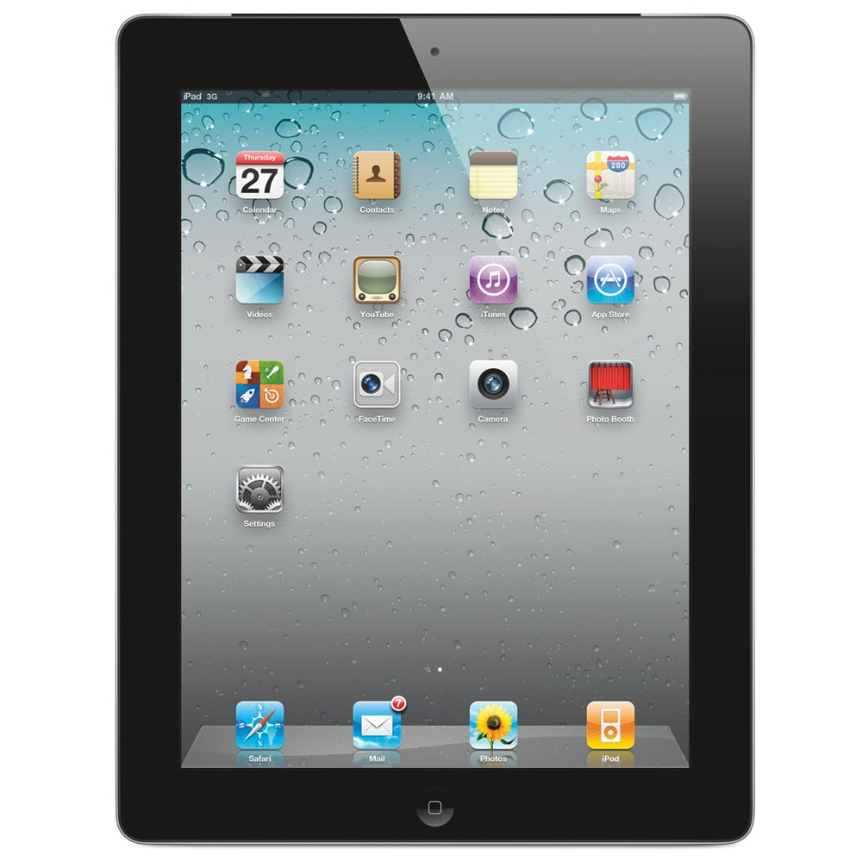
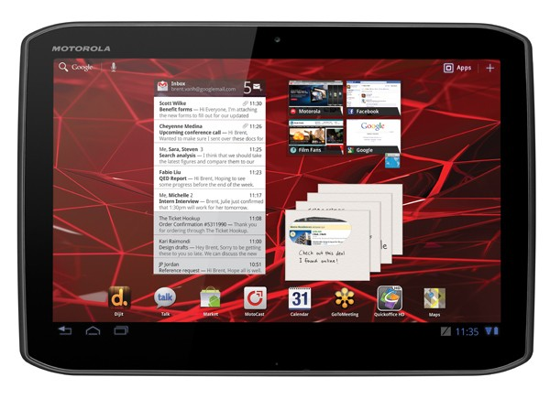
Methodology
Baseline data collected by questionnaire from students from three modules (one from each year group). (January 2012)
Tutors marked and annotated assessed assignment scripts in electronic PDF format using tablet PCs .
Annotated scripts (pdf) and feedback sheets (Word) uploaded onto Gradebook.
Post-intervention questionnaire given to students. (April 2012)
Academic and administrative staff interviewed post trial for their impressions.
Method rolled out to all staff – to trial at least one assignment in their modules. (2012-2013)
Further data gathered from students (Years 1, 2 and 3) by questionnaire. (May 2013-May 2014)

Slide 4
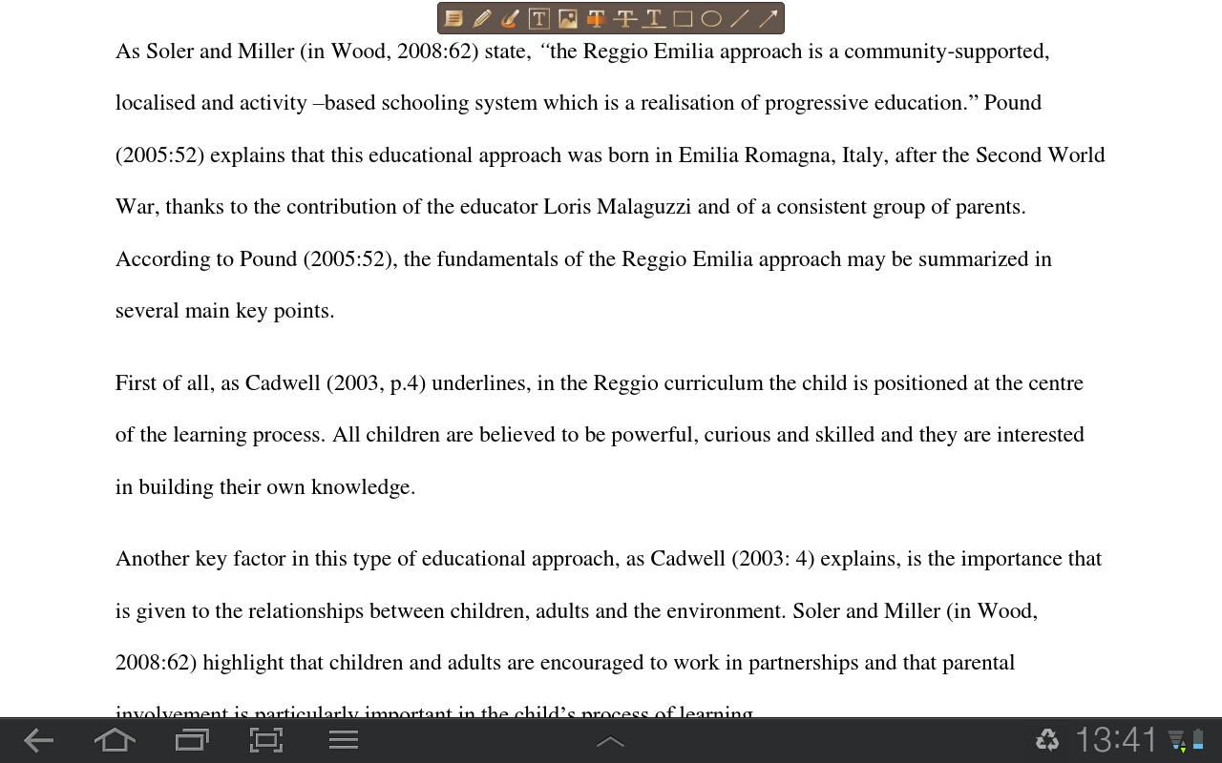
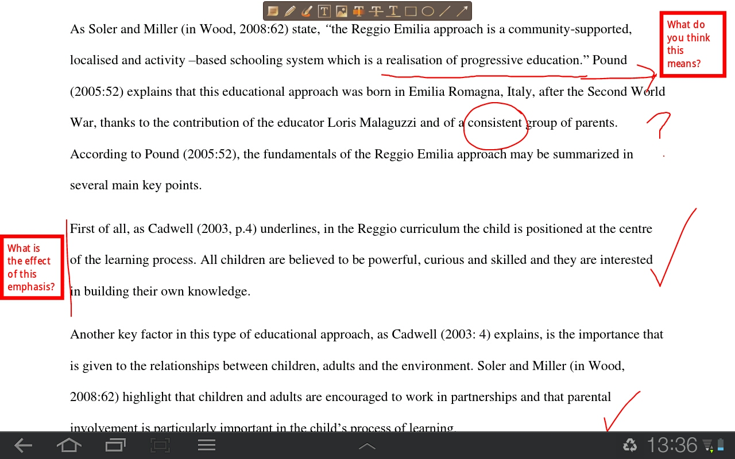
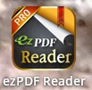
Methodology:

Slide 5

Colour coding annotations

Slide 6
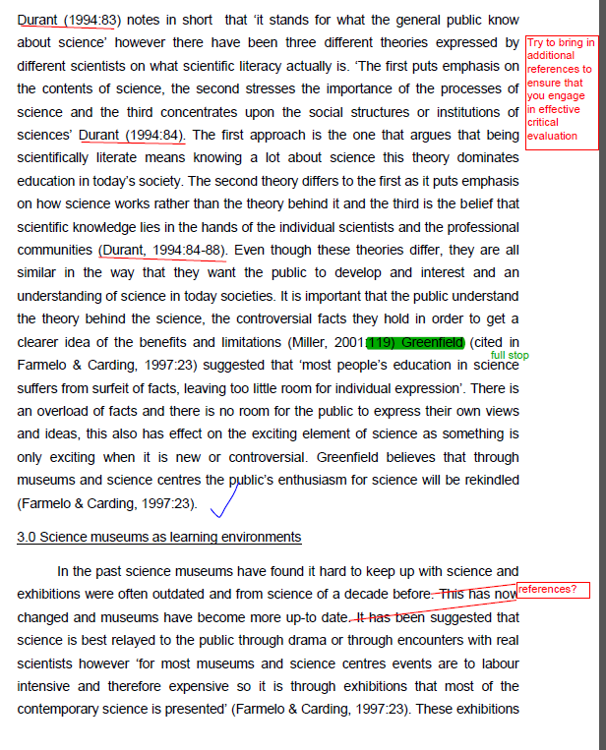

Slide 7
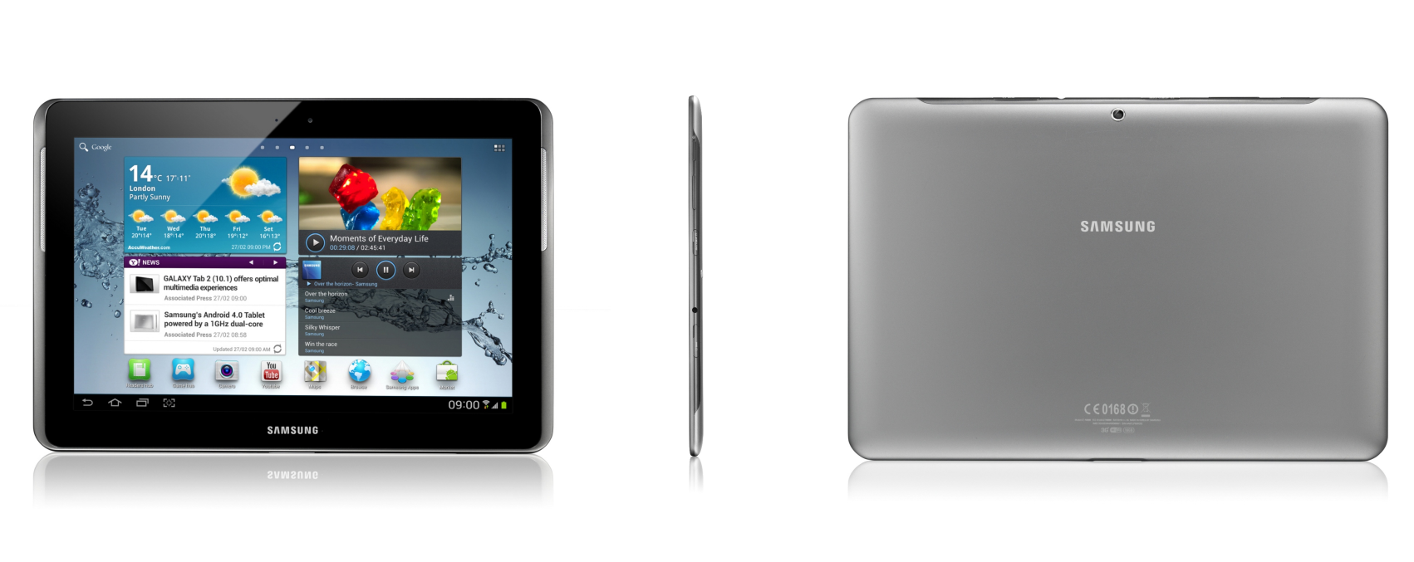
Galaxy tab 2

Slide 8
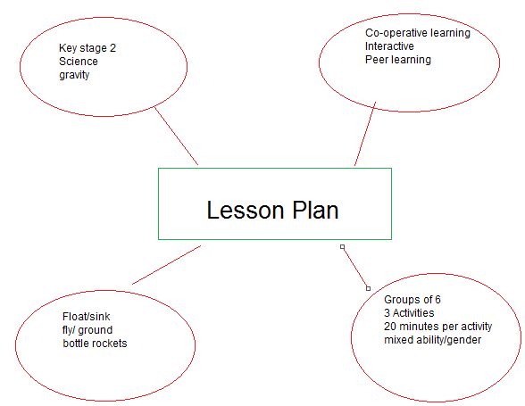
Tablets- the new a3 paper??
Group work
Electronic files to be placed on Blackboard.

Slide 9
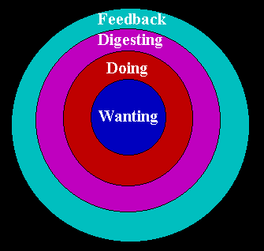
Ripples on the pond model
Race (2005)

Slide 10
activities
Classroom based research
Demonstrations of Primo
Identify uncertainty regarding assignments- Blackboard forum feature

Slide 11
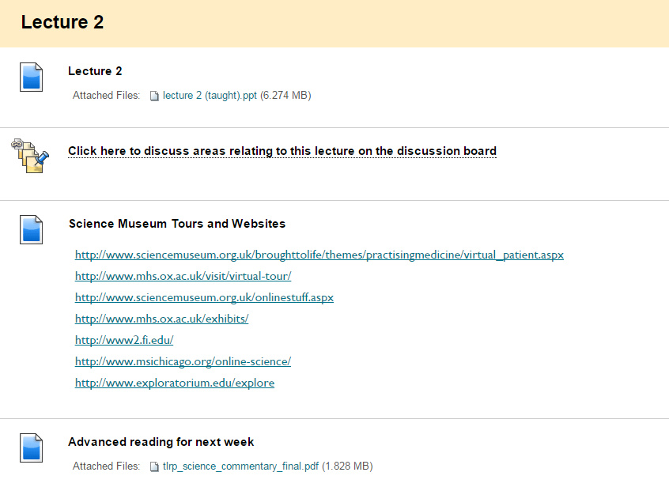
activities

Slide 12
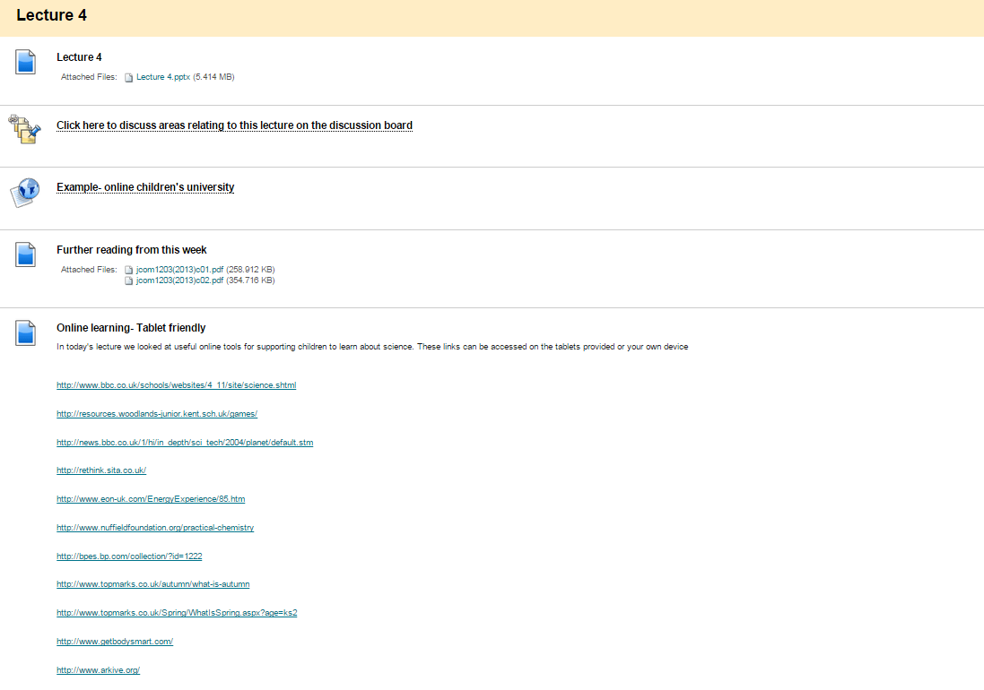

Slide 13
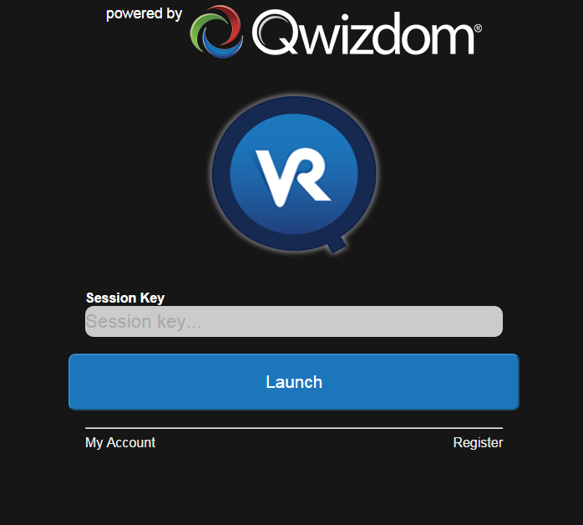

Slide 14
problems
Privacy
  Students have to log in to Eduroam each time
  Students remain logged in to Primo
Facebook
Flash
Tablets are “out of date”.

Slide 15
Student perceptions
The use of tablets, technology, guest speakers and teaching styles suit every learner, no matter what their learning style….
I enjoyed using the tablets in the group work sessions…
The primo session worked much better with the tablets….
QVR was awesome…..
More tablet sessions please……

Slide 16

Where next?
Augmented Reality?
https://www.youtube.com/watch?v=uHIxYpBW7sc&list=PLYk2ySKukLs6Fih_6xze0EYRyGJguDYCF&index=8

