Slide 1
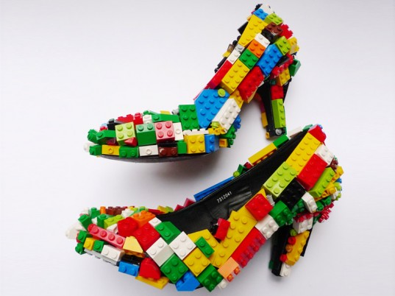
Engaging students creatively and interactively
Dr Alison James, UAL
National Teaching Fellow 2014
Image: Finn Stone Lego Stilettos
Notes:
Set up a todaysmeet page?
Set up a poll – play in HE, does it have a place in your practice? Professional, administrative, managerial, academic?

Slide 2
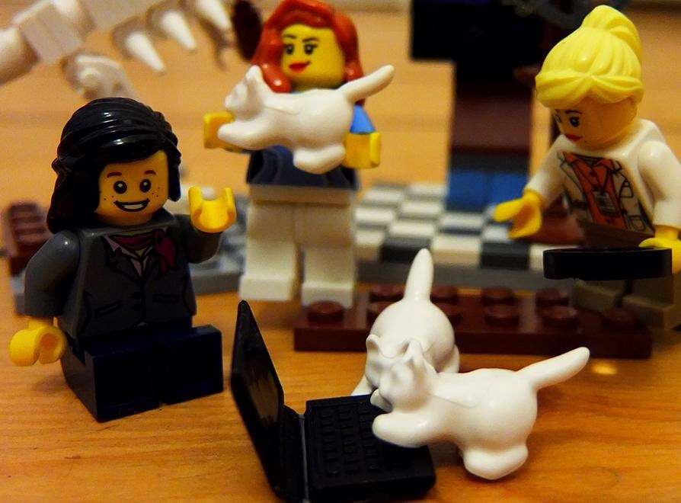
@Lego Academics pic.twitter.com/WAFduBPAOd

Slide 3
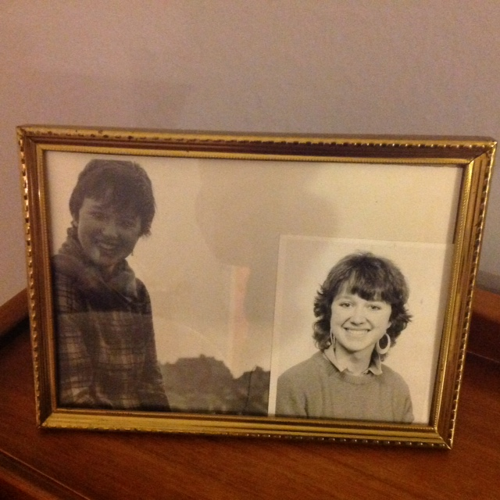
Notes:
Make point was languages graduate and moved into creative arts teaching after doing different kinds of jobs

Slide 5
three key terms in engaging & interacting
creativity
The making of newness, including adoption of thinking processes or borrowing from one domain to enhance another
Joy, flair, value
imagination
Conjuring possibilities
Fanciful, not necessarily fantasist
play(fulness)
A childlike, not childish, mode of enquiry
A means of exploring possibilities through simulation
Other ways of being, seeing, doing and becoming
Extending and fulfilling
Re-energising and freeing
Not just wacky
Notes:
How positive/comfortable do you feel with each of these words?
Any burden, pressure or reticence?
By creativity not just making and sticking, creativity in thought, in words, in probing and challenging

Slide 6
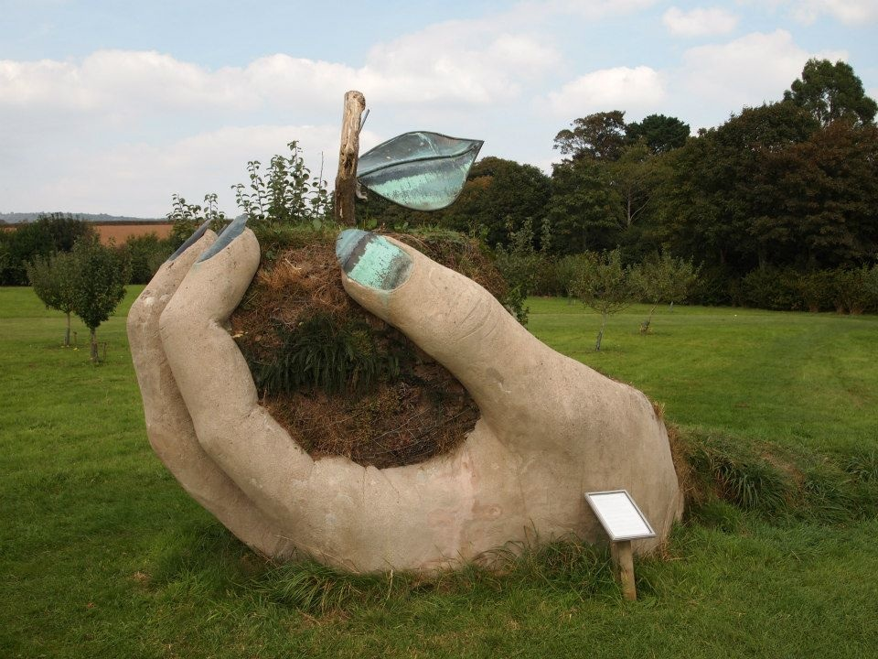
The hands are central to constructionist learning, based on neuroscientific data showing that nerve receptors in our fingers send electrical codes to the brain via our central nervous system. There, in the cerebral cortex, these messages are interpreted, thus we can envisage thinking as starting with our hands, as opposed to the popular assumption that the brain ‘thinks’ first and tells the hands to act.

Slide 7
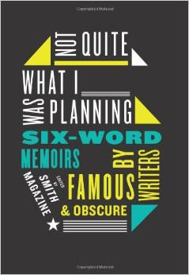
Not quite what I was planning
Struggled with Photoshop friends were lifesavers
Taking risks will often work wonders
Unexpected triumph followed by stressful depression
I should have gone to lectures
Slept a lot, felt loads better
Always wanted a dog, nowivegota dog!
Notes:
First came across when reading Daniel Pink A Whole New Mind
http://www.sixwordstories.net some of these incredibly moving
“Torched the haystack. Found the needle”
Crime stories on beer bottles
Good grief exclaimed Bertie - the butler really did do it
Theakstons old peculier ten word crime writing competition

Slide 8
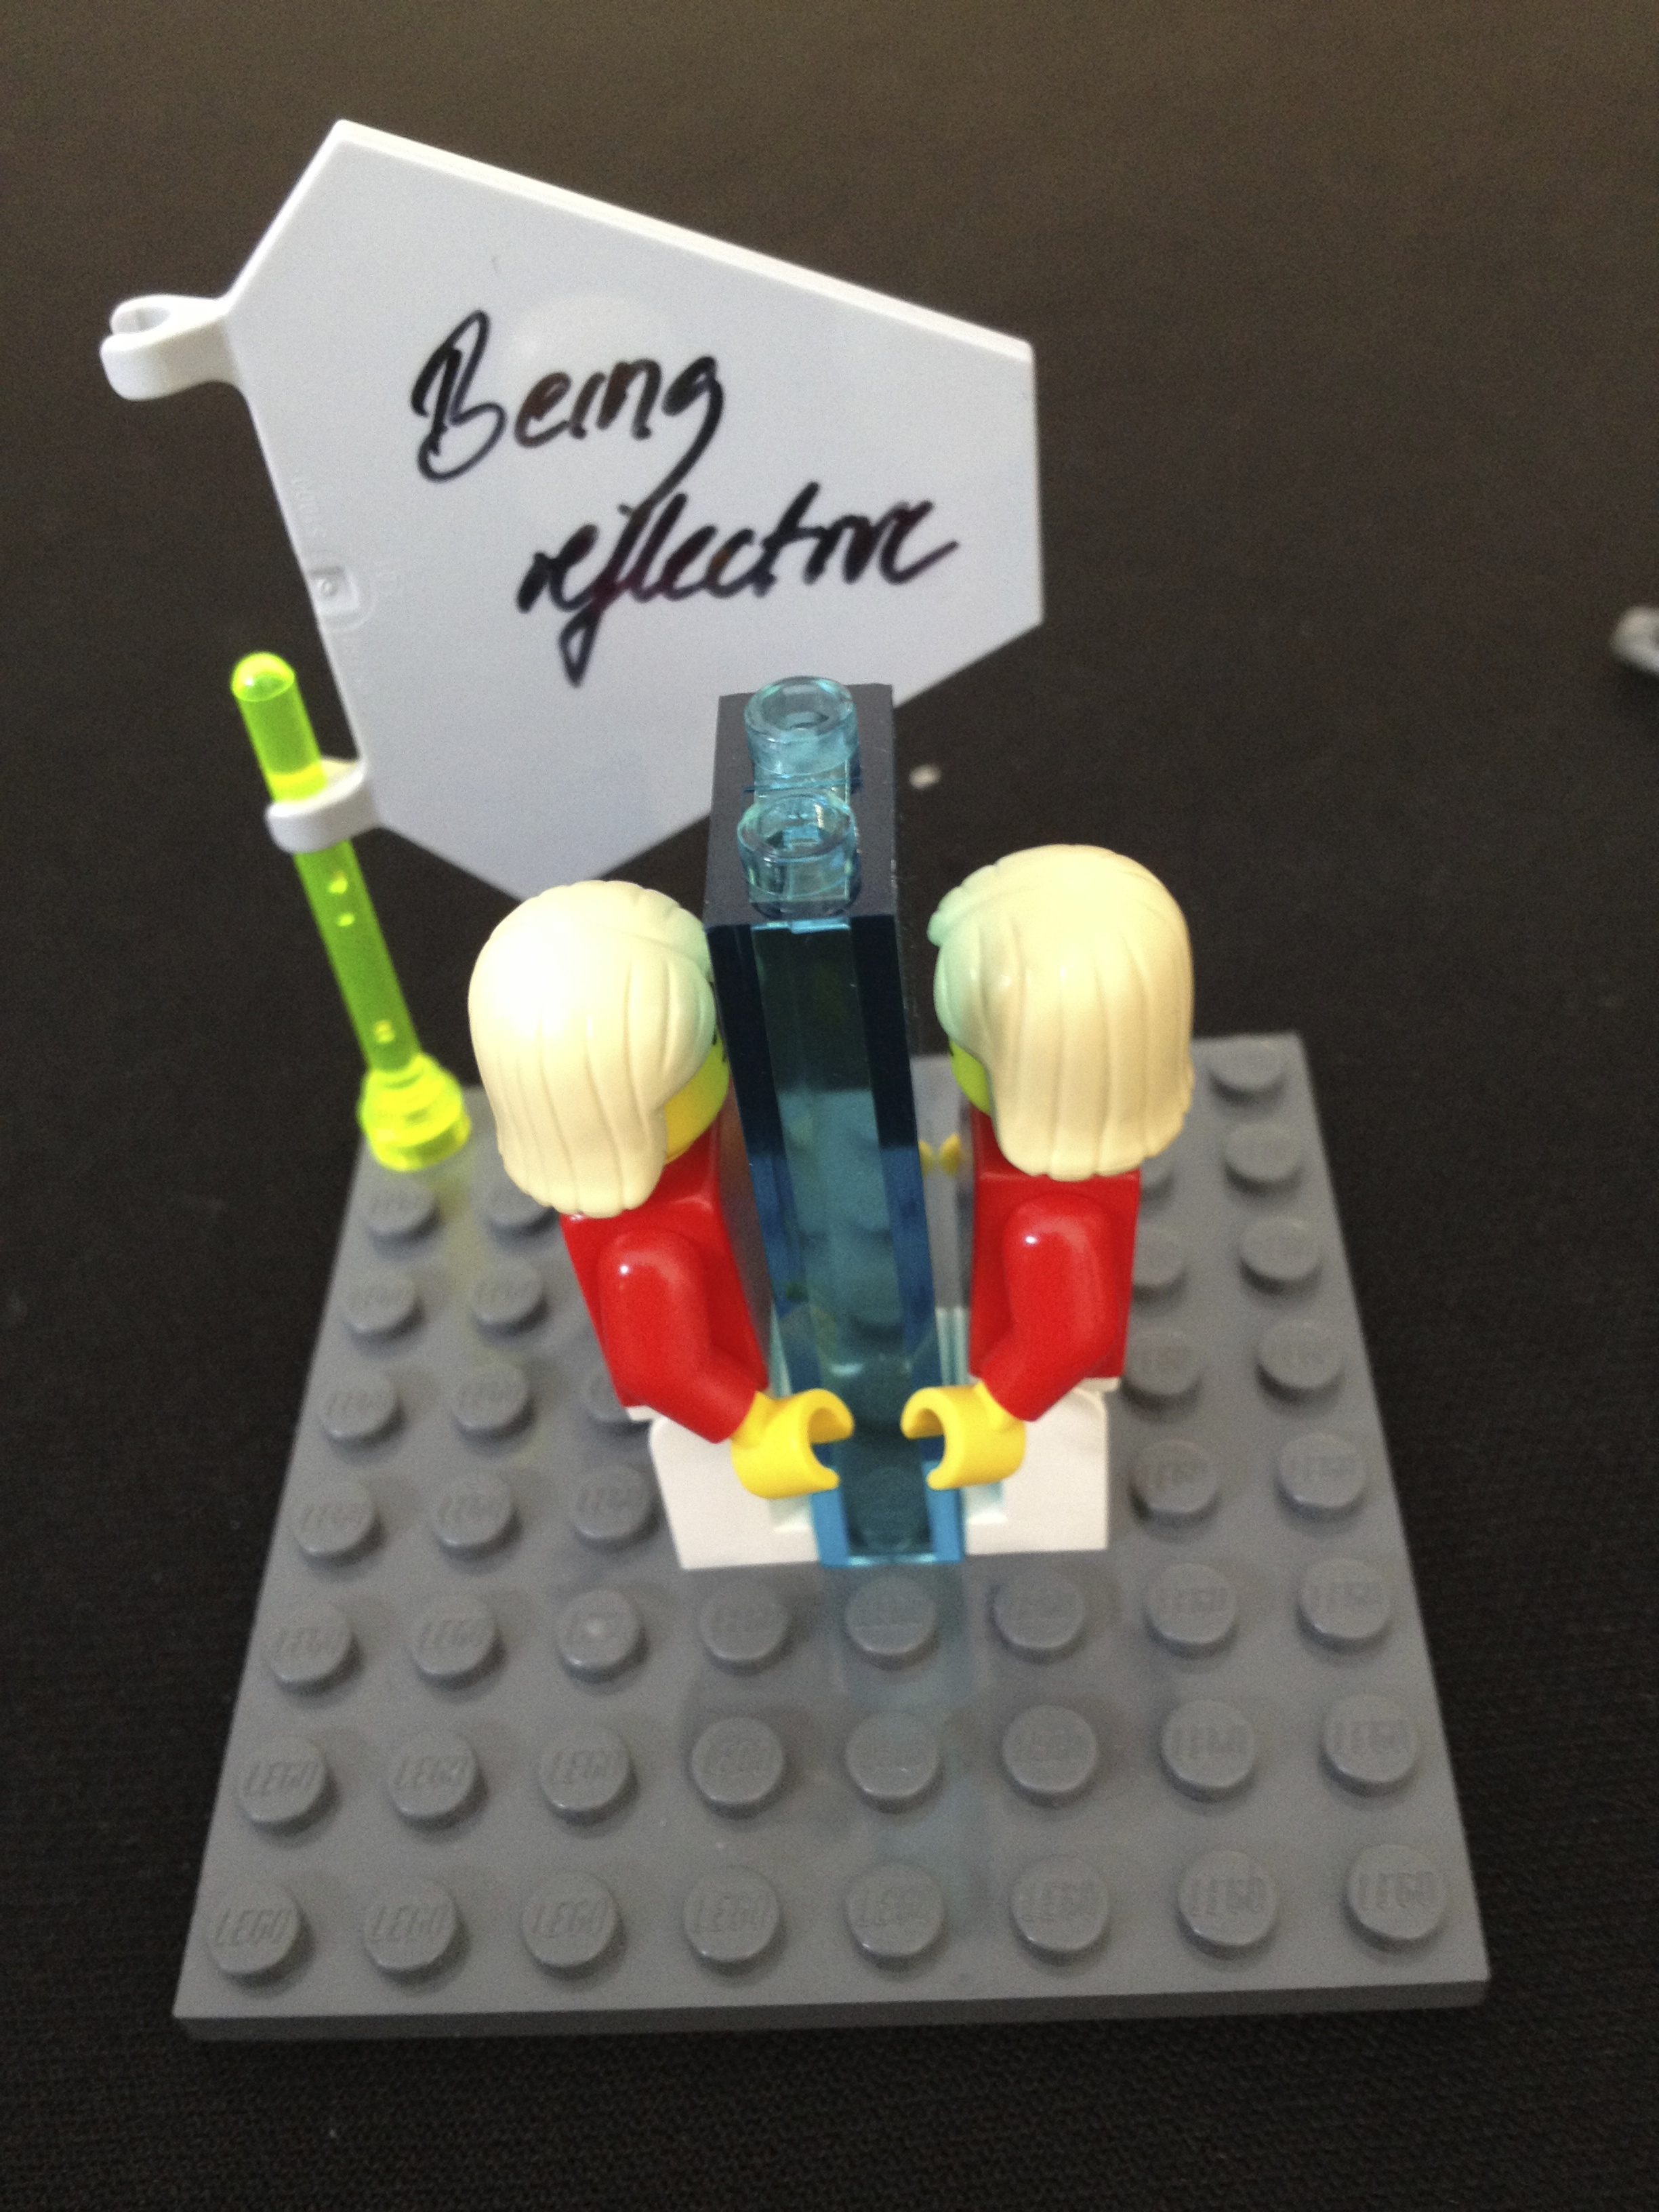

Slide 9
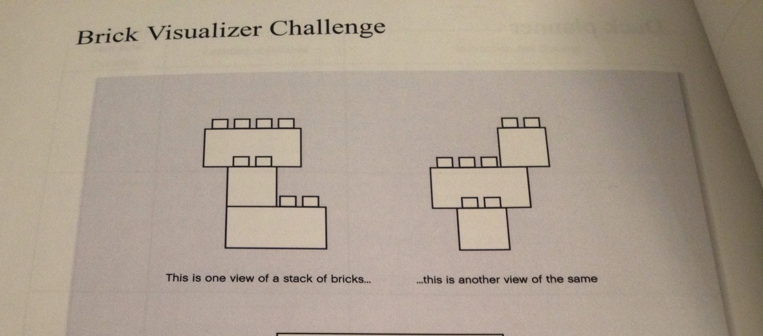

Slide 10
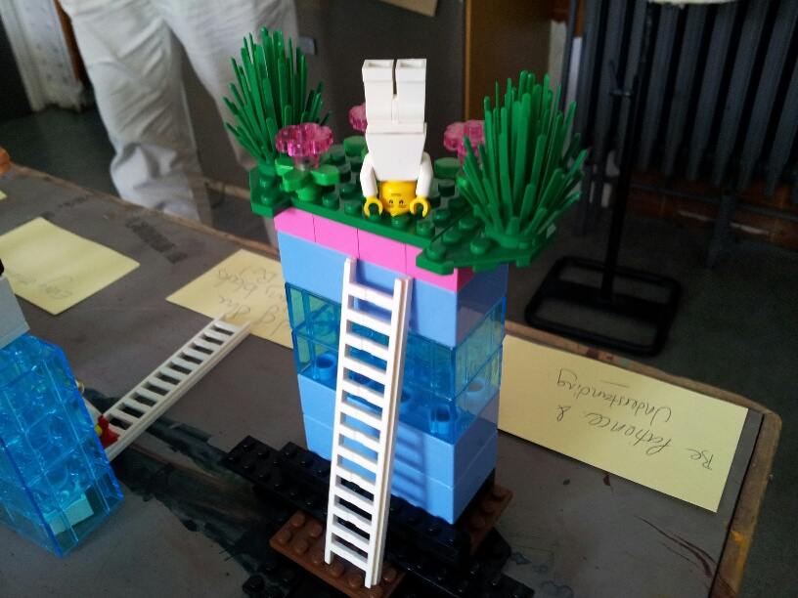

Slide 11
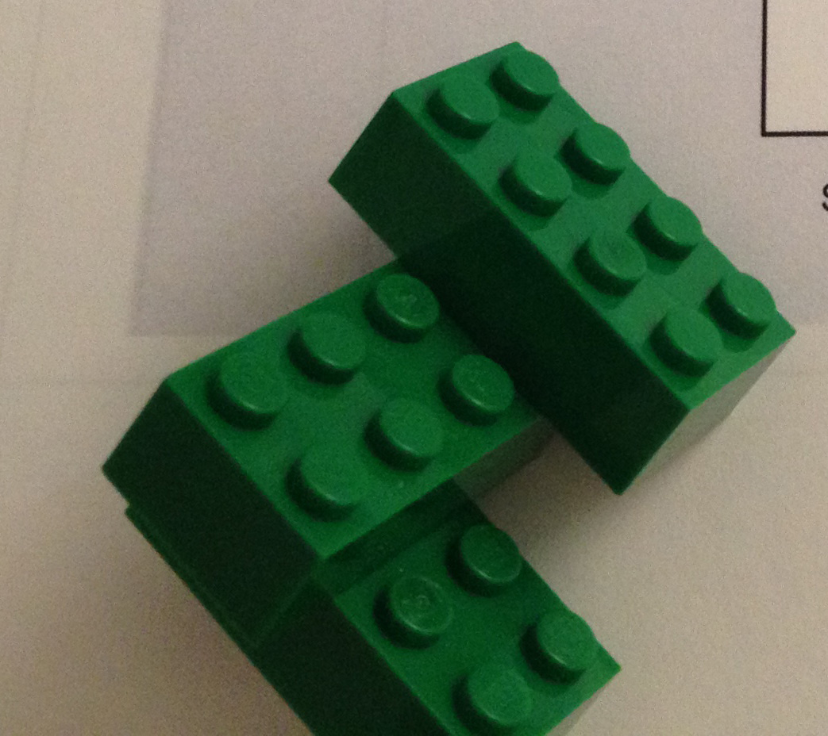

Slide 12
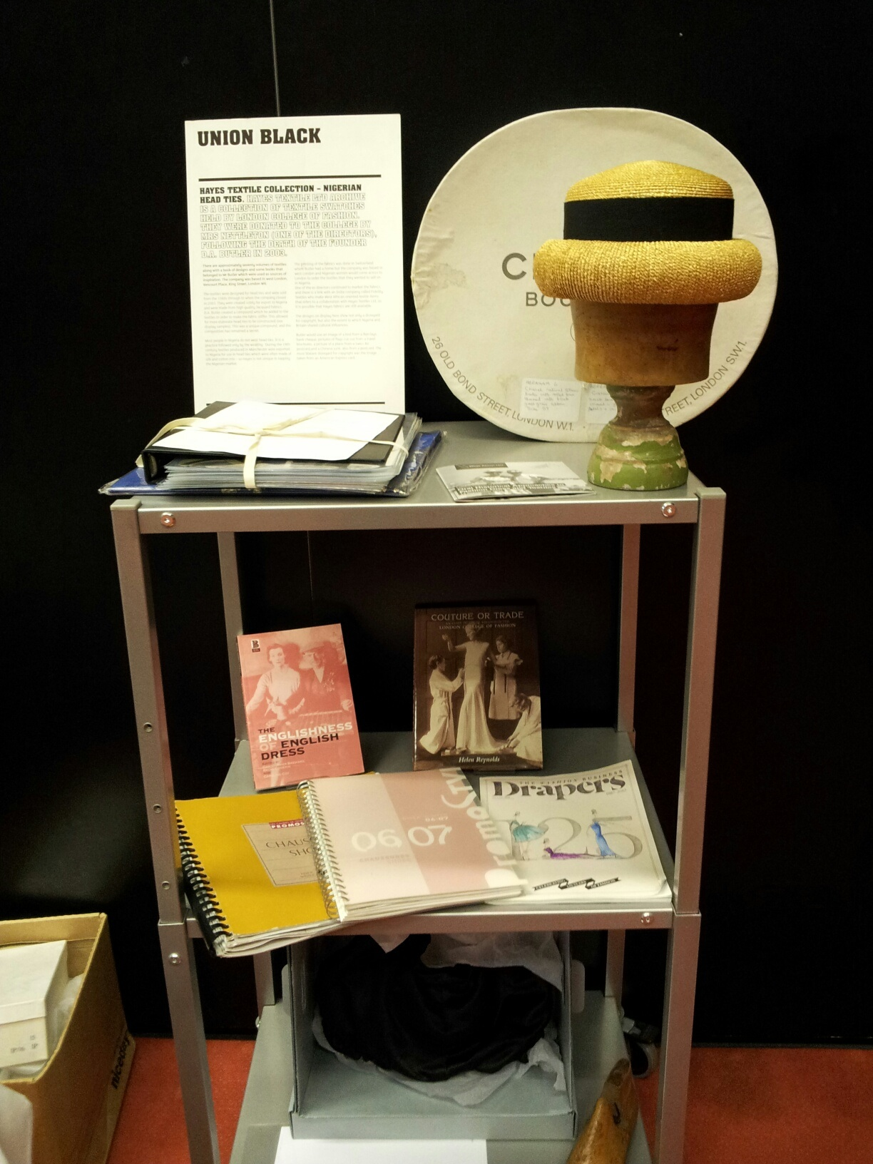
Making the familiar strange
Jules Prown’s three stages of material culture analysis: Description, Deduction & Speculation.
How can we use these stages, employ objects or playful methods to see the overlooked, spot opportunities, make connections, explore what if scenarios?
“The Memory Project”

Slide 13
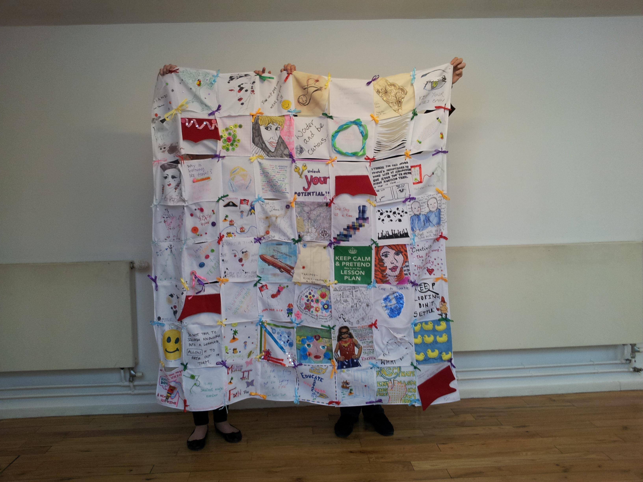

Slide 14
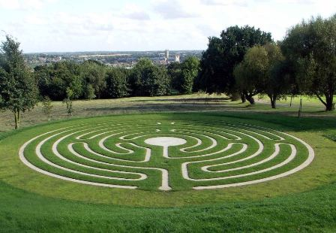

Slide 15
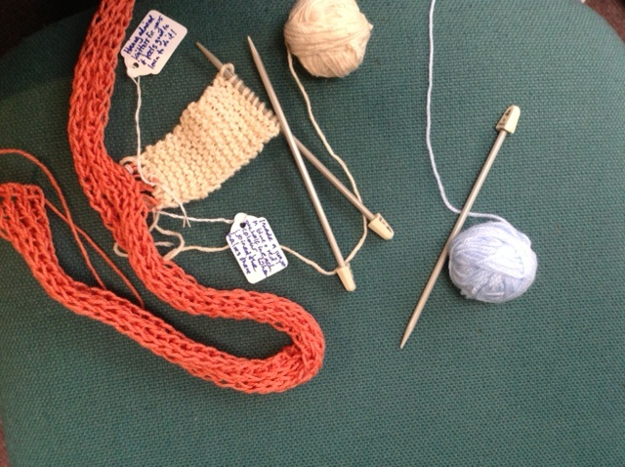

Slide 16
Lego® Serious Play®
…is a systematic set of techniques and applications which allow participants to explore complex issues or topics with no immediate obvious answer.
…uses metaphor, symbolism and association…
Each activity involves a four part process of posing a question, building, sharing and reflecting
Builders own the meaning in their model
Models can be individual and joint, small and large: whole landscapes of situations can be created, ‘what ifs’ can be safely explored
Sessions last from between two hours to one day

Slide 17


Slide 18
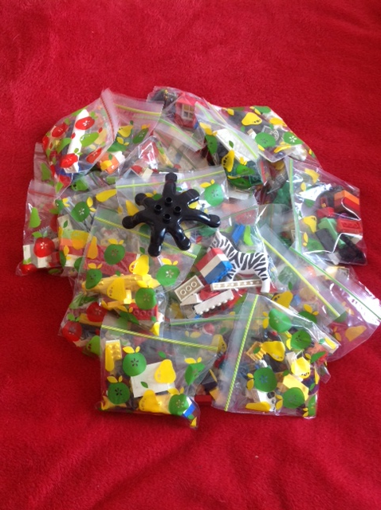
Spider
Lego base
Holder for mobile
Hairdryers
Tiddly-wink game
Dennis the Menace
Lego holders
Cup holder
A piece of jewellery
Weird crab
Ink blot
Base to launch a rocket
A garment worn by
Janet Jackson

Slide 19
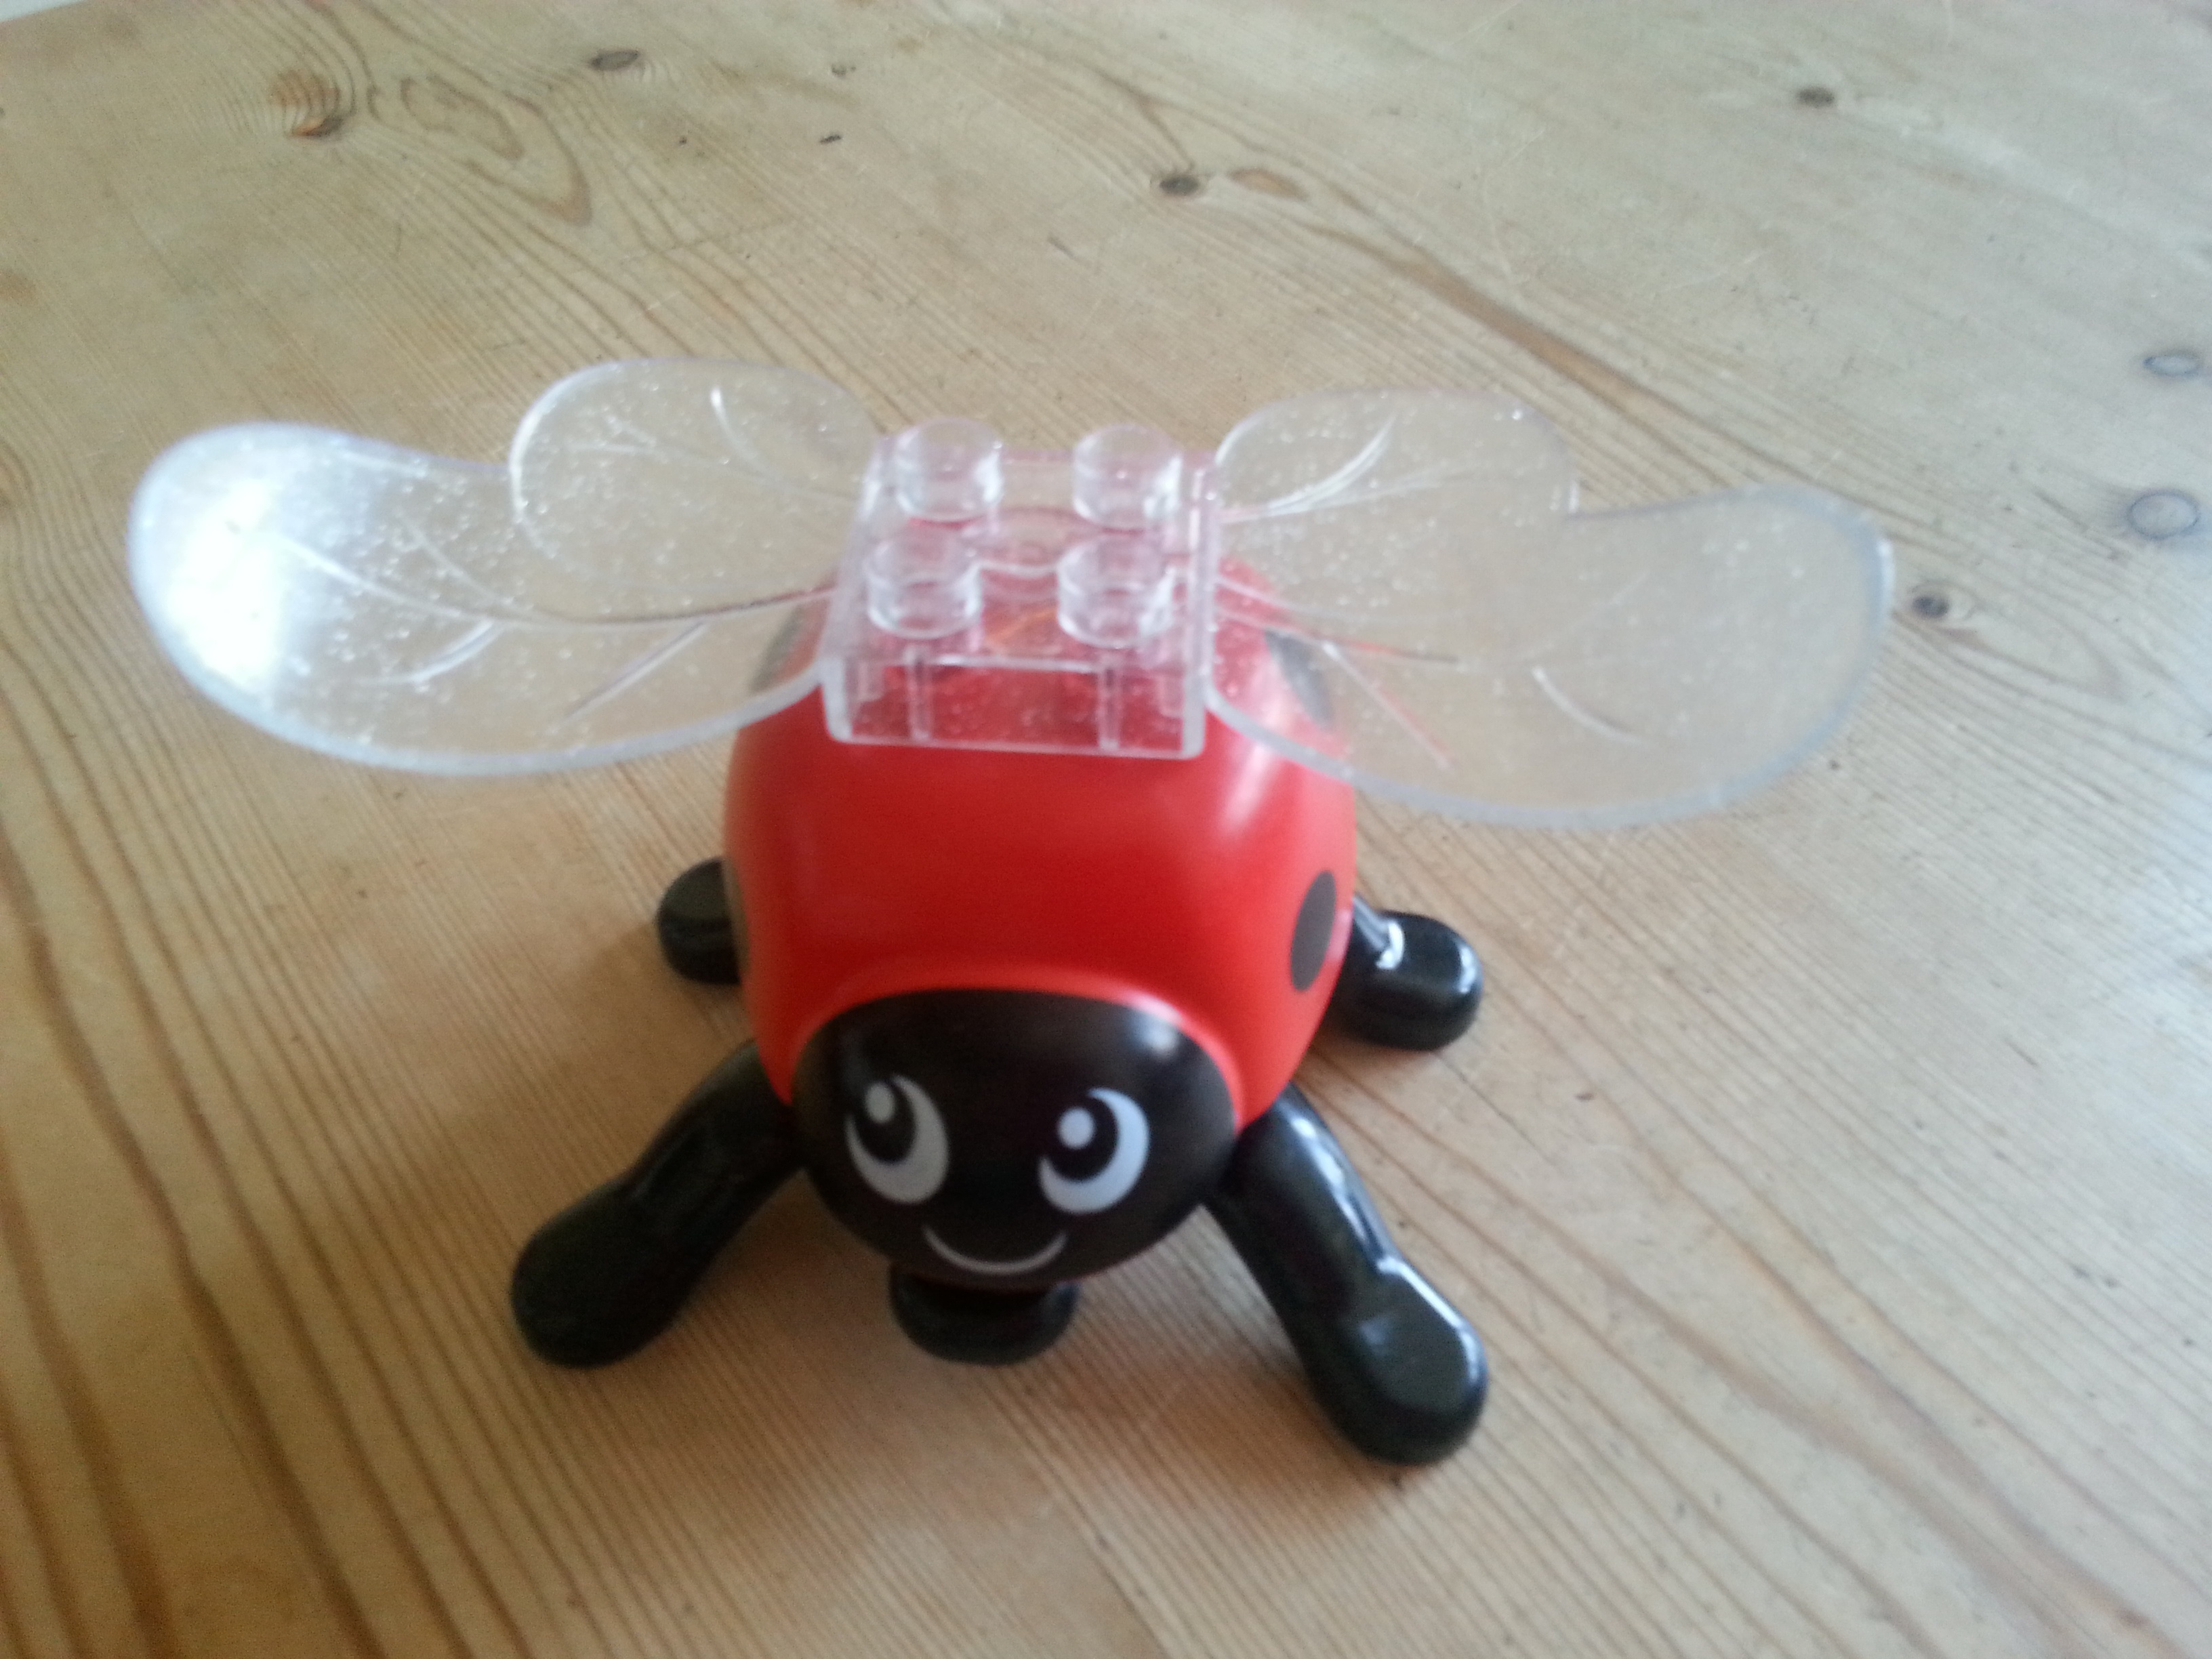

Slide 20
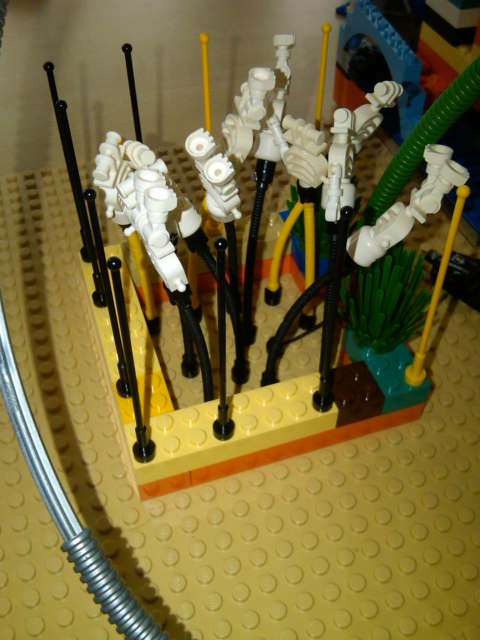
“How do I know what I think till I see what I say?”
E.M.Forster, Aspects of the Novel

Slide 21
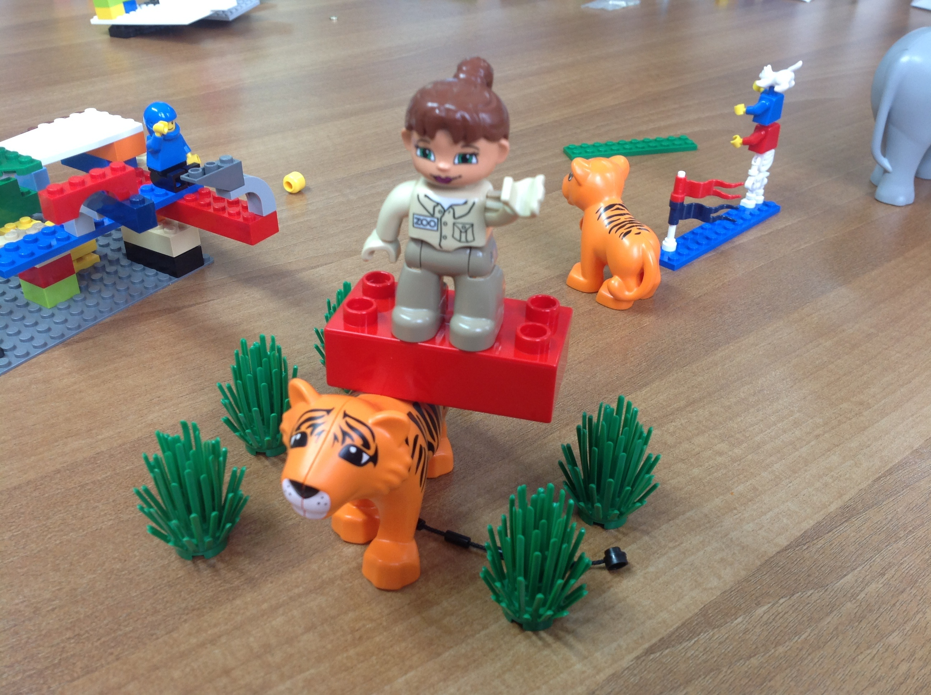

Slide 22
how I am using Lego® & LEGO® SERIOUS PLAY®
to explore team identity
For student PPD
To think about student engagement
To reflect on roles
To think about progress and planning
In industry collaborations
To understand topics better
For academic support
To understand threshold concepts
For evaluation & course monitoring
To develop consensus and share ideas
To build connections between people
To explore sustainability
To share conceptions of how we motivate learning
In doctoral study
For professional development outside the university/abroad
In a Community of Practice
For strategy planning
To facilitate major change

Slide 23
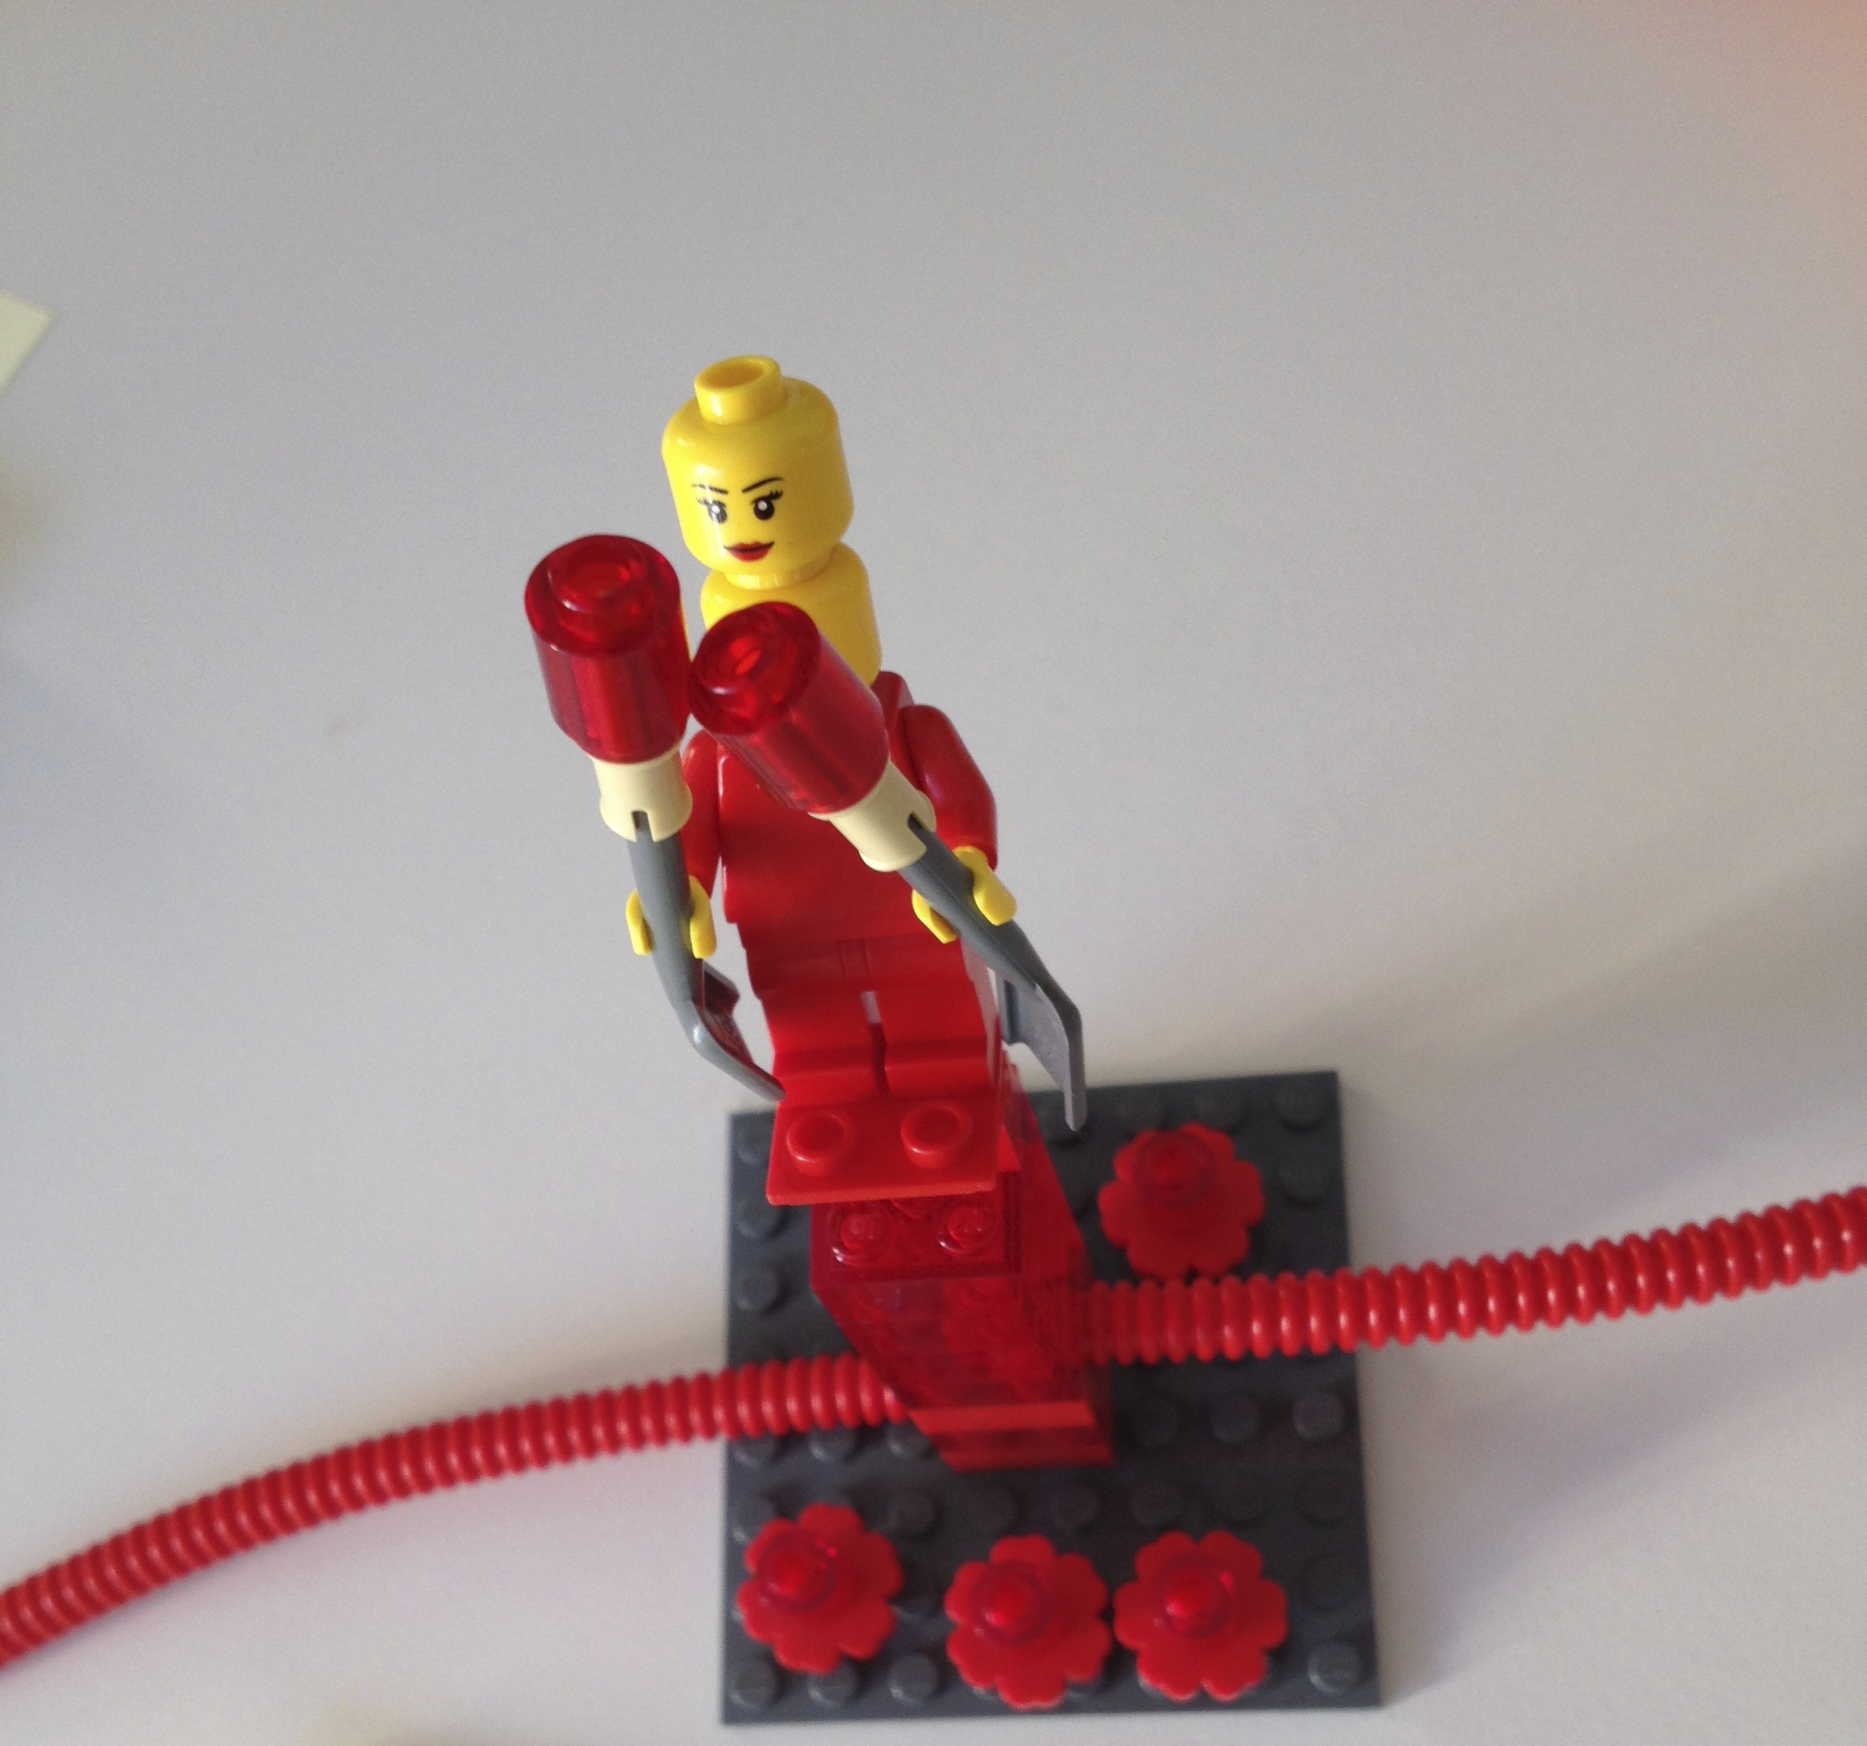
Things students appreciated
Using metaphor helped them think more creatively
Ways of listening and responding
Improved attention and concentration
Deepening of analysis of experience
Visualising actions and emotions
Planning next steps in 3D
Broadened English
Good for students with dyslexia/ADHD
international students felt more included
Relationship building

Slide 24
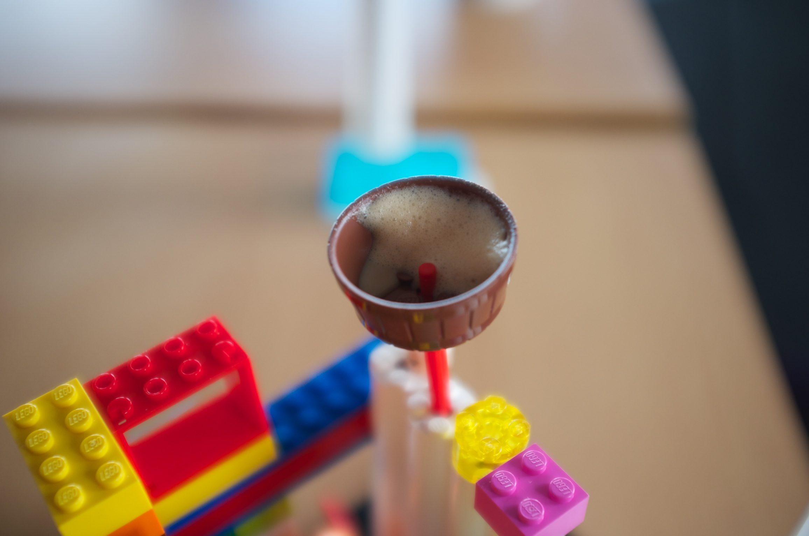
Things staff appreciated
Exploring difficult situations ‘at one remove’ through building
Understanding others’ viewpoints
Being surprised by other people’s models and stories
Being surprised by what they themselves built and said
Finding common ground
Seeing diverse solutions
Building for others and being built for
Connecting with others
Shifting thinking creatively

Slide 25
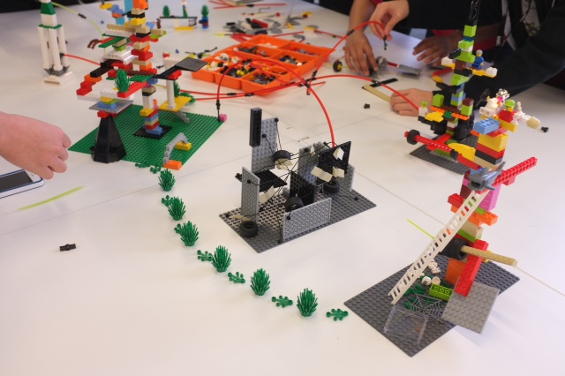
To conclude, creative or playful approaches
  bring people together
  are inclusive of all roles and contributions
  release potential
  allow people to find their own level
  help engender important conversations
  mobilise ideas
  refresh and energise when we are stale, stuck and tired
  add memorable dimensions to thinking, discussion
  and next steps
  are not relief from the day job – they are the day job

Slide 26
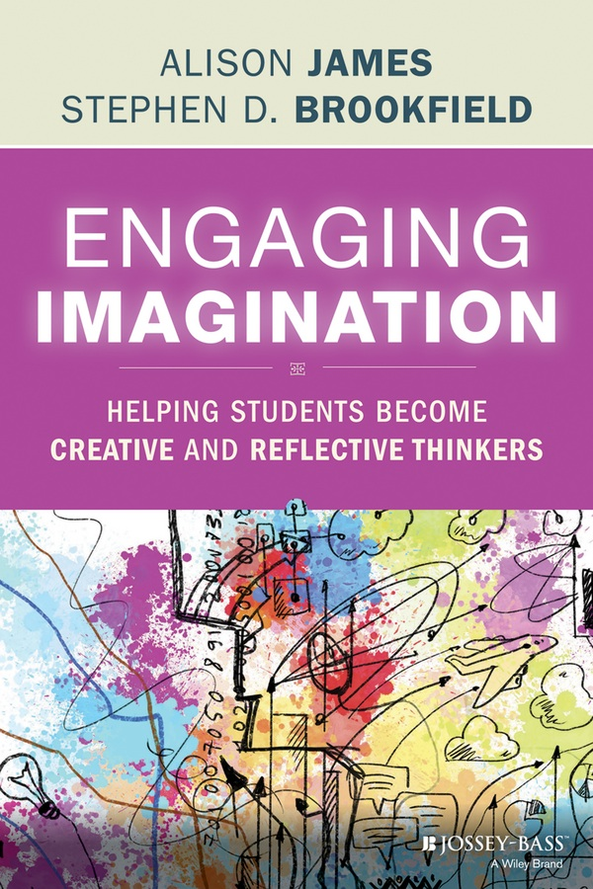
Dr Alison James, NTF, PFHEA
Associate Dean, Learning and Teaching
London College of Fashion, UAL
a.james@fashion.arts.ac.uk
@alisonrjames

