Slide 1
Module Evaluation Using QR Codes and Online Surveying: Trialling, Transitioning and Tracking Student Perspectives.
Andrew James Davies & Laura McSweeney
School of Education and Lifelong Learning - Ysgol Addysg a Dysgu Gydol Oes

Slide 2
The ‘Issue’ - y ‘Consyrn’
Paper-based system of Module Evaluation well-embedded across the School.
Disadvantages
Advantages
‘Cumbersome’ (Morris and Smith, 2012).
Manual processing can mean delays in feeding back to students and introduce human error (Ibid.).
High resource cost both in terms of inputting and processing hours, and paper wastage.
‘Students prefer online methods’ (Layne, DeCristoforo, & McGinty 1999; Donovan, Mader, & Shinsky, 2007).
Well-established, and staff comfortable with method (Dommeyer et al., 2002).
Good response rates (Nulty, 2008).
Easy and quick to administer, face-to-face.

Slide 3
Using online surveys – defnyddio arolygon arlein
Disadvantages
Advantages
Providing students with a seamless digital experience (e-mail, web, primo, Aspire, e-books and journals, BlackBoard etc.).
Students prefer it (Layne, DeCristoforo, & McGinty 1999; Donovan, Mader, & Shinsky, 2007)
Accuracy of data, and lower processing time and cost (Ibid., Dillman, 2000).
Initial development time (Sax et al., 2003).
Transition: training staff / students to use the method.
Accessibility / availability of technology (Gjestland, 1996).
Security and data integrity (Smith, 1997).
Response rates . . .

Slide 4
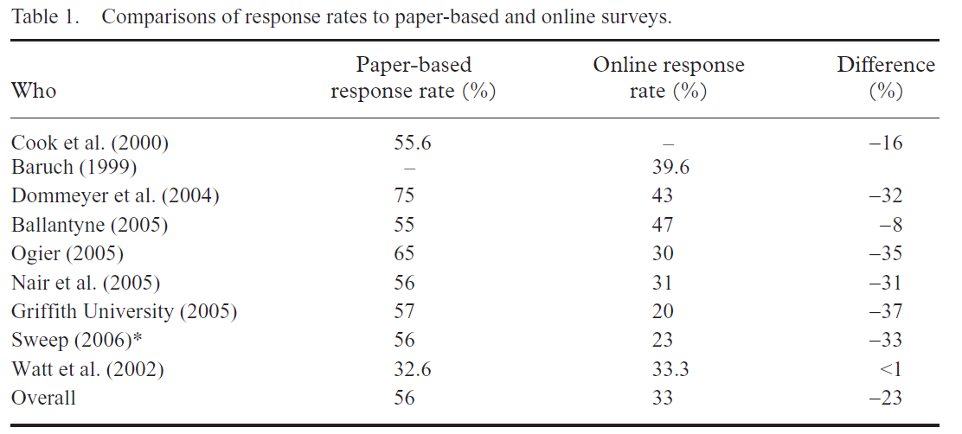
Response rates – cyfraddau ymateb
Nulty, 2008: 303.

Slide 5
Paper or online / papur neu arlein?
“We moved to online surveys, but the response was dreadful, so last year we introduced mid-module surveys and went back to paper. The response was super, and we are now able to turn around feedback in two weeks maximum.” - Professor Ian Marshall, Deputy Vice-Chancellor, Coventry University (quoted in Morris and Smith, 2012).

Slide 6
Range of online methods and boosting strategies – ystod o ddulliau ar-lein a strategaethau hybu
Emailing an online link to students.
Embedding a link into lectures slides.
Lead in time and participants preparation / notice.
Repeat reminder messages (Nulty, 2008).
Incentives. (Ibid.)
‘Ease of distribution does not guarantee effectiveness, nor do multiple e-mail reminders always appeal to students’ (Sax et al., 2003).
Most research on on-line completion has been based on students completing surveys in their own time.
Not necessarily the online method that leads to the response rate being lower, but the lack of a completion ‘occasion’.
‘Take away’ paper survey can have as low a response rate as ‘take away’ online.
Nub of the issue is in situ versus ‘take-away’, rather than paper vs. online.

Slide 7
Piloting models – arbrofi gyda modelau
Mechanism for online in situ completion.
Set up of online survey fairly straightforward (via BoS).
Access mechanism more challenging.
Tried URLs on lecture slides – errors in inputting, even with Tiny URLs.
Links in email, and asking students to open the email in the lecture. Two cumbersome – added a stage.
QR Codes – the most promising, instant access.
BUT: students needed a device, a reader and to be guided through the process.

Slide 8
The model – y Model
Week prior to the Module Evaluation Lecture
Students given notice
Asked to download QR reader and bring their mobile devices.
During the Lecture: QR Code embedded in lecture slide
Tablets provided to students without mobile devices (and paper)
Lecturer facilitates and troubleshoots
Data uploaded and available immediately
Can respond quickly (in the session?).
Report produced by Academic Operations Officer

Slide 9
How did it go and what did students think? Sut aeth hi a beth oedd barn myfyrwyr?

Slide 10
How did it go? Sut aeth hi?
Response rates comparable with paper-based system.
Non-response was typically small: 1-3 at the most (groups sizes ranged from 7-40), but no larger than paper.
Non-response slightly higher for first time groups, but improved with familiarity.
Informal feedback suggests students liked the process, and some groups made good-natured informal complaints when they were not involved in the pilot.
Accessibility concerns regarding mobile technology were overcome through using SELL tablets for students without devices.

Slide 11
The process of downloading a QR code reader to my device was:

Slide 12
The process of scanning the QR code to access the survey was:

Slide 13
The process of completing the Module Evaluation questionnaire online was:

Slide 14
Think about the method of online module evaluation you used today compared with the paper-based system. Which do you prefer?

Slide 15
Thinking about this QR and online method as a whole, please rate the whole process out of 10, where 10 is 'Excellent' and 0 is 'Very Poor'.

Slide 16
Further comments – sylwadau pellach.
‘Easier for everybody’; ‘Online is much quicker’; ‘Less hassle’.
‘People are less likely to see my answers’; ‘More comfortable as less people are able to tell it was me and due to this I felt I could be more honest;’ ‘More accurate.’
‘Saves paper’; ‘Environmentally friendly’.
‘Just prefer paper’.
‘The app takes up storage on the phone so have to delete and re-download.’
‘No need to print out the QR code – just put it in the slides.’

Slide 17
What happened next?
Beth digwyddodd nesaf?
Following pilot, the method was implemented across the School’s first- and second-year Undergraduate provision.
Staff briefing and training event at Undergraduate Away Day.
Worked alongside the Tell Us Now (TUN) team to share practice.
Small scale TUN pilot undertaken in Semester 2 2016.
Proposals to upscale this approach for TUN Module Evaluation.
  TUN consulting with Departments and Institutes.
  Significant reduction in processing time.
  Need to investigate the accessibility of technology.
Method will evolve mutatis mutandis.
Step forward in normalising online module evaluation.
Student experience – better evaluation interface, preferred method, quicker turnaround of results, greater responsiveness in enhancing teaching and learning.

Slide 18

Module final Evaluation
Paper-based copies are available. OR if you have a smart phone or tablet . . . you can do this online . . . First connect to Eduroam or the Cloud.
If you do not have a QR code reader (Neo-reader, i-nigma etc.) on your phone or tablet, you can download i-nigma from Play Store or AppStore now (It’s free, and will only take a minute or so to download).
Then, scan this QR code, and your browser will take you to the final evaluation questionnaire.
If you want to take part in this part of the survey please do so. But you don’t have to do this – it’s completely optional, and if you do take part you can withdraw your response later.

Slide 19
Gwerthusiad Terfynol y Modiwl
Mae copïau papur ar gael, OND os oes gennych ffôn clyfar neu dabled. . . . Gallwch wneud hyn ar-lein. Yn gyntaf oll, cysylltwch ag Euduroam, neu’r Cloud.
Os nad oes gennych ddarllenydd QR, (Neo-reader, i-nigma etc.) ar eich ffôn neu dabled gallwch lawr-lwytho i-nigma o’r Play Store neu’r AppStore nawr (mae e am ddim a dim ond munud bydd e’n cymryd i chi ei lawr-lwytho).
Wedyn sganiwch y cod QR hwn a fydd yn mynd â chi at yr arolwg barn gwerthuso ar-lein.
Os ydych am gymryd rhan, mae croeso i chi wneud hynny, ond, nid yw’n orfodol i wneud hynny - mae’n hollol opsiynol, ac os ydych yn cymryd rhan, mae modd tynnu eich ymateb nôl yn hwyrach.

