Slide 1
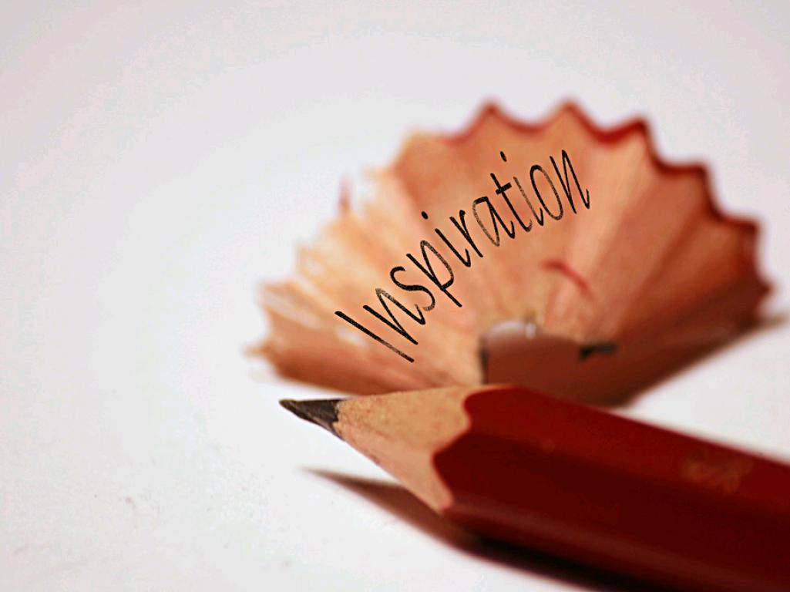
Digital Storytelling for Learning: A case study
Stephen Chapman, IBERS
Mary Jacob, IS / Department of English and Creative Writing
cc: Alan Cleaver - https://www.flickr.com/photos/11121568@N06
Notes:
Hello everyone,
I’m Stephen Chapman, I’m currently working as a lecturer at IBERS and I’m also coordinating distance learning MSc’s in Industrial Biotechnology and together with Mary Jacob, we will present our collaborative project, in which we are investigating if creative writing can inspire and enhance student learning

Slide 2
Outline:
Distance learning at Aberystwyth University
  Introduction to the MSc Industrial Biotechnology
What is Digital storytelling?
Methods
Research aims/questions
Preliminary results
Discussion and conclusions
Any further questions?
Notes:
So, I’ll just begin with an outline of the talk, in which I’ll first introduce distance learning at Aberystwyth university…….

Slide 3

Take individual modules to increase your knowledge or work towards a range of postgraduate qualifications.
January 2016
Biorenewable Feedstocks
Crop breeding for optimal traits, waste streams, matching feedstocks to end-use, emerging technologies, scaling up production, societal pressures
May 2016
Conversion, Separation and Transformation Technologies
Thermochemical, enzyme, microbial, metabolic engineering, pretreatments, AD, integrated biorefinery, chemometric data, etc
September 2016
Product Development
Design, development, manufacturing processes, economic assessment, regulation, LCA etc. For products such as pharmaceuticals, foods, cosmetics, resins, plastics, packaging, forest products
w
w
w
.
i
n
d
-
b
i
o
t
e
c
h
.
c
o
m
0
1
9
7
0
8
2
3
2
2
4
a
t
p
s
t
a
f
f
@
a
b
e
r
.
a
c
.
u
k
Notes:
So, here are some examples of the modules that go into a Distance learning MSC that I ‘ve coordinated, each module is 20 credit, the first module covers renewable plant crops that are bred for producing energy, or specific therapeutic compounds that are locked up within cell walls for example, the next module looks at how we can extract the high value compounds and the final module looks at how they can be turned into useable commodities like fuels,

Slide 4
20 credit Module
14 weeks
10 units
Module is split into 3 blocks
Separated by a reading week
Notes:
And when we look at a block in more detail, highlighted here. The blocks are released at a block at a time, thereby giving access to several units at a time. This is really intended to introduce some flexibility to your timetable, so you can do more than one unit in a week, to compensate other weeks that you know you might be busy and not have the time to complete a unit. Each block contains a written assessment, in addition to a forum, and details for all the assessments of the module can be found in your welcome packs, or under the assessment button from the blackboard homepage. As you can see, this module will last for 14 weeks, and includes3reading weeks giving you time to work on assessments and forums. All assessments can be accessed at the start of the module.

Slide 5
How far can a student go?
MSc
Postgrad Diploma
Postgrad Certificate
Notes:
Those three modules are core to earn a Postgrad certificate:
A postgraduate diploma is awarded when a student completes 6 modules
Or a full MSC is awarded when 6 modules are completed in addition to a 60 credit dissertation is awarded, and we are finding the scheme is running really well, typically we are attracting mature students who are already involved in various biotechnology sectors all wanting to gain CPD or increase knowledge in a specific topic,

Slide 6

https://blackboard.aber.ac.uk/webapps/blackboard/content/listContentEditable.jsp?content_id=_527079_1&course_id=_12312_1&mode=reset
cc: HckySo - https://www.flickr.com/photos/54191388@N00
Notes:
Distance learning through Aberlearn

Slide 7

Distance Learning
Notes:
Traditionally, subjects such as the arts are viewed in a completely different way than the sciences and its generally accepted that science lacks creativity:
Subjects that follow a scientific orientation are often viewed with a mechanical endeavor, missing imagination and creativity.
Furthermore, the methods used to disseminate, or transmit knowledge to graduate students through the use of lectures and seminars may also lack creativity.
The generally, the teaching of the arts naturally presents a better opportunity to be more creative and presents a better example of transformative teaching using material that transforms the learner on many different level.
*animation* I see distance learning as a hybrid, where as you seen, we can use creative means to produce learning material that’s rich in media to promote transaction or transformative teaching to science students. I’ve long had an interest in spoken word and poetry and I wanted to try a little experiment in using creative writing with my distance learning module. And that’s when I met Mary at a CPD session involving the use of Digital storytelling to enrich my modules.

Slide 8
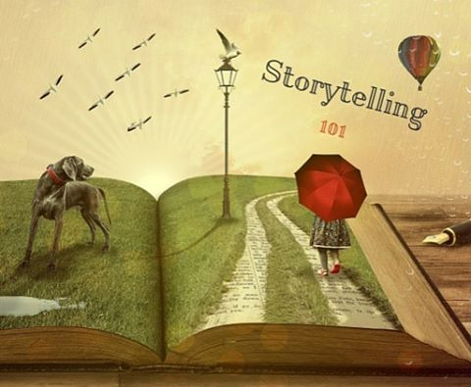
What is a digital story?
Storycenter http://www.storycenter.org/ Joe Lambert, the co-founder of the Center for Digital Storytelling (CDS)
Educational Used of Digital Storytelling http://digitalstorytelling.coe.uh.edu/page.cfm?id=27
Short
Recorded narration
Single idea
Images, not elaborate video
“Storytelling 101” by Walter Lim, Licence CC BY 2.0
https://www.flickr.com/photos/coolinsights/26378049095

Slide 9

The project
digital storytelling using video poems
for distance learning science module
Notes:
Building up from previous slide, my idea was to see weather digital storytelling and creative writing can enhance student learning through distance learning, and and if so, how can digital

Slide 10
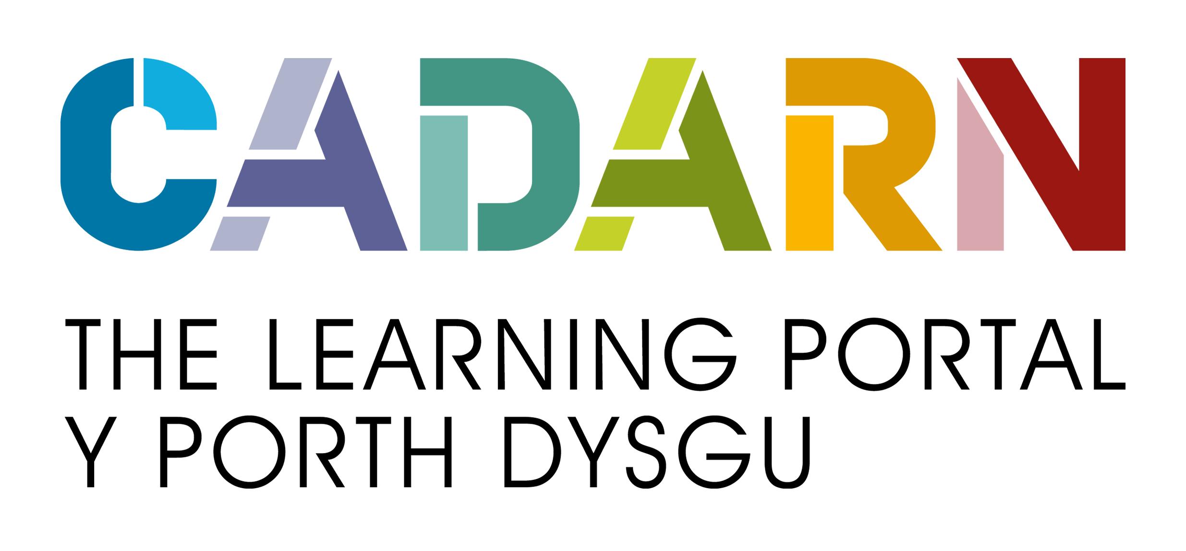
Method
Project lead: Stephen Chapman, Institute for Biological, Environmental, and Rural Sciences
Trainer – Mary Jacob
Poets - PhD students in English and Creative Writing
  Katya Johnson
  Linda Rhinehart
  Mary Jacob
Used WeVideo licence provided by
Notes:
Three poets were invited by Stephen Chapman, a lecturer in the Institute for Biological, Environmental, and Rural Sciences department, to write poems inspired by the science of biofuel.
The poets are PhD students in the English and Creative Writing department at Aberystwyth University: Mary Jacob, Katya Johnson, and Linda Rhinehart. We created video clips for use in a distance learning module, BDM7720 Conversion, Separation and Transformation Technologies for Biorefining (2015-16).
Used facilities and software provided by CADARN Learning Portal

Slide 11
Research aims and questions
Teaching aim
Make the science of biotechnology engaging for distance learners
Research question
How effective is the digital story/poem format for learning and teaching?
Notes:
The video poems are intended to make the science of biofuels more engaging for distance learners, who are often work-based learners rather than traditional undergraduates.
The project as a whole has a larger aim of exploring how effective the digital story/poem format is for learning and teaching in general, and identifying good practice in this area.

Slide 12
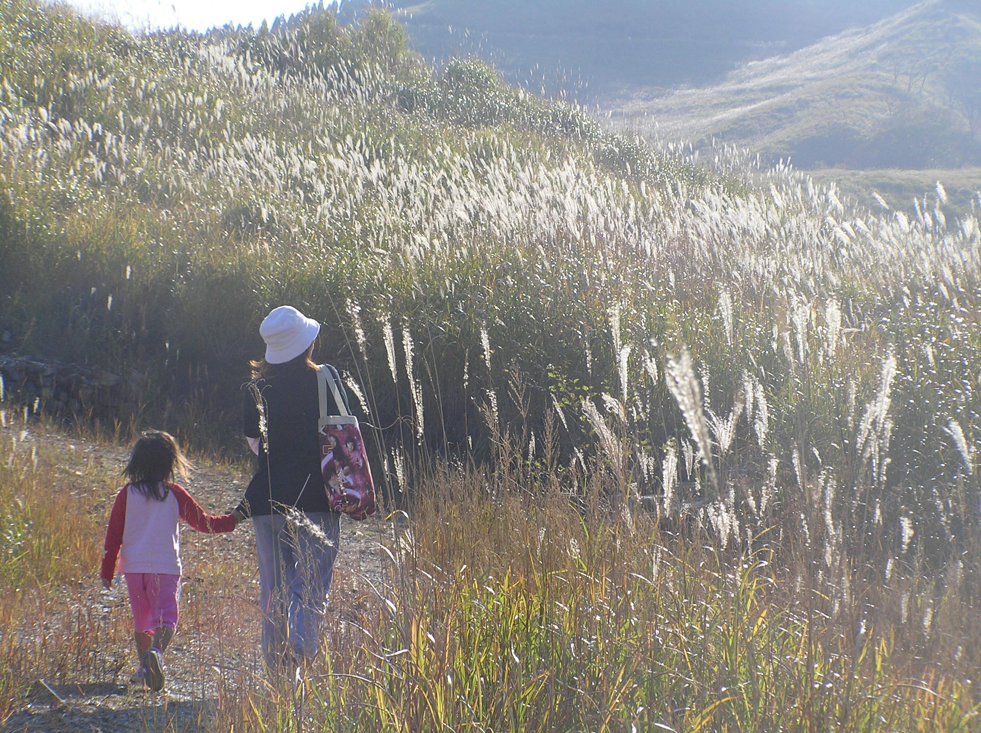
A journey
Notes:
Bridging the Divide: Literature and Science, 3rd June 2016

Slide 13
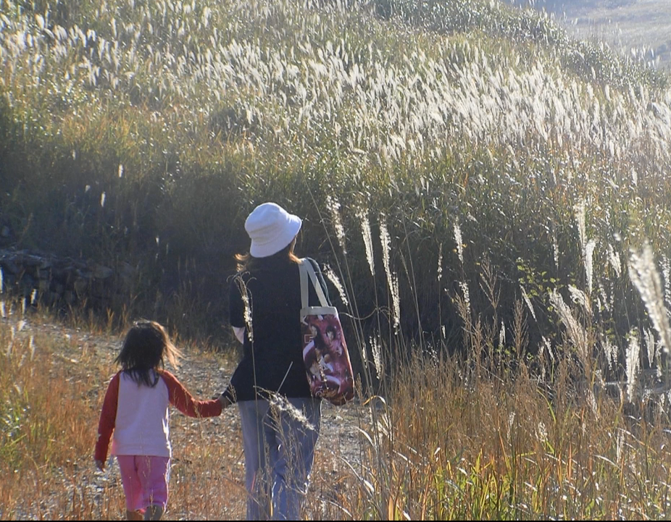
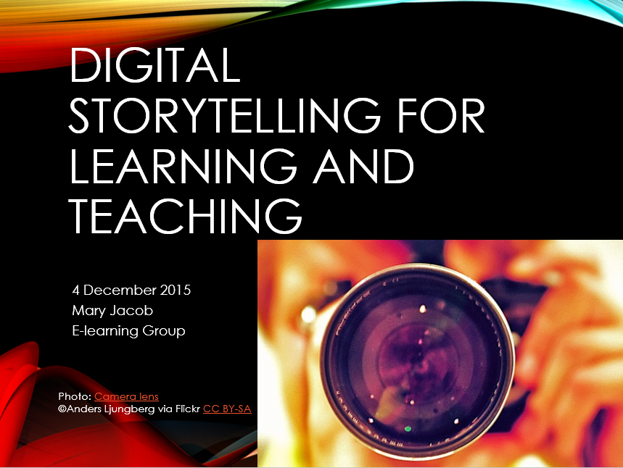
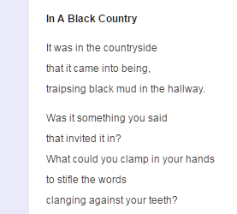
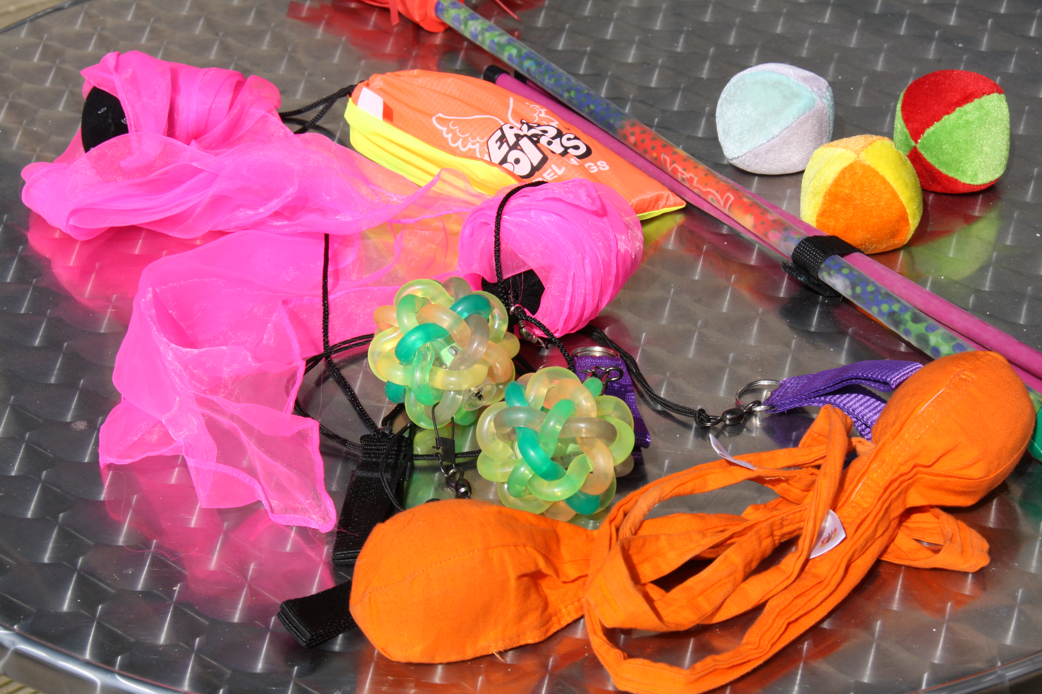
A journey
Make DS poem for module
Train others in DS
Poetry - Creative Writing PhD
Personal digital story (DS)
Notes:
Seeking integration –

Slide 14
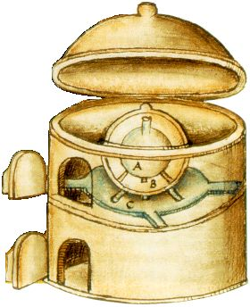
Digital storytelling
Poetry
Science of Biorefining
Video poems for science teaching
Athanor
alchemical furnace
Notes:
Athanor alchemical furnace https://commons.wikimedia.org/wiki/File:Athanor.jpg public domain

Slide 15
Video Poems
Miss Canthus https://vimeo.com/166030947
Green Alchemy https://vimeo.com/164392472
Life Cycle https://vimeo.com/166030495
Notes:
What inspired me to write the poems?
Scientific name for one of the varieties they are working with, Miscanthus Sinensis, means Chinese miscanthus. My background in Chinese language and literature made it easy for me to imagine this plant as person going on a journey. I researched the genealogical ‘roots’ of the plant, as it were.

Slide 16
Student feedback
Good poetry says a lot with just a few words and good pictures/video can say even more. I think the pace of the videos was great.
I would recommend the use of video poems for up-coming modules, general themes can be good, but I think it would also be good for specific ideas, techniques, etc.
Notes:
Question 5: Short Answer
What did you like best about the video poems?
Good poetry says a lot with just a few words and good pictures/video can say even more. I think the pace of the videos was great.
Question 6: Short Answer
What suggestions do you have about the future use of video poems for up-coming module development?
I would recommend the use of video poems for up-coming modules, general themes can be good, but I think it would also be good for specific ideas, techniques, etc.

Slide 17
To me I liked the way all three poems though creative and beautifully written using appropriate technical terms seemed to also be written in a fun manner and not taking themselves too seriously. I also liked the optimism of some writers. It gives me motivation to succeed and contribute in this field for global benefit.
I am by no means an expert in poetry but have some very good friends who are poets. I would be open to a task whereby I would be required to work with my more literally gifted colleagues to critique or even write my own poem.
Notes:
Question 5: Short Answer
What did you like best about the video poems?
Good poetry says a lot with just a few words and good pictures/video can say even more. I think the pace of the videos was great.
Question 6: Short Answer
What suggestions do you have about the future use of video poems for up-coming module development?
I would recommend the use of video poems for up-coming modules, general themes can be good, but I think it would also be good for specific ideas, techniques, etc.

Slide 18
Conclusions
How can videos link poetry and science?
Can video poems enhance science learning?
Make them short and sweet, simpler is better
Yes, don’t be afraid of more detail
Choose right visuals, Creative Commons
Let students make videos if they want to
Notes:
How can poetry and digital storytelling be used to bridge the divide between science and literature?
What is the potential for video poems in enhancing the learning of science?
What happens to the poetry-writing process when you use it this way?

Slide 19
Questions?
?

Slide 20
7 Elements of Digital Storytelling
1. Point of View
2. A Dramatic Question
3. Emotional Content
4. The Gift of Your Voice
5. The Power of the Soundtrack
6. Economy
7. Pacing
Center for Digital Storytelling, quoted in http://digitalstorytelling.coe.uh.edu/page.cfm?id=27&cid=27&sublinkid=31
Notes:
The Center for Digital Storytelling (CDS) in Berkeley, California is known for developing and disseminating the Seven Elements of Digital Storytelling, which are often cited as a useful starting point as you begin working with digital stories.
Point of View
What is the main point of the story and what is the perspective of the author?
A Dramatic Question
A key question that keeps the viewer's attention and will be answered by the end of the story.
Emotional Content
Serious issues that come alive in a personal and powerful way and connects the audience to the story.
The Gift of Your Voice
A way to personalize the story to help the audience understand the context.
The Power of the Soundtrack
Music or other sounds that support and embellish the story.
Economy
Using just enough content to tell the story without overloading the viewer.
Pacing
The rhythm of the story and how slowly or quickly it progresses.

