Slide 1


www.aber.ac.uk/wpsi
Y Ganolfan Ehangu Cyfranogiad, Cydraddoldeb a Chynhwysiant Cymdeithasol / Centre for Widening Participation, Equality and Social Inclusion

Slide 2


“EQUALITY, ANYONE?”
NOT IDENTICAL, BUT EQUAL:
FAIR AND REASONABLE
Dr Debra Croft,
Director of Equality,
CWPESI,
Aberystwyth University

Slide 3
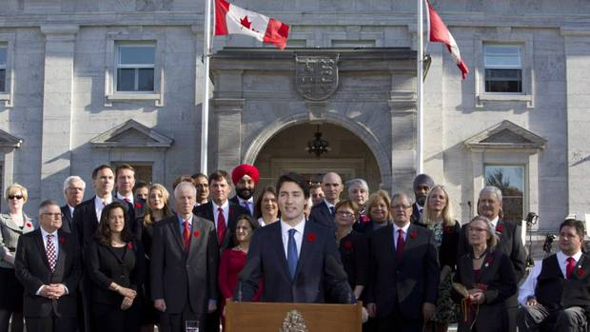
Because it’s 2016 …

Slide 4
Diversity & Difference
- not a static concept
Anyone following any news over the last 12 months will have seen the trans* discourse elevated to a topical and urgent debate and call for action, across many sections of society – and the same has been, or will be, true for the other ‘protected characteristics’.
“University”
a place of higher learning and teaching
incumbent on us to be relevant, in the vanguard, appropriate to the age we live in, adaptable, challenging but supportive.

Slide 5
Quiz
What percentage of the UK population say they are Muslim (2011 census)?
  2.5% b. 4.5% c. 8.0% d. 12%
The percentage of unemployed white graduates is approx. 7%. What is the percentage for Black graduates?
  5% b. 7% c. 10% d. 14%
When was the age of sexual consent made equal, at 16, for all?
  1972 b. 1980 c. 1998 d. 2001
Bonus – how many UK MPs are openly LGBT ?
Notes:
4.5%, 14% 2001 (45),

Slide 6
Quiz
4. When could women have a mortgage in their own right?
  1950 b. 1960 c. 1970 d. 1980
5. When was the first Black Female MP elected to Westminster?
a. 1947 b. 1965 c. 1987 d. 1995
6. What percentage of UK students claim DSA?
a. 5% b. 7% c. 9% d. 12%
Notes:
1980. 1987 (Diane Abbott), 7%

Slide 7
Equality Matters
What does it mean to you?
What areas of teaching does it affect?
Students
Teaching Colleagues
Support Teams
Services
Shorthand – leads to Boxes (7.00-8.06)

Slide 8
Equality Act 2010
Characteristics
Age
Disability
Marriage & Civil Partnership
Pregnancy & Maternity
/ Paternity
5. Race
6. Religion and Belief
7. Sex (legal ID)
8. Sexual Orientation
9. Gender reassignment - soon to be “Gender Identity”

Slide 9
Equality & Diversity … it’s personal!
I use her, she, Dr, Ms (but would prefer Debra, the / they (singular), Mx, hir)
I am in the 51 – 60 age group
I have a partner (whom I happen to be married to)
I am a parent (biological, non-biological, and once you get to “grand-” it’s too complex to even think about)
I am bi-sexual (but have a long-term, monogamous relationship with a man)
I am White (non-BME?)
I am British / Welsh / European
I have a chronic long term disease (disabled, unseen)
I am a carer
I am a scientist, but work in Equality and Access
I am from a widening access background
I was a non-traditional HE student and a mature student undergrad (both/separate)

Slide 10
Equality Matters?
Aberystwyth University
…. 6 themes / strands going forward to Strategic Planning for the next 4 years
…. ACE Awareness, Confidence, Empathy
…. enhanced and reviewed training
www.aber.ac.uk/en/equality/

Slide 11
2016 – 2020 SEP
Objective 1 | To embed the role of Equality and Diversity data in strategic decision making
Objective 2 | To provide inclusive Learning and Teaching (including the recruitment and retention of a diverse student body)
Objective 3 | To attract, retain and develop a diverse and talented workforce
Objective 4 | To attract, retain and develop sustainable research teams
Objective 5 | To provide inclusive Estate and Facilities, encompassing Access in its widest sense
Objective 6 | To communicate our commitment to Equality and Diversity both internally and externally and promote a cultural shift

Slide 12
PAU – E & D
Focus groups
Result - we have a series of 6 videos
Cultural awareness, Disability, Working with the Equality Act, Banter in the workplace, Sexual Orientation, and Bullying and Harassment.
Banter (0-1.15)

Slide 13
Monitoring / Data
HE funding / Fee & Access Plan / Business case / Research Funding / A ‘good thing’
HESA – staff and students
Athena SWAN (Gender Equality)
and specifics e.g. JUNO (IoP)
Gender Pay Review
Chwarae Teg (The Other Half)
Governance 50/50 by 2020
Race Equality
Stonewall Workplace Index

Slide 14
Equality Matters?
Equal but different - its individual ….
… so numbers matter, but language matters too :
Gender Equality is not a female issue it is an everyone issue
Maternity / paternity and other caring responsibilities go beyond biology …
Cultures, beliefs, religions, race, ethnicity are an integral part of who we are
Difference – and the ability to express that - leads to a more productive and more successful student (and workforce), who are free to excel and innovate

Slide 15
Equal but different - its individual
… so
No easy solutions
Your E & D team can’t do it alone
YOU have the answers – you are the stars

Slide 16

Dr Debra Croft dec@aber.ac.uk
Equstaff @aber.ac.uk
01970 621890 / 07968 77 55 23
Equality Champions Network
Could be you!
Diolch!
Thank you!

