Slide 1

Projecting the Perfect Image?

Slide 2
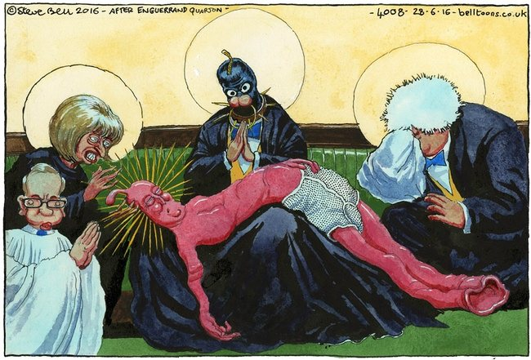
Steve Bell The Guardian (published 28th June 2016)

Slide 3
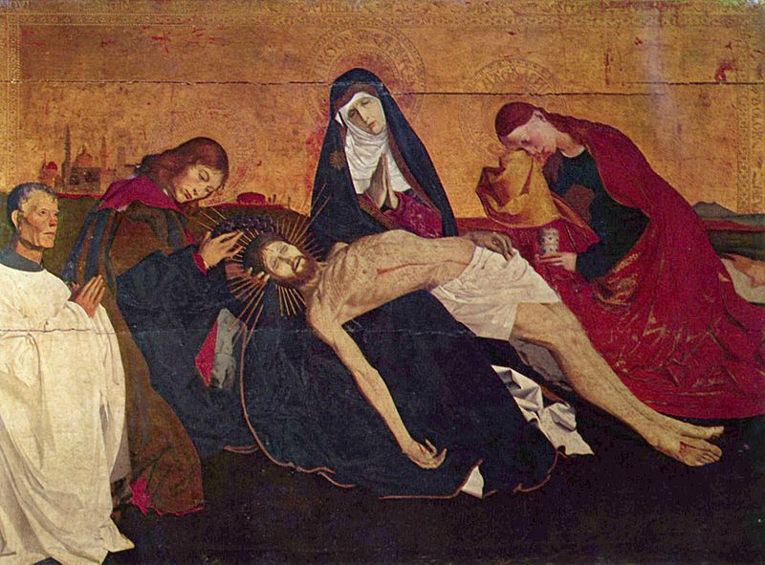
Enguerrand Quarton ‘The Avignon Pietà’ (Pietà of Villeneuve-lès-Avignon) (1456)

Slide 4
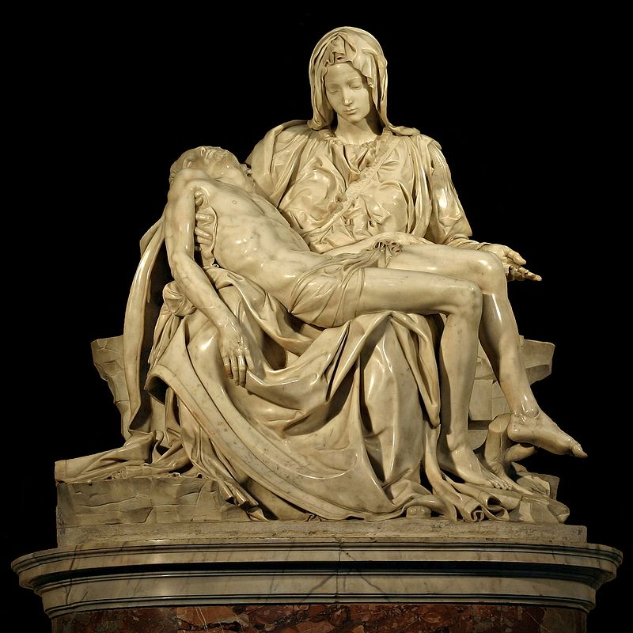
Michelangelo Pietà c.1498-1500, marble

Slide 5
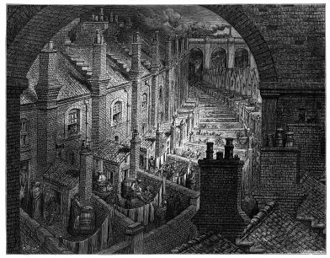
Gustave Doré ‘Over London by Rail’ from London: A Pilgrimage 1872 (with text by Blanchard Jerrold)

Slide 6
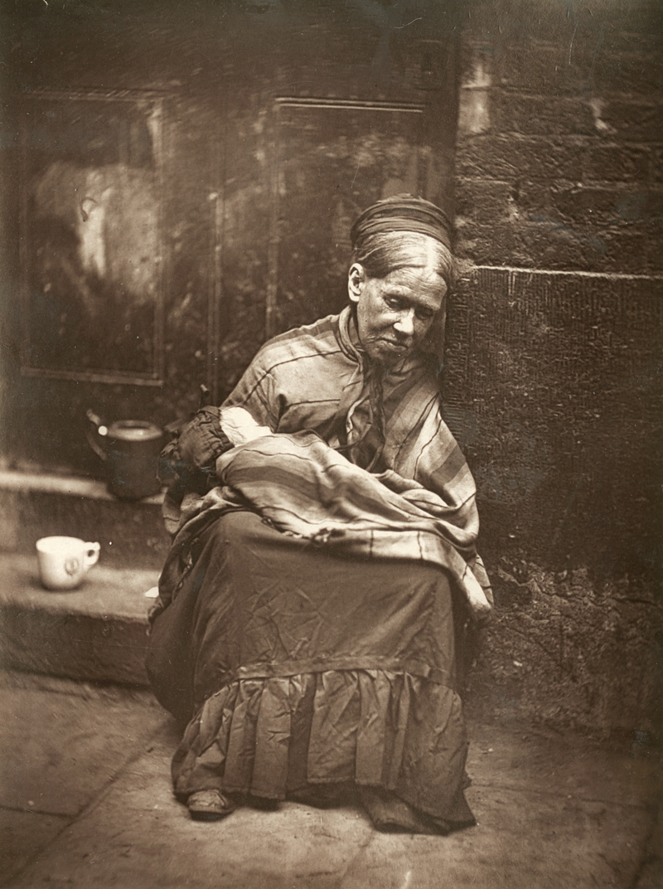
John Thompson ‘The Crawlers’, 'Woodburytype’, from Street Life in London, 1877 (with text written in collaboration with Adolphe Smith [Headingley])

Slide 7
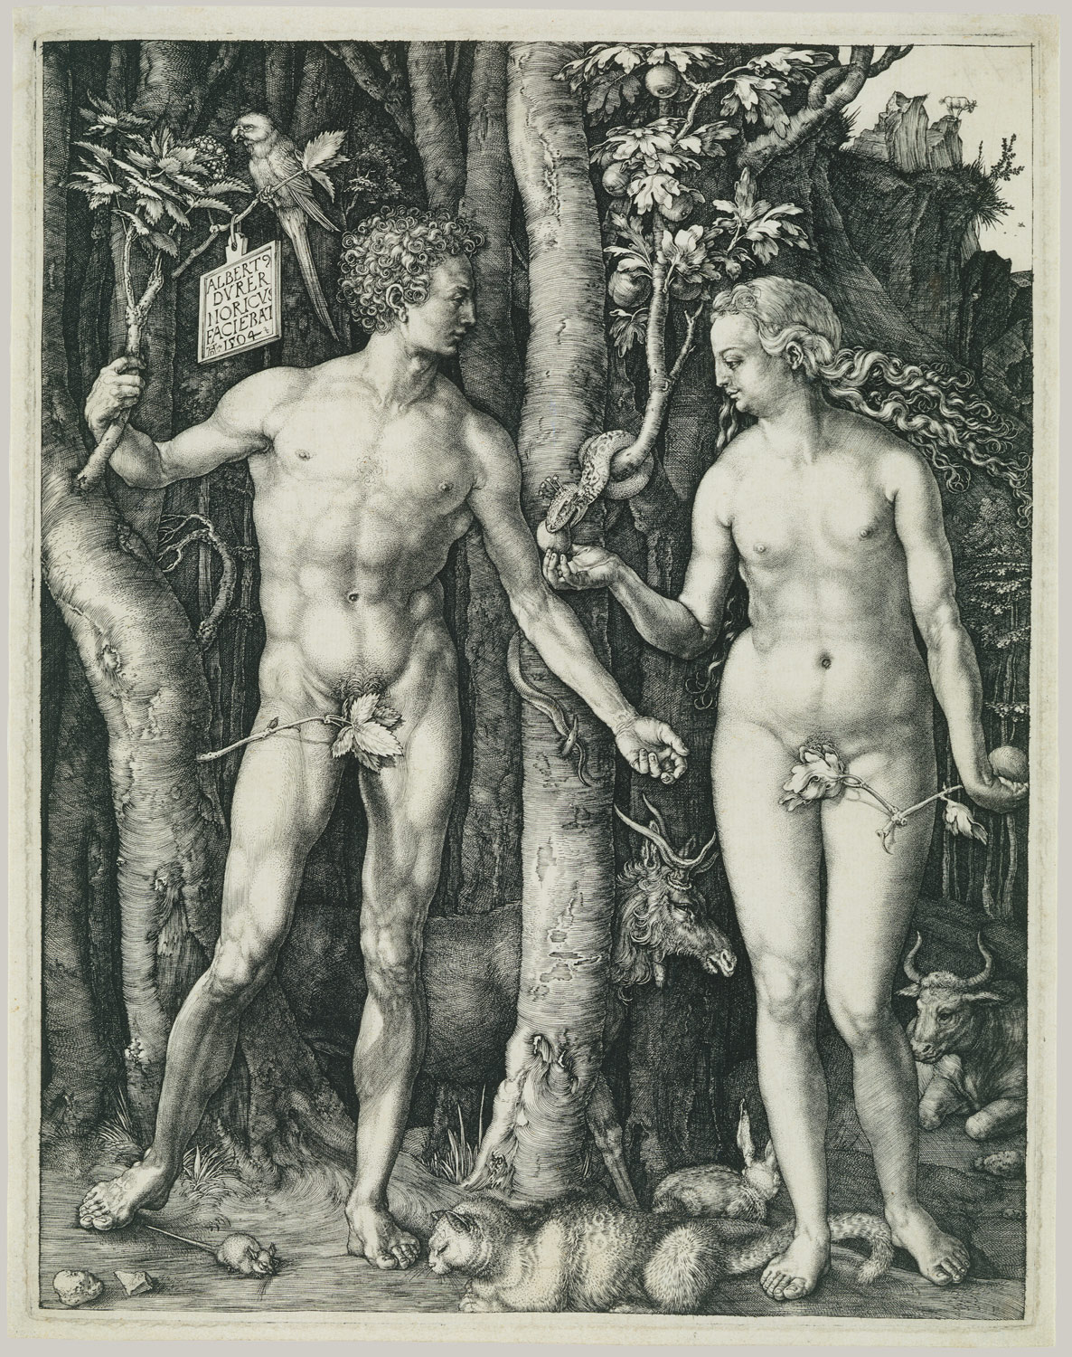
Albrecht Dürer (1471 – 1528) The Fall of Man (Adam and Eve), engraving on copper, 1507

Slide 8
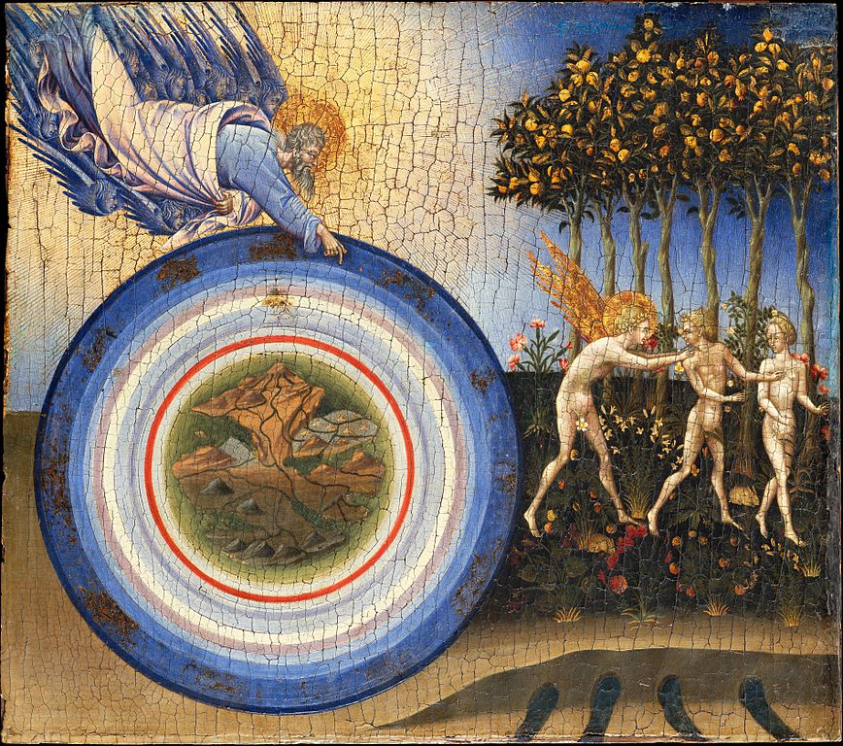
Giovanni di Paolo (Giovanni di Paolo di Grazia) (1398–1482 ) The Creation of the World and the Expulsion from Paradise 1445

Slide 9
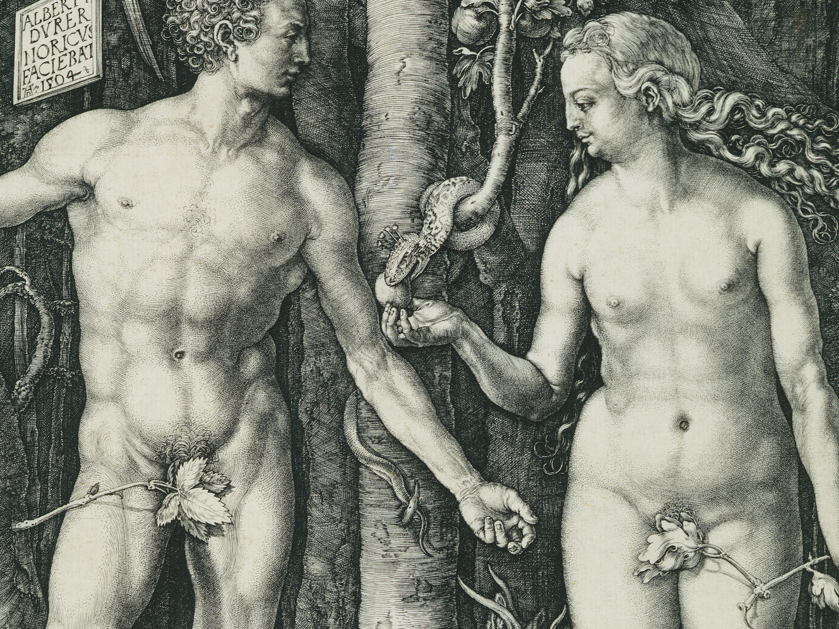

Slide 10
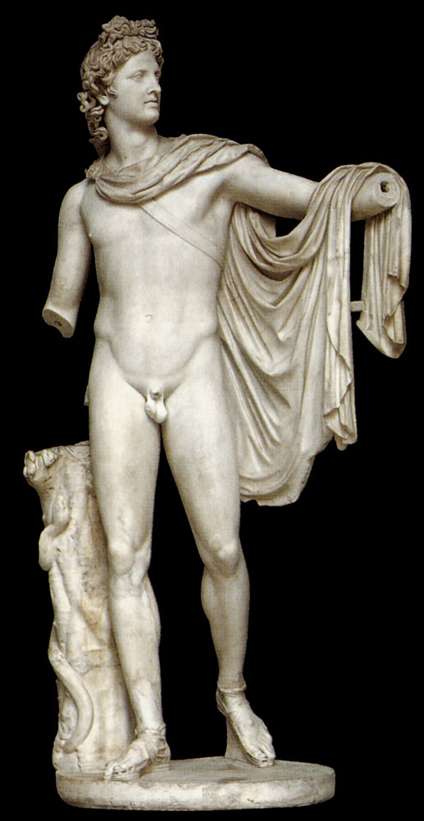
Apollo Belvedere 2nd century A.D. (copy of an original bronze statue of 330-320 B.C. by Leochares) marble

Slide 11
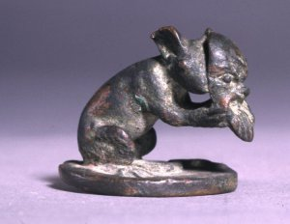
Apollo Smintheus
Lamp lid with mouse, 1st century A.D., Bronze, cast, 3 cm h x 3.2 cm diam., British Museum

Slide 12
The Bronze Mice of Apollo Smintheus
Philip Kiernan American Journal of Archaeology Vol. 118, No. 4 (October 2014), pp. 601-626

Slide 14
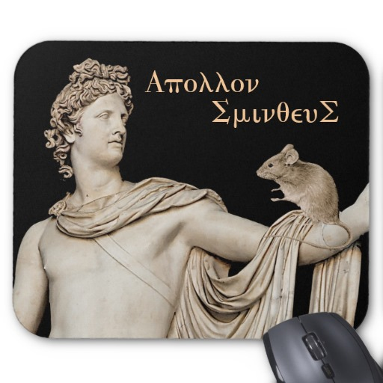
Apollo Smintheus Mouse Pad £11.70 per mousepad
“Style: MousepadCreate a custom mouse mat for home and office! Decorate your desk with your favourite image or choose from thousands of designs that look great and protect your mouse from scratches and debris”.

