Slide 1
Encouraging reflection on feedback
Hazel Davey (hlr@aber.ac.uk)
IBERS
@hazeldaveyaber

Slide 2
The theory
Feedback
  Explains the mark
  Justifies the mark
  improves future marks
Feedforward
......IF students engage with that feedback!
@hazeldaveyaber

Slide 3
The problem – unused feedback
For the marker
  Same old mistakes
  “Wasted” time
For the student
  Same old mistakes
  No improvement
  Poor satisfaction
@hazeldaveyaber

Slide 4
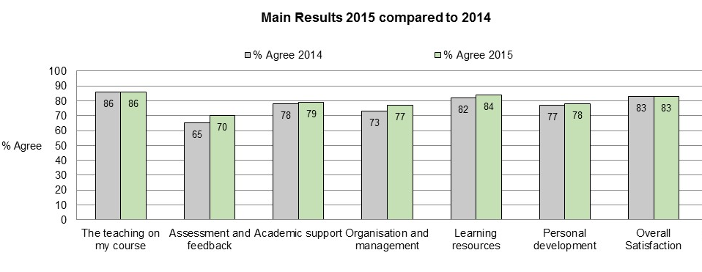
Aberystwyth NSS 2014 and 2015
@hazeldaveyaber

Slide 5
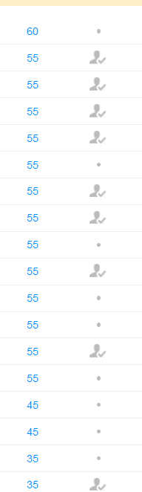
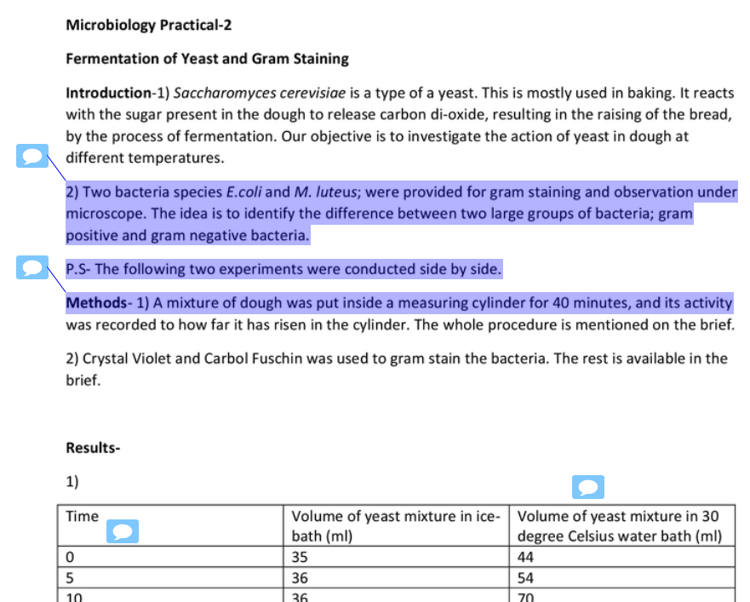
Too much feedback still goes unread

Slide 6
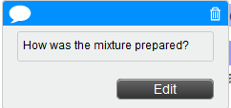
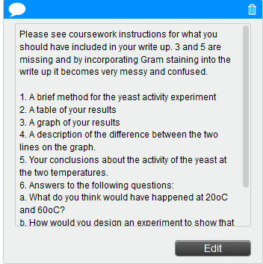
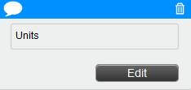
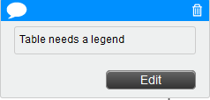
A lot of this feedback is relevant to future assignments

Slide 7
The intervention
Level zero module (most need and most impact)
Scheme structure
  2 x 40 credit ‘content’ modules
    Coursework 70%, Exam 30%
  2 x 20 credit skills modules
    100% coursework
Semester 1 – reflection on coursework (assessed)
  Ensure feedback is used
  Underpin revision
  Something else to do in January
  Engender good habits?
@hazeldaveyaber

Slide 8
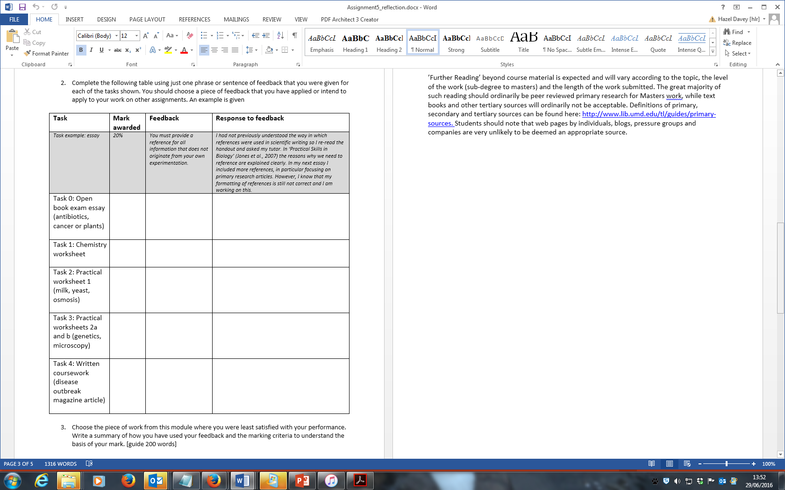

Slide 9
@hazeldaveyaber

Slide 10
@hazeldaveyaber

Slide 11
@hazeldaveyaber

Slide 13
@hazeldaveyaber

Slide 15
What next?
Encourage (assess) reflection earlier in the semester
Other tools
  Patchwork text?
  Learning logs?
@hazeldaveyaber

