Slide 1
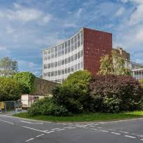

Low cost 3D-printing methods used in an undergraduate project
Dr Chris Finlayson, Department of Physics

Slide 2
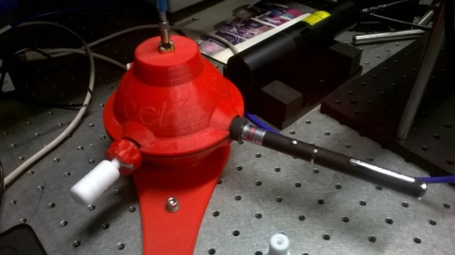
Contents
Final year science projects
Technological innovations
The science bit (short!)
Conclusions and future directions

Slide 3
Projects
Final year student projects are a cornerstone of most undergraduate science degree courses. Exley K. Key aspects of teaching and learning in science and engineering. Fry H, editor. London: Kogan Page; 1999.
Research-led student projects not only desirable, from the pedagogic perspective…
Also essential in the context of student satisfaction and employability.
Requires “expert” staff, but also a pragmatic and innovative approach to (limited) available resources.

Slide 4
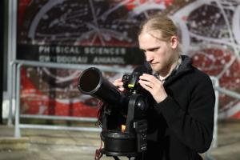
Situation in Aberystwyth Physics schemes
In the Department of Physics at Aberystwyth University, students undertake major research-based projects, working in groups of one or two.
These projects count for 40 credits, or 1/3rd of the overall final year assessment. In the M.Phys. scheme, this is 60 credits, or ½ of the final year. http://www.aber.ac.uk/en/phys/prospective/
Diverse topics cover-
  Materials, semiconductors
  Space science and astronomy
  Instrumentation
  Theoretical physics
  Simulation and computation

Slide 5
Contents
Final year science projects
Technological innovations
The science bit (short!)
Conclusions and future directions

Slide 6
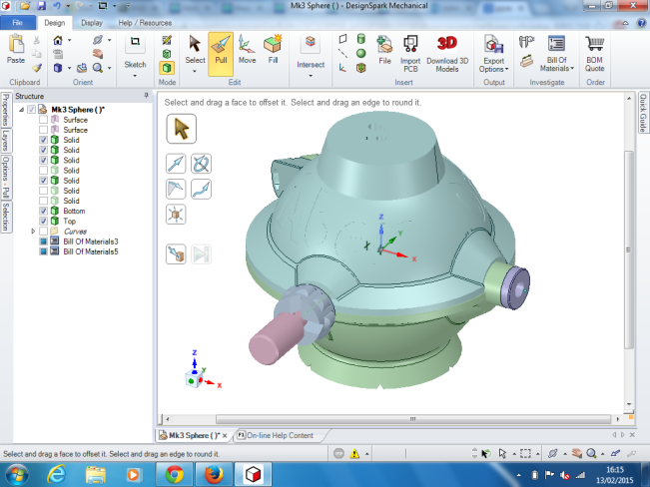
3D printing
Exploitation of the latest 3D printing technologies to provide low-cost instrumentation solutions, for use in an undergraduate level final-year project
3D printing or additive manufacturing is a process of making three dimensional solid objects from a digital (CAD) file.
The creation of a 3D printed object is achieved using an additive process by laying down successive layers of material until the object is created. Each of these layers can be seen as a thinly sliced horizontal cross-section of the eventual object.
3D printed instrument (integrating sphere) ca. few £s
Commercially available instrument ca. £5-10k
(https://www.newport.com/f/integrating-spheres)
CAD design

Slide 7
Innovation in student projects
Presented here is a 3rd year undergraduate physics project which developed a low cost (£25) method to manufacture an experimentally accurate integrating sphere by 3D printing.
The project addresses prescient research issues in optoelectronics, which would otherwise be inaccessible to such undergraduate student projects.
The experimental use of an integrating sphere in conjunction with a desktop spectrometer presents opportunities to use easily handled, low cost materials as a means to illustrate many areas of physics such as spectroscopy, lasers, optics, simple circuits, black body radiation and data gathering.

Slide 8
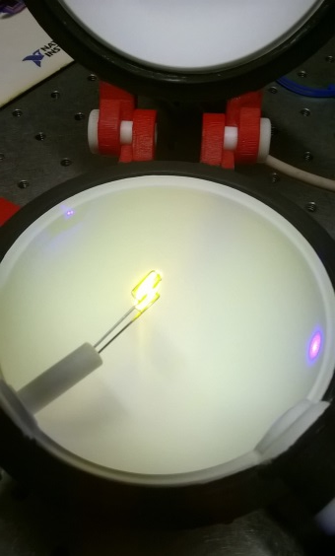
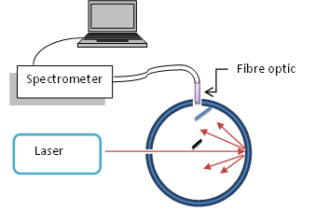
Integrating spheres (what are they?)
“An integrating sphere is an optical component consisting of a hollow spherical cavity with its interior covered with a diffuse white reflective coating, with small holes for entrance and exit ports. Its relevant property is a uniform scattering or diffusing effect”. (Wikipedia)
Idea is to collect light emitted from samples in all directions to enable quantitative measurements of light sources, thin-films and devices
Luminescent materials (light absorbed and re-emitted)
Light Emitting Diodes (LEDs)

Slide 9
Contents
Final year science projects
Technological innovations
The science bit (short!)
Conclusions and future directions

Slide 10
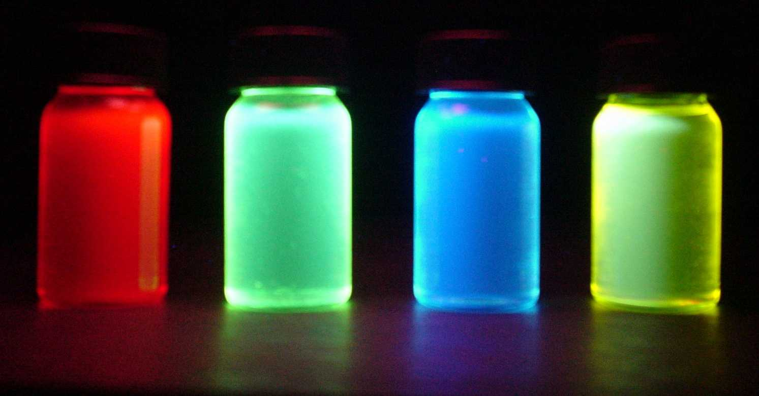
(Photo)luminescent materials
Photoluminescent materials old and new have been extensively investigated since the first descriptive understanding of fluorescence by Sir George Stokes in 1852. (Phil. Trans. of the Royal Society of London. 1852; vol.142, p463-562)
In the modern world, luminescent materials are used in a wide variety of applications, ranging from advanced diagnostic markers in biomedicine, new mobile phones, TVs and computer tablets which have display screens that use organic semiconducting polymers to produce light emission,(Burroughes J, et al., Nature. 1990, 347, p.539-41.) to simple highlighter pen inks.
Light absorbed is re-emitted,
usually at a different wavelength

Slide 11
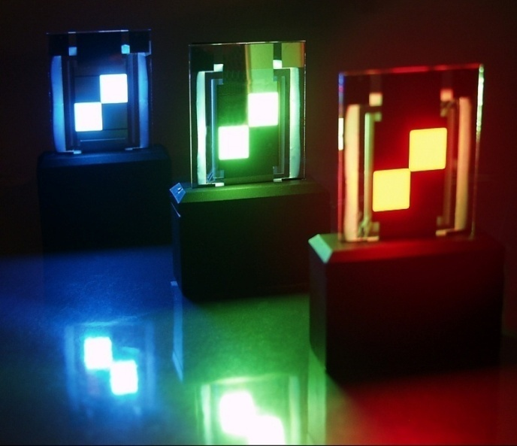
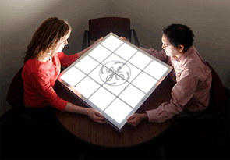
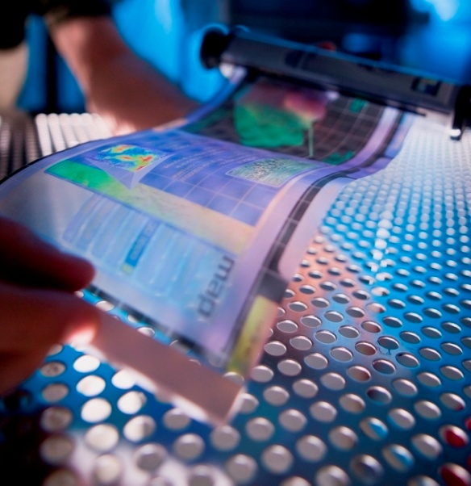
“Quantum yield” measured by integrating sphere
The efficiency of a fluorescent material is related to its photo-luminescent quantum yield (QY).(Finlayson CE, et al. Journal of Modern Optics. 2005; 52, 955-64)
The QY is simply the ratio of the light emitted by the material to the light absorbed (i.e. “photons out / photons in”).
So mobile phones, TVs and computer tablets use display materials that have a high QY because this reduces energy consumption.(Shuai Z, et al. Phys. Rev. Lett. 2000; 84, 131-4)
Experiments to find the QY of film materials can be difficult to achieve because of problems in collecting all of the emitted light due to an angular anisotropy of emission. (de Mello J, et al. Advanced Materials. 1997; 9, 230).

Slide 12
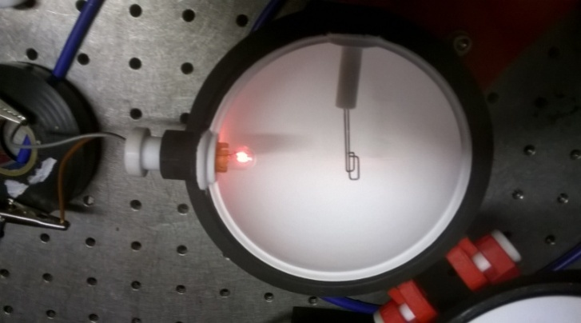
Calibration and measurement
Homemade internal reflectance coating formulated from readily available materials, and a robust instrument calibration method using a tungsten bulb. (Kosch M, et al. Proceedings of the 30th Annual European Meeting on Atmospheric Studies by Optical Methods, 2003).
The instrument is demonstrated to give accurate and reproducible experimental measurements of luminescence quantum yield of various luminescent semiconducting materials, in excellent agreement with literature values.
Low cost laser-pointers as excitation source(s)
Total costs approaching only £25.

Slide 13
Contents
Final year science projects
Technological innovations
The science bit (short!)
Conclusions and future directions

Slide 14
Conclusions
3D printing is a technology which has a potentially transformative effect in laboratory teaching and practical science across many scientific and engineering disciplines.
The latest 3D printing technologies provide low-cost instrumentation solutions for optoelectronic materials characterisation, which would otherwise be inaccessible to such undergraduate student projects.
This project also leaves a clear legacy, in terms of new apparatus, enhancing the scope of future projects.

Slide 15
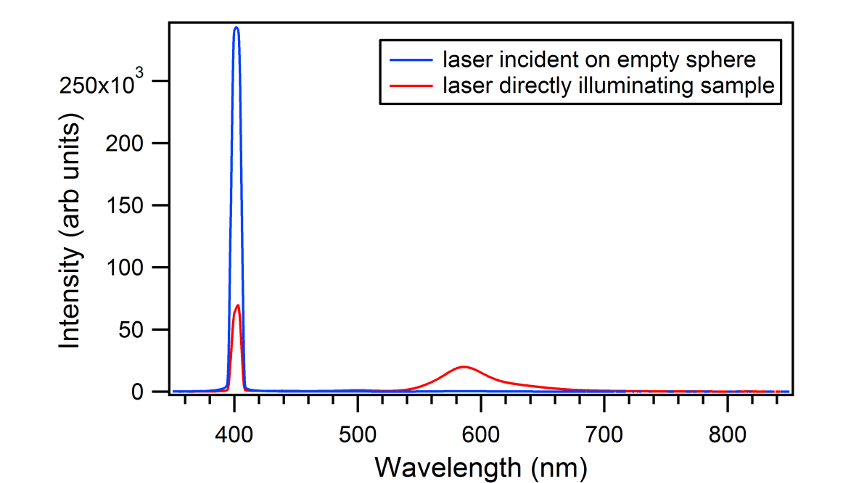
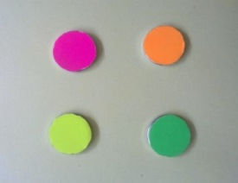
Publication Pending!
John Tomes and Chris Finlayson, Low cost 3D-printing methods used in an undergraduate project; an integrating sphere for measurement of photoluminescence quantum yield.
European Journal of Physics (in press 2016)
E-mail; jjt10@aber.ac.uk, cef2@aber.ac.uk

Slide 16
Thank you for your attention!

