Slide 1

Effective lectures: engaging all students
Mary Jacob, E-learning Group
Notes:
Image Students with Tablets, ©University of the Fraser Valley via Flickr CCBY, from https://www.jisc.ac.uk/blog/five-steps-for-embedding-technology-use-in-colleges-28-jan-2015
12.10 Welcome, introduction of participants
What makes a bad presentation? A good one?
12.20 Presentation on structure, visual design, and delivery, to include the following sample topics:
Make it readable – good layout, font and colour choices
Using visuals effectively to reinforce the message
Accessibility and how it can enhance learning for all students – 5 minutes
Organise the presentation for maximum retention of subject content
Effective delivery
12:50 Small group work in which participants analyse printouts of PowerPoint slides and identify ways to improve the presentation. Samples will include contributions from participants as well as examples provided by the trainer.
13:00 Sharing of results of group work.
13.10 Presentation on interaction, to include the following sample topics:
Break up lecture with interaction
Insert interactive cues into the presentation
Use a branching structure for contingent teaching
13.20 Large group discussion in which participants explore how they can make their own lectures more interactive.
13:30 Finish

Slide 2

What makes a presentation bad?
What it looks like
What the presenter does
Notes:
10 minutes

Slide 3
Students want…
More interaction
Lecture capture
More visuals
Less reading from screen
Less text on screen
More text in notes
Notes:
Spring 2013 we ran LEX Student Experience study. The results reinforced message we had heard from students in focus groups and other surveys – there is variation in practice from exemplary to weak, but in general students want better lectures. This means better delivery, better use of PowerPoint, better use of time during the lecture hour.

Slide 4
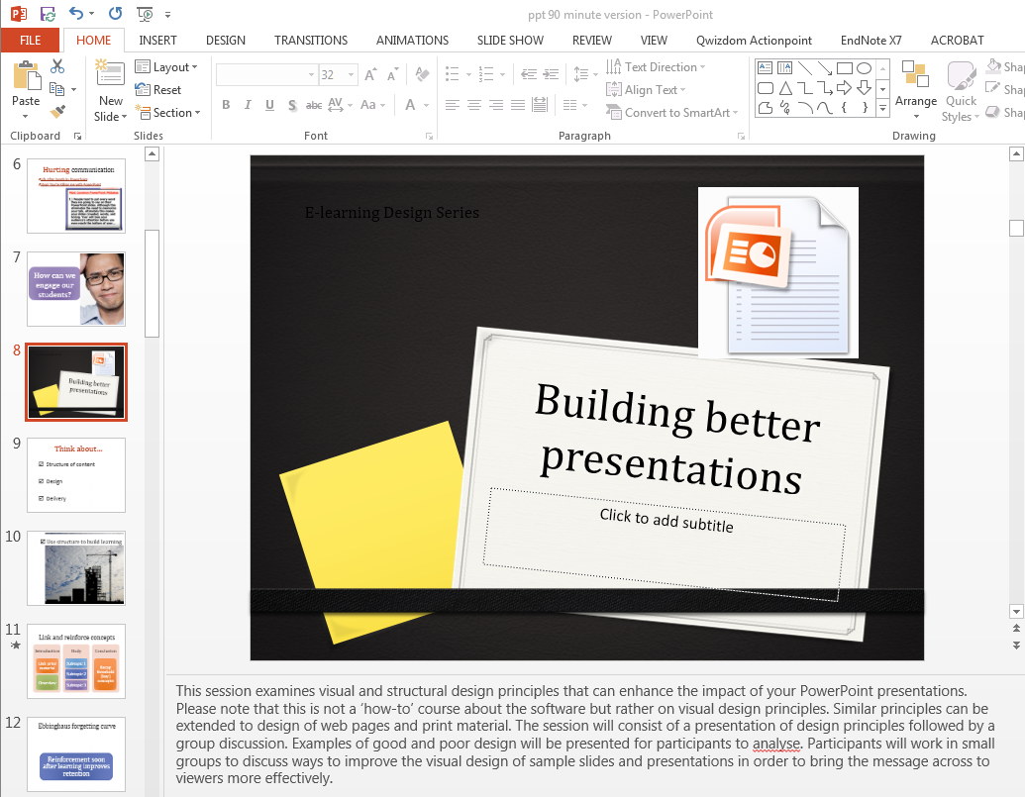
Helping students revise
Use Panopto (AberCast) for Lecture Capture
Put lecture notes into the Speaker Notes section

Slide 5
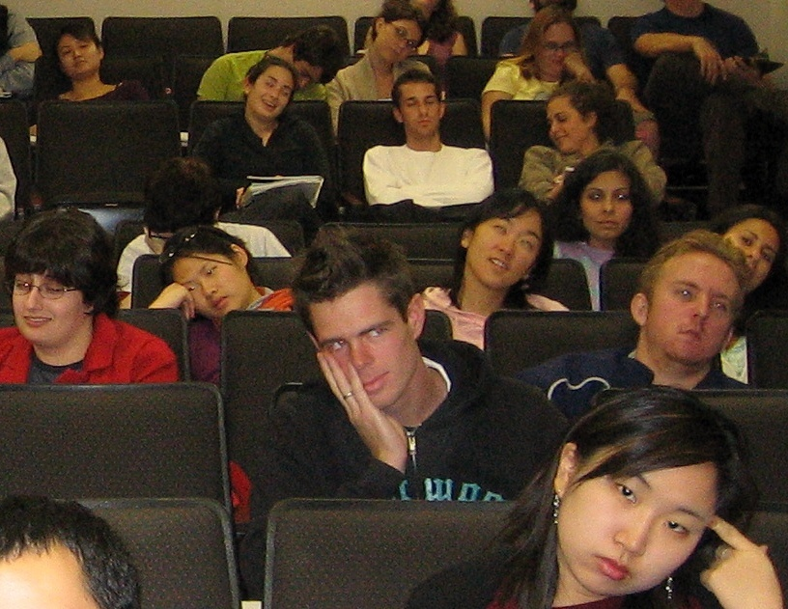
Have you experienced this?
http://www.english.ucla.edu/faculty/mcgurl/student%20feedback.htm
Notes:
http://www.english.ucla.edu/faculty/mcgurl/student%20feedback.htm

Slide 6
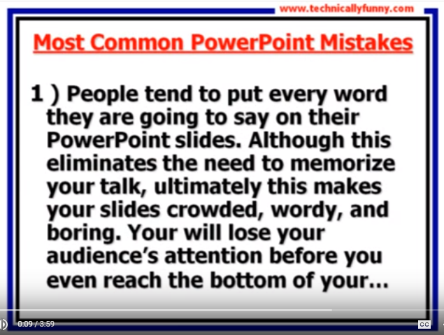
Hurting communication
Life After Death by PowerPoint
Stop! You’re Killing me with PowerPoint
Notes:
This video clip shows what not to do.
Life After Death by PowerPoint Don McMillan https://www.youtube.com/watch?v=MjcO2ExtHso
Stop! You’re Killing me with PowerPoint http://www.youtube.com/watch?v=_JU48-FVqvQ

Slide 7

How can we
engage our students?

Slide 8
Think about…
Structure of content
Design
Delivery
Notes:
Comment:
This slide lists the three subtopics in my presentation

Slide 9

☑ Use structure to build learning
Notes:
Linear structure with as much info crammed into the hour as possible is not the most effective method.
Loop back periodically to recap main ideas.
More repetition is needed than would be necessary in a written paper.
Give students breathing room to process the information and interact with it.

Slide 10
Link and reinforce concepts
Introduction
Link prior material
Overview
Body
Subtopic 1
Subtopic 2
Conclusion
Recap threshold (key) concepts
Subtopic 3
Notes:
Start with a link to prior material.
Give overview of the new topic.
Give each subtopic, with a recap at end before moving on to next subtopic.
Recap threshold concepts at end.
Break up with interaction whenever possible.

Slide 11
Ebbinghaus forgetting curve
Reinforcement soon after learning improves retention
Notes:
Ebbinghaus forgetting curve – most of the forgetting occurs in first 20 minutes after learning new material
The curve of forgetting and the distribution of practice Journal of educational psychology [0022-0663] Easley vol:28 iss:6 pg:474 -478
Ebbinghaus, Hermann. Translated by Henry A. Ruger & Clara E. Bussenius. Memory: a contribution to experimental psychology (New York: Teachers College, Columbia University, 1913). http://psychclassics.yorku.ca/Ebbinghaus/index.htm (Accessed 15 March 2012).

Slide 12
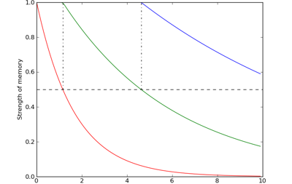
Ebbinghaus forgetting curve
50%
50%
Strength of memory
Time (days)
Ebbinghaus, Hermann. Translated by Henry A. Ruger & Clara E. Bussenius. Memory: a contribution to experimental psychology (New York: Teachers College, Columbia University, 1913). http://psychclassics.yorku.ca/Ebbinghaus/index.htm (Accessed 20 November 2013).
Notes:
Ebbinghaus forgetting curve – most of the forgetting occurs in first 20 minutes after learning new material
The curve of forgetting and the distribution of practice Journal of educational psychology [0022-0663] Easley vol:28 iss:6 pg:474 -478
Ebbinghaus, Hermann. Translated by Henry A. Ruger & Clara E. Bussenius. Memory: a contribution to experimental psychology (New York: Teachers College, Columbia University, 1913). http://psychclassics.yorku.ca/Ebbinghaus/index.htm (Accessed 20 November 2013).

Slide 13
A possible structure for difficult subject material

Slide 14
Main topic
Subtopic 1
Subtopic 2
Subtopic 3
Details
Details
Details
Notes:
Repeat connection among the big ideas at the end. Check students’ understanding.

Slide 15

☑ Good Design
Meaningful visuals
Readable font
Not too much text
Variety of layout
No distracting animations or sound
Image: Colorful! By Jonas Tana
Licence: CC BY SA
https://www.flickr.com/photos/jonastana/5254525449/sizes/l

Slide 16

☑ Good Design
Meaningful visuals
Readable font
Not too much text
Variety of layout
No distracting animations or sound

Slide 17
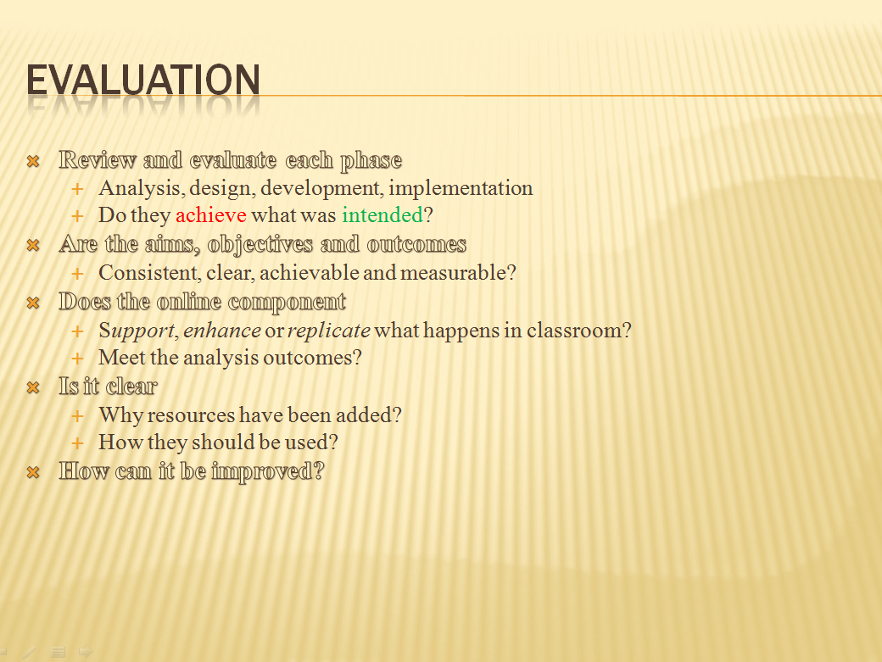
Hurting communication
Adapted from Wiki Books Instructional Technology/Instructional Design
https://en.wikibooks.org/wiki/Instructional_Technology/Instructional_Design
Notes:
Click into the example of poor and improved accessibility on slides.
Adapted from Wiki Books Instructional Technology/Instructional Design
https://en.wikibooks.org/wiki/Instructional_Technology/Instructional_Design

Slide 18

Accessibility helps all students
Notes:
Click into the example of poor and improved accessibility on slides.

Slide 19




Diversity
Sensory impairment
Mental health
Cognitive processing (SpLD)
Social communication

Slide 20
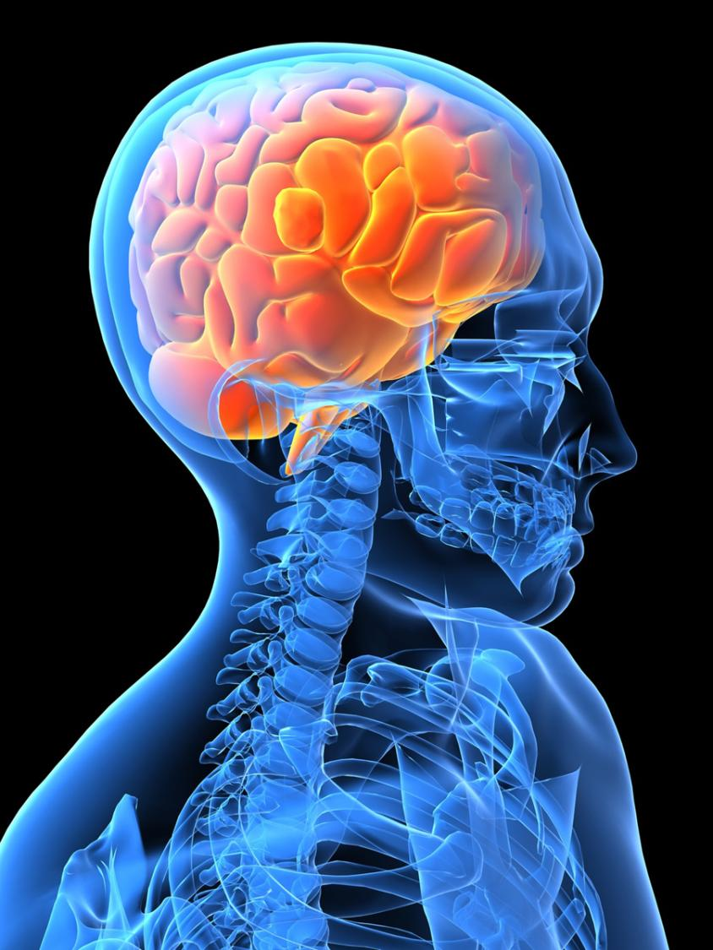
Dual processing - image plus spoken words
John Sweller
cognitive load theory

Slide 21
Cognitive load and dual processing
If you provide written text plus spoken words, the result is interference because students can read faster than you can speak. The message is being sent at different speeds along the same channel (the verbal one).
If you provide an image plus spoken words, the result is reinforcement because you are using two different channels with the same message (visual and verbal).

Slide 22
Hurting communication –
same channel
Spoken Words
Written words
Interference
Notes:
Same message at two speeds along same channel

Slide 23
Helping communication –
different channels
Spoken words
Image
Reinforcement

Slide 24

☑ Delivery
Don’t read - talk to your audience
Make eye contact
Expand on ideas in slides
Move around
Practice
Use mic –
connects with hearing loop

Slide 25

Communicate clearly
Got it?

Slide 26
What are principles of good presentation?
Notes:
Don’t look at handouts! See how much they remember from first part of presentation.
By the way, have you noticed that there is a symbol I use to signal to you (and to me) that when we come to this slide, we will be doing something requiring your participation?

Slide 27

Group work
Apply principles
to redesign a slide
http://www.slideshare.net/shahinurrahaman/biofuel-its-importance
http://www.slideshare.net/mungo13/teaching-poetry
http://www.slideshare.net/brianbelen/what-is-politics-1699125
Notes:
Small group work
Participants will work in small groups to apply the principles of good practice to redesign a presentation.
Work in small groups to brainstorm and complete the worksheet, then each group will share.

Slide 28
Group discussion
What will you do differently now?
Notes:
Give each group a chance to contribute their experience. Adjust your approach depending on the dynamic in the class – you might have each person contribute or have an open discussion of each topic in the slide. Other ideas for topics may emerge, so follow them if desired.

Slide 29
E-learning support
Drop-in for module MOT, other consultation
  Friday 9-12 Hugh Owen Library room E11
Email bb-team@aber.ac.uk
Phone X2472
Training sessions – see Nexus
Nexus http://nexus.aber.ac.uk
Delicious bookmarks http://www.delicious.com/is_alto/ppt
Notes:
Who we are
The E-learning Team. Our primary aim is to support University staff, and to some extent students, in e-learning. This includes both technical and pedagogical guidance.
We also comprise the Blackboard Team. We maintain the ALTO e-learning support website. For general e-learning queries, contact us at is-alto. For Blackboard queries, contact us at bb-team.

Slide 30
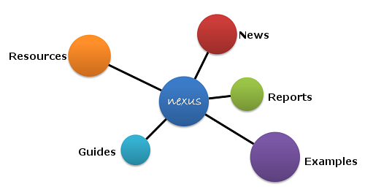
http://nexus.aber.ac.uk
Notes:
Here is where you can find a detailed handout

