Slide 1
Appreciative Inquiry for Blackboard
Kate Wright, E-learning Group Manager

Slide 2
What is Appreciative Inquiry?
“Appreciative Inquiry (AI) is a technique for approaching change in a positive way … The approach is about focusing on the positive as opposed to identifying “what is wrong and what you need to do to fix it”. ”
https://www.jisc.ac.uk/guides/change-management/appreciative-inquiry
Methodology developed by David Cooperrider (in conjunction with Diana Whitney and Suresg Srivasta)
Discover
The best of what is
Dream
What can be
Design
Plan what will be
Deliver
Provide the new vision
Notes:
Appreciative inquiry is about change management – often when we think about change we start with the idea that something is wrong and we need to fix it.
Appreciate inquiry is about generating ideas from people – gather their best experiences of system, process, approach and building something new based on this. It’s only one approach to change, but we liked the idea because it’s a new way of thinking about things. It’s too easy to fall into the trap of complaining and looking at the negatives, but often we a little lateral thinking or just the time to reflect, you can find positives and then build on them.
There’s a four-apart process to appreciative inquiry – we’re going to do a shortened form of it today.
So it’s starts with Discover – finding out the best of what is with the current situation. This means thinking about the best experience you have of the current situation – telling the story of when things have worked, helped etc. So when we start the process we’ll be asking you to think about the times when Blackboard has helped you, when you’ve found it’s helped …
Once we’ve done that we’re going to combine the next two steps – dream and design. In the dream phase we think about what the future could look like and start making that a reality. In our exercise this is going to be very practical – I’m going to ask you to create something that we can use.

Slide 3
Why are we doing this?
Blackboard is overcrowded and confusing to first time users there's too much stuff and items and tabs going on and not sure where to go or how to get there
The AberLearn Blackboard is not the most user friendly system and I often get frustrated trying to find things. A better layout … would be very useful!
AberLearn Blackboard is not intuitive and the interface is both ugly and confusing.
Notes:
Well – I know we said that this was about positives, but we’ve had lots of feedback from staff and students that Blackboard isn’t working. These quotes are from the recent IS User Survey. For the first time this year we asked about the Blackboard interface. This was in part because we knew that the interface needed looking at again.
It’s been a long time since we designed the look and feel of Blackboard. It hasn’t had a substantial make-over since 2012 when we gained the ability to add new tabs etc. The implementation of the new Blackboard look and feel was done quickly over one summer and it’s about time that we re-visited it

Slide 4

Photo by Lesley Van Damme used from Flickr under Creative Commons (https://flic.kr/p/gi7s6Q)
Notes:
But of course we know that there are negatives, and not acknowledging these isn’t positive. However, AI is about positive thinking – so there will be an opportunity in this session to note down your negatives. There will be a few minutes for you to note them down on post-it notes and put them down. Hopefully this will recognise the negatives that you have, but allow you to move beyond the negatives. It will be chance to put them aside and find the space to think positively.

Slide 5
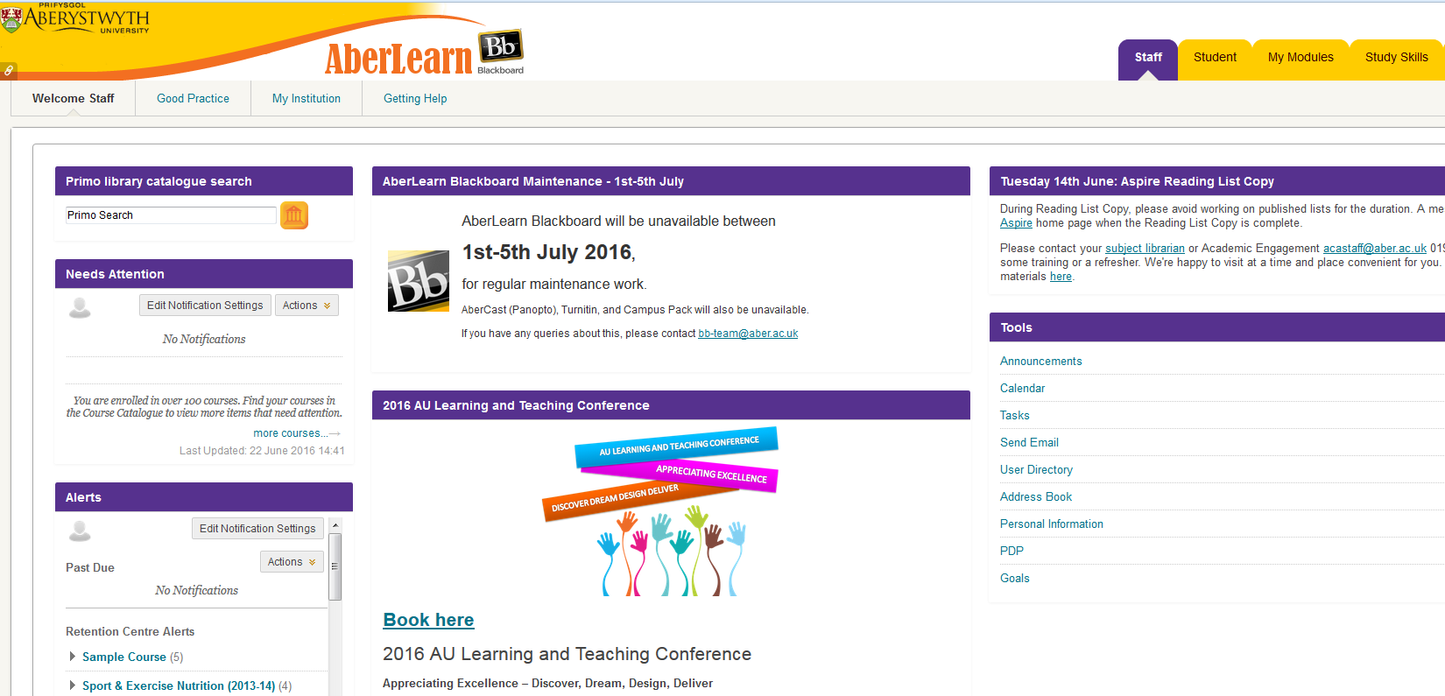
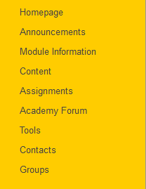
Scope
Notes:
So, what are we going to thinking appreciatively about – we’re going to spend some time thinking about the tabs and pages in you see when you login and then we’ll think about the actual modules sites themselves.
We’ll be hopefully be running some of these sessions throughout the year and all the ideas will be put together to give us something we can put in place for next summer.

Slide 6
Discover
Discover
Dream
Design
Deliver
What’s working well?
What is valuable?
What would you not want to lose?
What do you appreciate?
Notes:
So let’s start with discovery – think about either the tabs / pages or the module sites themselves and talk about these questions ….

Slide 7
Dream / Design
Discover
Dream
Design
Deliver
What would the future look like for the tabs or
the courses?
Describe, draw or create your ideal.

Slide 8
References
JISC, Appreciative Inquiry, https://www.jisc.ac.uk/guides/change-management/appreciative-inquiry
Brunel University, ApprecHATive Inquiry Toolkit, https://coursedesignproject.files.wordpress.com/2013/03/apprechative-inquiry-workshop-toolkit.pdf
JISC, Appreciative Inquiry Script, http://jiscdesignstudio.pbworks.com/w/file/fetch/52211921/Appreciative%20Inquiry_script.pdf
Case Western Reserve University, Appreciative Inquiry Commons, https://appreciativeinquiry.case.edu/
Cockerell, McArthur-Blair & Schiller, Appreciative inquiry in higher education: a transformative force (2012)

Slide 9
Thank you …
For taking part; we appreciate it!

