Slide 1
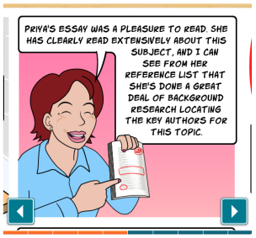
AU Learning and Teaching Conference:
AVOIDING PLAGIARISM- Case Study
Friday 8th July

Slide 2
Content
Why provide training?- benefits for students, staff and the university
Why training needed in SMB? What SMB needed? What SMB did?
Epigeum- what if offers?
Epigeum- how it works?
Student Feedback
Conclusion
Screen shots of Epigeum

Slide 3
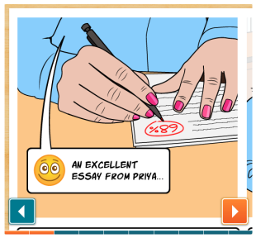
Why provide training on academic integrity and avoiding plagiarism?

Slide 4
Plagiarism remains a common problem in universities
Creating positive messages about the importance of academic integrity is far more successful than simply punishing students
Students need to be reminded of our regulations on unfair practice
Students can undertake their studies and complete their assessments without having to worry that they might be breaking the rules
Students will learn how to correctly use citations and references

Slide 5
Students will feel adequately prepared for their assignments
The results of student plagiarism cause anguish for the student and University alike
There are strict rules and harsh penalties, some students last year did not graduate, or had their degree classification reduced, because they violated the rules
Accidental plagiarism is still plagiarism
Ignorance of the rules is not a defense if found in violation

Slide 6
Are you confident?
Do you understand what plagiarism is and why avoiding it is so important?
Are you familiar with the key terms associated with plagiarism and academic integrity?
Can you identify the different types of plagiarism?
Do you appreciate the importance of referencing and accurate citation?
Are you able to identify strategies for avoiding both intentional and inadvertent plagiarism?

Slide 7
Training is needed and Valuable- SMB
In the last academic session (2014/2015) in SMB we had over 70 cases of unacceptable practice/plagiarism
Staff hours involved phenomenal- module co-ordinators identifying and investigating, Senior Tutor- further investigating and contacting each individual student, staff sitting in unacceptable practice panels with the students
Students were constantly telling us in the unacceptable practice meetings that ‘they were not aware their actions constituted ‘plagiarism’
There was a strong feeling within the SMB that this issue needed to be addressed.
Providing this training helps us comply with the QAA guidelines on plagiarism training.

Slide 8
What We Needed- SMB
We scrutinised the existing learning resources on offer -useful and informative, contain the AU regulations, lists of advice and resources/ interactive exercises and internet detective
With 70+ students in the 2014/2015 session sitting before unacceptable academic panels- we needed more- we needed the assurance that students have been adequately prepared for their assignments and we needed evidence that students have received and engaged with this training on avoiding plagiarism.

Slide 9
What We Did- SMB
We presented to all students during the first few weeks of Semester 1- why we provide training? correct citation and referencing, AU resources-(Regulations, Penalties, Avoiding plagiarism, Internet Detective, The Effective Study Collection), Turnitin
At the end of the presentation we introduced the Avoiding Plagiarism Course by ‘Epigeum’.
We made it compulsory for all students to complete the course (UG’s and PG’s), set them a deadline and monitored the engagement- over 600 students successfully completed.

Slide 10
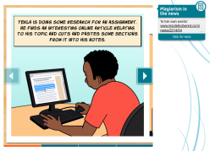
What does the course offer?
When completing the training students:
are introduced to different types of plagiarism
learn how to avoid plagiarism and correctly use citations, paraphrasing and references
The course includes:
scenarios
students views
how plagiarism has hit the news headlines- contextualise the content through links to recent articles
review quizzes
practice exercises.

Slide 11
How it Works?
Students log onto the website with their aber id: https://plagiarism.epigeum.com/
60 minute course
Once completed the various elements and tests/quizzes receive a certificate as proof of completion- (multiple attempts allowed at passing the final test, pass mark 75%)
Staff have admin rights so can check which students have engaged and whether they have successfully completed the training- ESSENTIAL THAT WE CAN DO THIS

Slide 12
Student Feedback

Slide 13
Conclusion
In the main student feedback highlighted the usefulness of the training
2nd and 3rd years did comment that they should have had the training in their first year- next academic session- roll it out to 1st years and Masters students during the first few weeks of term
SUCCESS STORY FOR SMB- Only 3 reports of plagiarism for SMB in 2015/2016 academic session-compared to 70+ in 2014/2015.
The Epigeum licence was acquired for 1 year only as a pilot/ proof of concept (expires 25th Oct 2016). Whether using this product or one similar- WE NEED RESOURCES TO TRAIN STUDENTS IN GOOD ACADEMIC PRACTICE.

Slide 14

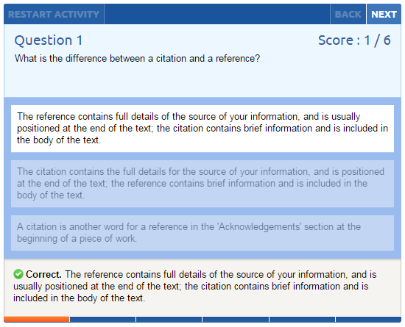
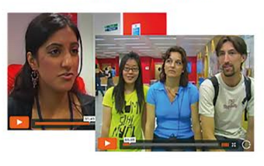
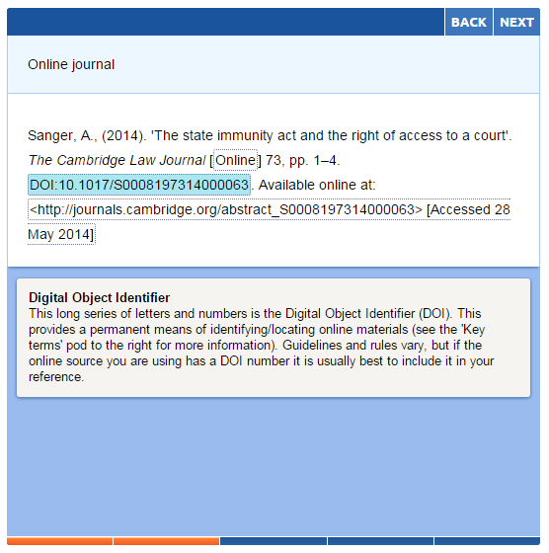
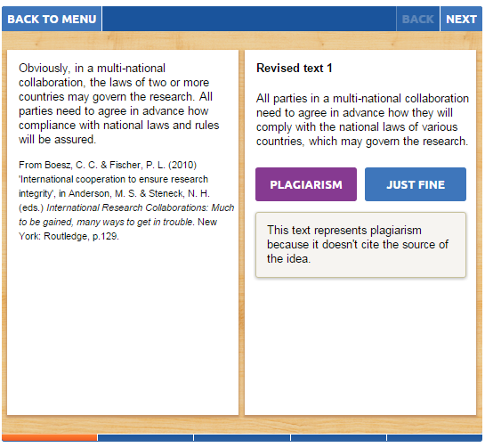
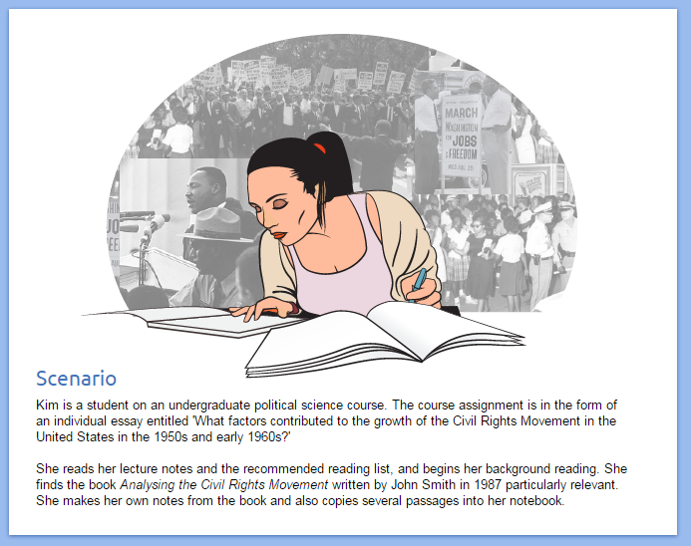
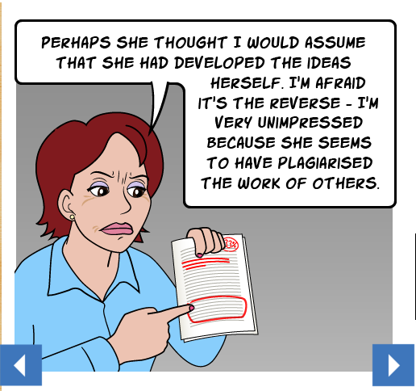
Avoiding Plagiarism – Key features
Diagnostic and Assessment Tests
Student voices
Examples
Comic Strips

Slide 15
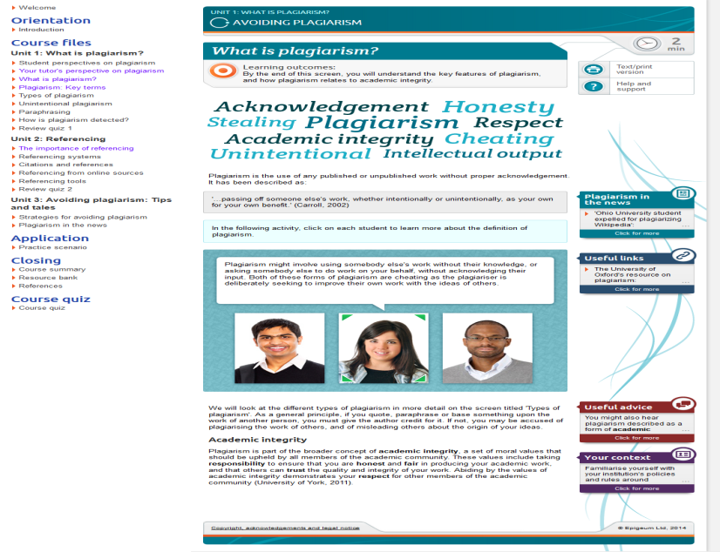

Slide 16
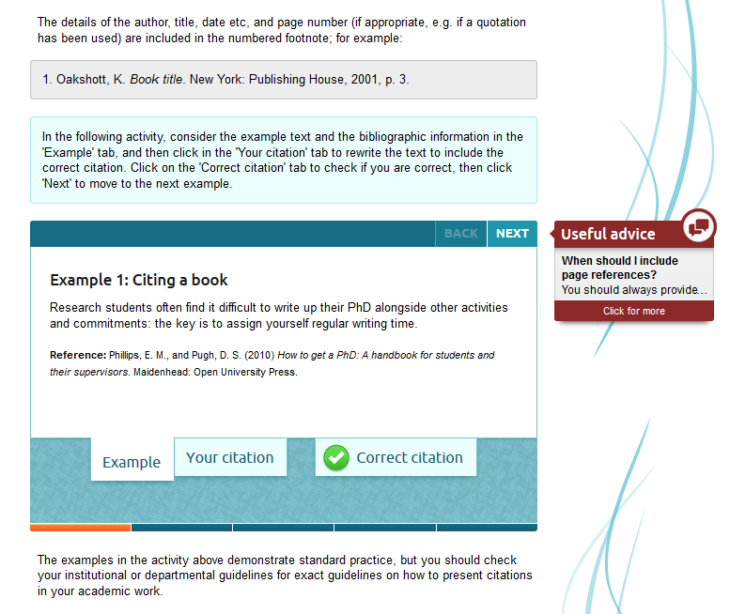

Slide 17
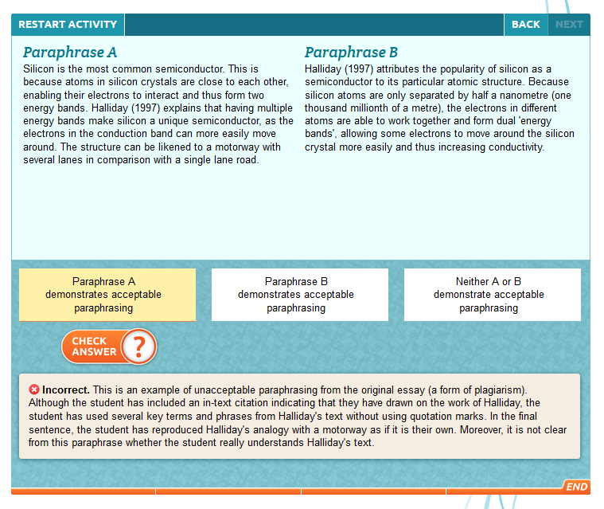

Slide 18
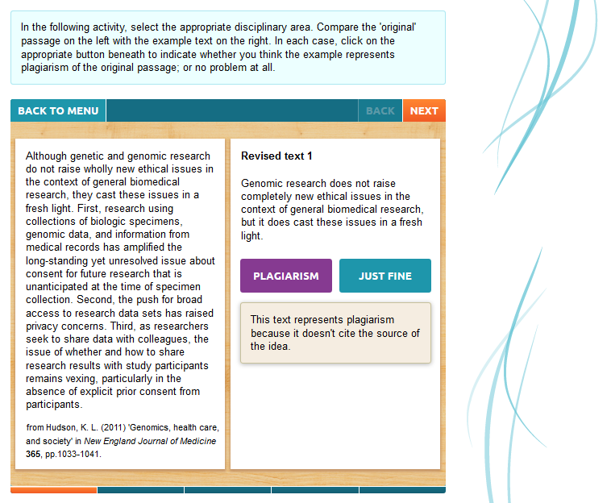

Slide 19
