Slide 1
Skills and Learning development Group
Audit referencing and citation practices by department
Make learning support materials available beyond induction and training programmes
Ensure all students and staff know where to access learning support courses
Develop online skills ’hub’
Open to all resource for staff and students
Notes:
Beginnings with referencing audit
Practical, tangible outcomes.
The problem
Help and assistance = many channels, departments and services
Means of drawing together disparate tools and services

Slide 2
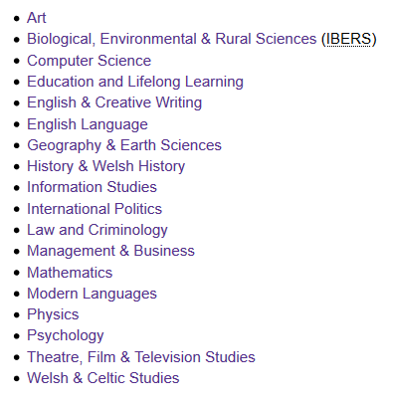
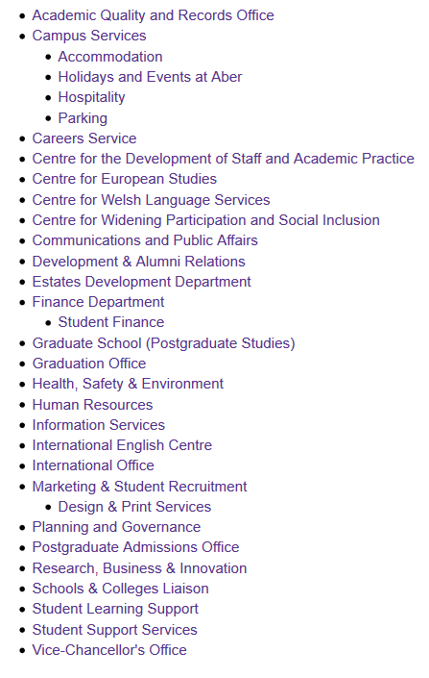
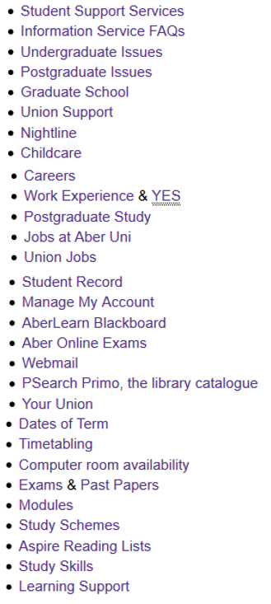
Notes:
Example:
First year student working on first assignment
Help with essay writing
- go to the department pages? Joint honours?
- find that presentation from the start of term?
- What about the library?
- What about Student support services?
- Student’s Union?
Make easy for students to contact AU services who can help with studies
Offer online skills resources
Support recruitment – demonstrating co-ordinated services
Support retention by improving chances of higher marks in first assignment.

Slide 3
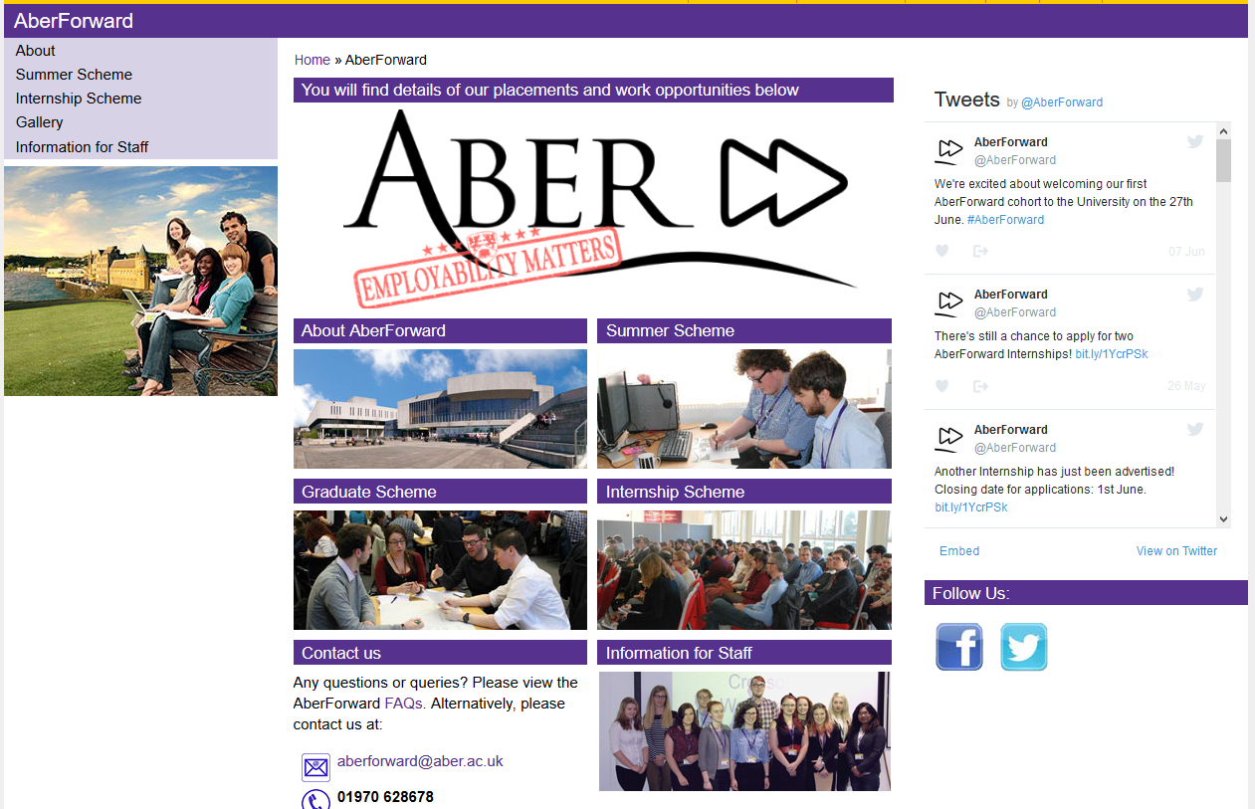
Notes:
Remind of mixed nature of the SLD group.
John Morgan, lead of Working Group; part of Student Learning Support
Library and information services staff history of collaborating with Student Learning Support.
Subject librarians teach on Undergraduate Information skills course, and PGRT
Then developed as way of contributing toward SSP goals – Skills Hub is its tangible outcome
Student led AF Trainee Benjamin Timbrell, supervised by Joy Cadwallader
Ben and Aber Forward background
Internship as a positive for once

Slide 4

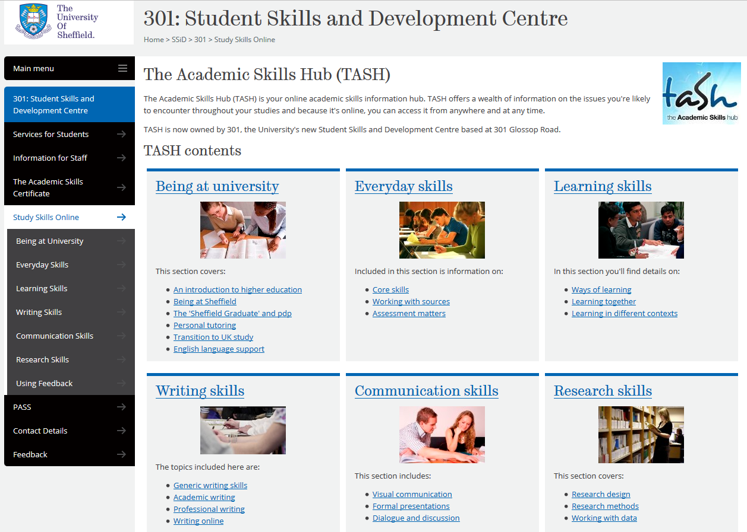
Notes:
Types – TASH, Northants use Wordpress, pros and cons

Slide 5
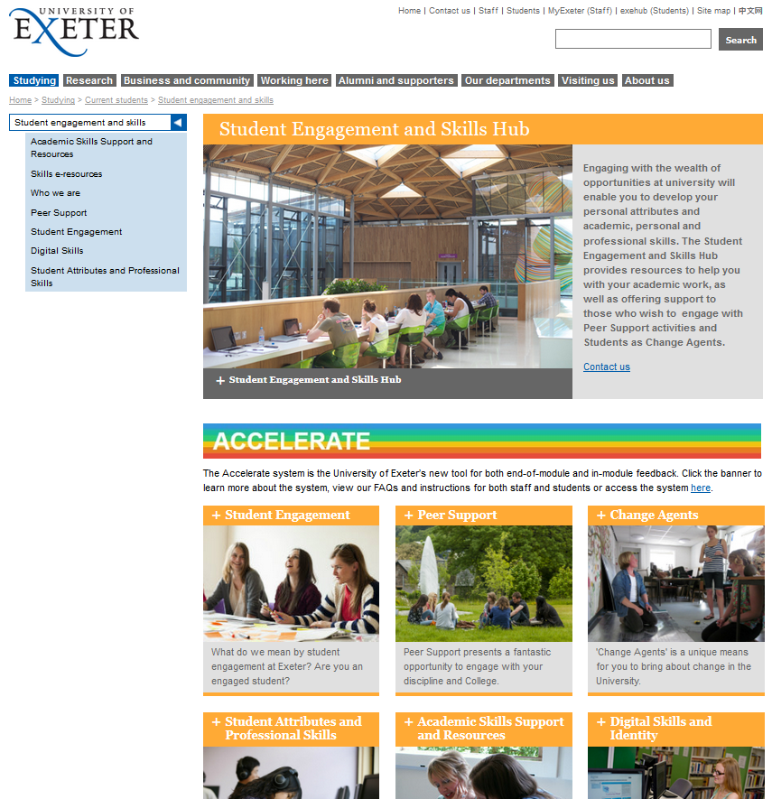
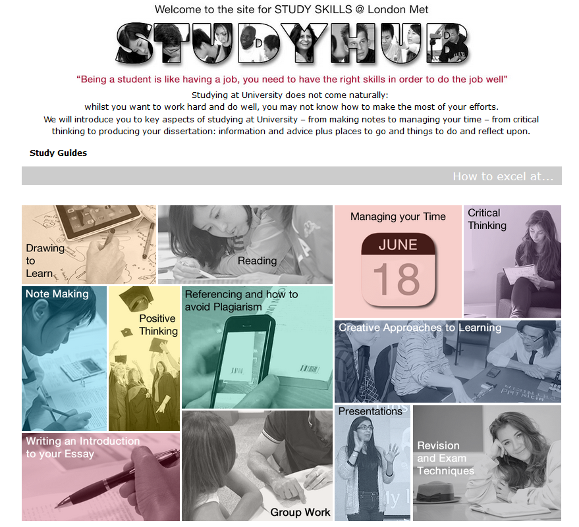

Slide 6
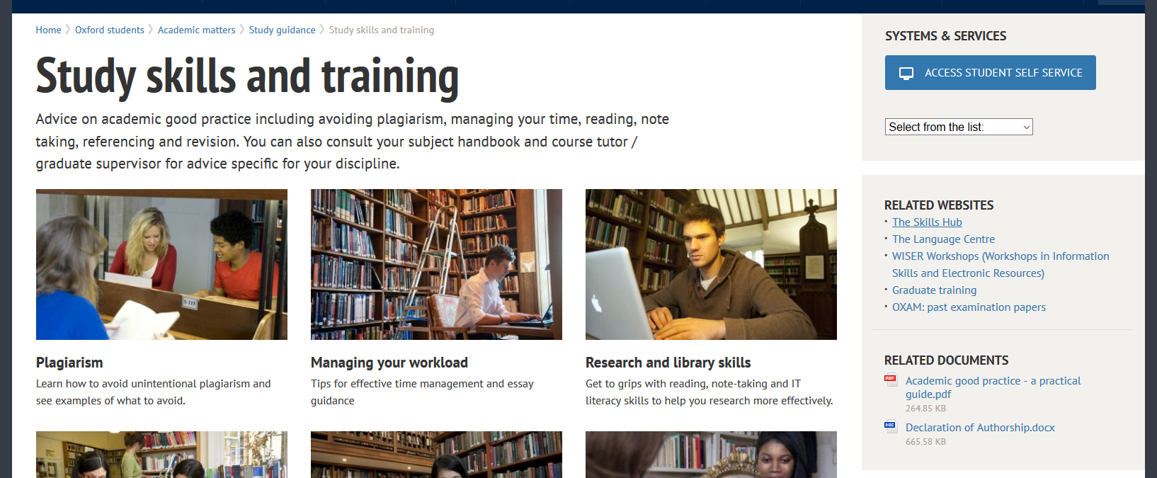
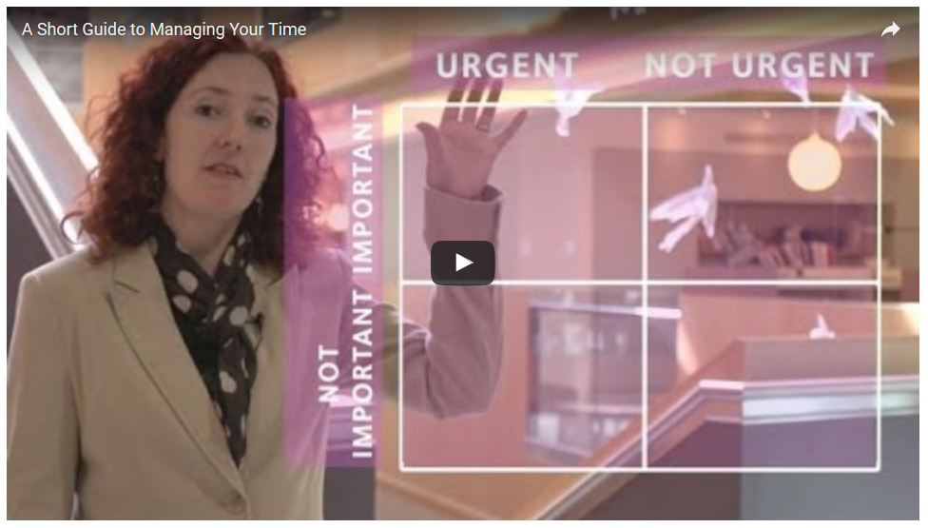
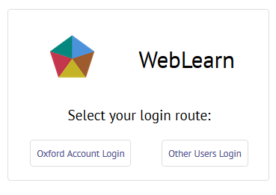
Notes:
Oxford,
Skills Hub, too
Behind log in
But many freely available resources

Slide 7
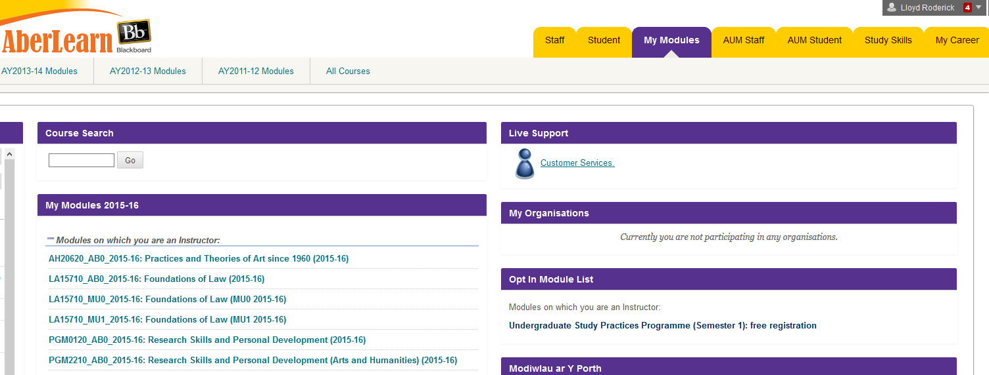
Notes:
Use of blackboard communities. Existed, under used.
No log in, available at source of a lot of work, VLE.
Alternative would have been to build as web page, but acts as link out to CMS pags
Administrative – Bb been customised in house so some tasks easier, such as editing bilingually,etc.
Inspiration; Sussex, etc.
Including support services and topic blocks.

Slide 8
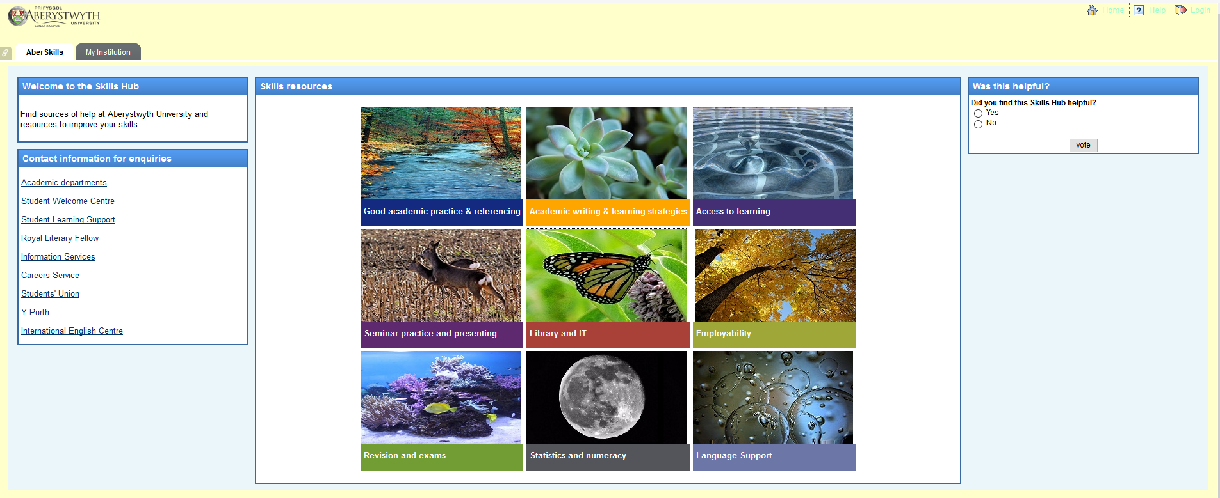
Notes:
Test server!
What to include
Student led – focus groups, AF trainees and current students
Top row (productive skills for main assignments)
Good Academic Practice and Referencing – Arfer academaidd da a chyfeirnodi [I’d be inclined here to see what is used in other departments to be consistent].
Academic Writing (as a separate category) – Ysgrifennu academaidd
Presentations (other oral skills will be covered under this) – Cyflwyniadau
Middle row (strategic planning and organisation)
Exams (drops the revision) - Arholiadau
Learning Strategies (separated from Academic Writing) – Strategaethau Dysgu
Reading and Research (change from Library and IT) – Darllen ac ymchwilio (Reading and researching) OR Darllen ac ymchwil (reading and research)
Bottom row (underlying skills and further development)
Statistics and Numeracy (stays as it is) – Ystadegau a rhifedd
Language Support (stays as it is) - [I’d be inclined here to see what is used in other departments to be consistent].
Employability (stays as it is) – Cyflogadwyedd

Slide 9
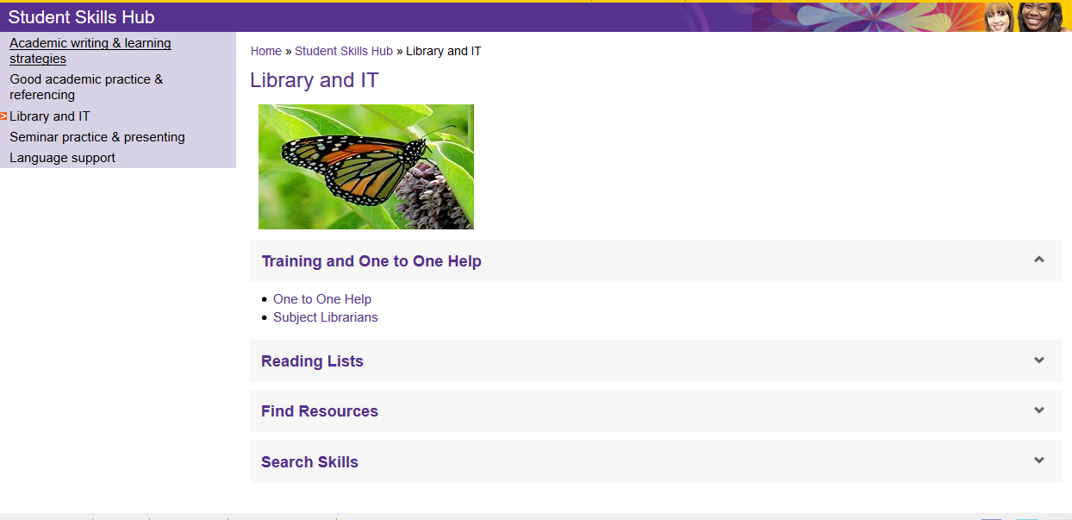
Notes:
Example click through

