Slide 2
Appreciating Excellence: What are students telling us?
8 July 2016
Professor Stephanie Marshall
Chief Executive

Slide 3
Overview:
        What is excellence?
        What are students telling us?
        Where does that leave us?

Slide 4


1. What is excellence?

Slide 5

“ Distinctive”, “quality”, “brilliance”, “expertness”, “greatness”
(OECD synonyms)

Slide 6

(Jim Collins, Good to Great 2001)

Slide 7

“ Fit for purpose”

Slide 8

2. What are students telling us?

Slide 9

Perceptions of value for money are falling across the board but are lowest among students from England
Base: all respondents in each nation – 2016 England (11,597), 2016 Scotland (945), 2016 Wales (520),
2016 Northern Ireland (312), 2016 EU (1,051), 2016 Non-EU (796).

Slide 10
Many subjects with high workload also have high value for money perceptions
Base: all respondents (15,221), by JACS 3.0 subject areas.

Slide 11
Teaching staff rated highest by students at Specialist institutions
Base: all institutions (15,221), Specialist (581), Post-92 (7,094), Pre–92 (3,327), Russell Group (4,219).

Slide 12
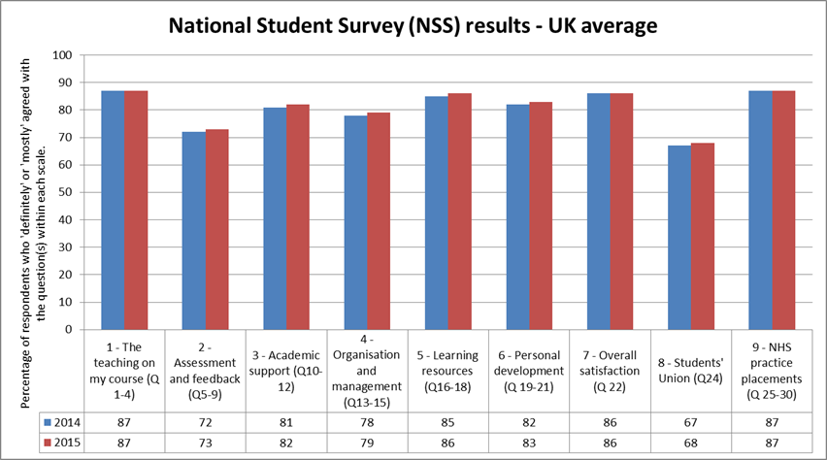
National Student Survey (NSS)

Slide 13
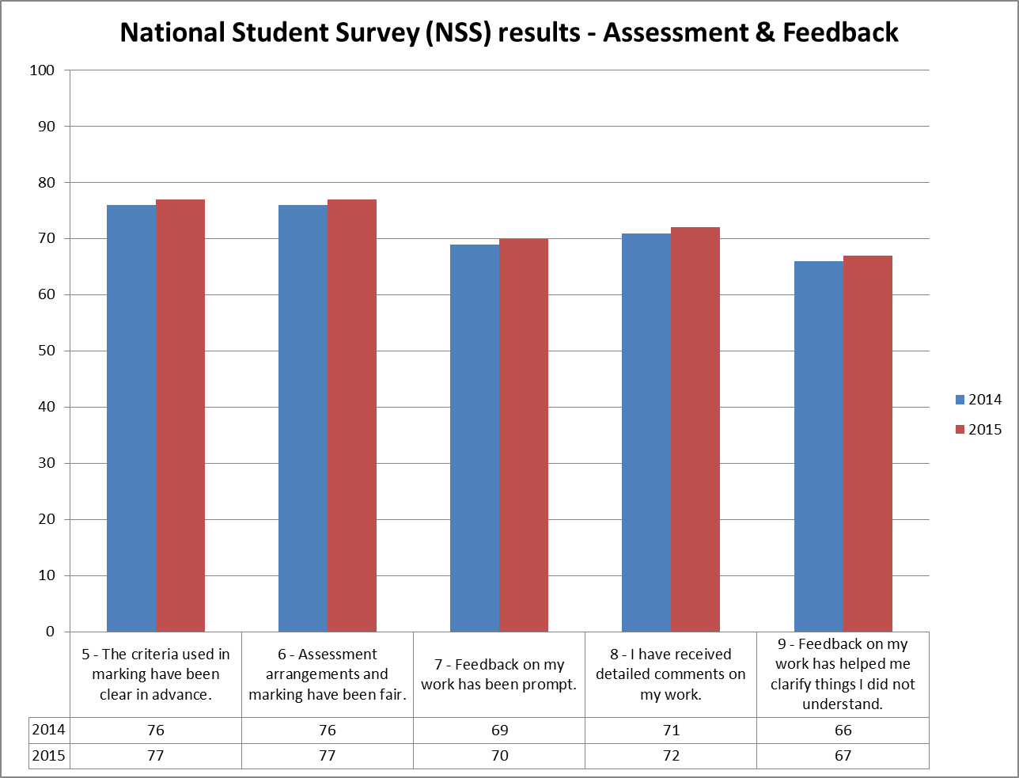
National Student Survey (NSS)

Slide 14
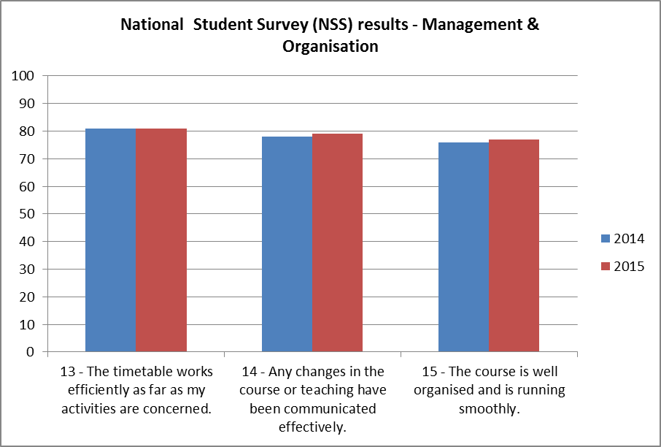
National Student Survey (NSS)

Slide 15
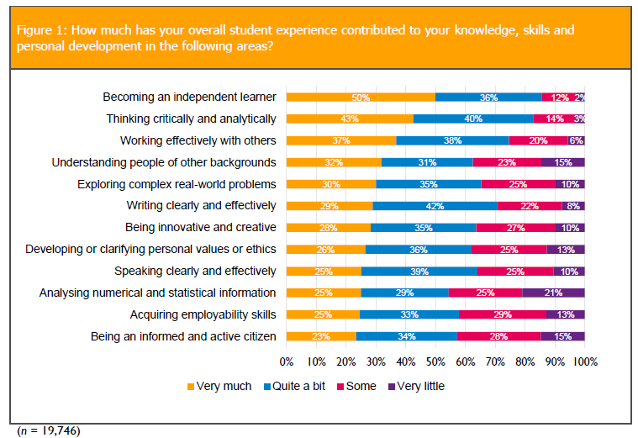
UK Engagement Survey

Slide 16
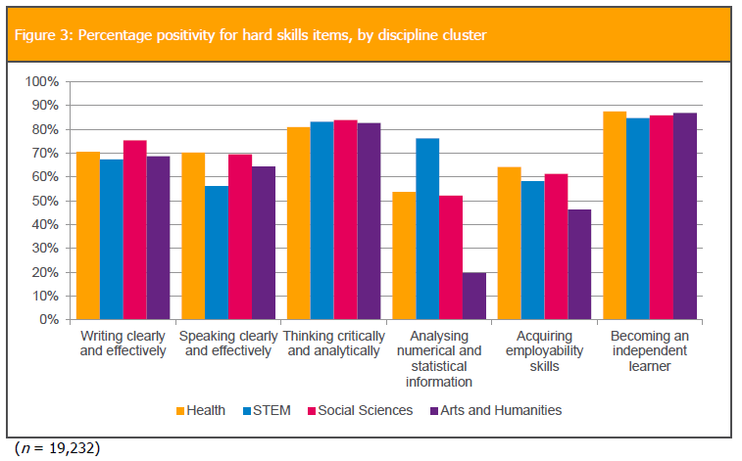
UK Engagement Survey

Slide 17
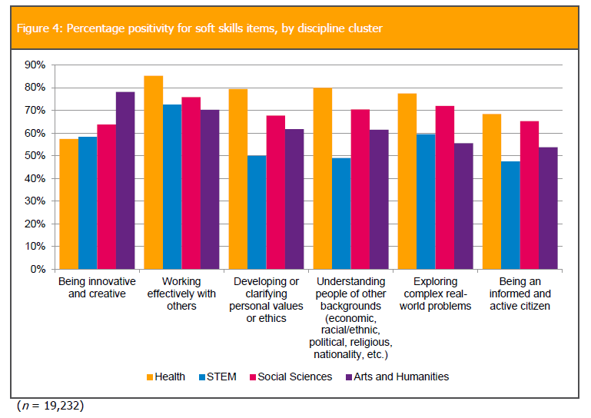
UK Engagement Survey

Slide 18

The Student Room survey
“ Proven depth of subject knowledge and passion are rated… highly by students”
The survey polled 500 UK students between 11 September and 26 September 2015

Slide 19
The Student Room survey
“ 57% of students are surprised that lecturers don’t always have some form of teaching qualification”
The survey polled 500 UK students between 11 September and 26 September 2015

Slide 20
The Student Room survey
“ 77% of the students surveyed believe university lecturers’ qualifications should be made publicly available”
The survey polled 500 UK students between 11 September and 26 September 2015

Slide 21

3. Where does this leave us?

Slide 22
Thank you for listening, any questions?

