Slide 1
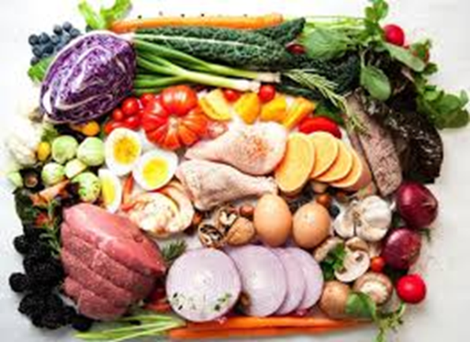
‘Teaching through teamwork and the challenges of assessment’
Dr Kamila Stullerova (kas@aber.ac.uk)
Department of International Politics
Module: IP37620 People, progress, environment: environmental ethics and politics
AUTEL 2016

Slide 2
Diagnosis of needs
Benefits of teamwork for employability
Signs of ‘unhealthy’ teacher-student relationship (one-way dependence)
Teamwork missing from departmental curriculum
Hypothesis: Students reluctant to engage in teamwork but once they overcome this they thrive (experience of co-ordinating student conference)
Need to find a good module that would be suitable for teamwork (project based work/assessment)

Slide 3
Challenges → Responses
IP37620 People Progress Environment (Part 2 option)
Restructuring the module to create space for teamwork (beyond seminar activities) → Part 1, Part 2
Restructuring assessment to incorporate team-produced assignments
Calibrating assessment so that individual work gets more weight than team-produced
Excellent organisation of the module – clarity in all aspects

Slide 4
Module structure
IP37620 People Progress Environment (Part 2 option)
Restructuring the module to create space for teamwork (beyond seminar activities) → Part 1, Part 2
Restructuring assessment to incorporate team-produced assignments
Calibrating assessment so that individual work gets more weight than team-produced
Excellent organisation of the module – clarity in all aspects

Slide 5
Assessment
Essay of 2,750 words; produced individually (45% of final mark).
This assignment traditional in its format but innovative in the sense that students were choosing their own essay questions – and had to discuss their choice with me, so that the question design allowed them to achieve highest marks.
Project Report of 7,000 words (for a team of four students – teams of other size, prorated word count); produced collectively (45% of final mark).
This assignment is innovative as it involves teamwork in both the researching and writing stages of the assignment.
Reflective Report of 1,000 words; produced individually (10% of final mark).
This assignment is innovative in the sense that instead of additional research it asked students to reflect on their learning process in their team & examine and assess their own role in it.

Slide 6
Priorities
Create excellent student – teacher rapport (attitude, quality, access, formal requirements)
Nurture good relationships among students during the first half of the module (teamwork activities in seminars; film session; campus garden walk; blog; extracurricular activities)
Make the module easy to access on Blackboard (use AU ECA rubric)
Include ongoing feedback; get students involved

Slide 7
Lessons learned
Students do not like teamwork and dread being assessed on team-produced work
Once they have the experience – they cherish it and view it very positively (excellent feedback)
Teamwork improves students’ academic performance and excellent outputs (average mark: 64)
Teamwork experience can be life-transforming (leadership qualities; self-esteem; access)

Slide 8
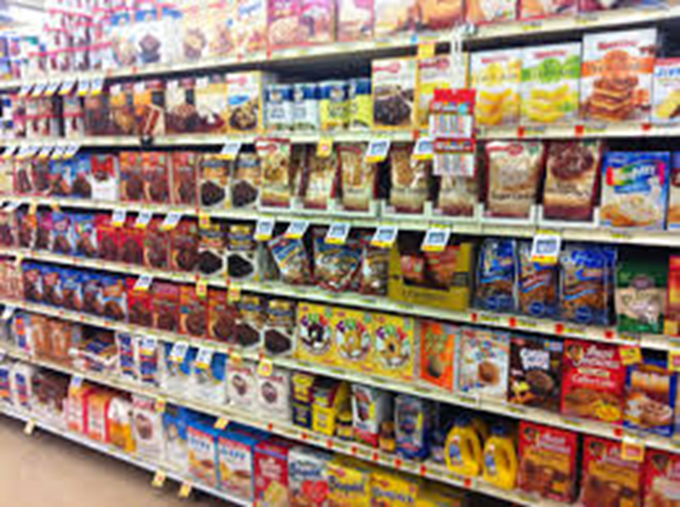
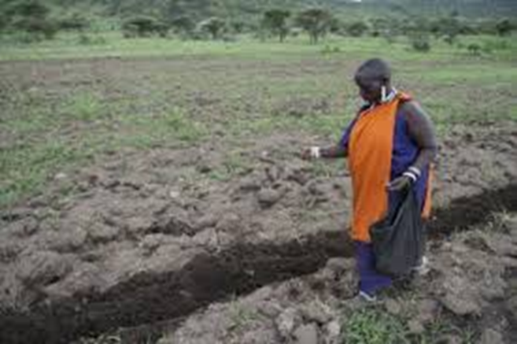
Thank you
… and looking forward to your questions and comments

