Slide 1
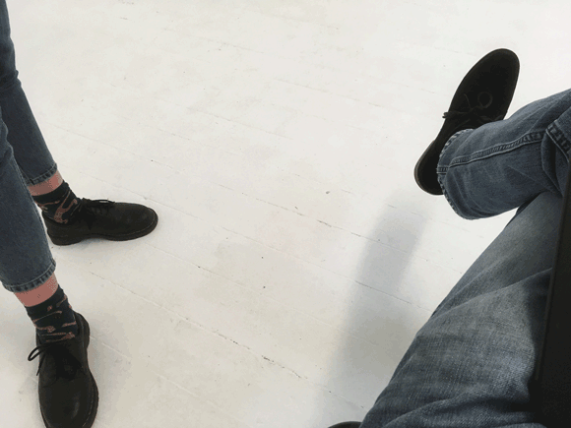
One-to-One-to-Many
sharing the fruit of individual instruction with the learning community, using social media

Slide 2
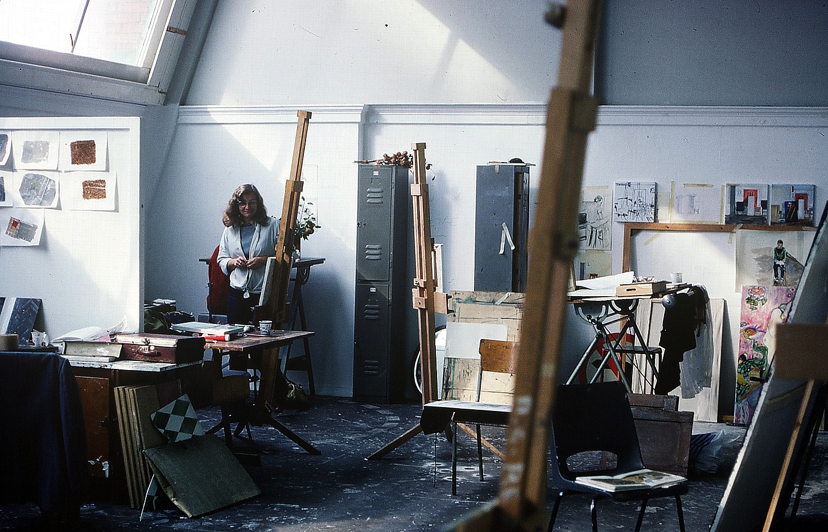
Fine art studio
Gwent College of Higher Education, Newport
June 1980

Slide 3
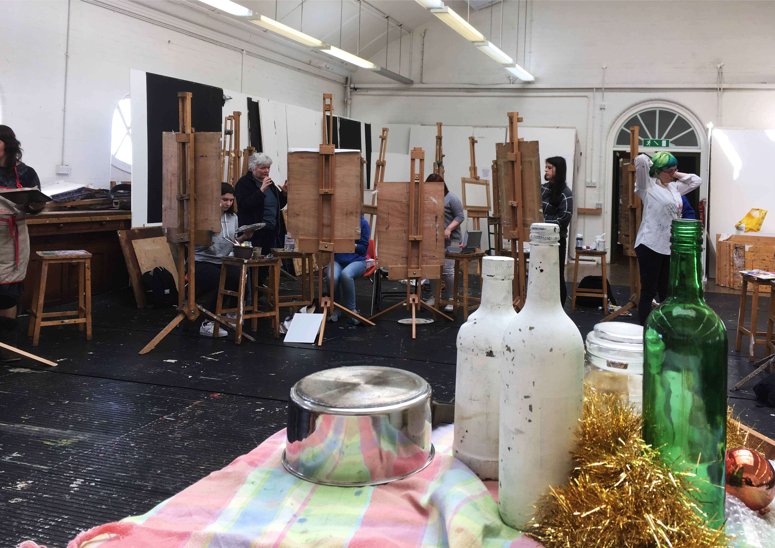
Fine art studio
School of Art, Aberystwyth University
May 2017

Slide 4
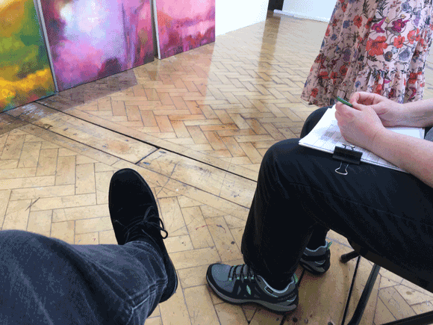
One-to-one tutorial
School of Art, Aberystwyth
University
May 2017

Slide 5
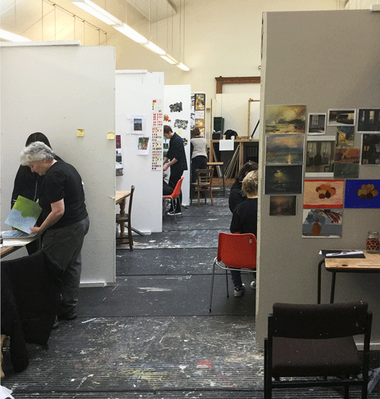
Fine art studio
School of Art, Aberystwyth University
February 2017

Slide 6
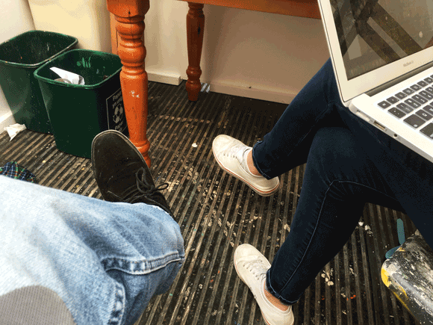
One-to-one tutorial
School of Art, Aberystwyth
University
May 2017

Slide 7
time and labour intensive
focussed on the individual rather than the collective
without residue (other than in the learning experience of the student)
difficult to capture either in its essence or particulars
yet, having content and significance that are relevant to others in the cohort, and, in some cases, worthy of repetition.
Problems with one-to-one
tutorials

Slide 8
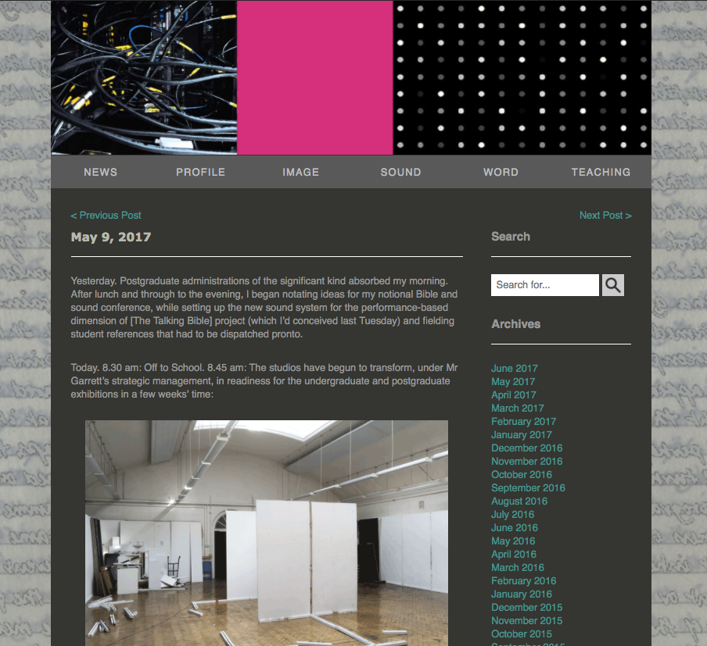
John Harvey
Diary
May 9, 2017

Slide 9

Postgraduate reminder to self
West Classroom, Old College
November 2016

Slide 10
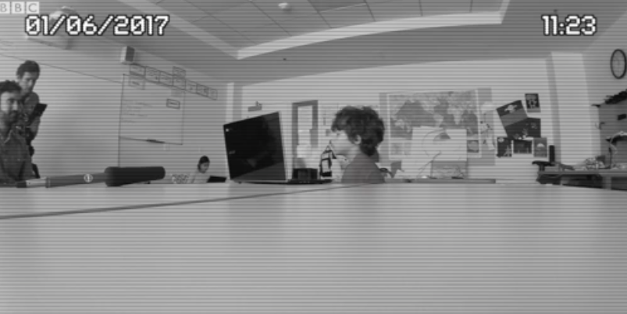
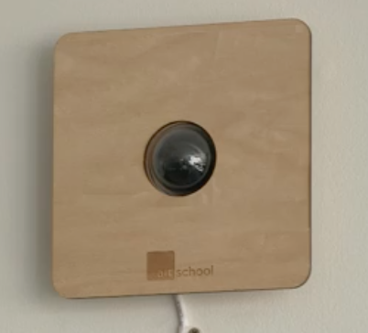
The Futuristic School Where you are Always in Camera
BBC News website
4 July 2017

Slide 11
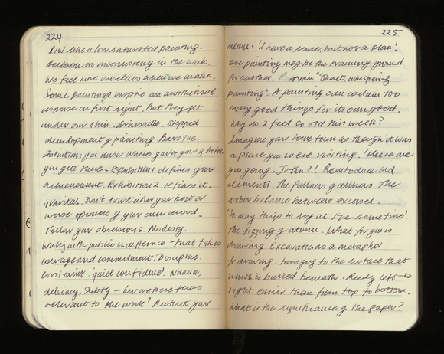
John Harvey
‘The Black Notebook’
February 6, 2017

Slide 12
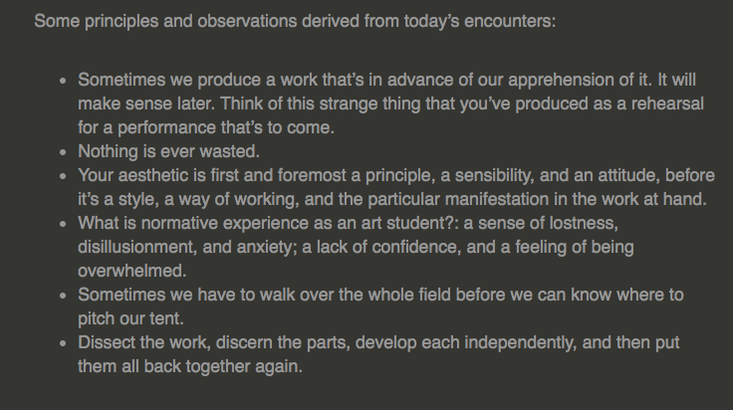
John Harvey
‘Principles and bservations’,
Diary
May 9, 2017

Slide 13

Concentric fields
Inner: Art and Professionalism
Structure
Composition
Style
Process
Materials and methods
Theory and practice
Subject matter
Project brief
Assessment

Slide 14
Concentric fields
Outer: Learning and Life
Psychology of learning
Encouragements
Dealing with discouragements and frustrations
Good and bad attitudes
Approaches to study
The fruit of experience
Value judgements
Wisdoms and sage sayings
Art/life dynamics
Values
Chastisements
Identifying weaknesses and pitfalls
Talent and hard work
Nature of teaching
Nature of art
Philosophy of art
Quotes from past students

Slide 15
Any mode of
Any mode of creative practice – however quirky, spontaneous, and instinctual – must submit to a discipline in order to have integrity.
Any mode of creative practice is undisciplined when the artist doesn’t know what they’re doing.
Any attempt to return to past ways of working, thinking, and being; relationships; and ambitions is unwise. Those things were not how you remember them, in any case. Nor would they be, now, how and what they were then. One cannot rewrite the past by trying to relive it.
Nevertheless, there are times when the past comes towards us (of its own volition) from the future. On these occasions, we should run to meet it.
Like many visual art forms, the splendour of the stained-glass window is appreciable only from the inside, looking out. (Make of that metaphor what you will.)
It won’t always be like this.
I’m content with who I am, but not with what I am.
‘Principles and observations’
Diary
May 5, 2017

Slide 16
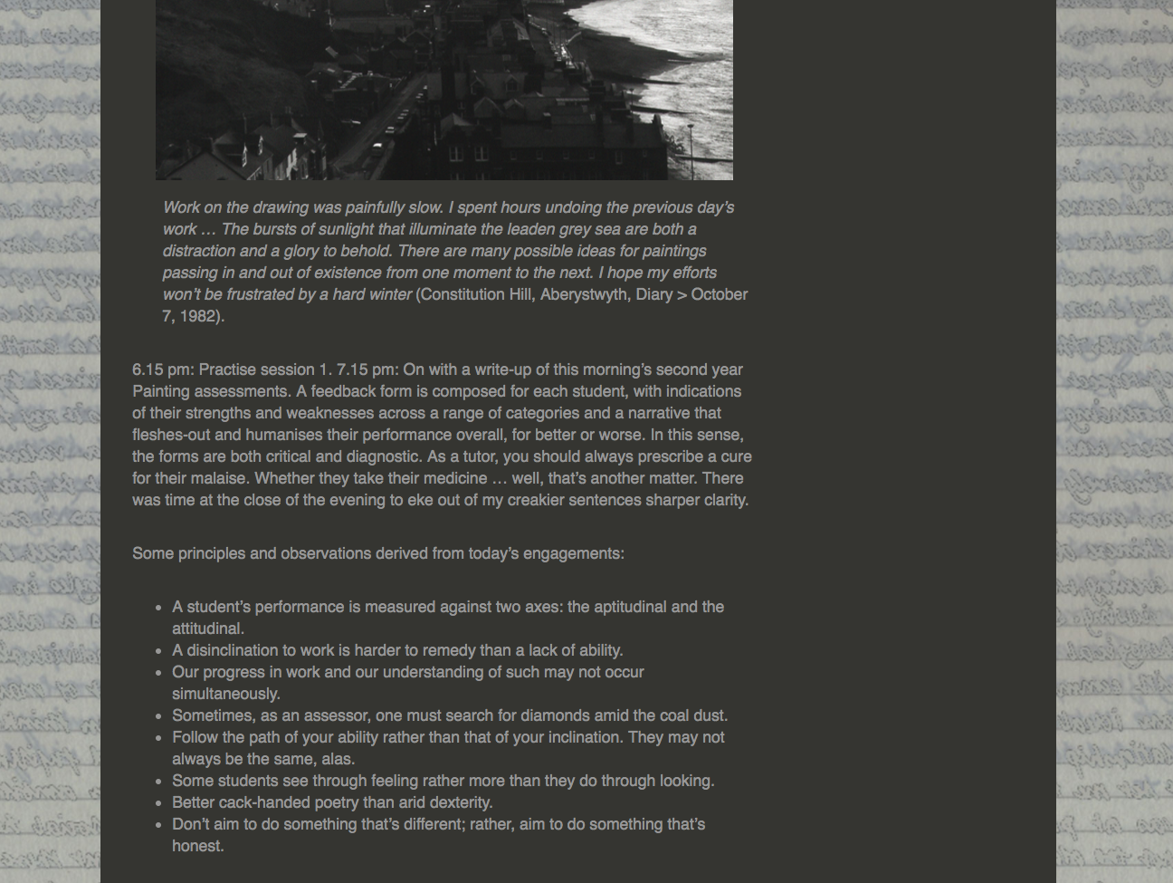
‘Principles and observations’
Diary
January 17, 2017

Slide 17
‘it helped me remember the important points we discussed at my tutorial’
‘drove home what you were encouraging me to do’
‘made me aware that other students had problems to’
‘it showed me the bigger issues surrounding my work’
‘helped me to distil principles from my practice’
‘I gained a sense of imperative’
‘It’s like we all have the same issues really’
‘Clearly my problems aren’t big in comparison to other student’s’
‘I think now that I understand how I can be better prepared for tutorials’
‘Made me think that it would be good idea if I made notes after my tutorials to’
‘Art is a way of life isn’t it?’
‘I keep coming back to the observations and principles weeks after the tutorial. They really helped me to think through my practice more deeply’
‘It’s like having an extra, on-line tutorial. Brill!’
Student reposonses
‘Principles and Observations’
November 2016 – April 2017

Slide 18
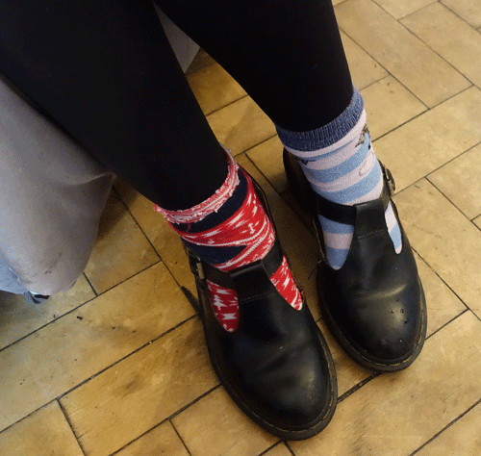
It enabled students to:
to realise that they weren’t alone in their struggles
learn from the experiences others
to absorb more from, and better reflect on, their tutorials
comprehend how – in the small as well as the big things – their metal was being tested.
Learner outcomes

Slide 19
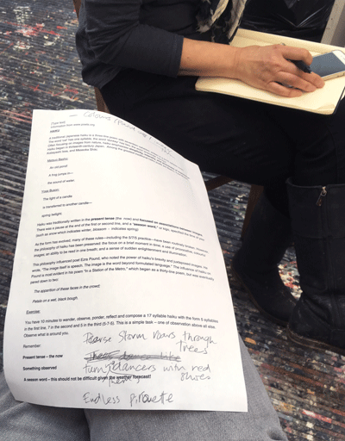
It enabled me to:
think much more essentially or summatively and philosophically when conducting one-to-one tutorials
view of the tutorial, at the point of delivery, as but one part of a continuity of discussion that extends beyond the bounds of the engagement
conceive of the individual tutorial as part of a communal experience
Teacher outcomes

Slide 20
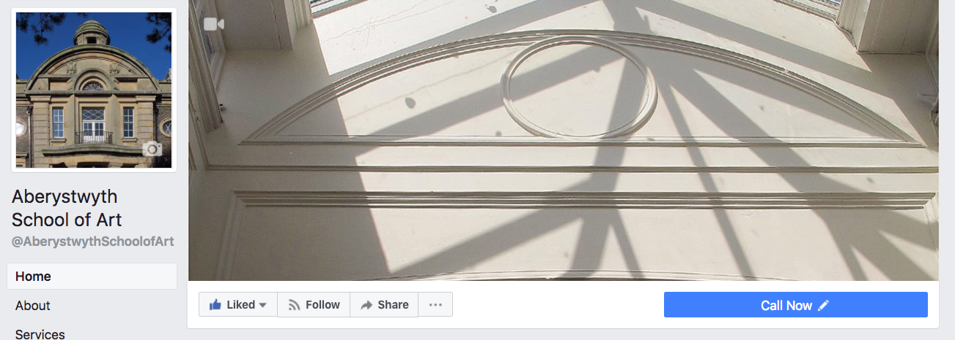
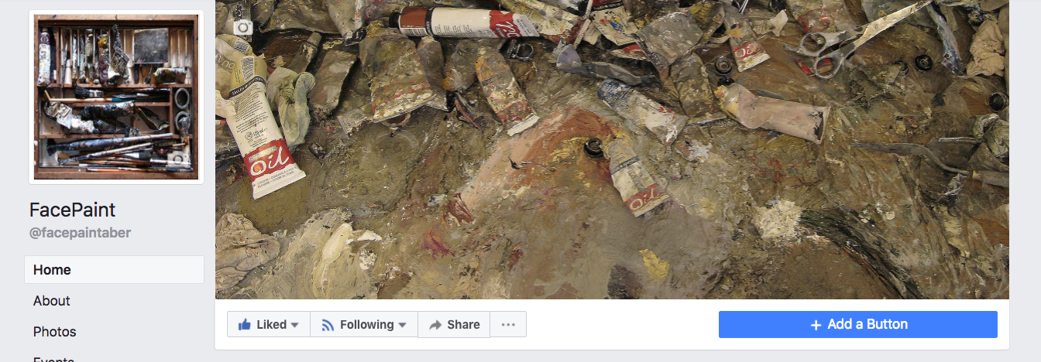

Slide 21
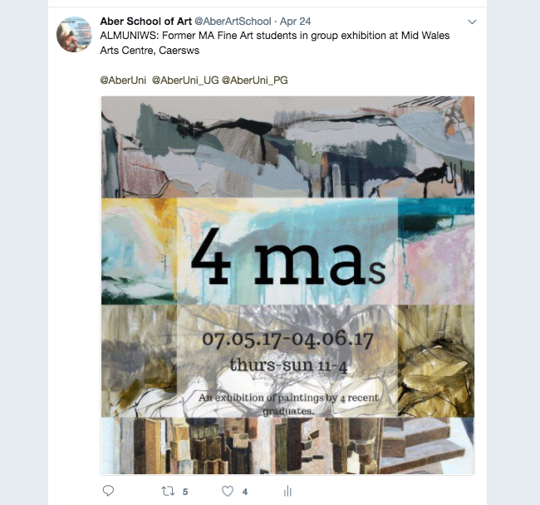

Slide 22
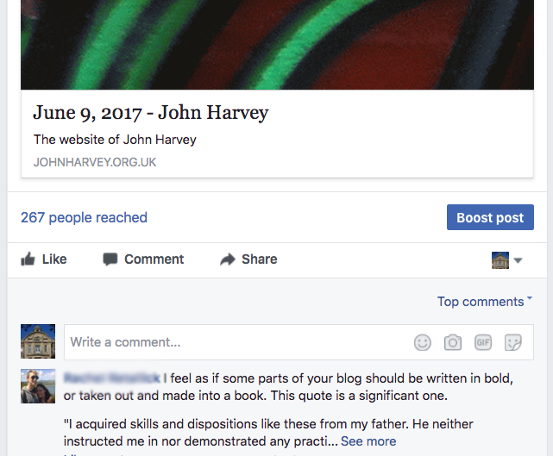

Slide 23
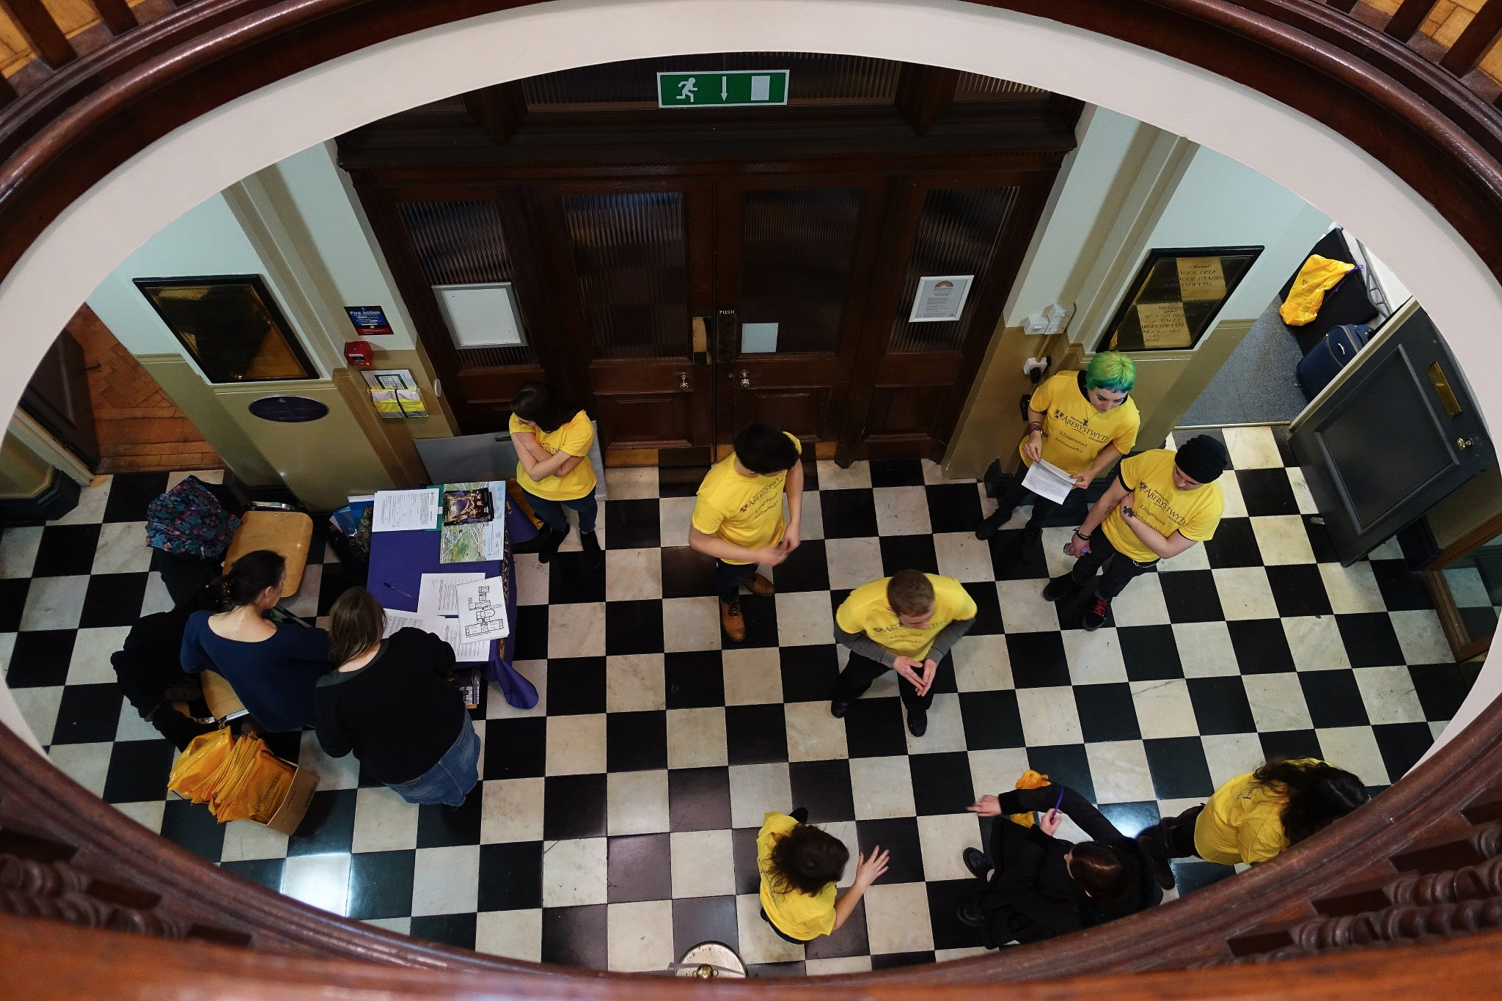

Slide 24
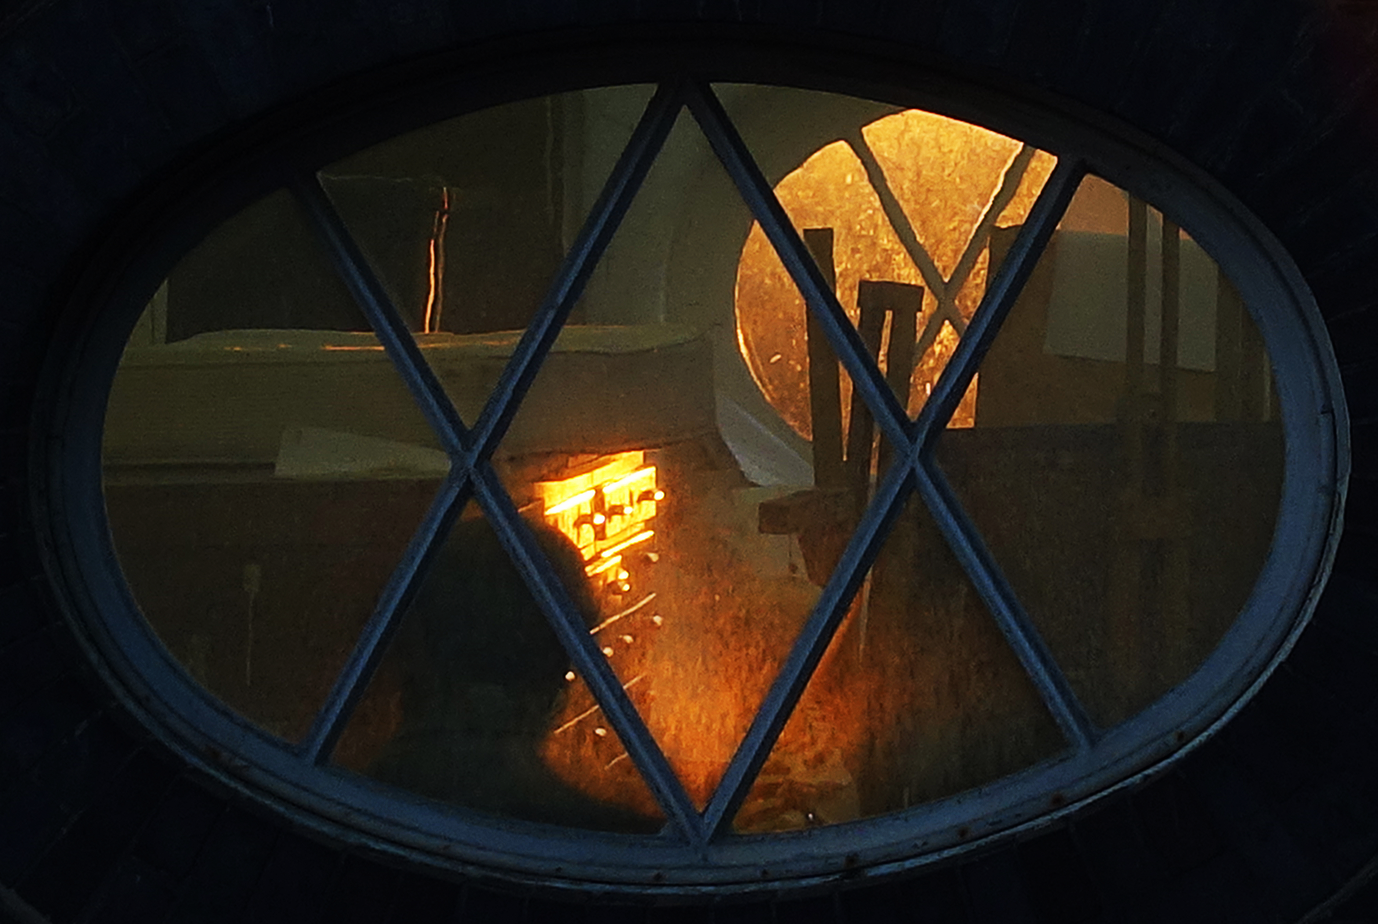
Professor John Harvey (jhh)
School of Art

