Slide 1

How successful is within-lecture
(self-)assessment of student engagement, knowledge & learning?: experiences from some
Part 2 Geography modules
Aberystwyth University
Learning & Teaching Conference
July 10-12th 2017
Stephen Tooth
Geography & Earth Sciences
set@aber.ac.uk

Slide 2
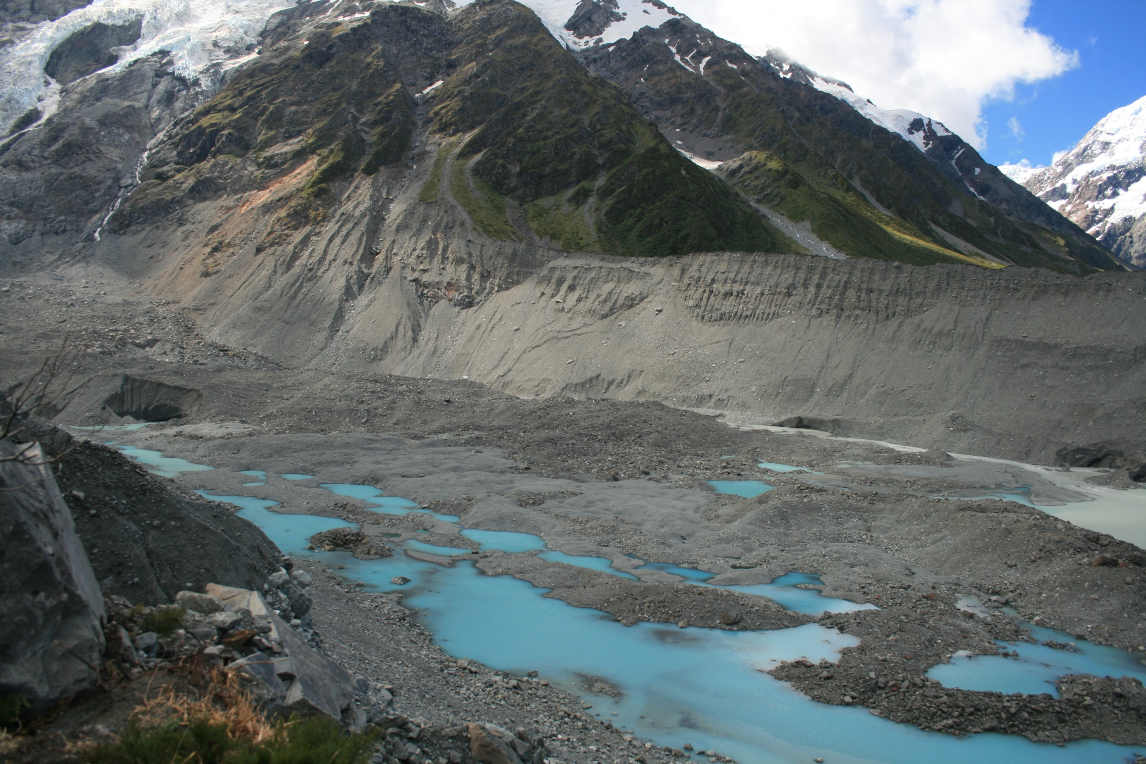
Please write down the first 5 words or phrases that you associate with this image

Slide 3
Structure of the talk
Background & context
- my research, teaching & outreach interests
- the key challenge for teaching physical geography (geomorphology)
- BSG Communicating Geomorphology Workshop & an epiphany
- design of the exercises
2) The exercises & the results
- GG23410 Sedimentary Environments
- GG30420 River Systems & Global Environmental Change
3) Evaluation
- successes
- partial successes
- failures
4) Where to next?
- possible developments to the exercises

Slide 4
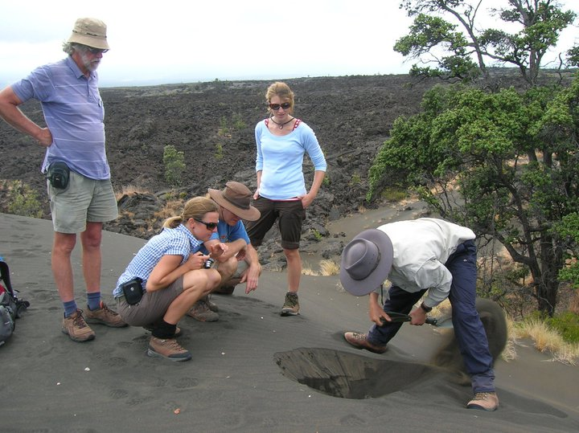
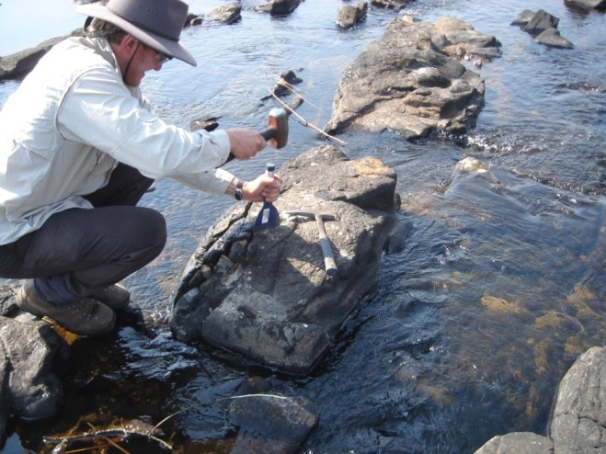
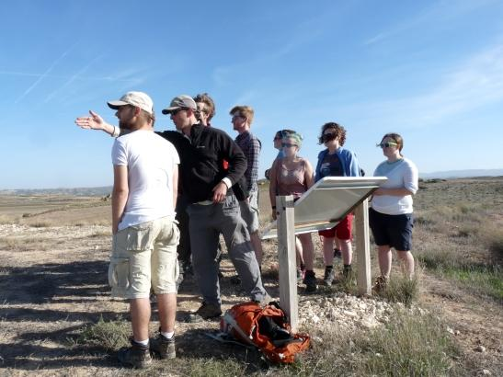

Geography BSc – University of Southampton
PhD in Physical Geography – University of Wollongong
Temporary Lecturer – University of Nottingham
Postdoctoral Fellowship – University of the Witwatersrand
Lecture/Senior Lecturer/Reader/Professor – Aberystwyth University
geomorphology (earth surface processes & landforms)
& sedimentology
past, present & future environmental change
human impacts on the environment
research, teaching, administration
outreach activities (e.g. interactive displays, public talks & brochures to promote geomorphology & science education …)

Slide 5
New Zealand Alps
how can we develop students’ (or the public’s) abilities to ‘read’ the landscape?
i.e. identify landforms, infer processes that link those landforms, & reconstruct landscape histories

Slide 6

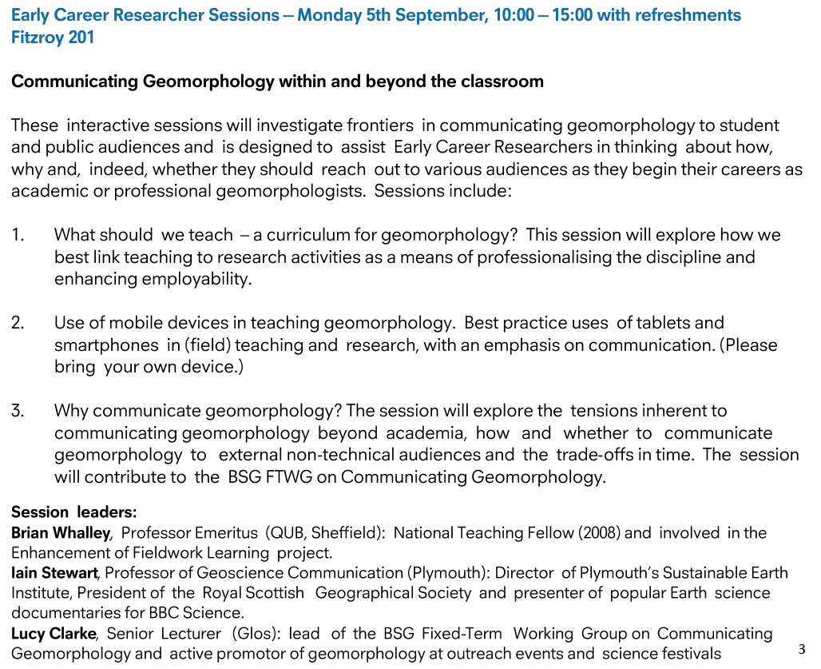
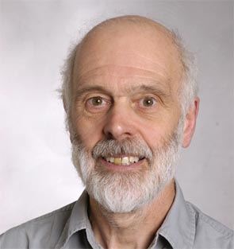

Slide 7
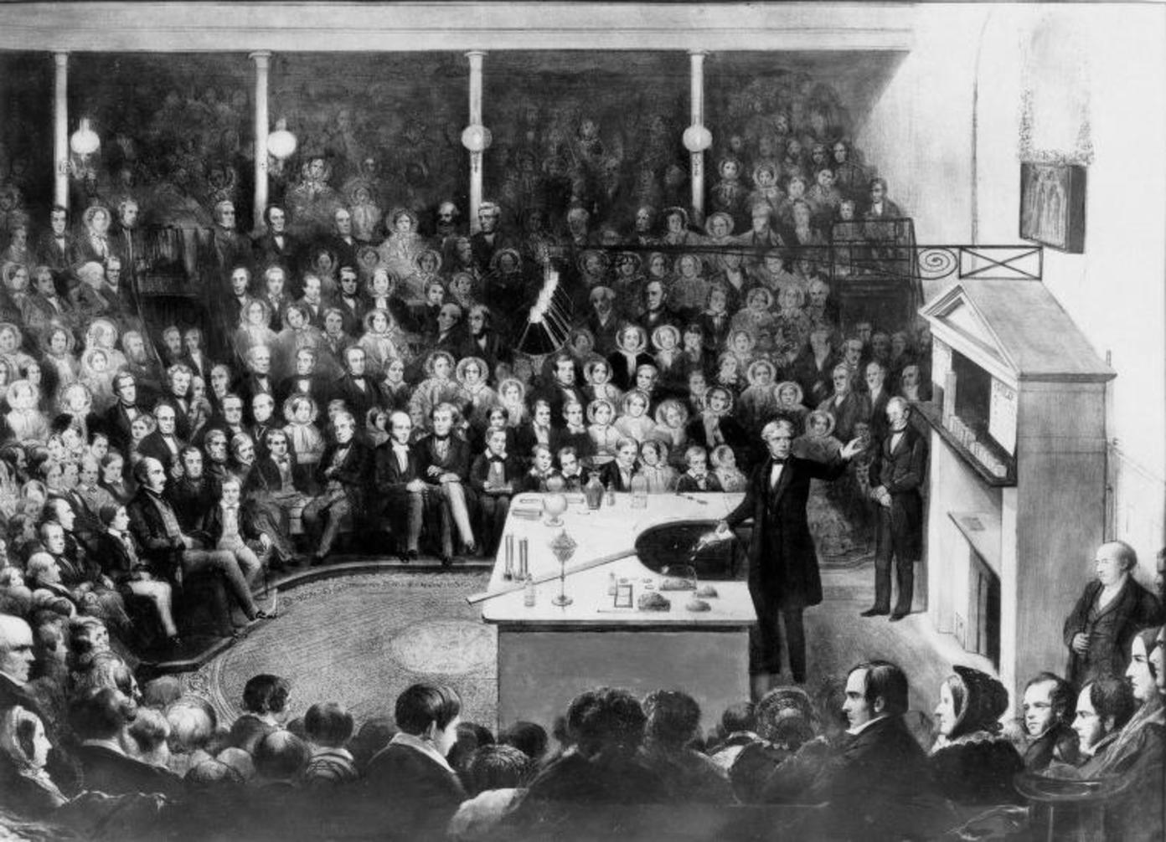
https://commons.wikimedia.org/wiki/File:Faraday_Michael_Christmas_lecture.jpg

Slide 8

a nice idea ….
https://www.steelcase.com/eu-en/research/articles/topics/active-learning/cats-college-cambridge/
“The big shift has been to move from teacher-led learning
— the sage on the stage —
to student-centered learning,
where the teacher’s role is to be the guide on the side.”

Slide 9
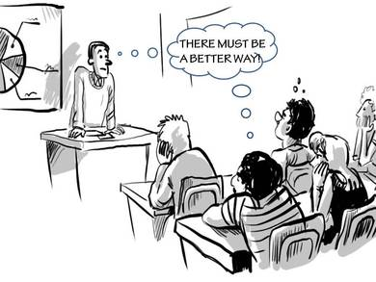
but back to grim reality
(for most of us anyway) …
http://www.creativeacademic.uk/blog/education-10-20-30-can-we-view-creativity-and-learning-ecologies-in-the-same-way

Slide 10
New Zealand Alps
(Mount Cook region … some permanent ice & snow)
Please write down the first 5 words or phrases that you associate with this image

Slide 11
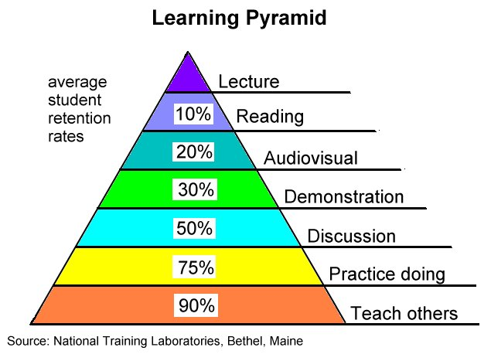
what can we potentially gain from such a simple activity?
create activities for students to undertake to get to know each other & get known by the lecturer (i.e. participatory model with greater personalisation)
improved student engagement by ‘doing something’ (= ‘active learning’?)
improved student note taking
gain a better understanding of what students know & what they don’t know (i.e. construct an idea of their prior knowledge e.g. command of terminology & their abilities to read the landscape … can we adapt lecture content accordingly?)
provide a chance for students to ‘fail’ in private but be gently let down & to have a chance to try again
provide students with a yardstick against which to measure knowledge & learning gains (i.e. self-assessment)
why I hadn’t I
tried this before?

Slide 12
Semester 1 Geography modules 2016/17
GG23410 Sedimentary Environments
(team taught, ~43 students in 2016/17)
harder to incorporate ideas
GG30420 River Systems & Global Environmental Change
(team taught, ~24 students in 2016/17)
easier to incorporate ideas
‘before’ & ‘after’ exercises
not compulsory & could be done anonymously
collect in, copy & return the follow week
other lecturers did similar exercises
success or otherwise assessed through:
observations of student engagement
quality of students’ responses (‘before’ vs ‘after’)
student comments in class or in MEQ process

Slide 13
GG23410
SEDIMENTARY ENVIRONMENTS
Lecture 3
Fluvial sedimentary environments

Slide 14
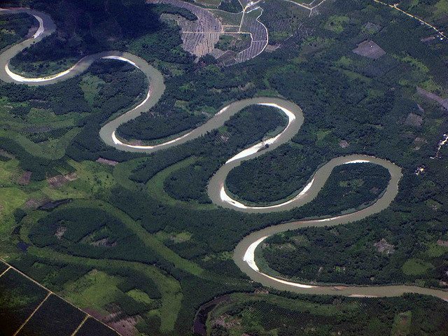
relatively easy example
river channel, meanders, floodplain, vegetation, sandy bars, infilled oxbow (abandoned bend) ...

Slide 15
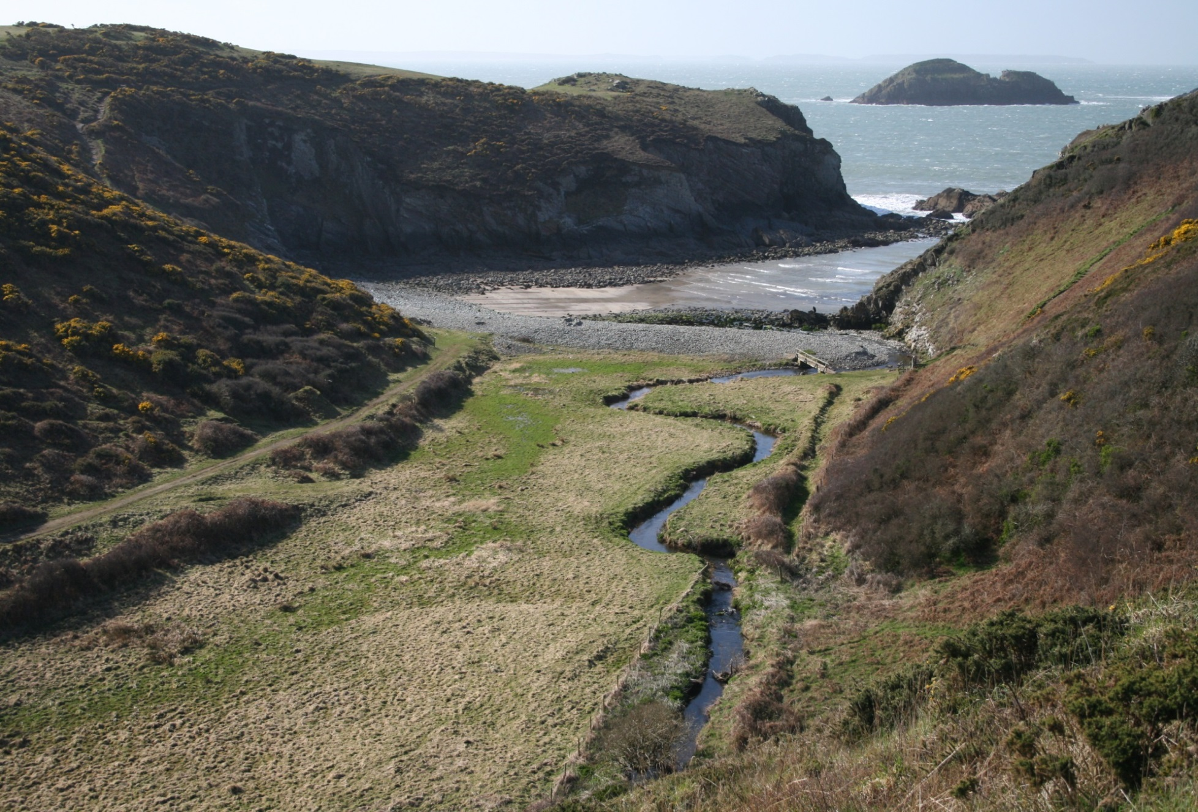
harder example
river channel, meanders, floodplain, bay, cliffs, headland, gravel beach ridge, back barrier marsh …

Slide 16
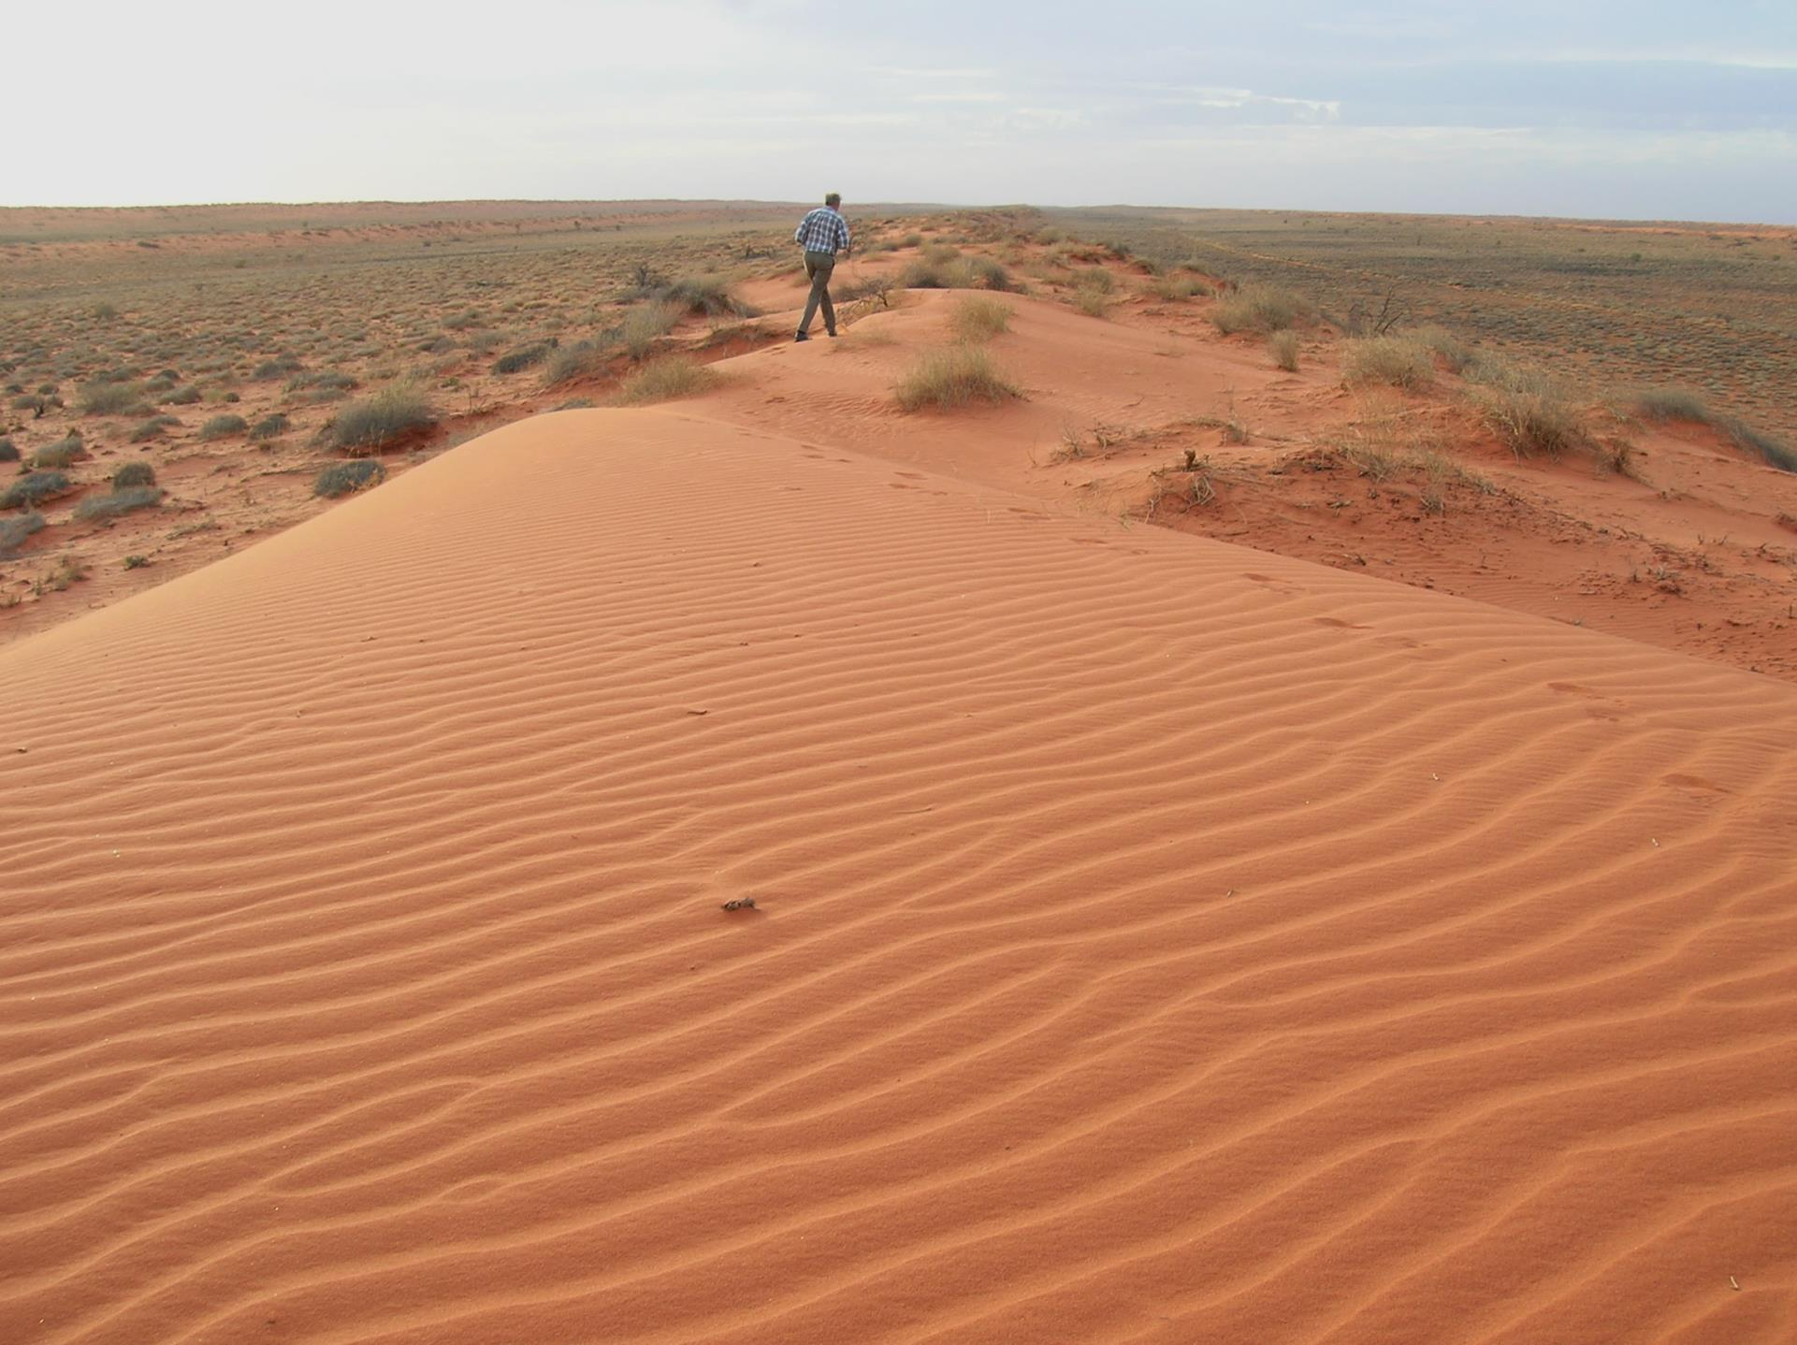
harder example still
desert, arid, sand, sparse/patchy vegetation, wind-blown ripples, linear dune, interdune swales ...

Slide 17
Outline of lecture
1) Coasts in the ‘sediment conveyor’
- link with fluvial & glacial sedimentary environments
- global diversity of coastal environments (deltaic vs. non-deltaic)
- main processes & controls in coastal sedimentary environments
2) Examples of coastal sedimentary environments
deltas, gravel ridges, hurricanes, tsunamis
3) Aeolian landscapes in the ‘sediment conveyor’
- link with fluvial, glacial & coastal sedimentary environments
- global diversity of aeolian environments (coastal vs. inland)
- main processes & controls in aeolian sedimentary environments
4) Examples of desert aeolian sedimentary environments
barchan dunes, transverse dunes, linear dunes
5) Fieldwork assessment

Slide 18
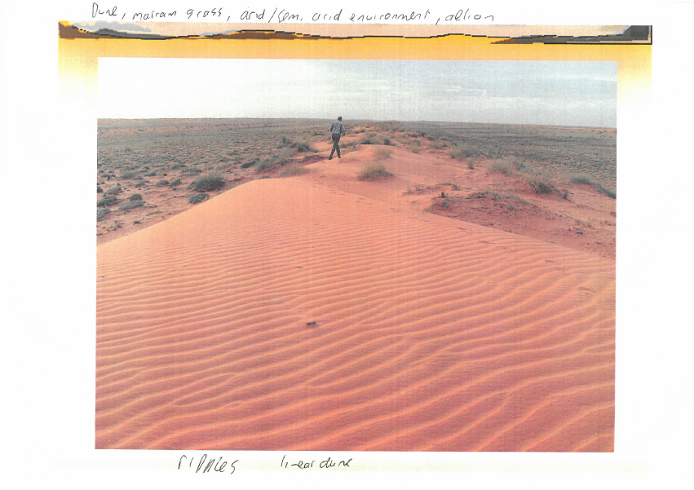
very good/excellent example

Slide 19
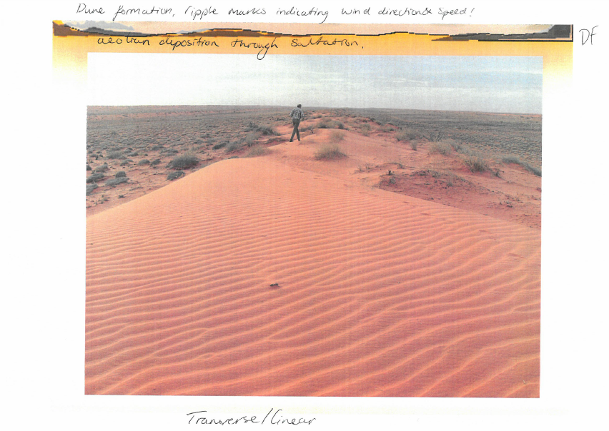
average example

Slide 20
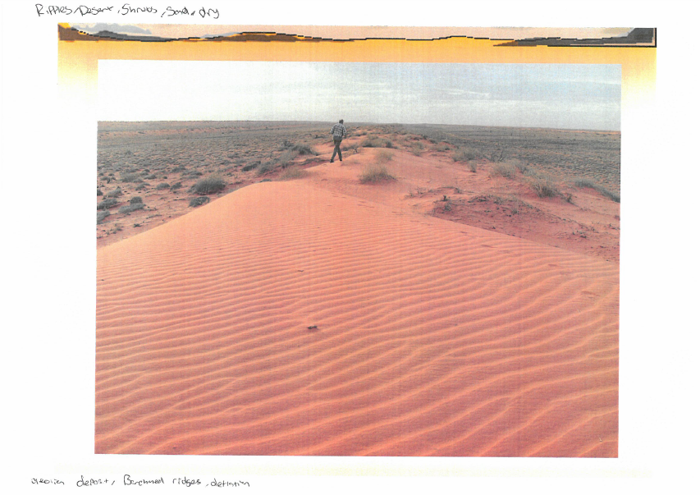
poor example

Slide 21
GG30420
River Systems &
Global Environmental Change
Lecture 1
Introduction

Slide 22
What is a river system?
Working in groups, provide a concise definition
(50 words maximum)

Slide 23
What is environmental change?
What is (global) environmental change?
Working in groups, provide concise definitions
(50 words maximum)

Slide 24
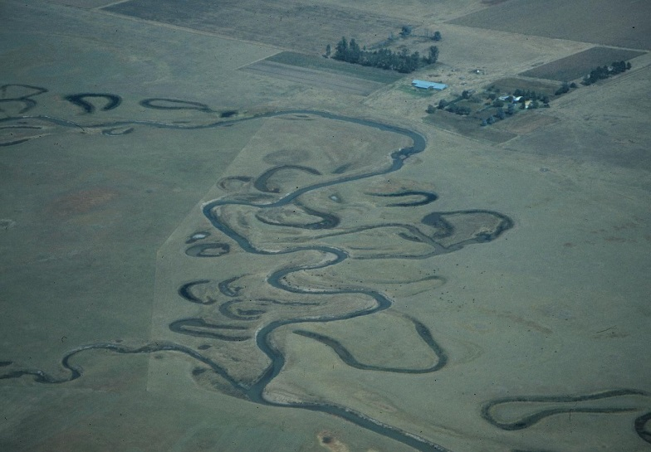
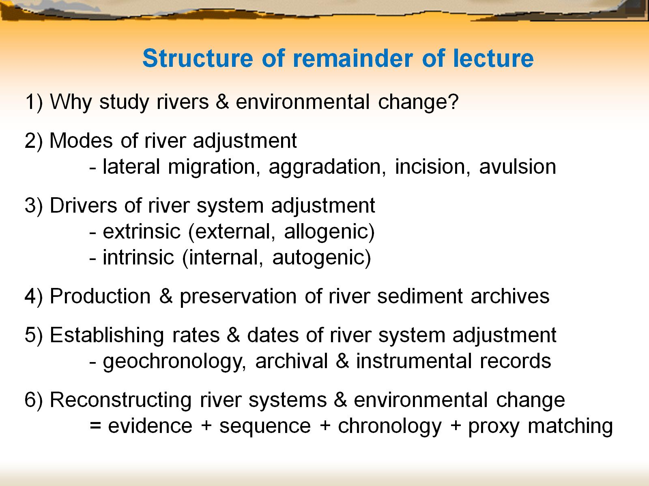
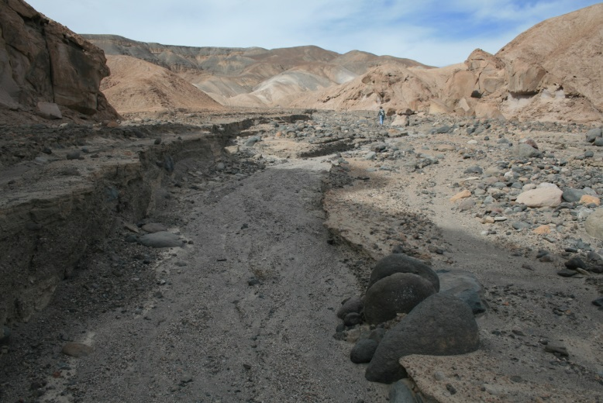
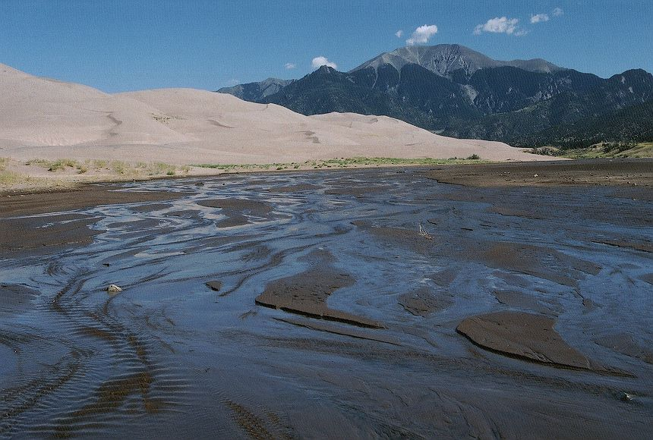

Slide 25
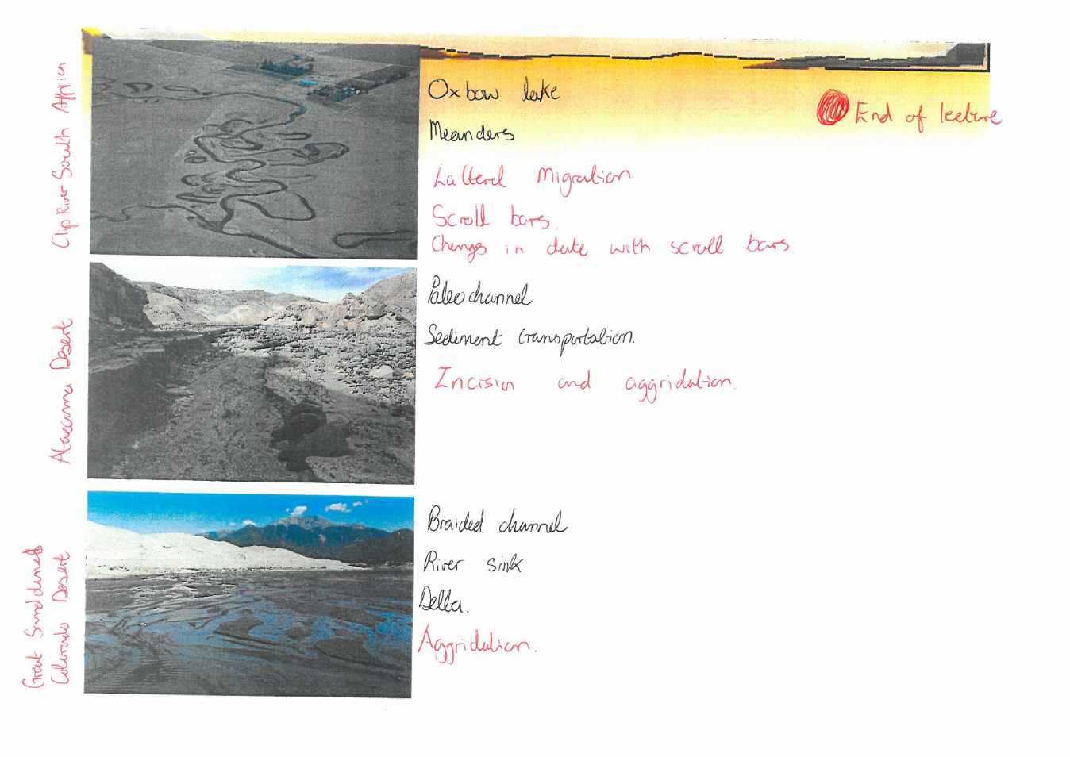
very good/excellent example

Slide 26
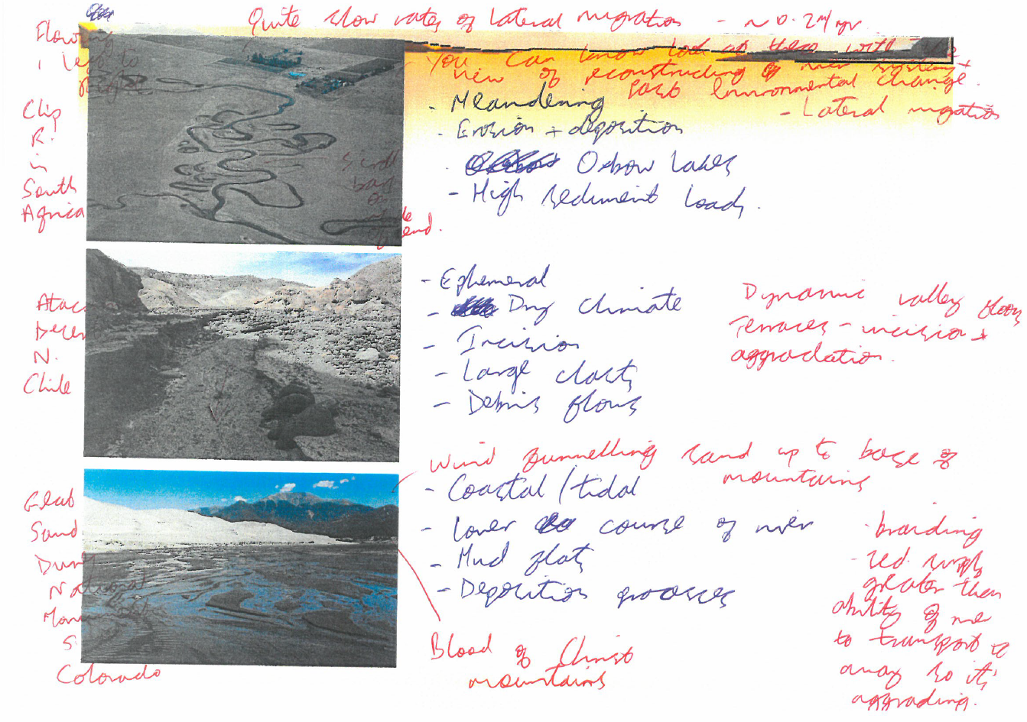
very good/excellent example

Slide 27
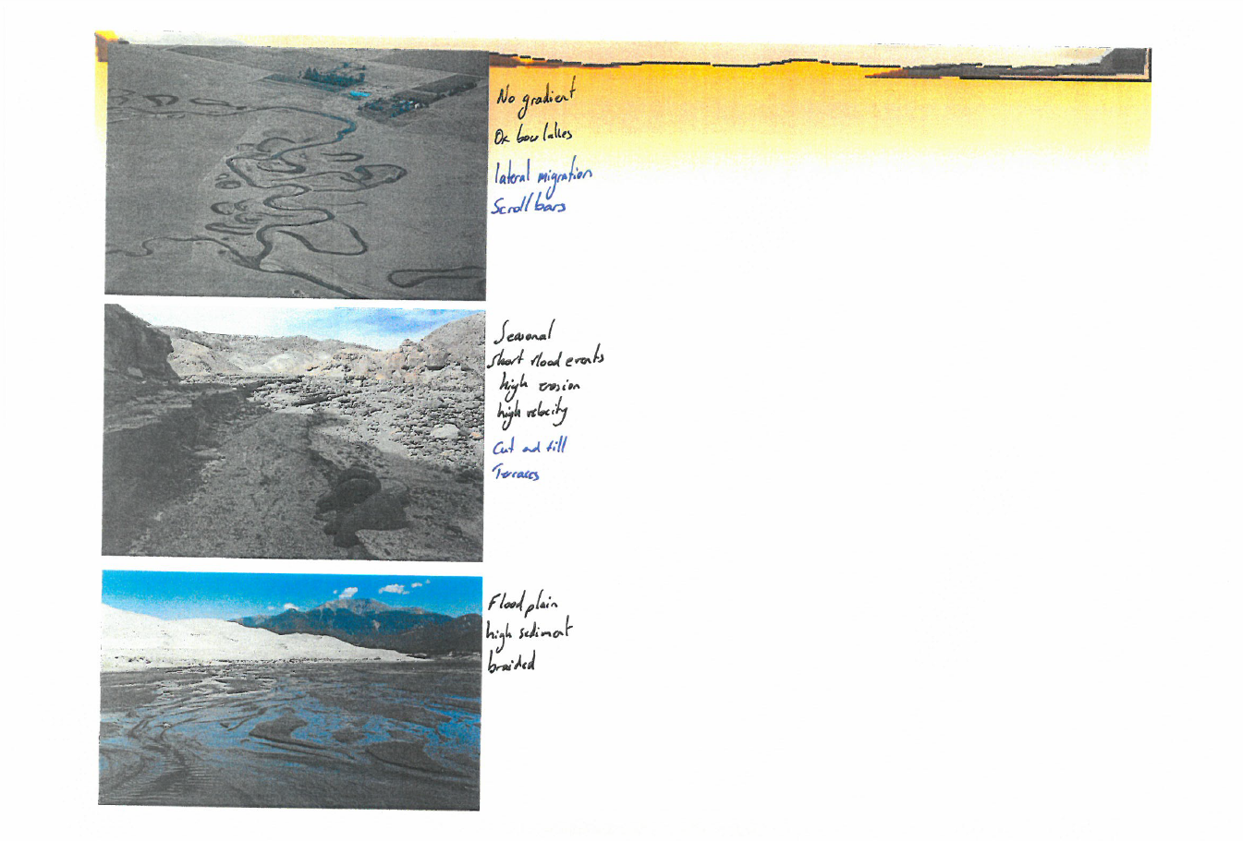
average example

Slide 28
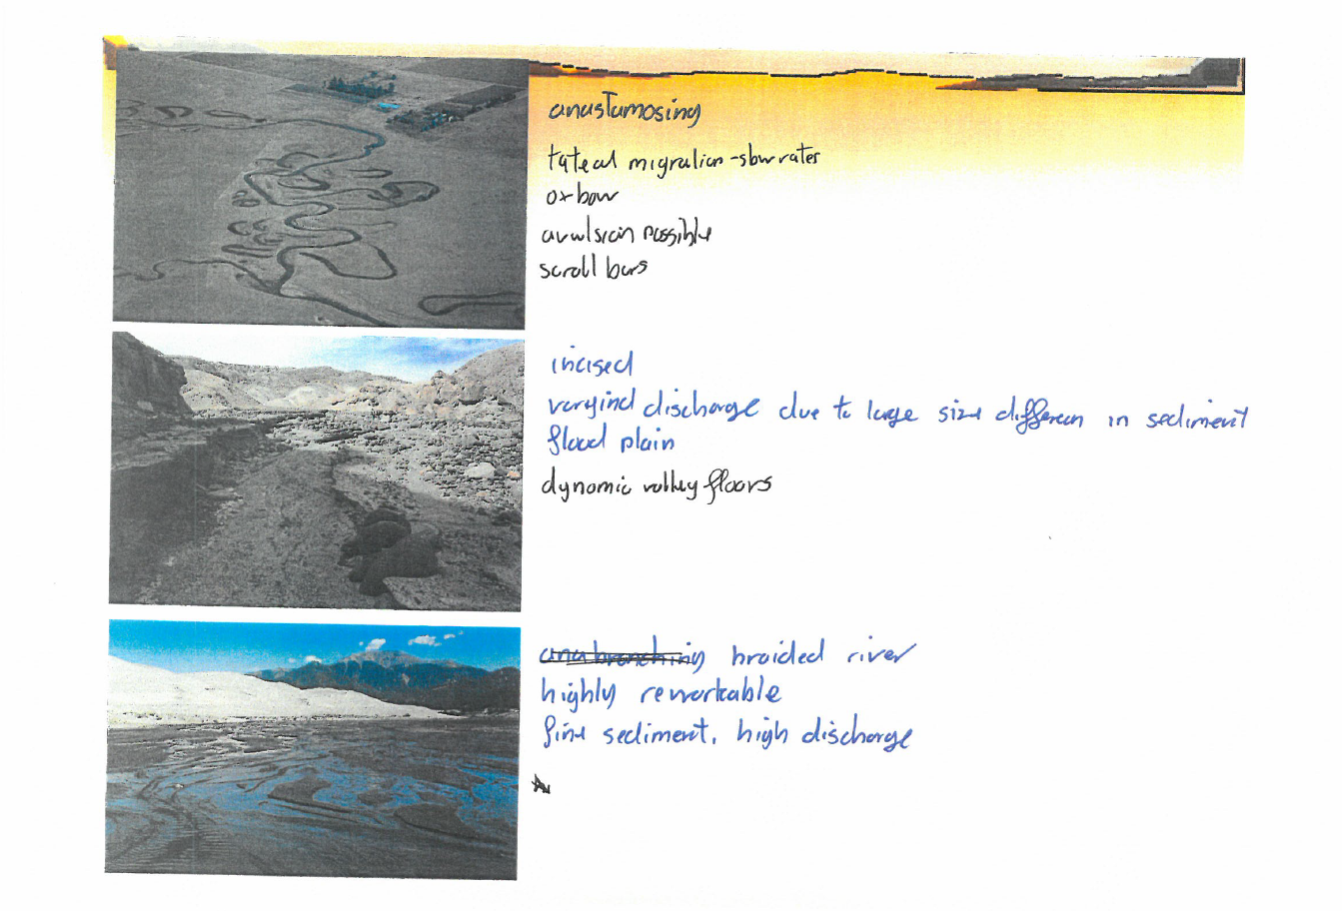
poor example

Slide 29
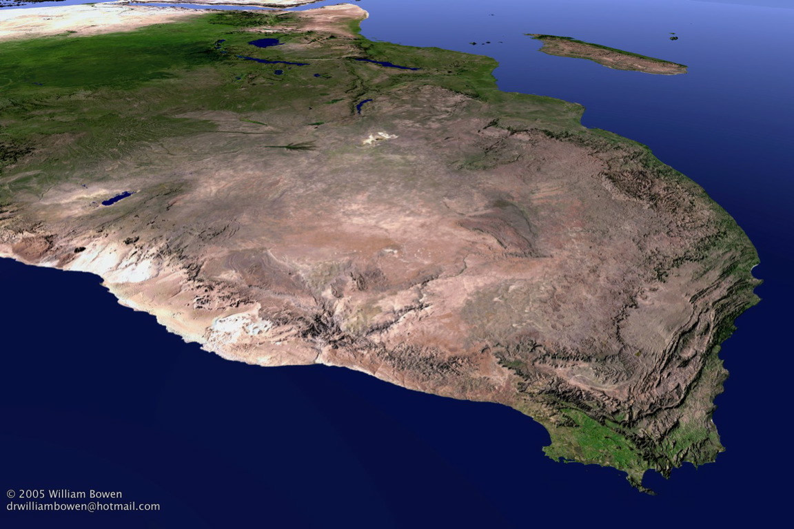
oblique satellite image of
southern & central Africa
Working in groups, label 1-10 the following features:
1) The Great Escarpment 2) Okavango Delta 3) Orange River valley
4) Etosha Pan 5) The South African/Namibian border
6) The Cape Peninsula 7) The Drakensberg
8) Kalahari Desert 9) Great Rift Valley 10) Victoria Falls

Slide 30
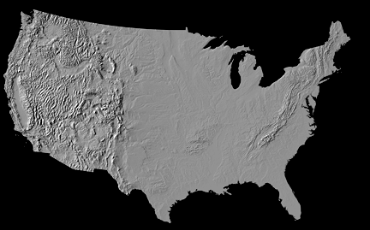
topographic map of the conterminous USA
Working in groups, label 1-10 the following features:
1) Appalachian mountain chain 2) Death Valley 3) Mississippi River basin
4) Colorado Plateau region 5) Everglades 6) Texas Gulf coastal plain
7) Channelled Scablands 8) Great Lakes region
9) Cascade Range 10) Grand Canyon

Slide 31
successes:
a high level of student engagement with the exercises
partial successes:
some evidence of improved quality of student labelling
in the ‘before’ & ‘after’ exercises
failures:
large numbers of uncollected sheets when returned
a lack of student recognition of the benefits of these opportunities for learning self-assessment, at least in the MEQ context

Slide 32
GG23410 (29 students, 67% response rate)
“1017987 Great structure to the course. Staff amazing & topics very interesting & rewarding. Thanks.”
vs.
“1017970 Make the lectures more interactive, rather than just getting talked at for 2 hours straight.”
nothing specific about opportunities for self-assessment of learning
or within-class feedback on exercises
GG30420 (10 students, 48% response rate)
“1019897 I was dissapointed that XXXX wasn't running the module, however feel that the use of 3 lecturers to cover the content allows specialist topics to be covered & adds variety. The module has inspired & increased my interest in river systems.”
vs.
“019904 Was hoping for more current information, less palaeo.”
again, nothing specific about opportunities for self-assessment of learning
or within-class feedback on exercises

Slide 33
an idea worth persisting with?

Slide 34
upping the task level:
definitions of key features?
use of key words as triggers for revision or for deeper, foundational concepts (e.g. magnitude-frequency)?
apply materials, process, geometry scheme to images?
reconstructions of local landscape history?
Please write down the first 5 words or phrases that you associate with this image

Slide 35
2
1
3
mountains, scree slopes, snow/ice, glacier (in recession), meltwater, supraglacial melt-out till, lateral moraine (Little Ice Age feature?) ….
potential for process inferences & reconstructions of landscape history

Slide 36
employment relevance?
at the end of the module, could students write a short caption to accompany
an image in a field guide or on an information sign board?

Slide 37
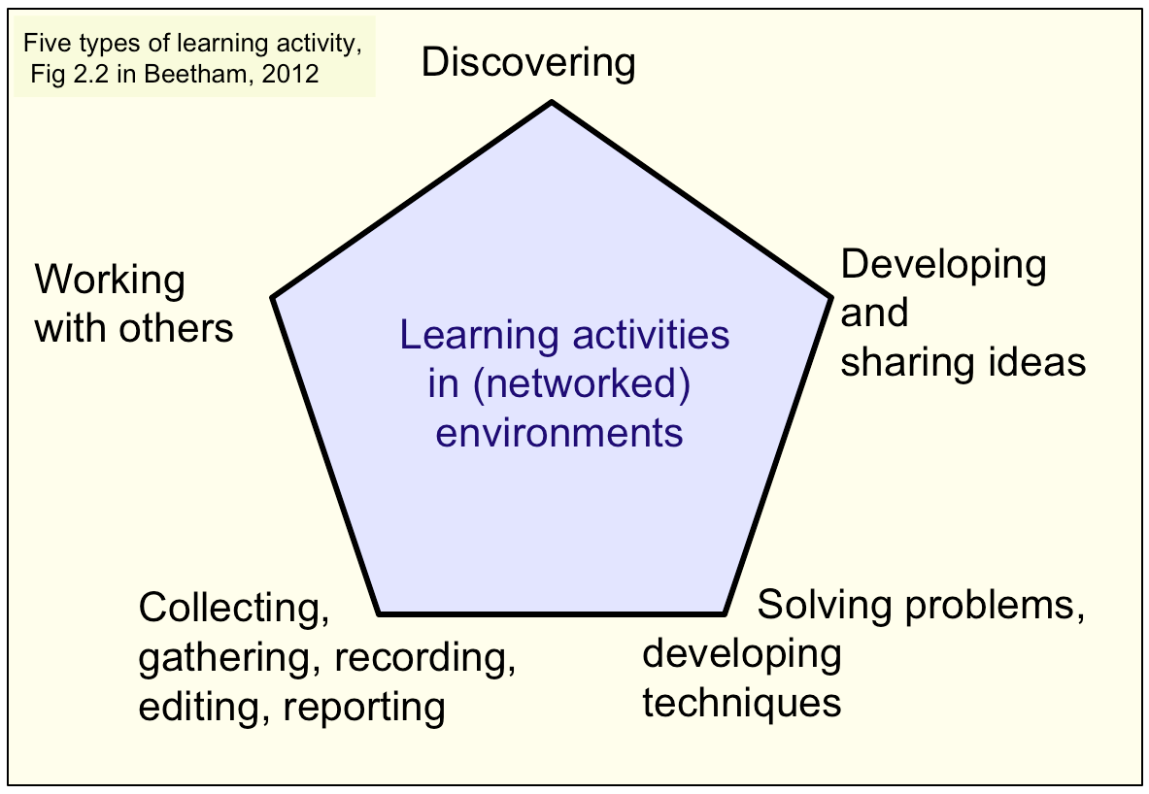
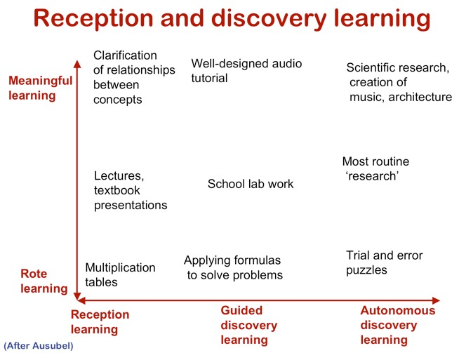
BSG Annual Meeting 2018 will be in Aberystwyth
we hope to develop some of these themes further
in another Communicating Geomorphology session ….

Slide 38
questions?

Slide 40
Where is the Mediterranean region?
Where are its physical boundaries
in hydrological terms?
Working in groups, sketch the boundaries onto the following maps
(50 words maximum)

Slide 41
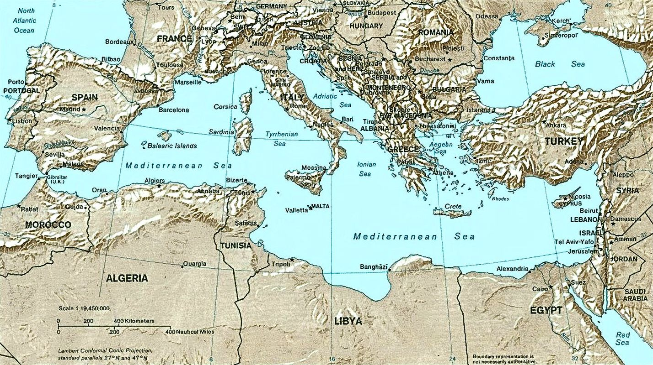
topographic map of the Mediterranean Sea region

Slide 42
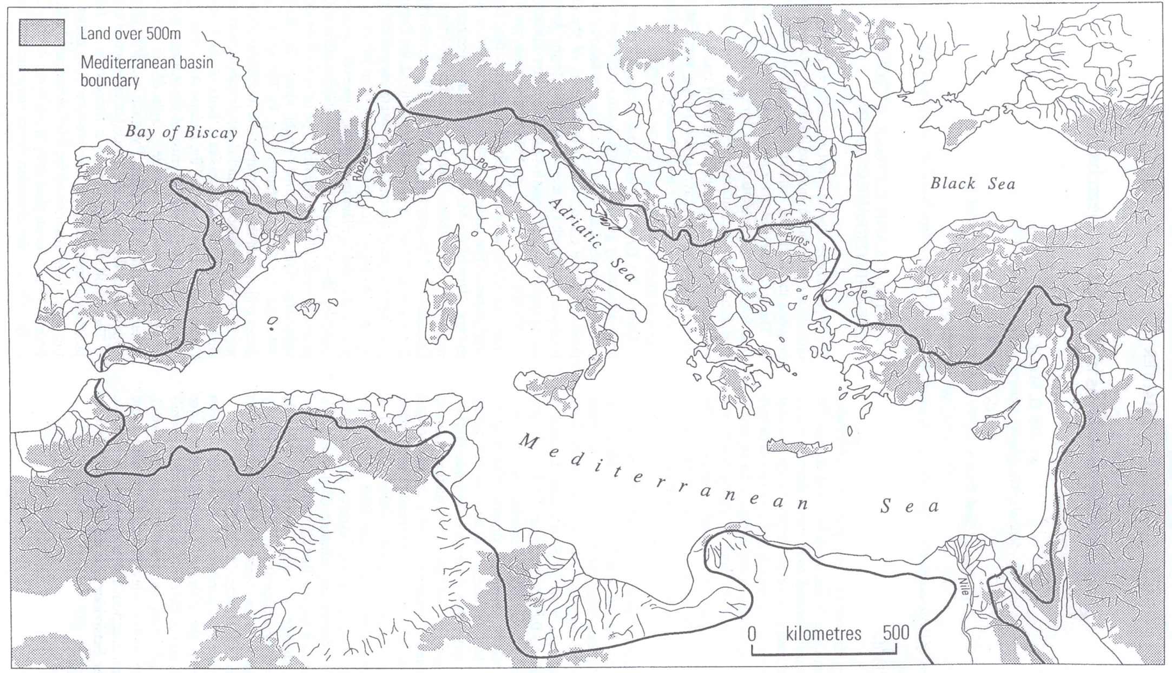
the Mediterranean basin (hydrological boundary)
Macklin et al., 1995
KEY QUESTION:
should we include the Nile River within the basin boundaries?

Slide 43
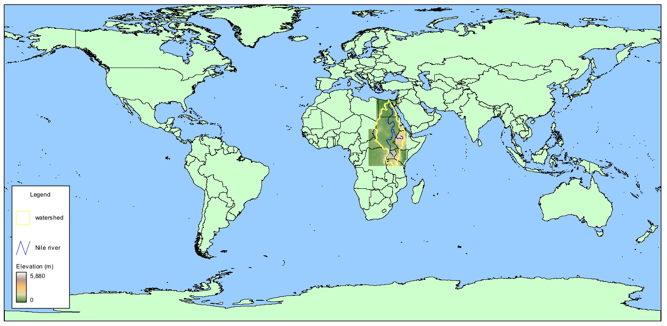
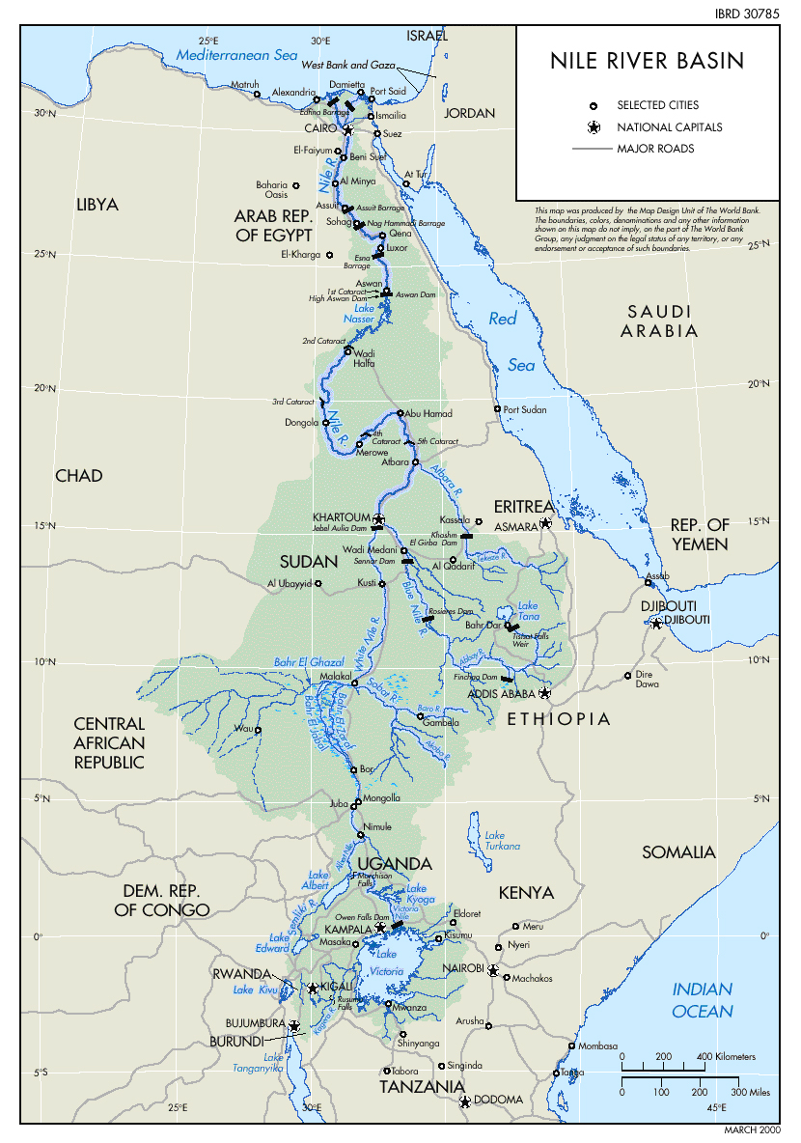

Slide 44
the Mediterranean basin (hydrological boundary)
Macklin et al., 1995
KEY QUESTION:
should we include fossil rivers within the basin boundaries?

Slide 45
What are the key characteristics
of Mediterranean rivers?
Working in groups, provide at least five
physiographic, hydrological, sedimentological or morphological characteristics
that might influence or reflect the nature of Mediterranean river response
to environmental change
(50 words maximum)

Slide 46
Macklin et al., 1995
if stuck, refer back to the Mediterranean basin map for clues …

Slide 47
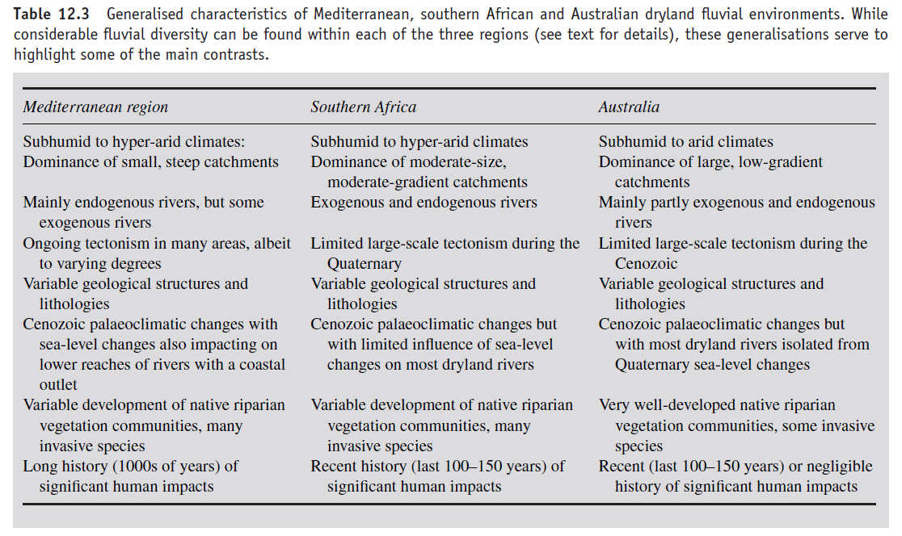
what are the key characteristics of southern African rivers
that might influence or reflect the nature of river response?
Tooth & Nanson, 2011

