Slide 1
Using Virtual Reality Headsets in Learning and Teaching
Dr stephen atherton
School of education
Aberystwyth university

Slide 2
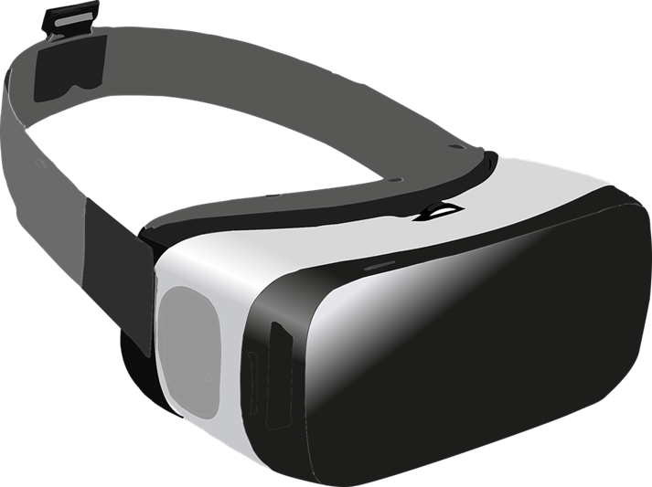
Outline
Overview of VR technologies available
Using VR for learning and teaching
Future plans
Interaction

Slide 3
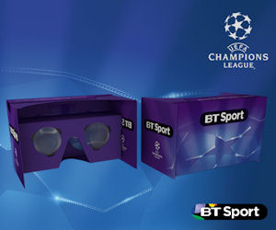
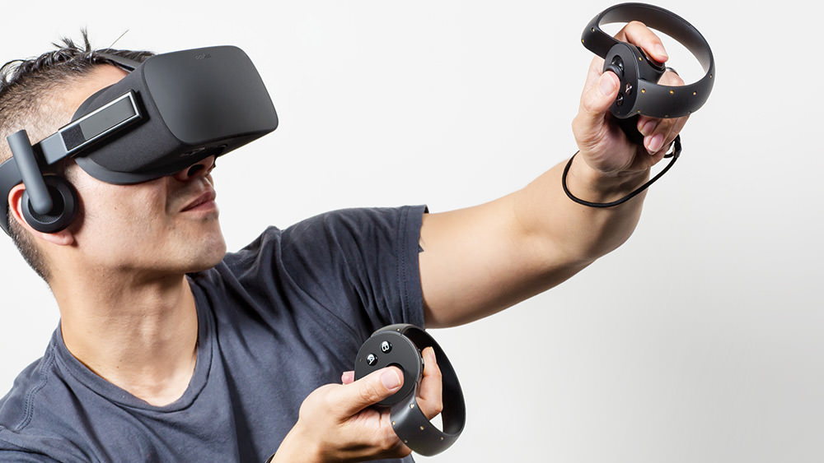
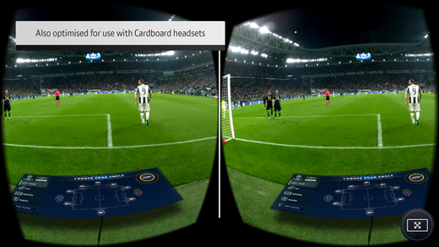
VR for Gaming and Play

Slide 4
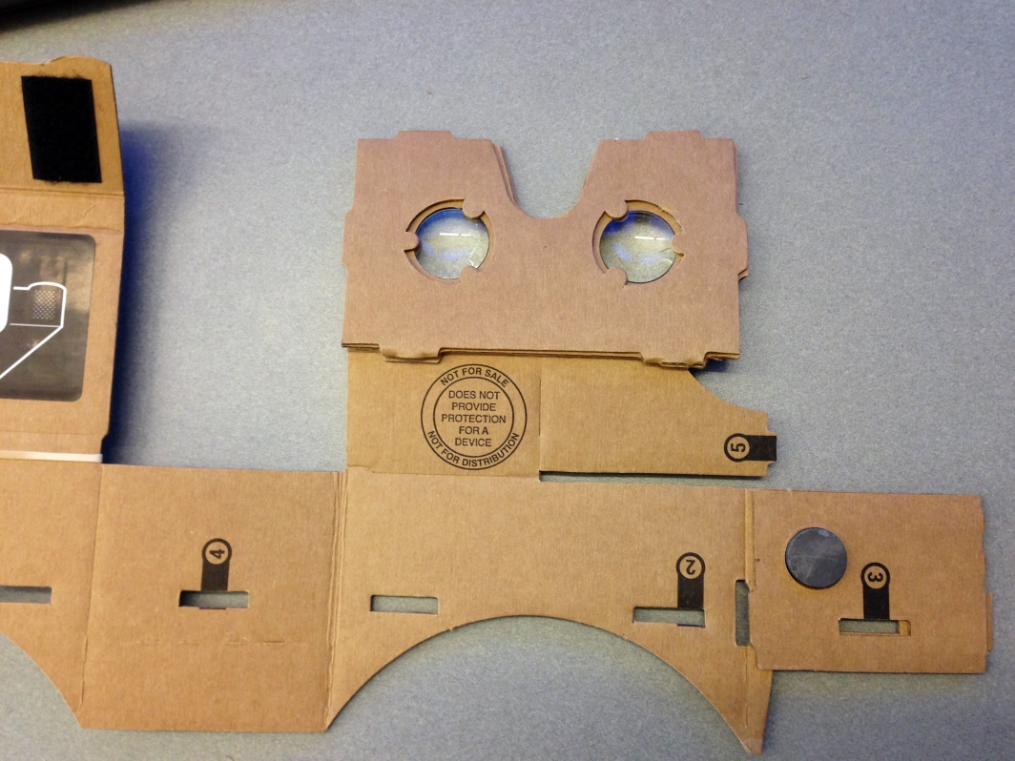
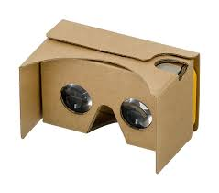
Google Cardboard

Slide 5
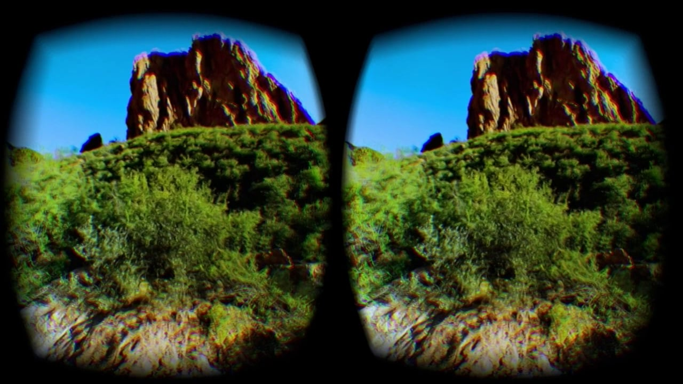
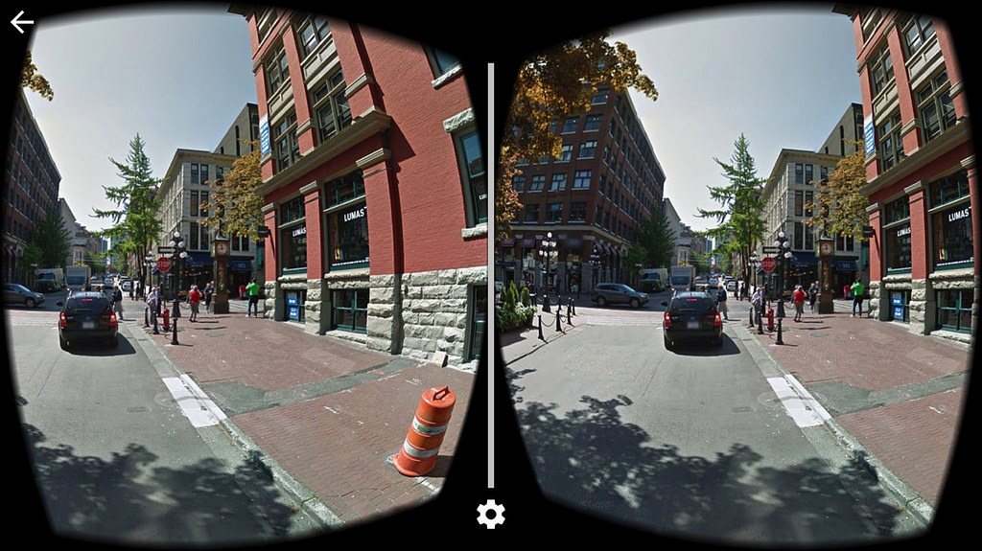

Slide 6
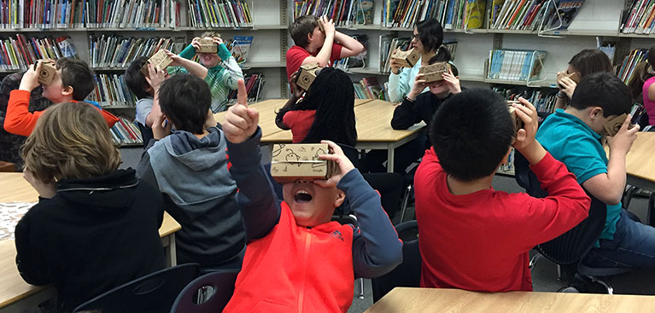
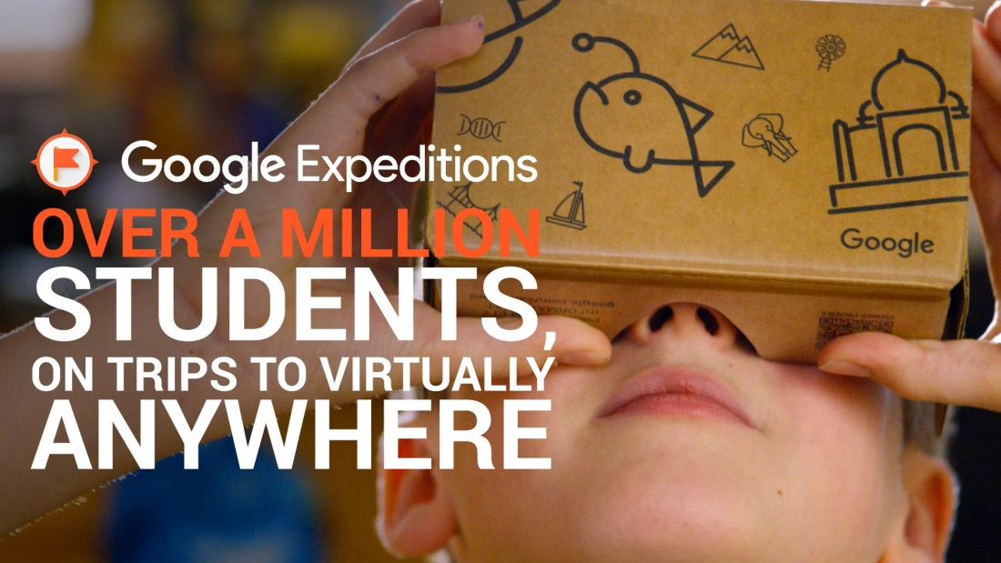
Google Expeditions

Slide 7
Cardboard Camera
Google Cardboard Camera
360 pictures that can be taken from most mobile phones and then viewed on pc, tablet, mobile or VR headset.
Potential to develop further content for academic purposes.

Slide 8
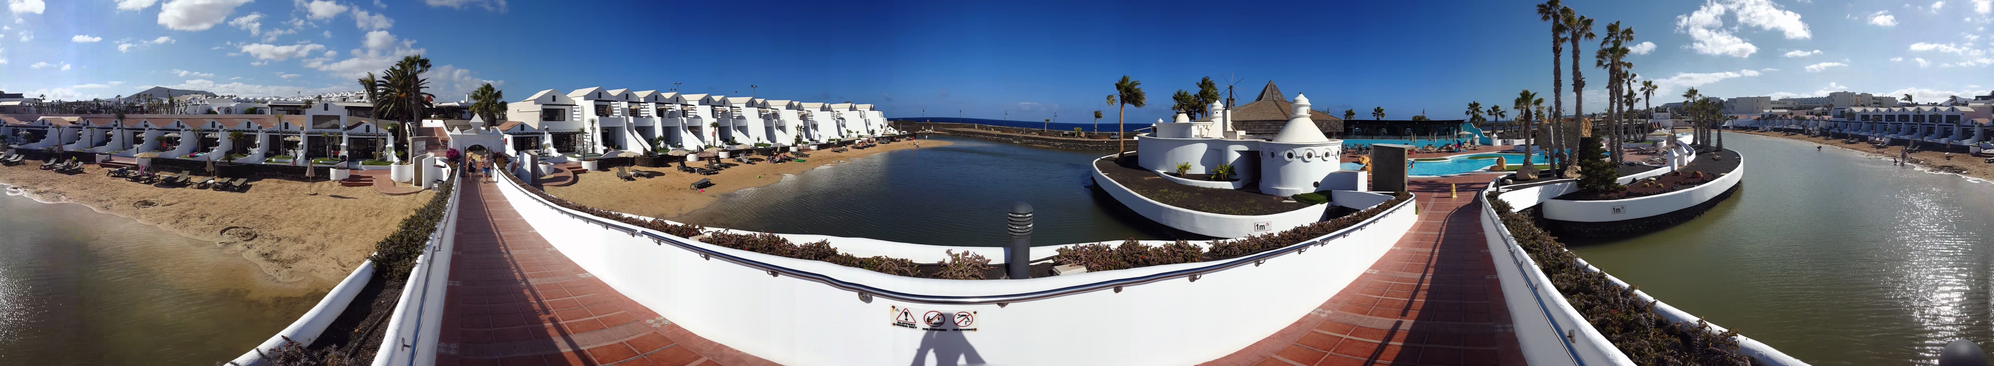

Slide 9
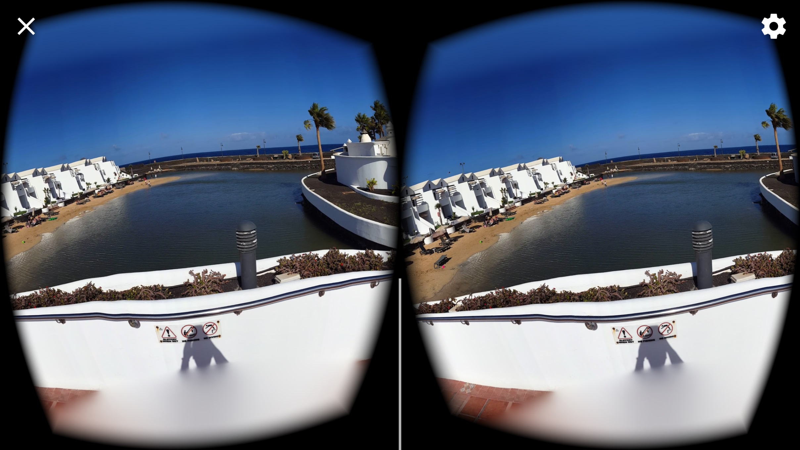

Slide 10
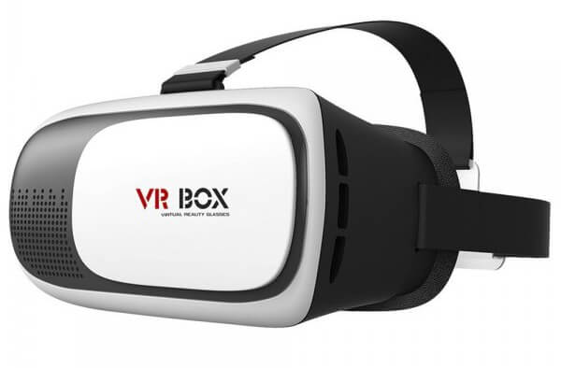
Using VR in Teaching
ED12820- Gender, International Development and Education
ED13720- Play and learning
ED33020- Communicating Science
Bring Your Own Device (BYOD)

Slide 11
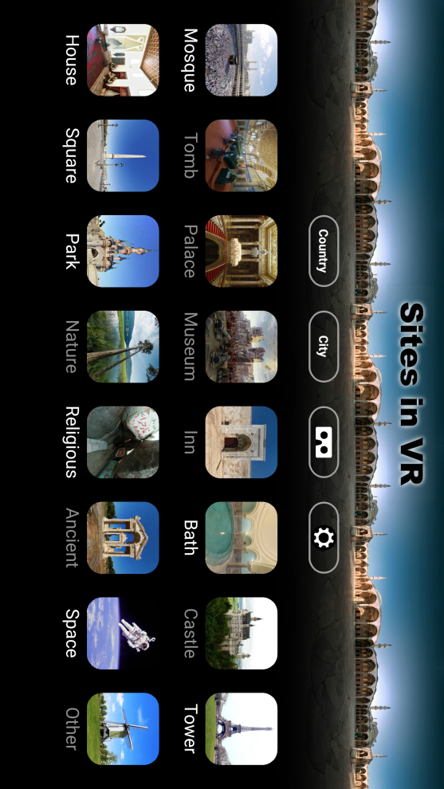
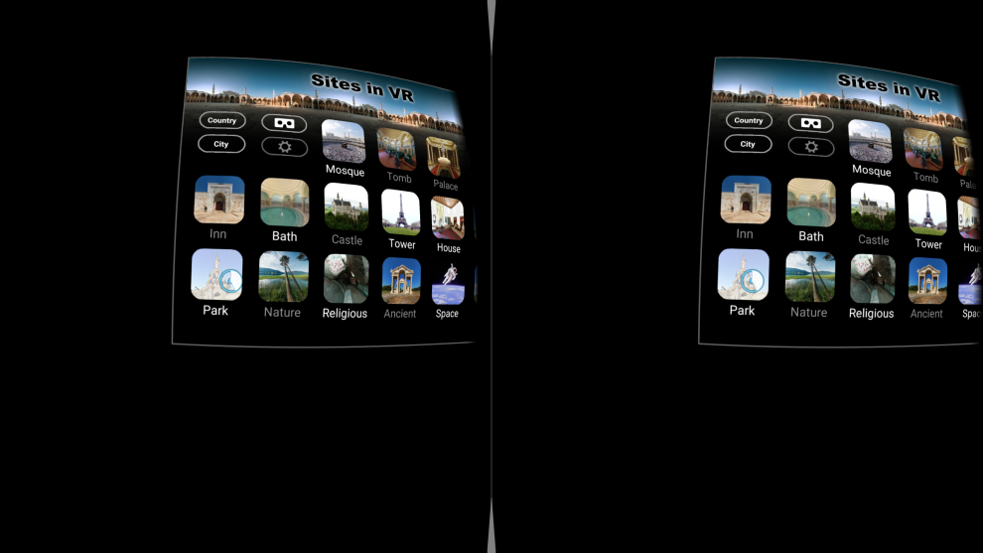

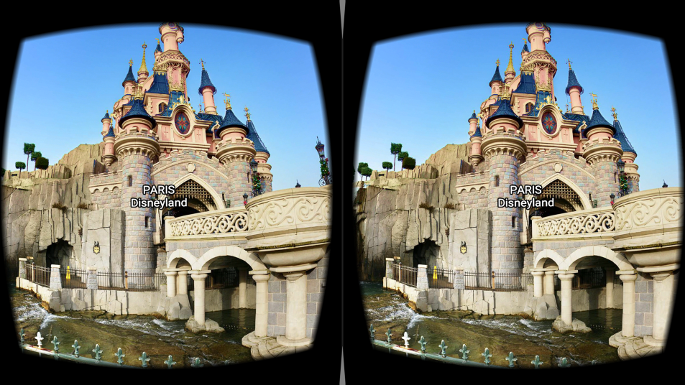
Sites in VR

Slide 12
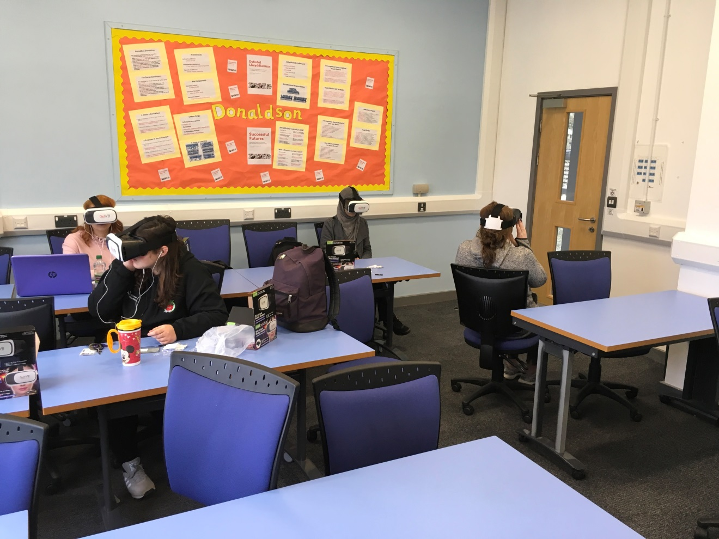
ED12820- Gender, International Development and Education

Slide 13
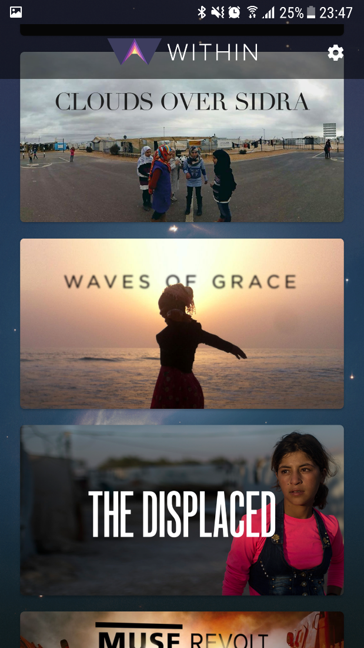
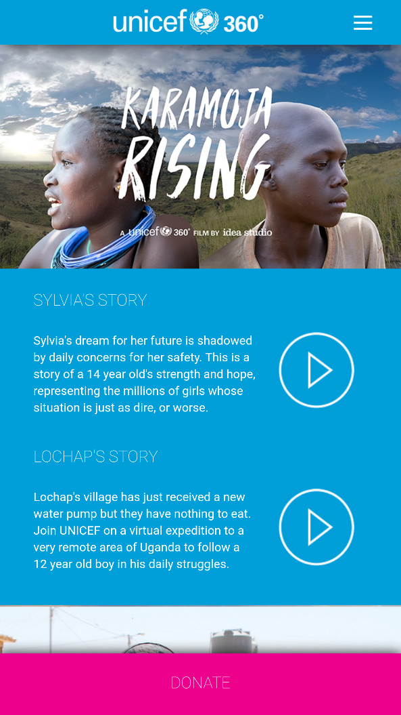
Resources used
UNICEF 360
    Clouds over Sidra (short version)
    Karamoja Rising
Within
    Clouds over Sidra (full version)
    The Displaced
    The Source

Slide 14

Resources used
Growing a World Wonder
Discovery VR
    Women Triumph over HIV in Africa
    Under the Net
Youtube 360

Slide 15
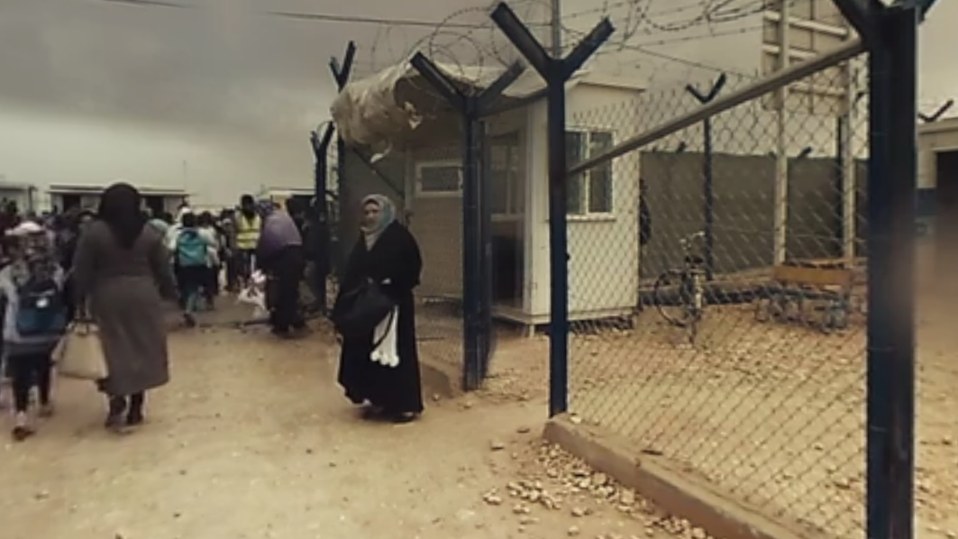
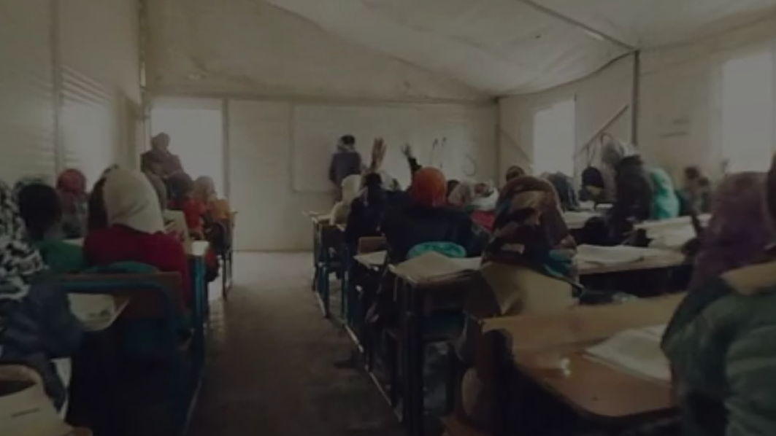
Clouds over Sidra

Slide 16
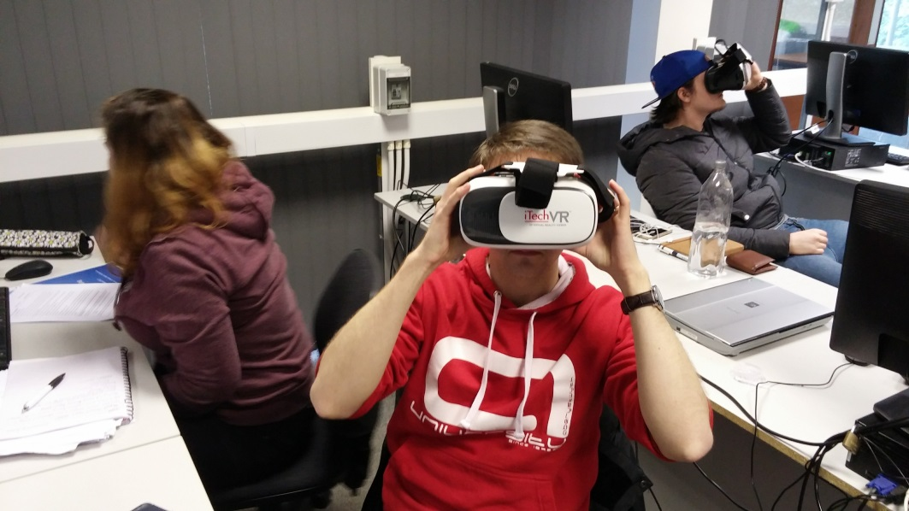
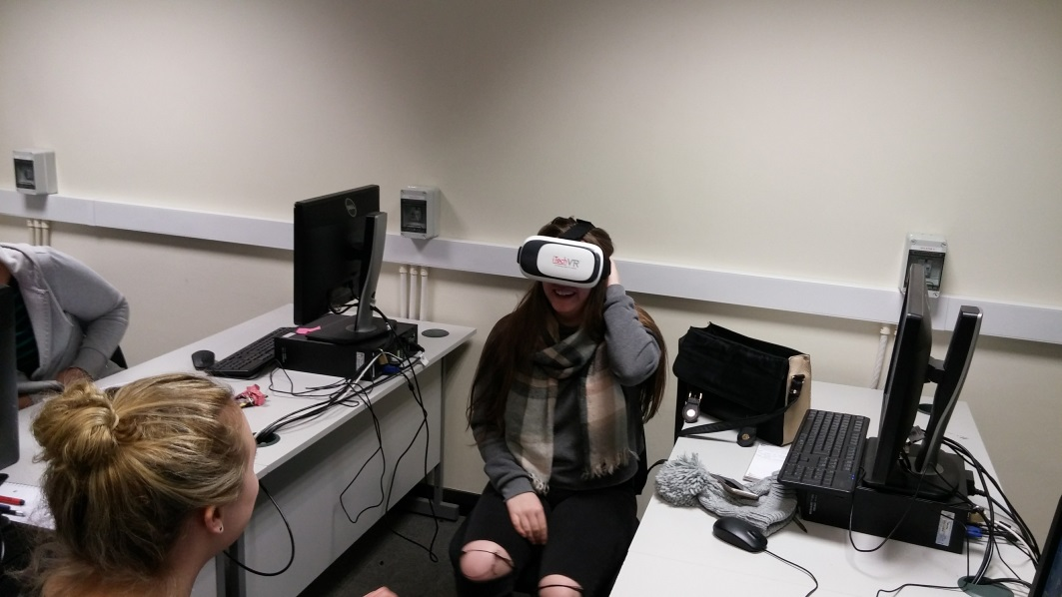
ED33020 Communicating Science

Slide 17
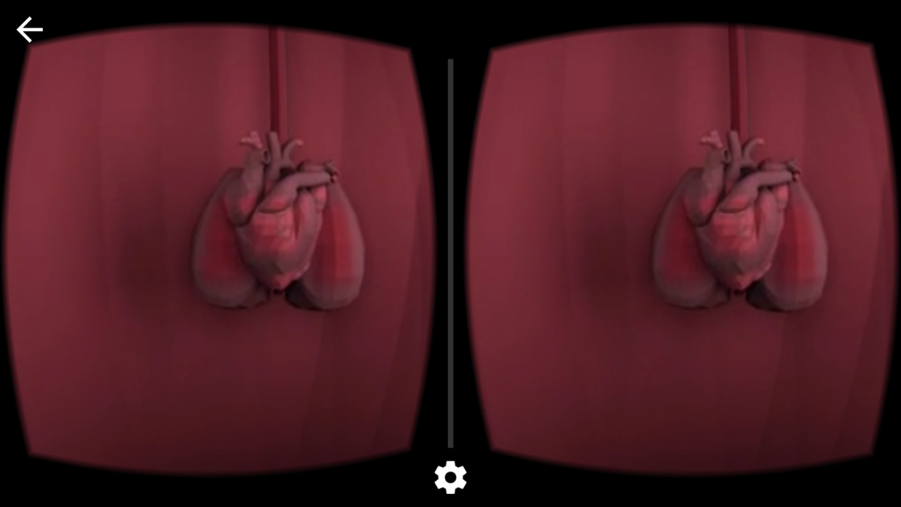
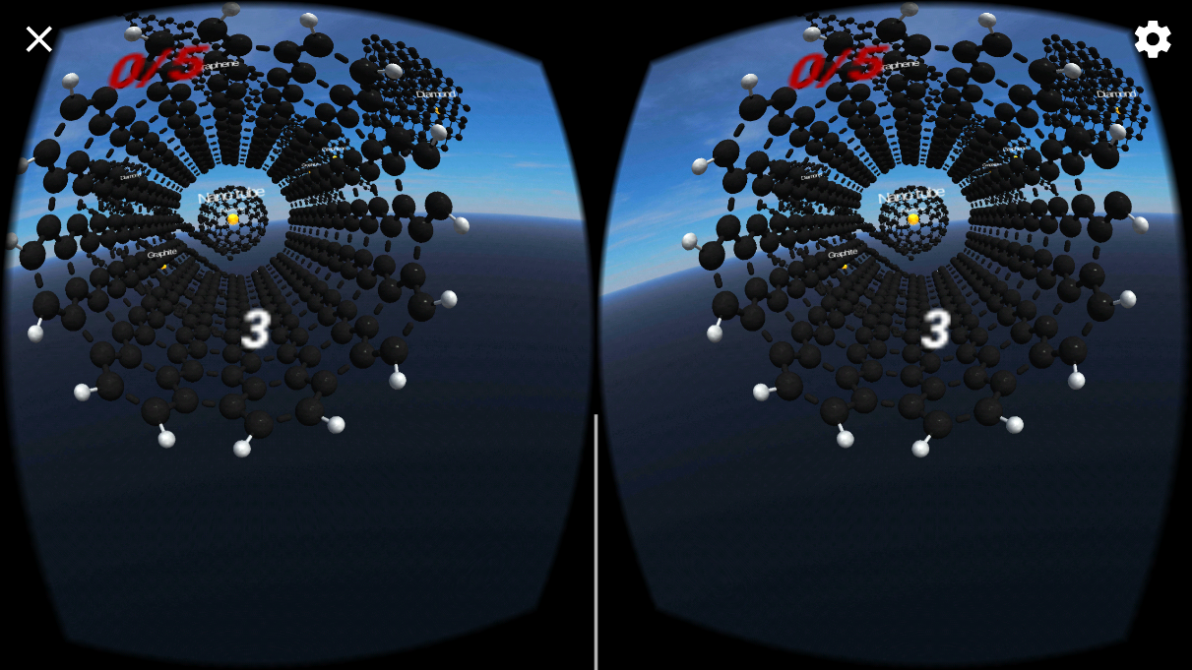

Resources Used
Google Expeditions
In Body VR
Carbons VR

Slide 18
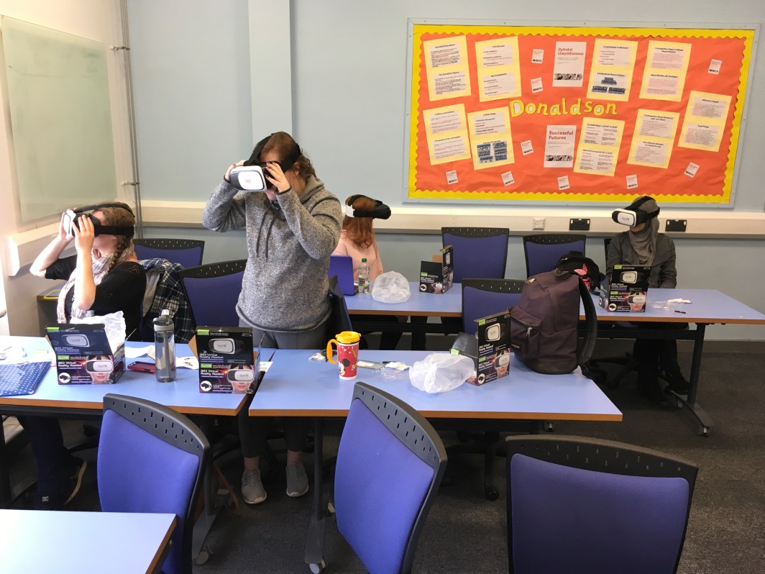
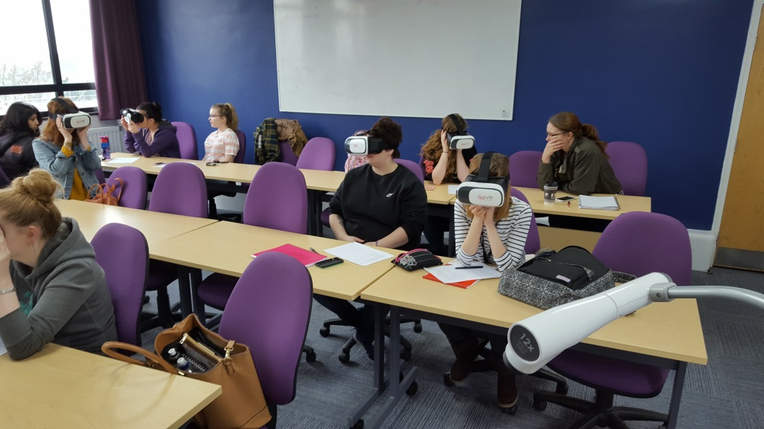
ED13720 Play and Learning

Slide 19
Student Perspectives
Imagine being able to transport yourself to a completely different place or country, be it a tour of Disneyland Paris or getting a 360 view of what it's like for children in developing countries trying to get an education, seeing exactly what the living conditions are like. By Steve getting us using virtual reality in the seminars we got to have these immersive learning experiences which are just a small sample of what's possible with VR in education today!

Slide 20
Student Perspectives
I found that using the virtual reality headsets were really interesting. At the beginning I was concerned that I wouldn't enjoy it at all as I'm not the biggest fan of learning through technology, however it was so easy to use and it put you in an entirely new world within seconds! I'm glad we had the chance to use it as it was very different to anything else myself or my friends had ever done in university.

Slide 21
Student Perspectives
I found the utilisation of VR headsets really useful as it provides a much more immersive experience with regards to situations affecting people in other parts of the world. Being able to see conditions that people are living in and how their daily lives are constructed from more of a first-hand perspective leads to a deeper understanding of the issues faced.

Slide 22
Student Perspectives
VR lessons are very exciting. Your visually able to see what life is like for children and adults in third world areas. Being able to hear their stories is also very factual and engaging. The VR sessions have consisted of different topics. Including girl’s rights to education as well as education for girls in Syria. This highlights the various factors to education e.g. conflict famine and social and cultural issues. Overall the VR sessions has been a great experience. The technology allows you to see first-hand the barriers.

Slide 23
Problems
Not all students had a smartphone (2 out of 75 in total).
Older smartphones, or budget models, did not have the necessary hardware.
Some students felt motion sickness from the headsets.
Some students felt discomfort wearing the headsets for more than 15 minutes.
Google Expeditions requires peer to peer network connection and did not work on Eduroam

Slide 24
Global Virtual Reality Classrooms
Work with schools across the globe to create 360 degree photos and videos of classrooms, learning environments, and schools.
Central hub where all material can be accessed for HEI, schools, researchers.
Allow for the evaluation of different learning environments globally.

Slide 25
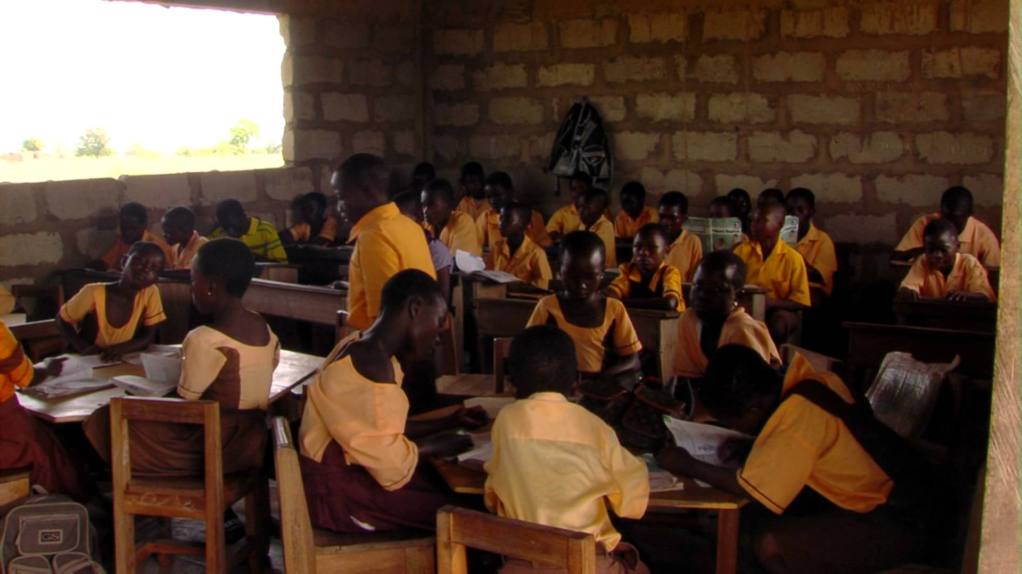
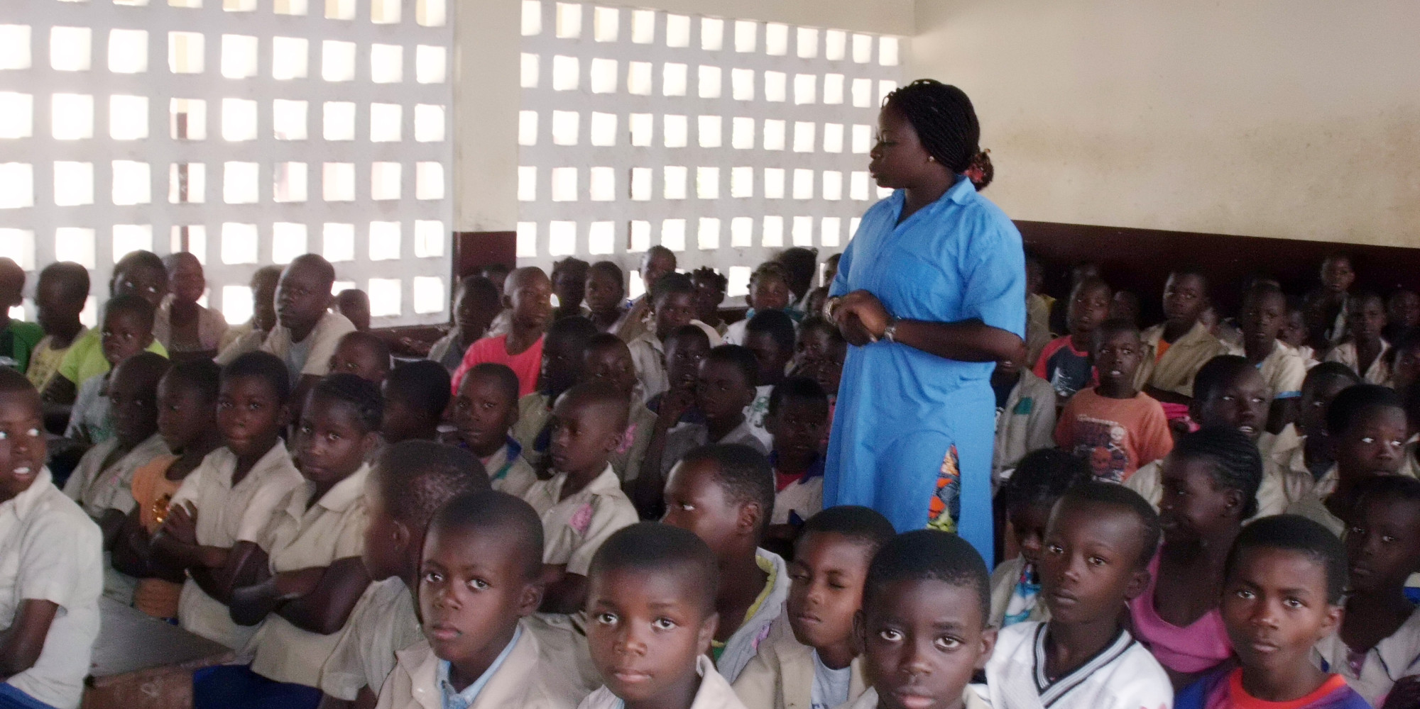
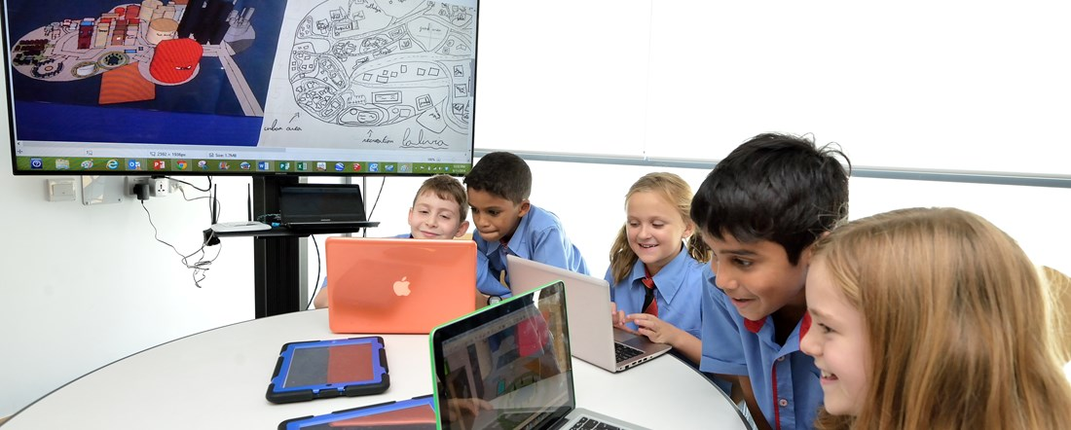
Global Virtual Reality Classrooms

Slide 26
Learning Resources
Developing Aberystwyth University branded VR resources for Education.
Learning and Marketing possibilities
Scope for HE students to benefit
Scope for students to become involved in developing materials.

Slide 27
Questions?
Thank you for listening.
Opportunities to interact.

