Slide 1

Interactive Technology and Teaching Excellence
Dr. Rachael-Anne Knight PFHEA NTF
Associate Dean Education & Associate Professor of Phonetics
@r_a_knight

Slide 2
Outline
The traditional lecture
Active learning
Interactive technologies
Teaching Excellence
Embedding interactive technologies

Slide 3
The ‘traditional’ lecture
The lecture is the most prevalent form of teaching in higher education institutions across the world
(Gorissen et al 2012)
Laurentius de Voltolina - The Yorck Project: 10.000 Meisterwerke der Malerei. DVD-ROM, 2002.
ISBN 3936122202. Distributed byDIRECTMEDIA Publishing GmbH.

Slide 4
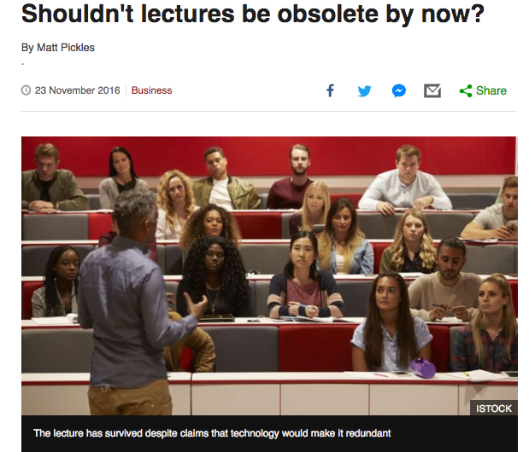
Criticisms of the traditional lecture
Phillips (2005) asserts that lectures:
  “can be used to teach information, including the framework of a subject, but an expository approach is unsuitable to stimulate thought or change attitudes” Bligh (1972:223)
  are “legitimised only by 800 years of tradition” Laurillard (2002: 93)

Slide 5
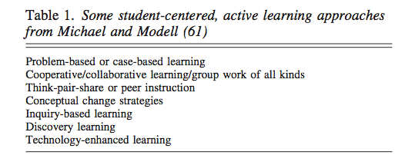
Enter active learning
Active learning is generally defined as any instructional method that engages students in the learning process. In short, active learning requires students to do meaningful learning activities and think about what they are doing
Prince (2004)
Michael, J. (2006). Where’s the evidence that active learning works?. Advances in physiology education, 30(4), 159-167.

Slide 6
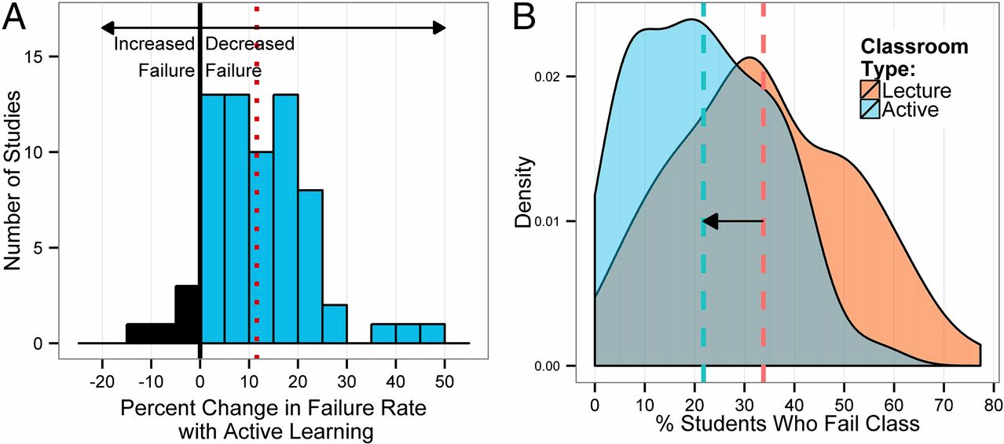
The evidence for active learning – Progression (SR)
Freeman et al (2014) show that passive lectures lead to higher failure rates than active learning

Slide 7
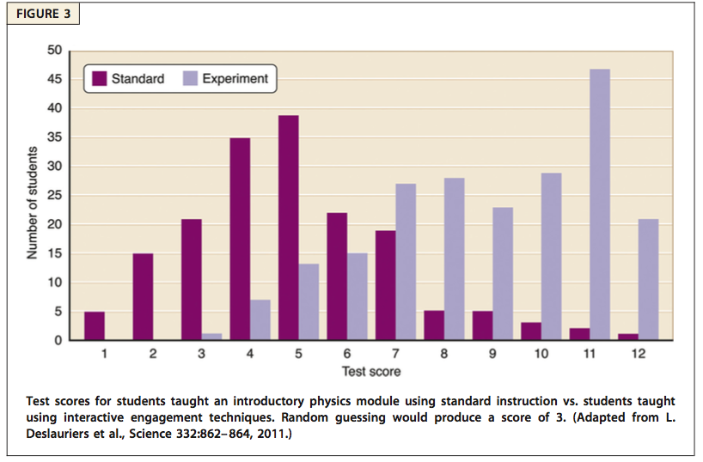
The evidence for active learning - attainment
‘Developing expertise requires intense practice that includes doing challenging and relevant tasks, followed by feedback and reflection on one’s performance’
Wieman and Gilbert (2015: 152)

Slide 8
Why do traditional lectures prevail? (SR)
Goffe and Kauper (2014)
Survey of 275 economics instructors
Median respondent:
  70% of class time was in lecture,
  20% was leading group discussion,
  10% was other learning activities
Traditional lecture seen as either preferred, or having substantial advantages
  Students learn best from lectures (33%)
  Students do not learn best from lecture, but it is cost-effective (28%)
  Students do not learn best from lecture, alternatives preferred (39%)

Slide 9
So, why do we sometimes persist with lectures?
Increasing class sizes
Transmission of information
A degree of control over the subject matter
Lack of awareness of alternatives
Workload / time in trying something new
Our own learning experiences
A desire to teach concentration/argumentation
Institutional quality and governance – teaching hours

Slide 10
Why doesn’t everyone move away from the lecture? (SR)
Moerschell (2009):
  Lack of motivation to learn new teaching methods
  Unable to visualise future, comfort with the status quo
  Lacking information or skills, uncooperative personality
Credibility issues for new approaches and technologies
  Scepticism about efficacy (does it really help)
  Gimmicky (effort may be wasted as we abandon it next year)
Time, incentives
  Good research gets you promoted, good teaching is suspect
  No incentive to spend time on excellent teaching

Slide 11
Current situation
Evidence that most teaching is traditional lectures
Evidence that students learn better from active learning
Evidence that lecturers might find it challenging to change their teaching style for a variety of reasons

Slide 12
How can we introduce active learning with minimum disruption?
Accept the realities of the situation
  Time, class size and incentives are genuine issues
Provide a solution which is easy to use and can be supported at institutional level
  Communities of practice
Work with the evidence about learning in higher education

Slide 13
Interactive class room technologies
Polling, or personal response systems, have been popular for a number of years
Originally using bespoke handsets, and now increasingly using students’ own devices
Many different systems with broadly similar features

Slide 14
A personal experience
No tech
Clickers
PollEverwhere
Kahoot!
Twitter

Slide 15
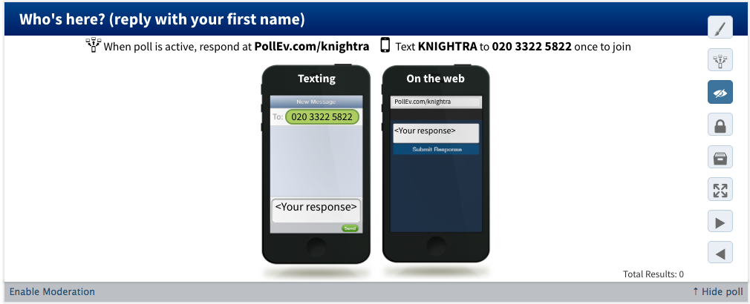
Breaking the ice
15
Notes:
Students like to see their names come up

Slide 16
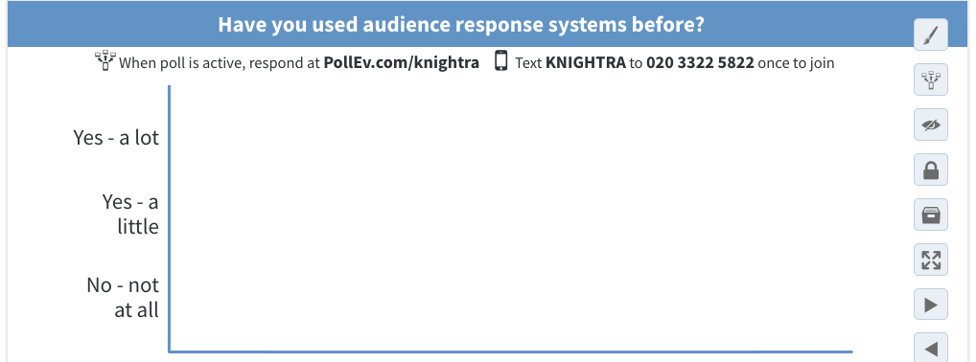
Surveys
Notes:
What do you want to revise?

Slide 17
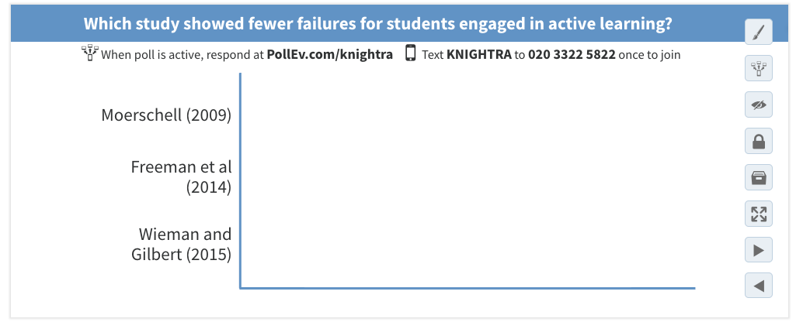
Testing knowledge – before, during, after

Slide 18
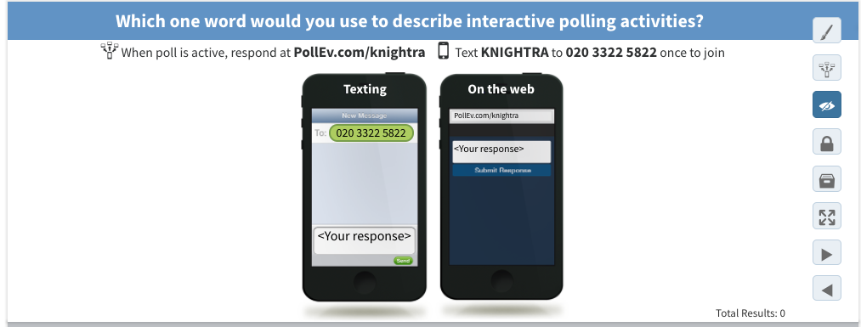
Gathering opinions
Notes:
Word cloud

Slide 19
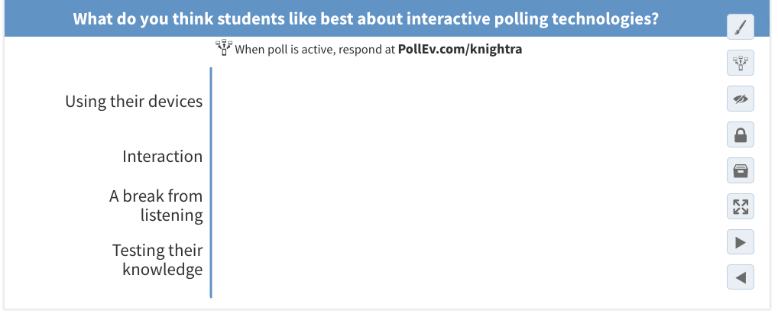
Reaching group agreement
Notes:
Ranking exercise

Slide 20
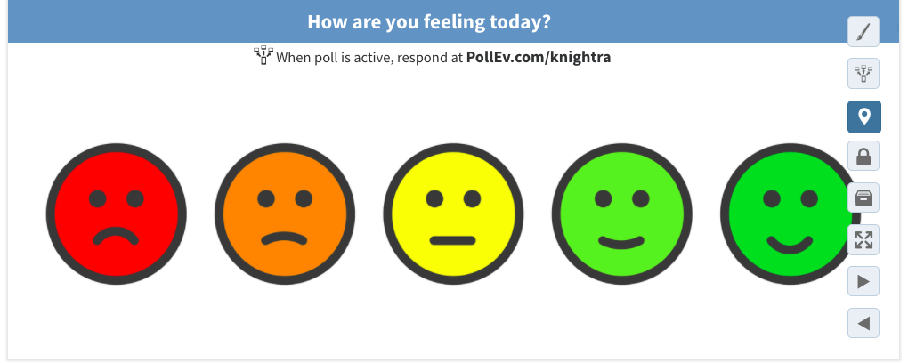
Using visuals
Notes:
Head diagrams, ipa chart but what to put here?

Slide 21
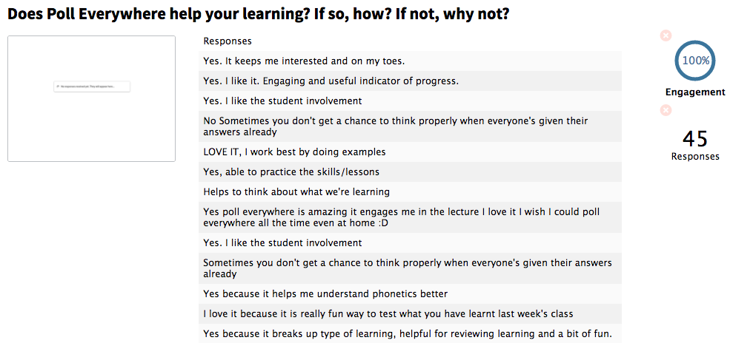

Slide 22

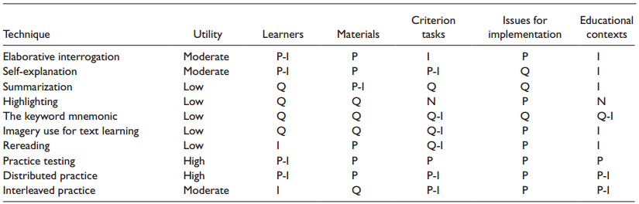
Evidence for the benefits of quizzing (SR)
Dunlosky et al. (2013)
Practice testing and distributed practice received high utility assessments because they benefit learners of different ages and abilities and have been shown to boost students’ performance across many criterion tasks and even in educational contexts.

Slide 23

Other options
Kahoot!
  https://kahoot.com/
Twitter
https://blog.bufferapp.com/twitter-polls
Quodl
  quodl.co.uk

Slide 24
Comparisons to a non-technological solution
Disadvantages
  Requires a device
  Requires data or wifi
  Learning curve for all
  Some set-up required
  Restrictions in question type and response format
Advantages
  Provides instant feedback to students and staff
  Anonymous but…
  Can be used to track progression
  Easily reusable
  Flexibly create questions on the fly

Slide 25
Good practice guidelines
http://wonkhe.com/blogs/analysis-lessons-from-the-hea-hepi-survey/

Slide 26


Focus on Teaching Excellence
In 2006 the UK Professional Standards Framework for teaching and supporting learning in higher education was published (A1-4, K2-5, V3)
In 2015 BIS said
  “place a spotlight on teaching and encourage excellent teaching for all students;
  help institutions improve the quality of their teaching by highlighting exemplary practices” (p 18)
  In 2016 BIS stated that
  “ Teaching excellence matters…. Excellent teaching needs to flourish across the sector…” (p13).
Notes:
16.15

Slide 27
Interactive learning and teaching excellence
The Teaching Excellence Framework
Progression/Non continuation
Employability
Student satisfaction

Slide 28
Defining Teaching Excellence
Teaching excellence is difficult to define.
Gunn and Fisk (2013) offer 3 provisional definitions which made some useful distinctions
• teacher excellence – conceptions of excellence related to individual
teaching excellence - relates to overall conceptions so is about more than the individual teacher
excellent learning – relates to the learning achieved
Notes:
16.20

Slide 29
Teaching excellence in the Health Sciences
Influenced by Michael Clift’s (2015) study about compassion in Health Care
What are the behaviours and concepts of Teaching Excellence?
84 students (18-54 ya) in Health Sciences wrote answers to two questions
  Part of a wider study of teachers and students across disciplines
Data were analysed thematically for each question
Thanks to Tanya Son and Yael Blank (UG dissertation students), and Prof. Pam Parker, my collaborator

Slide 30
Activity
30
Individually write answers to the two questions used in our study
  1. What does Teaching Excellence Mean to you?
  2. Can you think of a time when you experienced Teaching Excellence and describe the particular qualities and behaviours of your teacher/s that resulted in this experience?
Two interactive polls (vote up and down)
Notes:
Need to give short answers

Slide 31
Results - concepts
Category | Definition | Number of comments per category (Total = 369 comments) | Percentage of comments per category
Teacher attributes | The personal qualities and characteristics of the teacher | 79 | 21%
Relationship | The interaction between the teacher and their students | 108 | 29%
Teaching style and skills | The manner of teaching, the strategies employed and the materials selected. | 126 | 34%
Scholarly teacher | Someone who demonstrates superior knowledge of their subject, which is also evidence-based. Someone who is continually seeking to develop their understanding of the subject area. | 26 | 7%
Learning outcomes | Teaching which results in academic attainment, career readiness and the acquisition of learning and practical skills. | 25 | 6%
Political framework | Criteria devised by the government to measure Teaching. | 5 | 1%

Slide 32
Results - behaviours
Category | Definition | Number of comments per category (Total = 336 comments) | percentage of comments per category
Teacher attributes | The personal qualities and characteristics of the teacher | 65 | 19%
Relationship | The interaction between the teacher and their students | 120 | 36%
Teaching style and skills | The manner of teaching, the strategies employed and the materials selected. | 127 | 38%
Scholarly teacher | Someone who demonstrates superior knowledge of their subject, which is also evidence based. Someone who is continually seeking to develop their understanding of the subject area. | 16 | 5%
Learning outcomes | Teaching which results in academic attainment, career readiness and the acquisition of learning and practical skills. | 8 | 2%

Slide 33
Quotes – Teaching style and skills
Teaching methods (32%) A teacher who uses adaptable methods of teaching within an education setting
Interactivity (14%) Interaction, class participation, inviting opinions as and when required
Checking understanding (5%) Teachers who you perceive to care about whether you have understood the material they are teaching you

Slide 34
The future for interactive technologies
NMC Horizon Report (2017)
Mobile learning – Time to adoption one year or less
Specifically references in-class quizzing
Two thirds of students used their mobile devices to study
Recommends a variety of resources for integrating mobile learning
http://www.schrockguide.net/samr.html

Slide 35
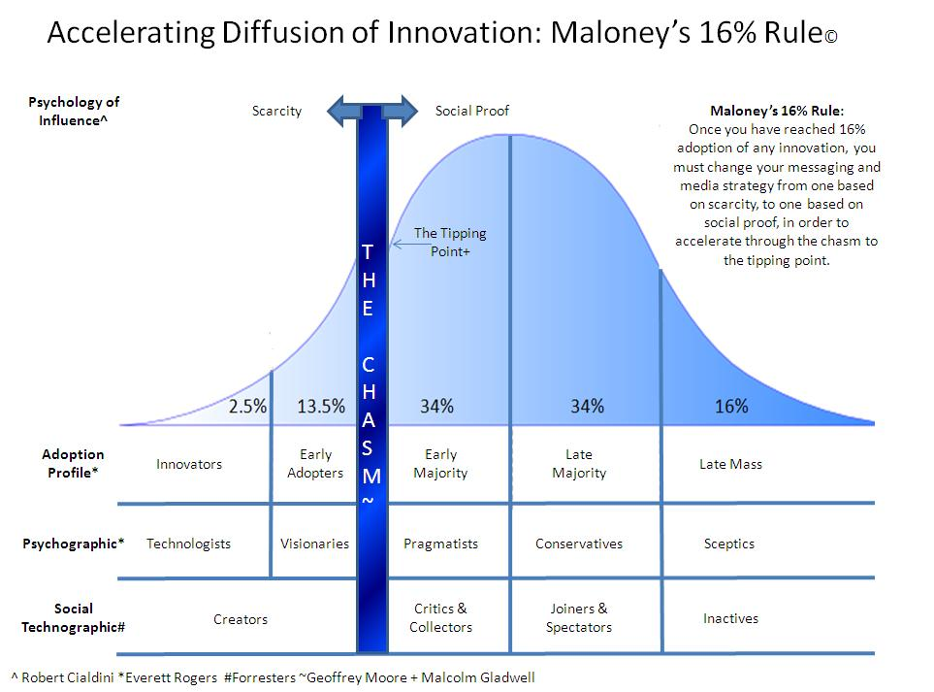
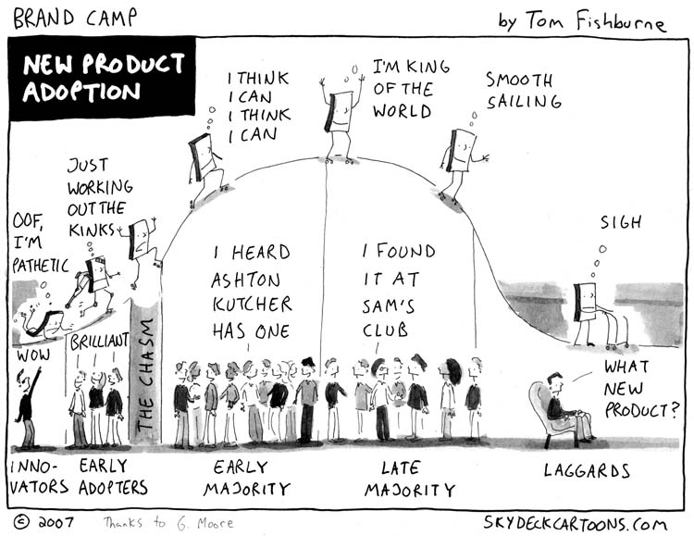
Diffusion of Innovation (Rogers, 1962)

Slide 36
Characteristics of adopter categories (Geoghegan, 1998)
Early Adopters | Mainstream
Like radical change | Like gradual change
Visionary | Pragmatic
Project oriented | Process oriented
Risk takers | Risk averse
Willing to experiment | Need proven uses
Self sufficient | Need support

Slide 37
Outline
The traditional lecture
Active learning
Interactive technologies
Teaching Excellence
Embedding interactive technologies

Slide 38
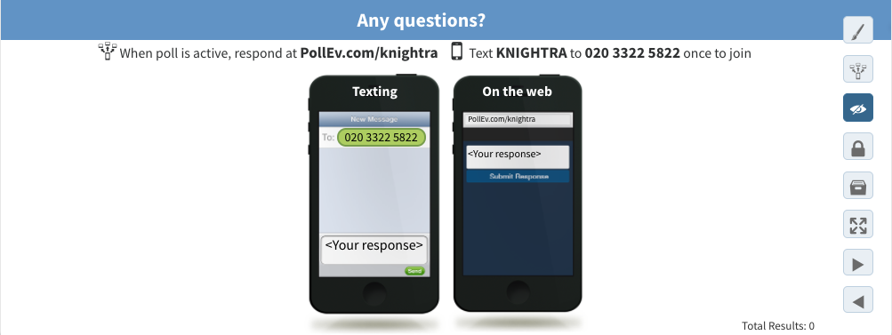
Any questions?

Slide 39
References
BIS (2015) Fulfilling our Potential: Teaching Excellence, Social Mobility and Student Choice London HMSO https://www.gov.uk/government/uploads/system/uploads/attachment_data/file/474227/BIS-15-623-fulfilling-our-potential-teaching-excellence-social-mobility-and-student-choice.pdf (
BIS (2016) Success as a Knowledge Economy: Teaching Excellence, Social Mobility and Student Choice. White paper. London HMSO https://www.gov.uk/government/uploads/system/uploads/attachment_data/file/523396/bis-16-265-success-as-a-knowledge-economy.pdf
Dunlosky, J., Rawson, K. A., Marsh, E. J., Nathan, M. J., & Willingham, D. T. (2013). Improving students’ learning with effective learning techniques: Promising directions from cognitive and educational psychology. Psychological Science in the Public Interest, 14(1), 4-58.
Freeman, S., Eddy, S. L., McDonough, M., Smith, M. K., Okoroafor, N., Jordt, H., & Wenderoth, M. P. (2014). Active learning increases student performance in science, engineering, and mathematics. Proceedings of the National Academy of Sciences, 111(23), 8410-8415.
Goffe, W. L., & Kauper, D. (2014). A survey of principles instructors: Why lecture prevails. The Journal of Economic Education, 45, 360-375.
Geoghegan, W. H. (1998) Instructional Technology and the Mainstream: The Risks of Success. in Oblinger, D. G. & Rush, S. C. (Eds.) The Future Compatible Campus: Planning Designing and Implementing Information Technology in the Academy. Bolton, Mass, Anker.
Gorissen, P., Van Bruggen, J., & Jochems, W. (2012). Students and recorded lectures: survey on current use and demands for higher education. Research in Learning Technology, 20(3), 17299.
Levy, P., & Petrulis, R. (2012). How do first-year university students experience inquiry and research, and what are the implications for the practice of inquiry-based learning?. Studies in Higher Education, 37(1), 85-101.
Moerschell, L. (2009). Resistance to technological change in academia. Current Issues in Education, 11.
Michael, J. (2006). Where’s the evidence that active learning works?. Advances in physiology education, 30(4), 159-167.
Phillips R. (2005) Challenging the primacy of lectures: the dissonance between theory and practice in university teaching. Journal of University Teaching & Learning Practice. Journal of University Teaching & Learning Practice. 2005; 2: 2.
Prince, M. (2004). Does active learning work? A review of the research. Journal of engineering education, 93(3), 223-231.
Rogers, Everett M. (1962). Diffusion of Innovations. Glencoe: Free Press.
Wieman, C., & Gilbert, S. (2015). Taking a scientific approach to science education, part I–research.

