Slide 1
Achieving instant
How to arrange digitized readings for your seminars through your Aspire module reading lists
Joy Cadwallader & Non Jones
Hugh Owen Library
Notes:
Add the bookmarklet
Get rid of everything in My Lists except for ED20910
Introductions

Slide 2
Why do we digitize?
How to arrange your digitisations through Aspire
What your students see
Coming soon
Notes:
What this presentation covers
Be thinking about questions you might have – ask them during the talk or at the end

Slide 3
Why do academic libraries digitize for modules?
Share book extracts and journal articles digitally e.g. for seminar readings
Reduce pressure on print holdings at busy times
Reduce photocopying
Extend access to library holdings
  within the context of the academic book market
  with value for money in mind
Support copyright compliance in the University
Notes:
This is a v practical session but I’ve included a video and a citation in the reference list at the end to give a flavour of how reading lists support learning and teaching

Slide 4
Arranging digitisation through Aspire
Staff in departments add chapters and articles to Aspire reading lists with a Note for Library: Please digitise
Then they (re)publish the reading list
Library staff are notified by Aspire that the list has been re-published
They use Aspire to manage the checking and scanning processes
An email is sent by Aspire to the List Owner when the digitizations are complete

Slide 5
Aspire: Live demo
Edit an Aspire reading list
Add sections
Add a journal article for digitising
Add a chapter for digitising
(Re)publish the list
Notes:
Log in with Chrome
Create a new list ED20910 Urban pacification – test for TEL
and link it to the hierarchy
Create week 1 and 2 sessions then save as a draft – the list will now be closed
It doesn’t matter how you find your journal article (I’m using Primo Articles and more)
When you have found it
http://www.tandfonline.com/doi/full/10.1080/19406940.2017.1287762
http://www.jstor.org/stable/24643192
Create and add to list
Add to week 1
Essential
Note for Library please digitise
Chapters
Primo - Cities in civilization : culture, innovation, and urban order
Peter Hall
Chapter …
Pages
Create and add to list, add to week 2, Essential, Note for library please digitise
Now open the list, show the notes and importance and publish the list

Slide 6
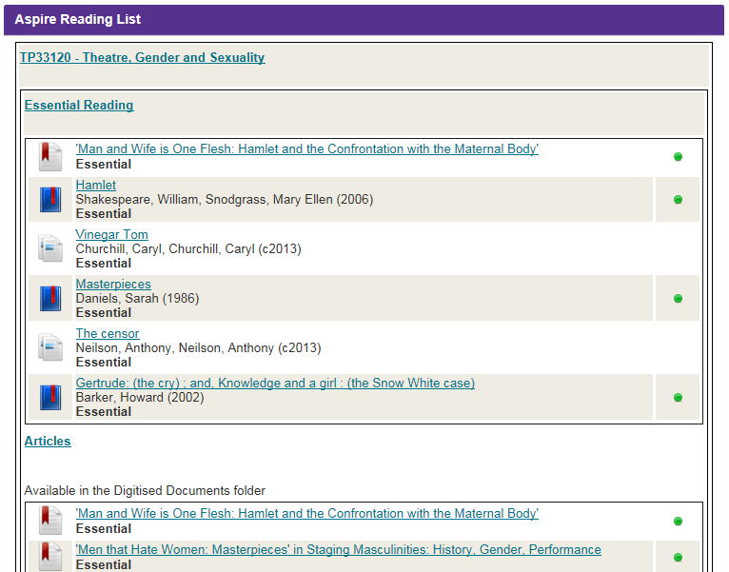
Notes:
One hour after publication – anyone can find you lits online, it is also linked to the modules database
Your students sees this in BB (left menu – Aspire reading list)
Links to chapters will click through to Primo records until the digitisation is done
Where an ebook or online article is already available, your student wills already be able to access them

Slide 7
Aspire deadlines: to spread the load
Ensure your reading list has been added/updated and (re)published by the deadline so that purchases and digitizations can be completed before the start of term.
Distance Learning: 30th June
Semester 1: 31st July
Semester 1 & 2: 31st July
Semester 2: 30th November
N.B. Ensure the reading list is published at least once in the 12 months prior to the Semester deadline or it will not be digitized.
Notes:
This is our attempt to spread the load for the staff digitising in the library. If you miss the deadline they will still digitise your chapters but cannot guarantee it will be ready for the start of teaching.
You must do a re-publish your list at least once in the 12 months before its semester; this is to ensure that the library staff know they are are working on lists that are current and being maintained.

Slide 8
Checklist
To ensure your reading list is digitised as quickly as possible please ensure the following
  Check and update your Aspire list at least once per year
  Meet the semester deadline!
  Supply the page numbers
  Supply the chapter title if there is one
  For a chapter in an edited book, supply the chapter author
  Note for library “Please digitise”
  Remember to (re)publish!
  And finally, ensure the reading list is published at least once in the 12 months prior to the Semester deadline or it will not be digitized.
Notes:
Yes I am repeating myself;f

Slide 9
What happens next
When the Aspire reading list is (re)published, Library staff are notified and your list is assigned to a member of staff who will process the whole of your list.
Notes:
Non!!!!!!!!!!!!!!!!!!!!!!!

Slide 10
Summer 2016: the Digital Content Store
The Library became a member of the Copyright License Agency’s Digital Content Store (DCS)
a cloud-based store of scans
we can use scans made by other member university libraries in the DCS and they can use ours
we can scan 10% of a book!
Notes:
Non

Slide 11
How digitisation works
Library staff check the availability of copyright cleared sources
  First, the Digital Content Store to see whether a scan has already been made by another university
  If not, whether we scan from our library holdings where permissable
  If not, whether the British Library hold a copy that we are permitted to request
Notes:
Speeds things up!
These scans are copyright cleared

Slide 12
If the source is excluded
A book chapter may have been excluded from scanning by the publisher.
If your chapter has been excluded, library staff have access to a copyright checking tool and will paste advice about any photocopying rights available for that chapter into an email to Aspire reading list owners so they know their options

Slide 13
New: direct links from the Aspire list
Library staff have begun pasting Digital Content Store links into the corresponding items in Aspire reading lists
What students will see in 2017-2018
Live demo: FM21220
When Library staff are processing your list they will contact you directly if there are questions related to the items on your list
When Library staff have completed processing your list, you will receive an automated message from Aspire to let you know so you can check it in Blackboard.
Notes:
Log into Blackboard with IE
FM21220 (Contemporary Television Drama
Follow the link in the list in the Week 2 section
There has been some development work in Blackboard Aspire widget and a change of workflows – testing with

Slide 14
What’s next?
For 2017-2018
As all digitised reading will be linked directly to Aspire Reading Lists, the old Digitised Documents folders will be removed from Blackboard modules
The Aspire Reading List page in Blackboard will be updated to reflect the changes

Slide 15
Help, advice and training
Contact Academic Engagement (your subject librarian)
Step-by-step guides, FAQs and videos https://faqs.aber.ac.uk/802
New set of training sessions in the CDSAP course list
Permanent offer of one-to-one help at your convenience

Slide 16
Any questions?
Joy Cadwallader
Academic Engagement (Learning & Teaching Support)
jrc@aber.ac.uk 01970621908 @aberlibjoy
Non Jones
Customer Services (Lending Team)
nrb@aber.ac.uk 01970622397

Slide 17
Reference links
Aspire Reading Lists http://aspire.aber.ac.uk/
CLA: HE Licence Documents https://www.cla.co.uk/higher-education-licence-docs
Reading List Policy https://www.aber.ac.uk/en/is/regulations/reading-list-policy/
Reading list blog http://aberssel.blogspot.co.uk/search/label/reading%20lists
Aspire FAQs
Add a chapter https://faqs.aber.ac.uk/607
Add an article https://faqs.aber.ac.uk/1176
Videos
Add a chapter https://hml.aber.ac.uk/Play/5930
Add an article https://hml.aber.ac.uk/Play/7239
CLA: Digital Content Store https://www.cla.co.uk/digital-content-store
University of Liverpool video https://stream.liv.ac.uk/4bt5nt6a
Kate McGuinn, Graham Stone, Alison Sharman, Emily Davison, (2017) Student reading lists: evaluating the student experience at the University of Huddersfield, The Electronic Library, Vol. 35 Issue: 2, pp.322-332, https://doi.org/10.1108/EL-12-2015-0252

