Slide 1
LEGO – the Building Blocks for Understanding Object-Oriented Programming
Helen Miles (hem23@aber.ac.uk)
Chris Loftus, Antonio Anjos, Wayne Aubrey

Slide 2
Background
First Year Computer Science:
  S1: CS12020 Introduction to Programming
  S2: CS12320 Programming Using an Object-Oriented Language
Students are introduced to two languages with different paradigms:
  C, a procedural programming language
  Java, an Object-Oriented (OO) Programming language
OO has been identified as a potential Threshold Concept in Computer Science [1]
This year we introduced a new tutorial using LEGO® SERIOUS PLAY® [2]

Slide 3
LEGO® SERIOUS PLAY® (LSP)
A methodology designed for playful exploration of innovation and business performance
Using a variety of LEGO pieces, participants construct a representation of the problem and explore ideas together.
LEGO allows for fast prototyping and the analysis of links between items, making it possible to quickly change things and try new ideas [3]
People think about a problem differently when:
  making things [4]
  using their hands [3]
  creatively challenged [5]

Slide 4
LEGO® SERIOUS PLAY® (LSP)
The process of an LSP activity follows four main steps:
  Facilitator poses a challenge
  Participants build models
  Participants explain their models
  Participants reflect on their models

Slide 5
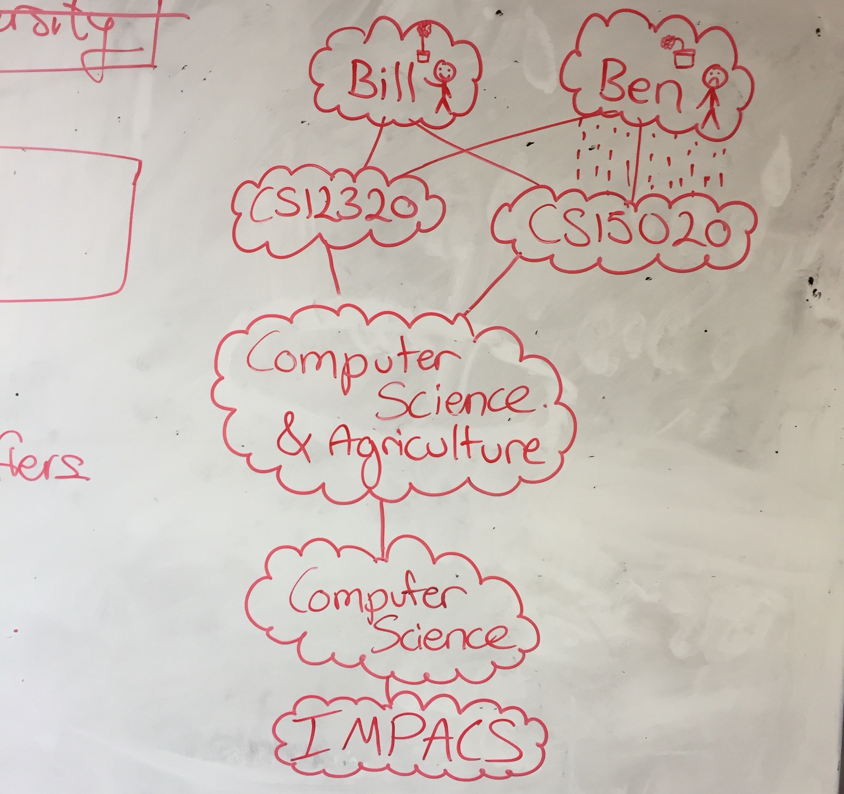
CS12320 Tutorial: Whiteboard Diagrams
Task: examine a problem statement and determine suitable objects for an OO program
Action: draw diagrams showing the connections between potential objects

Slide 6
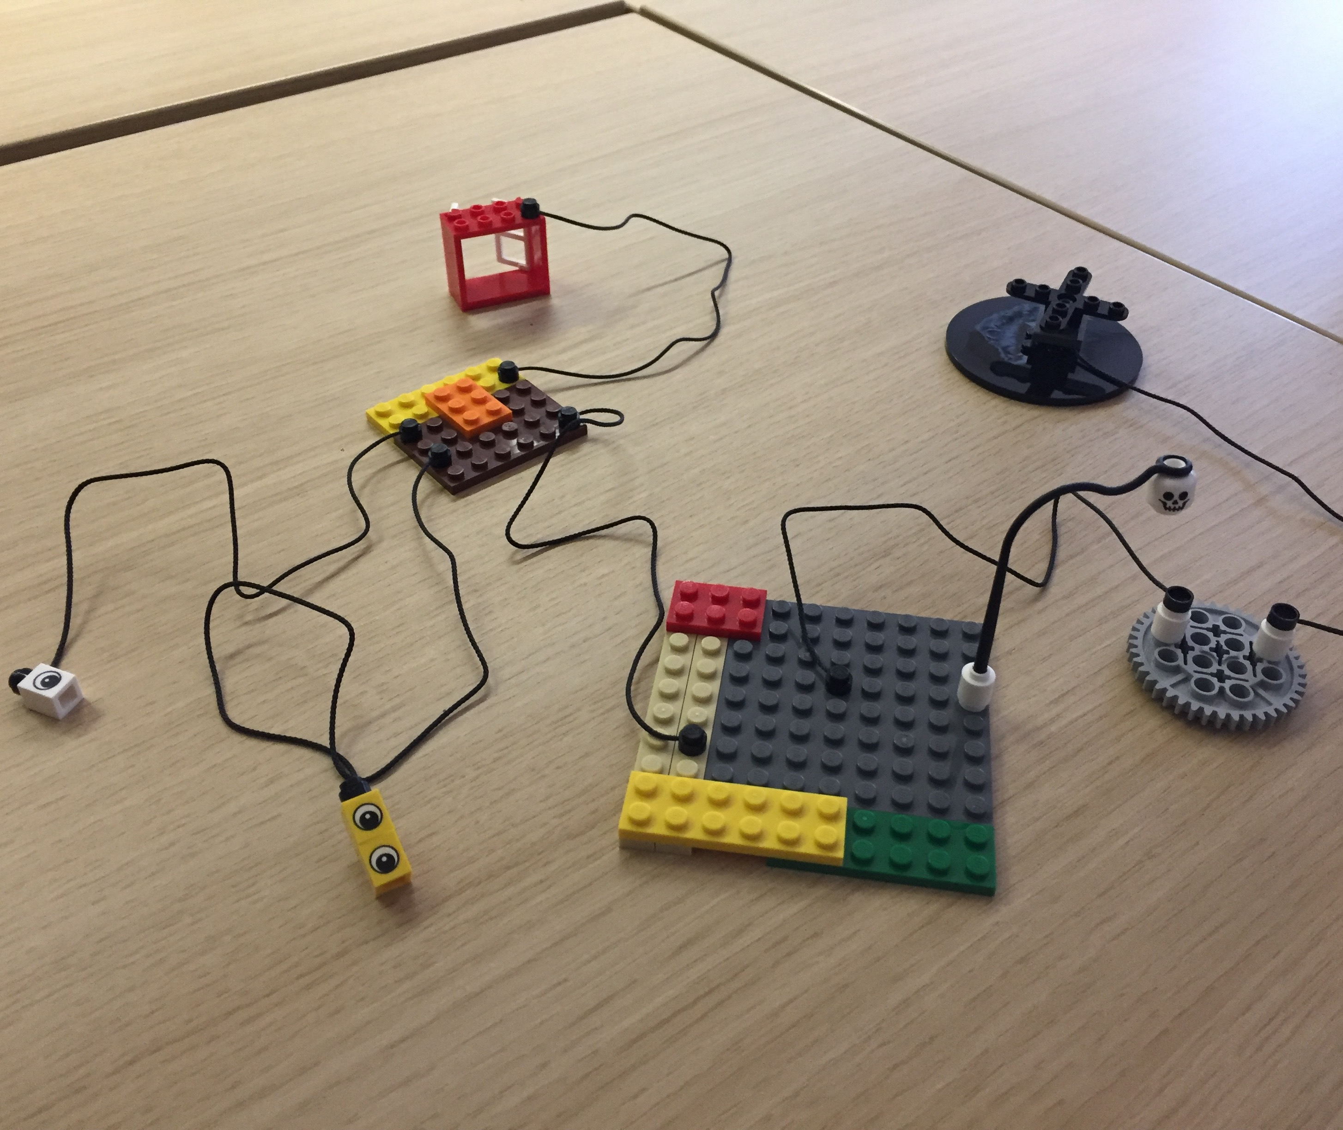
CS12320 Tutorial: LEGO® SERIOUS PLAY®
Task: examine a problem statement and determine suitable objects for an OO program
Action: create a LEGO representation showing the connections between potential objects

Slide 7
Action Research Project
Does LSP offer an additional method of exploring the task of identifying objects within a problem statement for OO?

Slide 8
Questions
Which of the two tutorials are most useful/preferred?
Does confidence grow on understanding of OO between tutorials?
  Does the order of the tutorials result in different amounts of confidence growth between weeks 1 and 2?
Does previous experience in OO affect the responses for most useful/preferred tutorial?
Does understanding of objects change differently during the two tutorials?

Slide 9
Gathering Data
12 tutorials per week
  CS12320: 11 x 17-18 students
  CC12320: 1 x 5 students
Compare the LSP and Whiteboard Diagrams (WBD) tutorials:
Week 1
  6 groups were randomly selected to start with LSP in first week
  Remaining 6 groups started with WBD
Week 2
  Both groups completed the second tutorial
Gathered questionnaire data after both tutorials for all groups

Slide 10
Questionnaires
Measured on a 4-point scale
  How clearly do you understand the concept of “objects” in an OO program?
  How much has your understanding of “objects” changed during the tutorial?
  How easy was it to represent objects during the tutorial exercise?
  How engaging was the tutorial exercise?
  Have you had any experience with OO Languages before CC/CS12320?
Free text
  Which of the two methods did you find the most useful? Why?
  Which of the two methods did you prefer? Why?
  General free text feedback area for each tutorial, and for overall

Slide 11
Which of the two tutorials do they cite as most useful / preferred?
No statistically significant difference between group ordering:
Most useful: F(1,98) = 0.79, p = 0.38
Preferred: F(1,98) = 2.48, p = 0.12
 | Useful | Preferred
LEGO | 33 | 53
Whiteboard | 56 | 39
Other | 11 | 8
Total | 100 | 100

Slide 12
Does confidence grow on understanding of OO Programming between tutorials?
Based on questions:
  How clearly do you understand the concept of “objects” in an Object-Oriented program?
  How much has your understanding of “objects” changed during the tutorial?
Flaw in questionnaire design: most participants reported highest level of confidence after first tutorial, so no increase could be measured
 | Q1 |  |  | Q2
 | After T1 | After T2 | Diff | After T1 | After T2 | Diff
Mean | 3.58 | 3.7 | 0.12 | 2.91 | 2.8 | -0.11
Mode | 4 | 4 | 0 | 3 | 3 | 0

Slide 13
Does confidence grow on understanding of OO Programming between tutorials?
Does the order of the tutorials result in different amounts of confidence growth between weeks 1 and 2?
  Examined question: How clearly do you understand the concept of “objects” in an Object-Oriented program?
  No statistically significant difference between group ordering:
    F(1,98) = 0.08, p = 0.08

Slide 14
Does previous experience in OO affect responses for most useful / preferred?
Previous experience with OO was found to have a statistically significant effect on responses for both questions
  Most useful: F(1,194) = 18.89, p = 2.23x10⁻⁵
  Preference: F(1,194) = 33.00, p = 3.52x10⁻⁸
Difficult to find any specific patterns in the data
  Statistics of small numbers problem?
 |  | Most Useful |  |  | Preference
Previous Experience | n | LSP | WBD | Other | LSP | WBD | Other
None at all | 38 | 29% | 58% | 13% | 50% | 42% | 8%
Some limited experience | 31 | 35% | 58% | 6% | 55% | 42% | 3%
Yes, a moderate amount | 21 | 33% | 52% | 14% | 57% | 29% | 14%
Yes, a great deal | 7 | 43% | 57% | 0% | 57% | 43% | 0%

Slide 15
Does understanding of objects change differently during the tutorials?
Examined question: How much has your understanding of “objects” changed during the tutorial?
Tutorial order was found to have a statistically significant effect on response
  F(1,198) = 282.76, p = 5.32x10⁻⁴⁰
Indicates that any change in understanding was between first and second tutorial regardless of tutorial modality
Response | LSP | WBD
Not at all | 11% | 8%
Not very much | 16% | 19%
A little | 57% | 51%
A lot | 16% | 22%

Slide 16
Further Questions… (1)
  Will ease of representing objects during the tutorial exercise be different for WBD and LSP?
  Will perceived engagement of the tutorial exercise be different for WBD and LSP?
Results:
  Both questions were asked independently for each tutorial
  Students generally rated the LEGO tutorial as easier and more engaging no matter which they did first
  Statistically significant difference between responses based on tutorial order:
    Ease: F(1,198) = 278.96, p = 1.17x10⁻³⁹
    Engagement: F(1,198) = 239.99, p = 5.58x10⁻³⁶

Slide 17
Further Questions… (2)
  Does the LSP activity work as a good icebreaker?
  Does the LSP contribute to tutorial retention?
Results:
  Questionnaires don’t ask the right questions for us to answer this
  Some feedback for thought:
    “It encouraged interaction with classmates”
    “Communication/feedback is key - good in this tutorial”
    “It was fun to use these and made it easy to work with others”
    “Lego Serious Play [was] was more relaxed”
    “whiteboard [was] much more interactive, however Lego was just getting used to the tutorial”
  Anecdotal evidence suggests it may not positively impact retention:
    more than one student remarked ‘I came because there was supposed to be Lego’ but did not come to the next tutorial anyway

Slide 18
Positive Feedback for LEGO
Should allow all further years to learn through Lego! Education should be both fun and informative.
It encouraged interaction with classmates
AMAZING, PLEASE AGAIN!!
It helped visualize the more abstract concepts of object orientation in a fun way so props to you
It was fun, but didn’t learn much A* for fun
It was fun to use these and made it easy to work with others
Communication/feedback is key - good in this tutorial
This was the best tutorial ever :)
Having something tangible to build and see was useful and different. We have seen class diagrams in lectures.

Slide 19
Positive Feedback for Whiteboard
Fairly well structured, probably a lot more helpful for people with less prior knowledge :)
Good exercise, physically drawing on board helped understanding.
Very good for making you think about how to link objects and figure out what attributes go where
Whiteboard task meant we had to talk so made session less awkward
It took a while to get into the tutorial but in the end I understood the topic better. We got constant feedback instead of just when we were explaining our design in Lego.
[Preferred] whiteboard - less distracting
[Preferred] whiteboard - required more planning and depth = better learning

Slide 20
Negative Feedback
LEGO
  Worksheet wasn’t too clear on what was wanted
  Some lego pieces were far too sparse, and too many strange non-useful pieces
Whiteboard
  Felt ‘stunted’, took time to get tangible out- put. First part of worksheet felt unnecessary
  Make the ”mission statement” less vague, more detailed definitions

Slide 21
Conclusions
  Students indicated that both tutorials were useful and engaging
  This suggests that both tutorials have merit
    Different tutorials may appeal to different learning styles
  Lessons learned:
    Not all students will like LEGO, some are very creative
    Need to maintain direction for some students!
    It can be difficult to get them to reflect on their design
    It is very interesting to observe the process
    It actually takes a while for the rumours to propagate; feedback from Friday tutorials of first week:
      “not enough Legos.”
      “I heard there was supposed to be lego.”
      “We were promised lego’s by other students. They lied”
      “I WANT LEGO”

Slide 22
References
https://www.lego.com/en-gb/seriousplay/
LEGO® SERIOUS PLAY®, LEGO and the methodology belong to © 2017 The LEGO Group
J Boustedt et al. Threshold concepts in computer science: do they exist and are they useful? In ACM SIGCSE Bulletin, volume 39, pages 504–508. ACM, 2007.
E Frick, S Tardini, and L Cantoni. Lego serious play. Universit`a della Svizzera italiana, Lugano, Switzerland, 2013.
D Gauntlett and P Holzwarth. Creative and visual methods for exploring identities. Visual Studies, 21(01):82–91, 2006.
IE Harel and SE Papert. Constructionism. Ablex Publishing, 1991.
M Csikszentmihalyi. Flow: The psychology of optimal performance. Cambridge University Press, 1990.
S Kurkovsky. Teaching software engineering with lego serious play. In Proceedings of the 2015 ACM Conference on Innovation and Technology in Computer Science Education, pages 213–218. ACM, 2015.

Slide 23
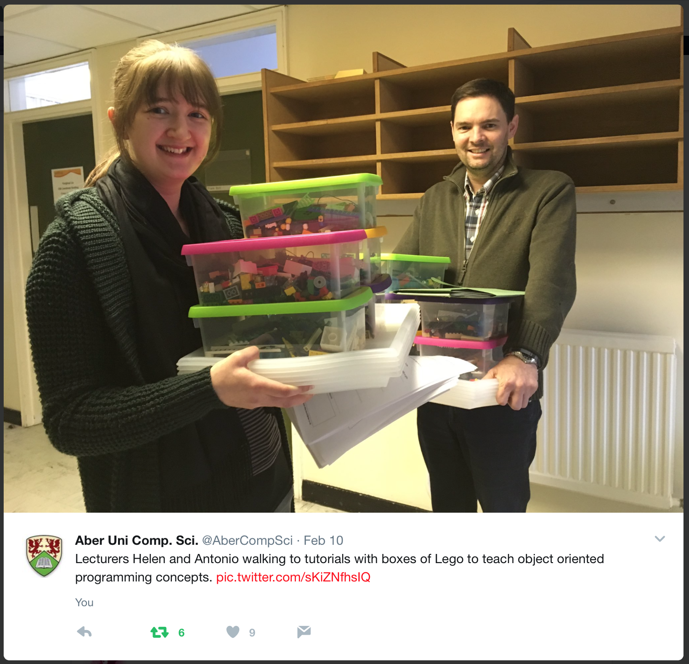
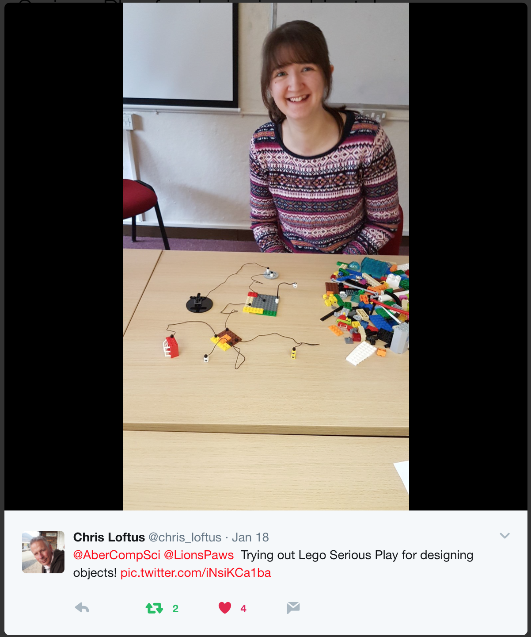
Thank you!

