Slide 1
Polling to boost student confidence and promote inclusivity
Anonymous
<
Dr Chrissy Stanley christina.stanley@chester.ac.uk
@crstanley_rsrch

Slide 2
Plan for this session:
Evaluate importance of anonymity in polling
Consider whether anonymity is particularly beneficial for certain groups of students
Overview of ongoing research project
Co-create guidelines for effective use of polling

Slide 3
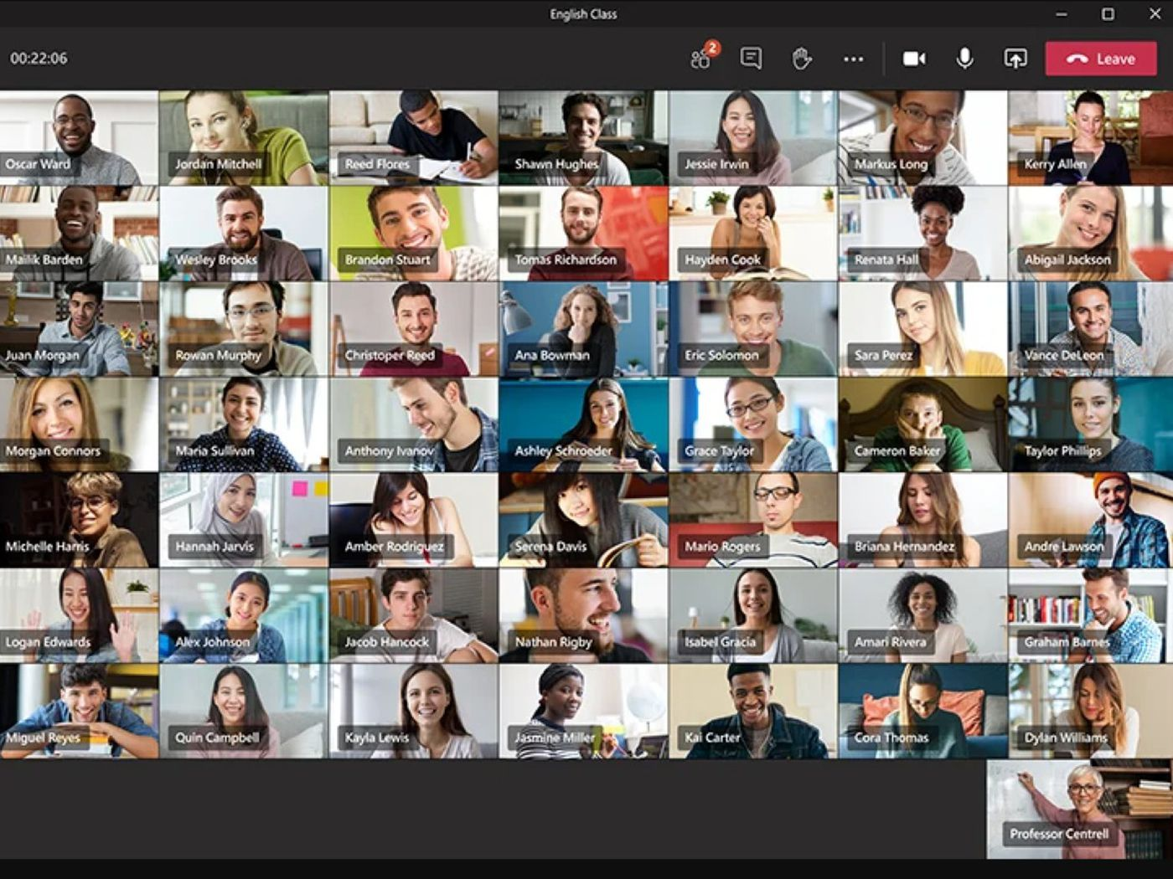
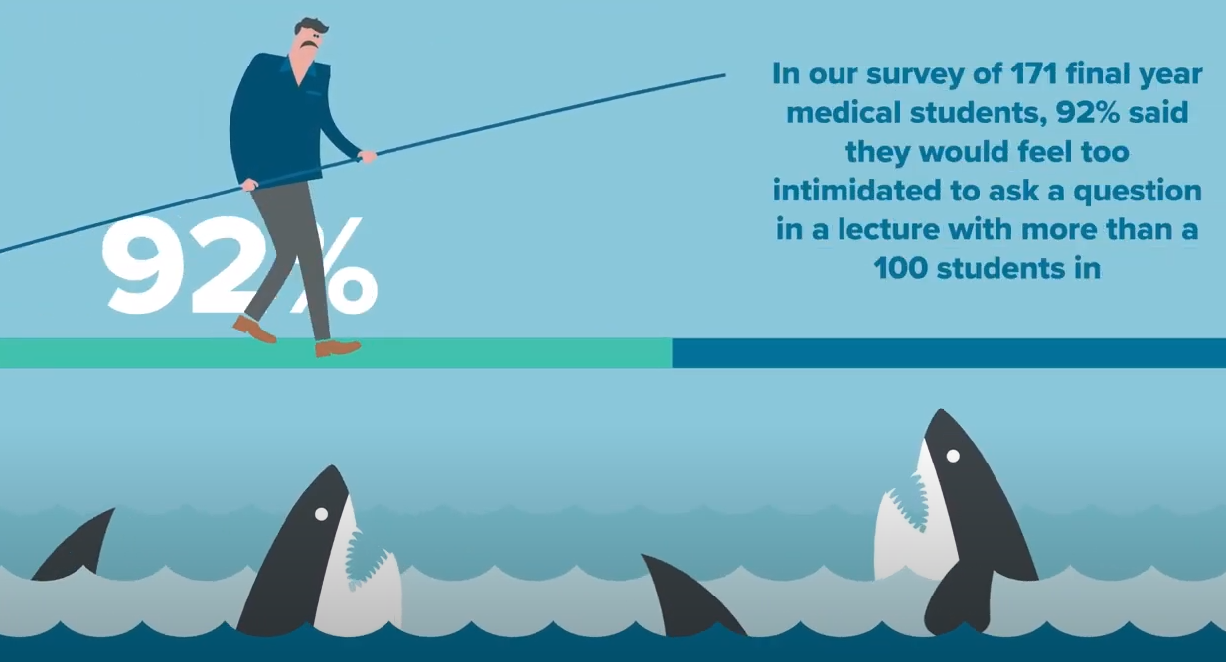
Sudden transition to online learning…
theverge.com
Farrow, 2018

Slide 4
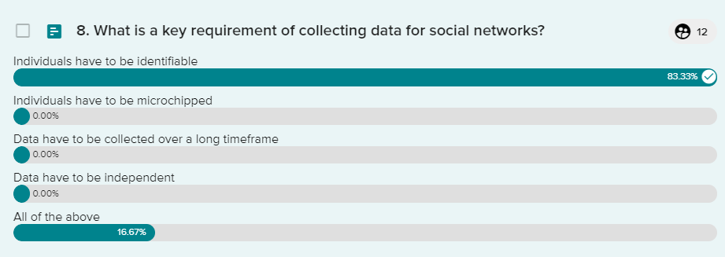
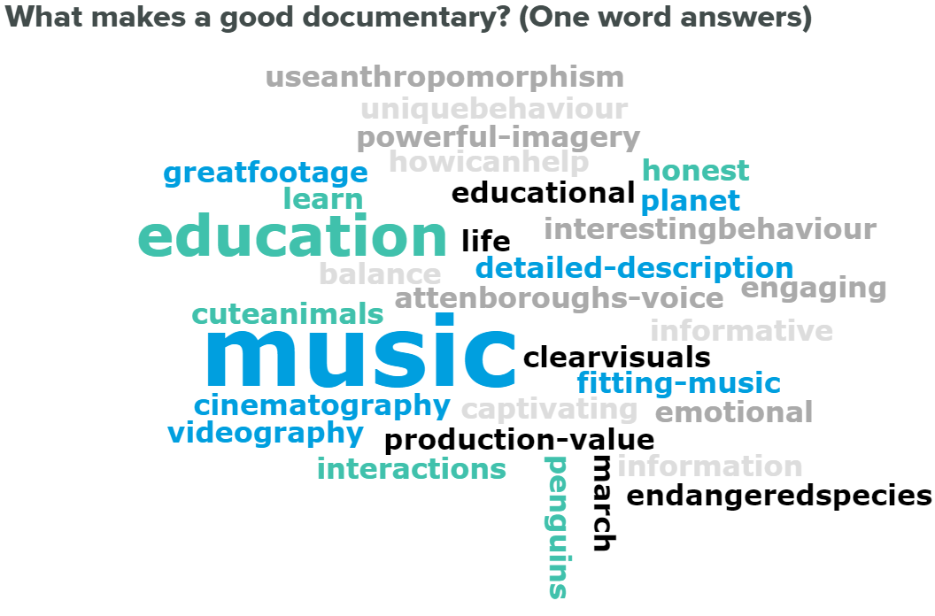
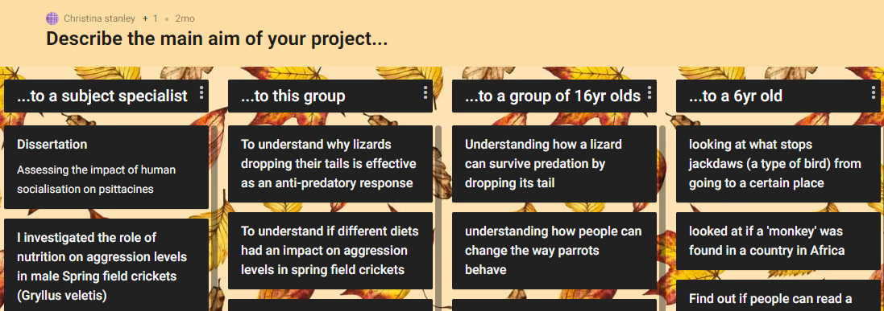
Allowing anonymity appeared to improve engagement
Farrow, 2018
www.vevox.com

Slide 5
Allowing anonymity appeared to improve engagement
Nothing new…
Anonymity can increase engagement/interaction, especially where students less confident in their answer (Freeman & Blayney, 2005; Siau et al 2006)
Allows non-threatening exploration of answers/
discussion of ideas (Davis, 2003)
Decreases negative emotions associated with answering a question in class – anxiety, fear, pressure & embarrassment (Barr, 2017)
Avoids discussion being dominated by the more
confident students in the class (Fies & Marshall, 2006)
Farrow, 2018
www.vevox.com

Slide 6
Is anonymity beneficial for students in the long-term?
4

Slide 7
A few thoughts…
Is anonymity beneficial for students in the long-term?
It could improve confidence over time – scaffolding effect – when do we remove scaffolding and how?
It could be detrimental to learning, due to having less personal responsibility (McKeachie and Svinicki, 2006)
Is it realistic/does it boost employability?

Slide 8
By removing social constraints, reduces impact of social norms; individuals can interact more fully & equally (Flanagin, Tiyaamornwong, O’Connor, & Seibold, 2002)
Useful for students who are shy (Fies, 2005), in a new/unknown group (Draper & Brown, 2004)
SPLDs?
Mental health diagnoses?
Neurodivergent?
English as 2nd language?
Gender?
Age?
Personality?
Are there certain groups of students for whom anonymity is beneficial?
Equality of opportunity
1

Slide 9
Aim: to explore student perceptions around active participation in university seminars/lectures
Why? By understanding students' feelings around participation and exploring potential barriers to this, we can ensure our learning and teaching methods are accessible to all, both here & elsewhere
Research study – student self-confidence and feelings around participation in university teaching sessions
“We would like you to complete a questionnaire – here is the link. You do not have to do this, it is not part of your learning on this module, but your answers will be really useful to us!”
“We will also be recording (ANONYMOUSLY) the number of students participating actively in the sessions in this module”

Slide 10
Project outline
6 first year modules in Faculty of Medicine & Life Sciences
3 randomly assigned “experimental”, 3 “control”
Initial questionnaire distributed, follow up questionnaire in session 5
Data collected on participation rates (standardised protocol)
Focus groups to be held in 2022
Progress: 4 modules almost complete, 2 starting after Christmas
Data from initial questionnaire visualised

Slide 11
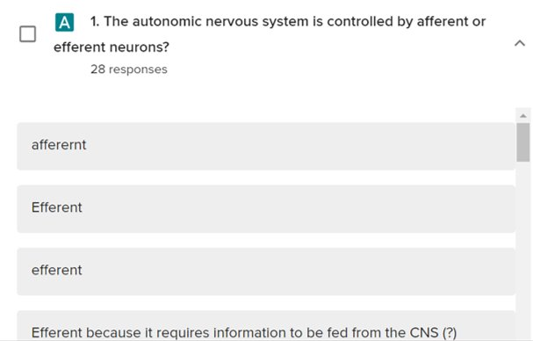
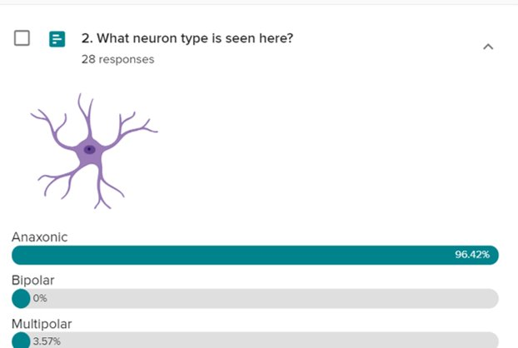
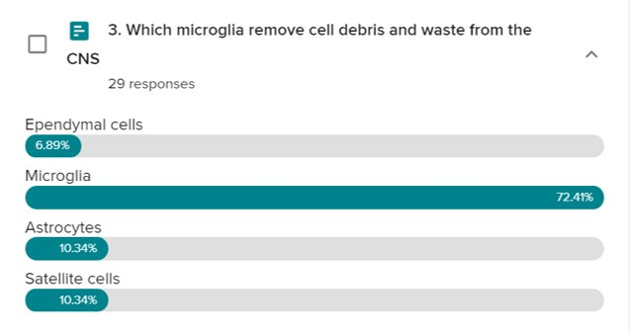
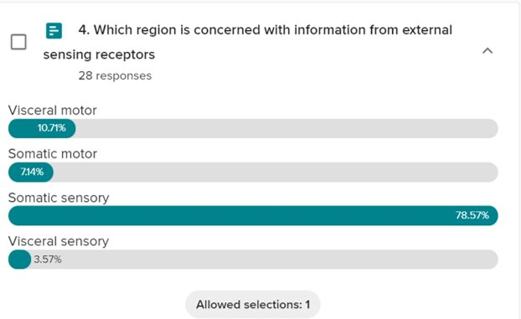
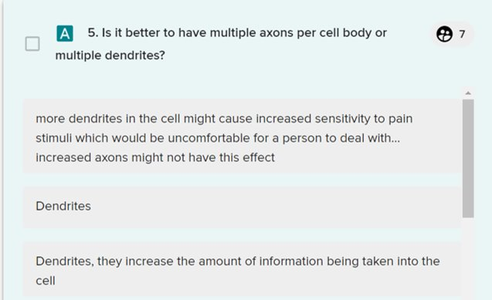
Example questions

Slide 12
Co-create guidelines for effective use of polling
Padlet:
https://uochester.padlet.org/christinastanley1/dhifdzqf06d2hyrz
What have we learnt?

Slide 13
Any questions?
Thanks go to:
Michelle Cordingley
Michael Randles
Lizzy Deery
Gareth Nye
Tanja Harrison
Grace Smith
Amie Fletcher, Joe Probert, Izzy Whitley
Vevox for funding the research project

Slide 15
References
Barr, M. L. (2017). Encouraging college student active engagement in learning: Student response methods and anonymity. Journal of Computer Assisted Learning, 33(6), 621-632.
Davis, S. (2003). Observations in classrooms using a network of handheld devices. Journal of Computer Assisted Learning, 19, 298–307 https://doi.org/10.1046/j.0266- 4909.2003.00031.x.
Draper, S. W., & Brown, M. I. (2004). Increasing interactivity in lectures using an electronic voting system. Journal of Computer Assisted Learning, 20, 81–94 https://doi.org/ 10.1111/j.1365-2729.2004.00074.x
Farrow, E. (2018). Vevox breaks down barriers in medical education. Accessed on 29/6/20 - https://www.vevox.com/blog/2017/vevox-breaks-barriers-in-medical-education
Fies, C. H. (2005). Classroom response systems: What do they add to an active learning environment? (Doctoral dissertation, University of Texas at Austin, Austin, TX). Retrieved from http://search.proquest.com/docview/ 305391634?accountid=9840
Fies, C., & Marshall, J. (2006). Classroom response systems: A review of the literature. Journal Science Education and Technology, 15, 101–109 https://doi.org/10.1007/s10956- 006-0360-1.
Flanagin, A., Tiyaamornwong, V., O’Connor, J., & Seibold, D. R. (2002). Computer-mediated group work: The interaction of sex and anonymity. Communication Research, 29, 66–93 https://doi.org/10.1177/0093650202029001004.
Freeman, M., & Blayney, P. (2005). Promoting interactive inclass learning environments: A comparison of an electronic response system with a traditional alternative. Proceedings from the 11th Australasian Teaching Economics Conference, pp. 23–34. Retrieved from http://ses.library.usyd.edu.au/ bitstream/ 2123/199/1/03%20Freeman%20Blayney.pdf
McKeachie, W. J., & Svinicki, M. (2006). McKeachie’s teaching tips: Strategies, research, and theory for college and university teachers (12th ed.). Boston, MA: Houghton Mifflin.
Siau, K., Sheng, H., & Nah, F. F. (2006). Use of a classroom response system to enhance classroom interactivity. IEEE Transactions on Education, 49, 398–403 https://doi.org/ 10.1109/TE.2006.879802.

