Slide 1
Embracing Virtual Reality within Healthcare Education for student nurses Cofleidio Realiti Rhithiol o fewn Addysg Gofal Iechyd i fyfyrwyr nyrsio
Amanda Jones- Principal Lead & Bleddyn Lewis- Senior Lecturer Mental Health & BSc Scheme Coordinator

Slide 2
Nodau’r Cyflwyniad ͠ Presentation Aims
Hanes ble rydym ni nawr
Pam mae rhith-realiti yn bwysig mewn addysg gofal iechyd
Sut bydd hyn yn cael ei roi ar waith mewn addysg gofal iechyd
Cynlluniau a rhagolygon ar gyfer y dyfodol
History of where we are now
Why is virtual reality important in healthcare education
How will this be implemented in healthcare education
Future plans and prospects

Slide 3
Hanes – History
Just over 2 years in developing healthcare education (nursing) at Aber University
Sept 2020 saw the new implementation of the NMC pre-registration nursing education standards
September 2022 – first professional programme in Aber Uni for Mental Health & Adult fields BSc Pre-registration nursing

Slide 4
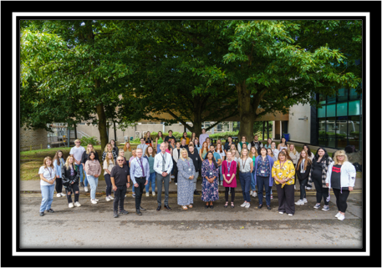
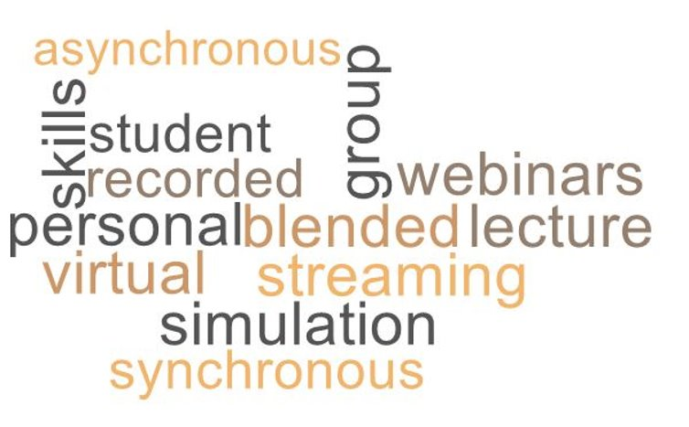
Canolfan Addysg Gofal Iechyd – Healthcare Education Centre
6 Academic staff appointed- variety of academia & clinical expertise and backgrounds
More recently Clinical skills & simulation technician- Welsh ambulance EMT background
Passionate about providing alternative experiences within our nursing programmes AU
BLENDED LEARNING DELIVERY MODEL

Slide 5
Evidence to Support
NMC Standards (2020) & HEIW ‘Once for Wales' are encouraging a more up to date pre-registration education for student nurses
Saab et al. (2021)- explored nursing students views on use of VR
- enjoyable & interactive
-supports a variety of learning styles
- inclusion of VR should be a priority in developing nurse education
Competitive across institutions who deliver healthcare programmes
Recognition of ongoing research requirements

Slide 6
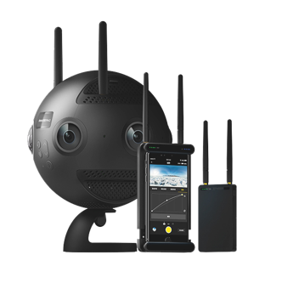
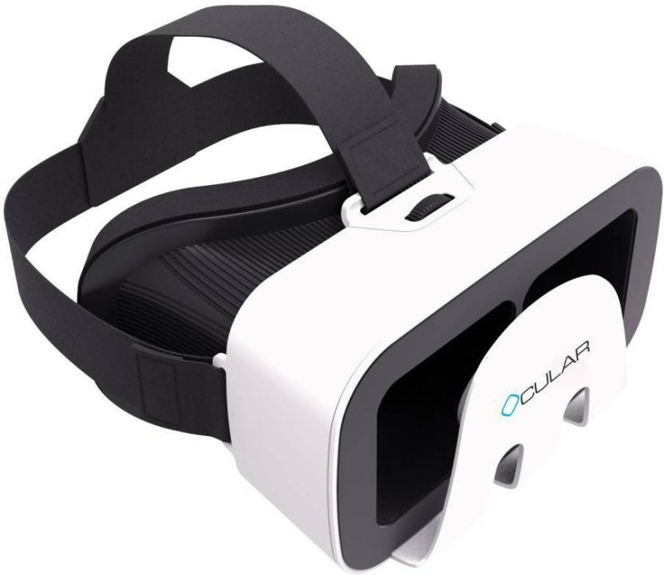
Embracing Virtual Reality- How?

Slide 7
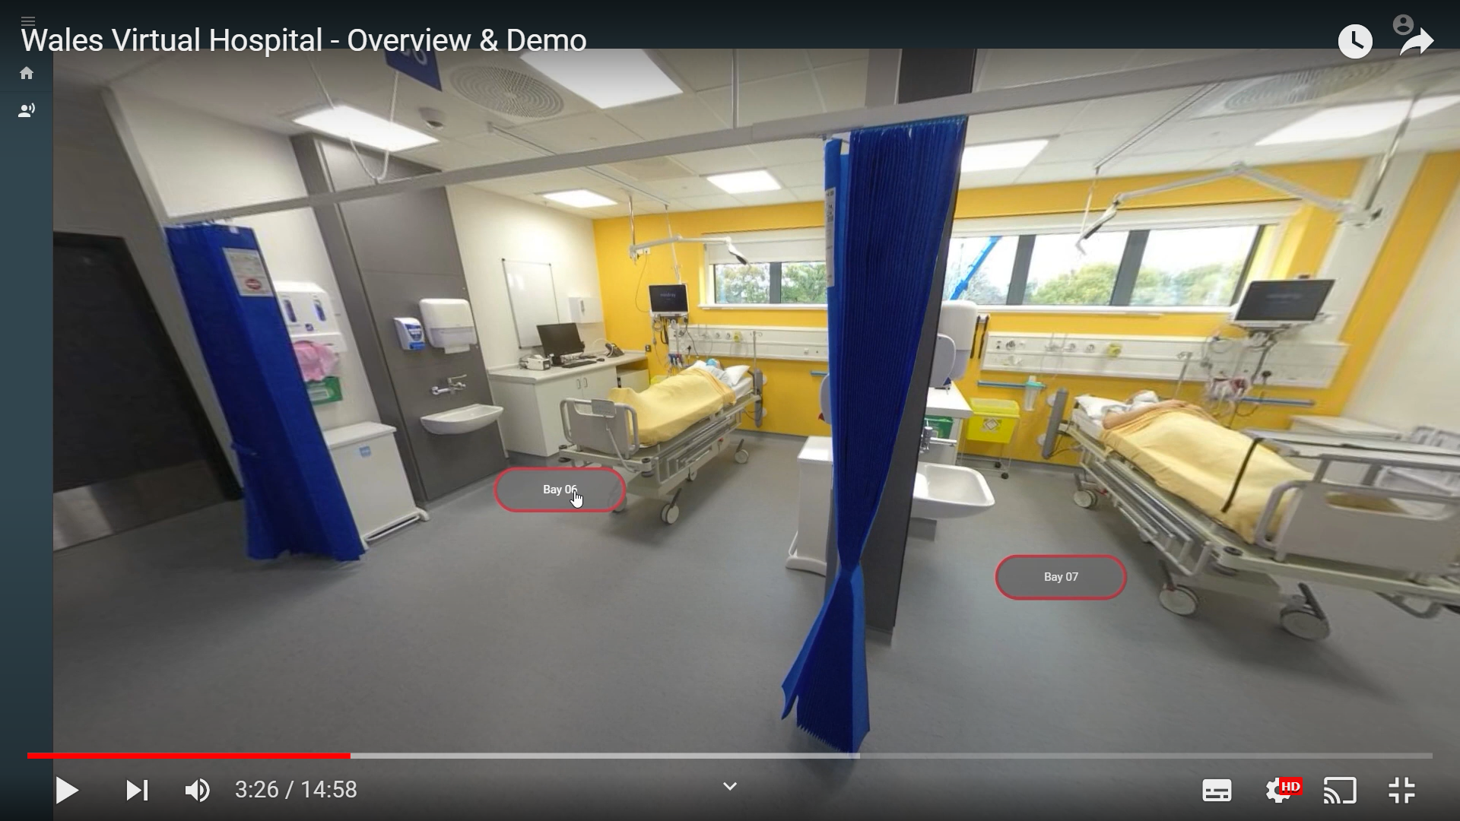
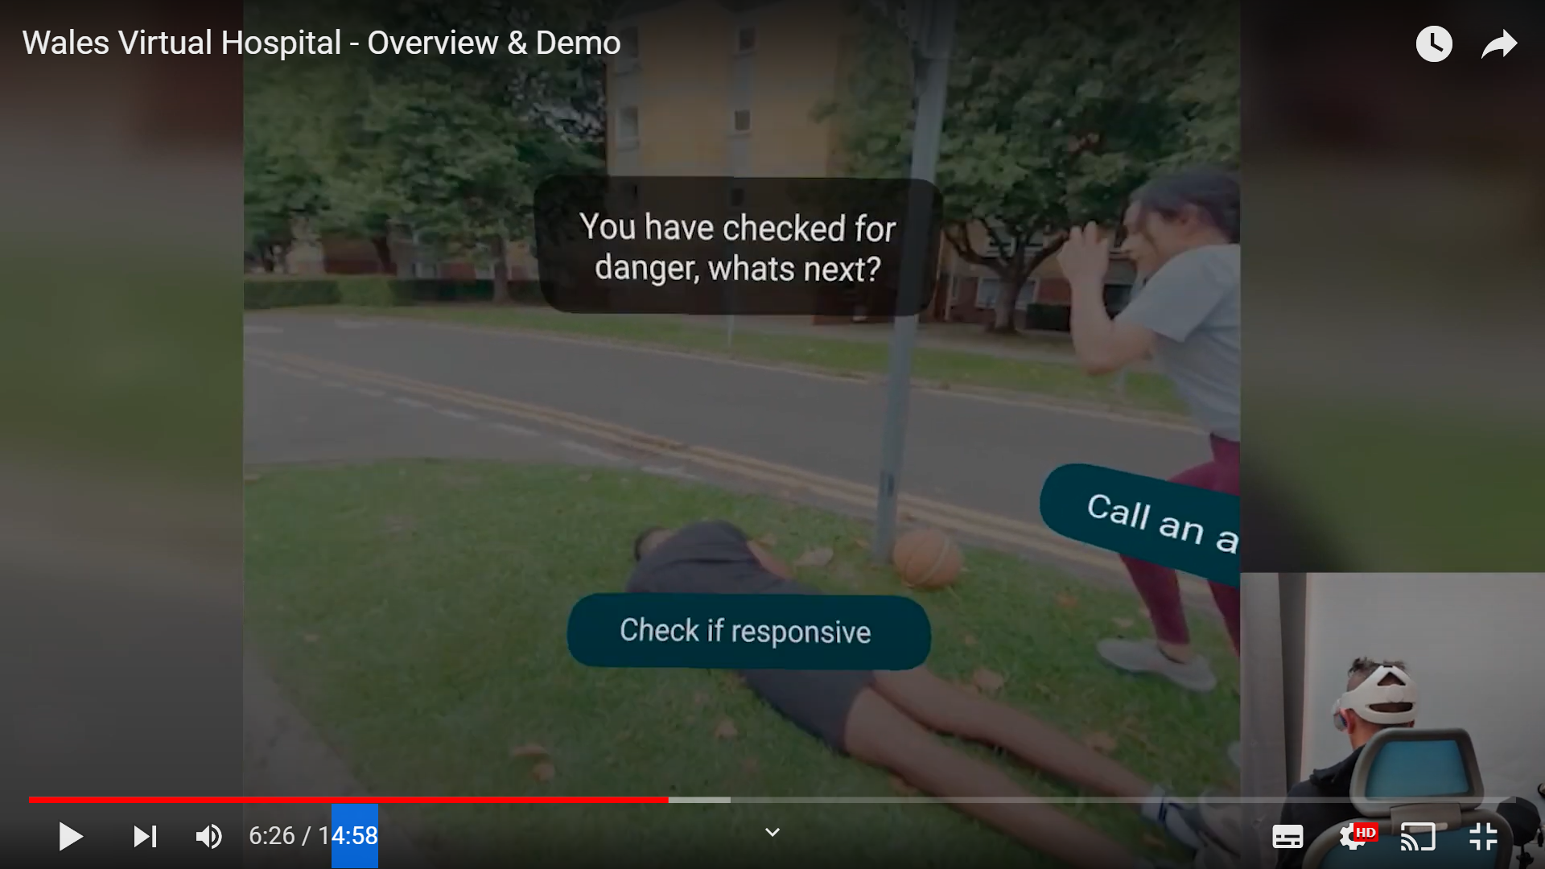

Slide 8
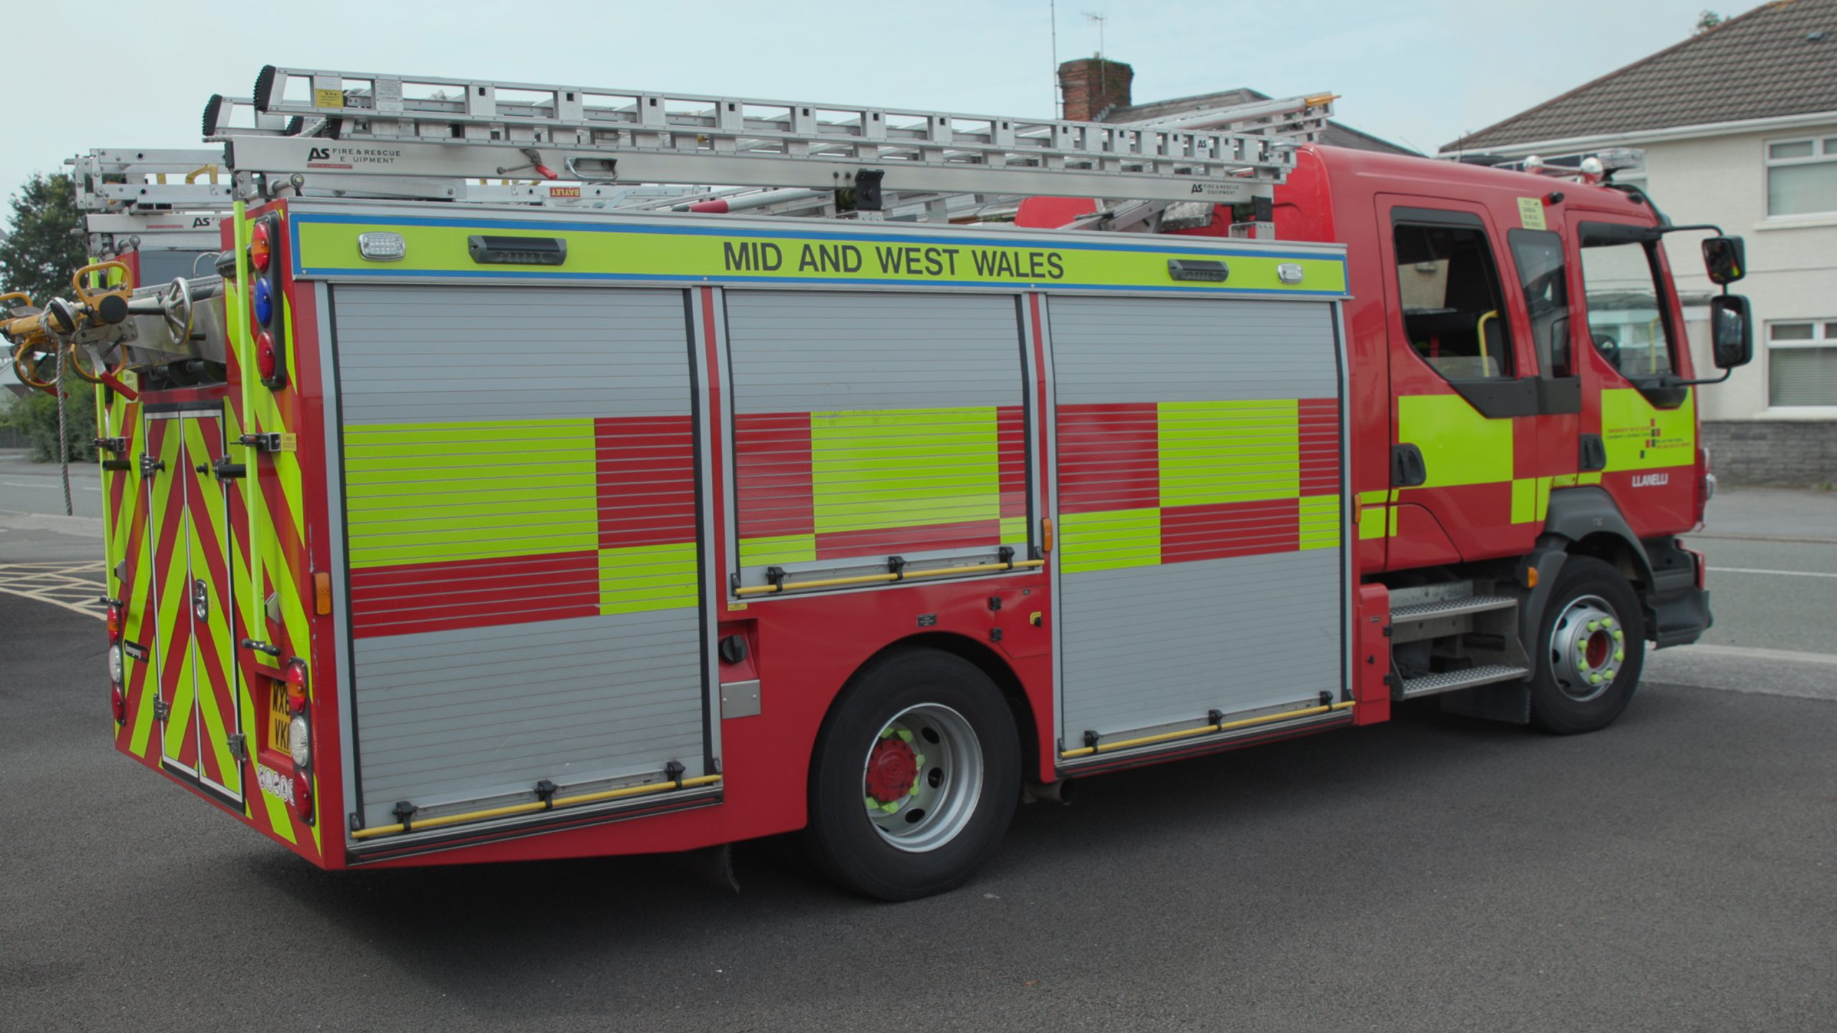
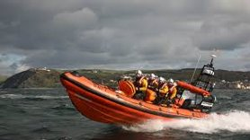
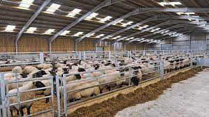
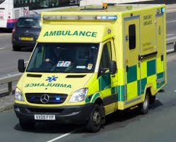
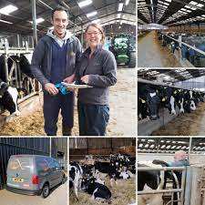

Slide 9
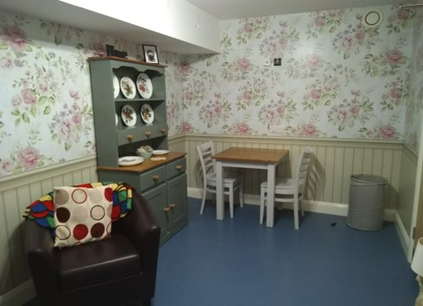
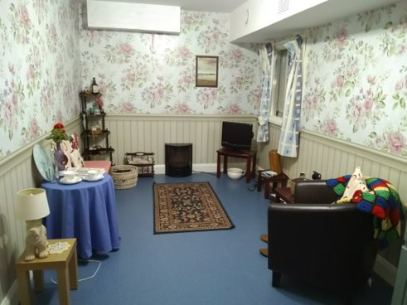
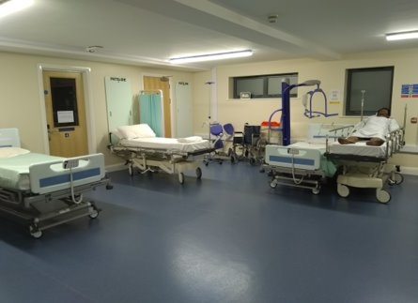
Y Dyfodol- Future Plans & Prospects

Slide 10
Use of VR around Mental Health Simulation

Slide 11
Diolch am Wrando / Thank you for listening
Cwestiynau? Questions?
Amanda Jones: amj36@aber.ac.uk
Bleddyn Lewis: bll10@aber.ac.uk

