Slide 1
‘Through their eyes’: virtual experience as a help-seeker of domestic violence and abuse

Slide 2
Investigators
Helen Miles, Andra Jones, | Rebecca Zerk, Sarah Wydall, Elize Freeman, | Natalie Hancock
Department of Computer Science, Aberystwyth University | Dewis Choice@ The Centre for Age, Gender and Social Justice, Aberystwyth University | Violence Against Women, Domestic Abuse and Sexual Violence (VAWDASV) in Mid and West Wales

Slide 3
“
And that's where I think we just start to scratch the surface of the true power of virtual reality. It's not a video game peripheral. It connects humans to other humans in a profound way that I've never seen before in any other form of media. And it can change people's perception of each other. And that's how I think virtual reality has the potential to actually change the world.
So, it's a machine, but through this machine we become more compassionate, we become more empathetic, and we become more connected. And ultimately, we become more human.
”
“How virtual reality can create the ultimate empathy machine” – Chris Milk, TED 2015

Slide 4
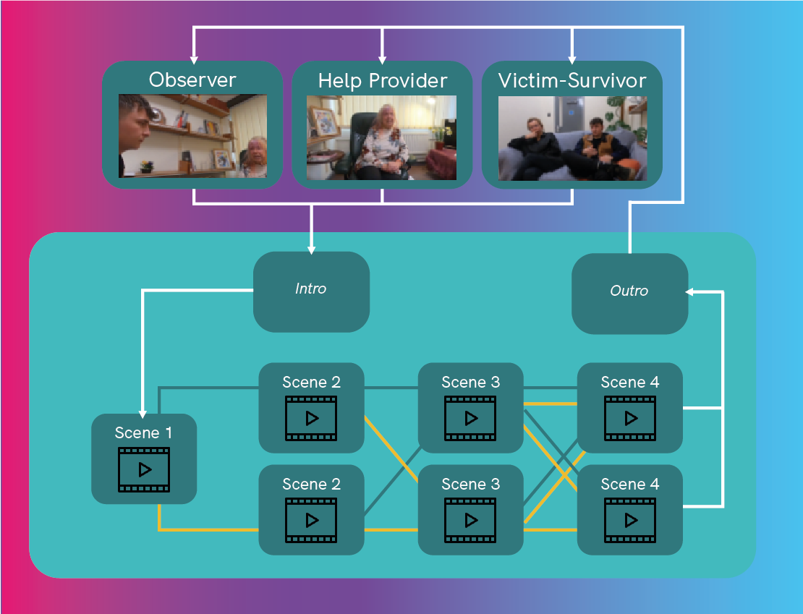
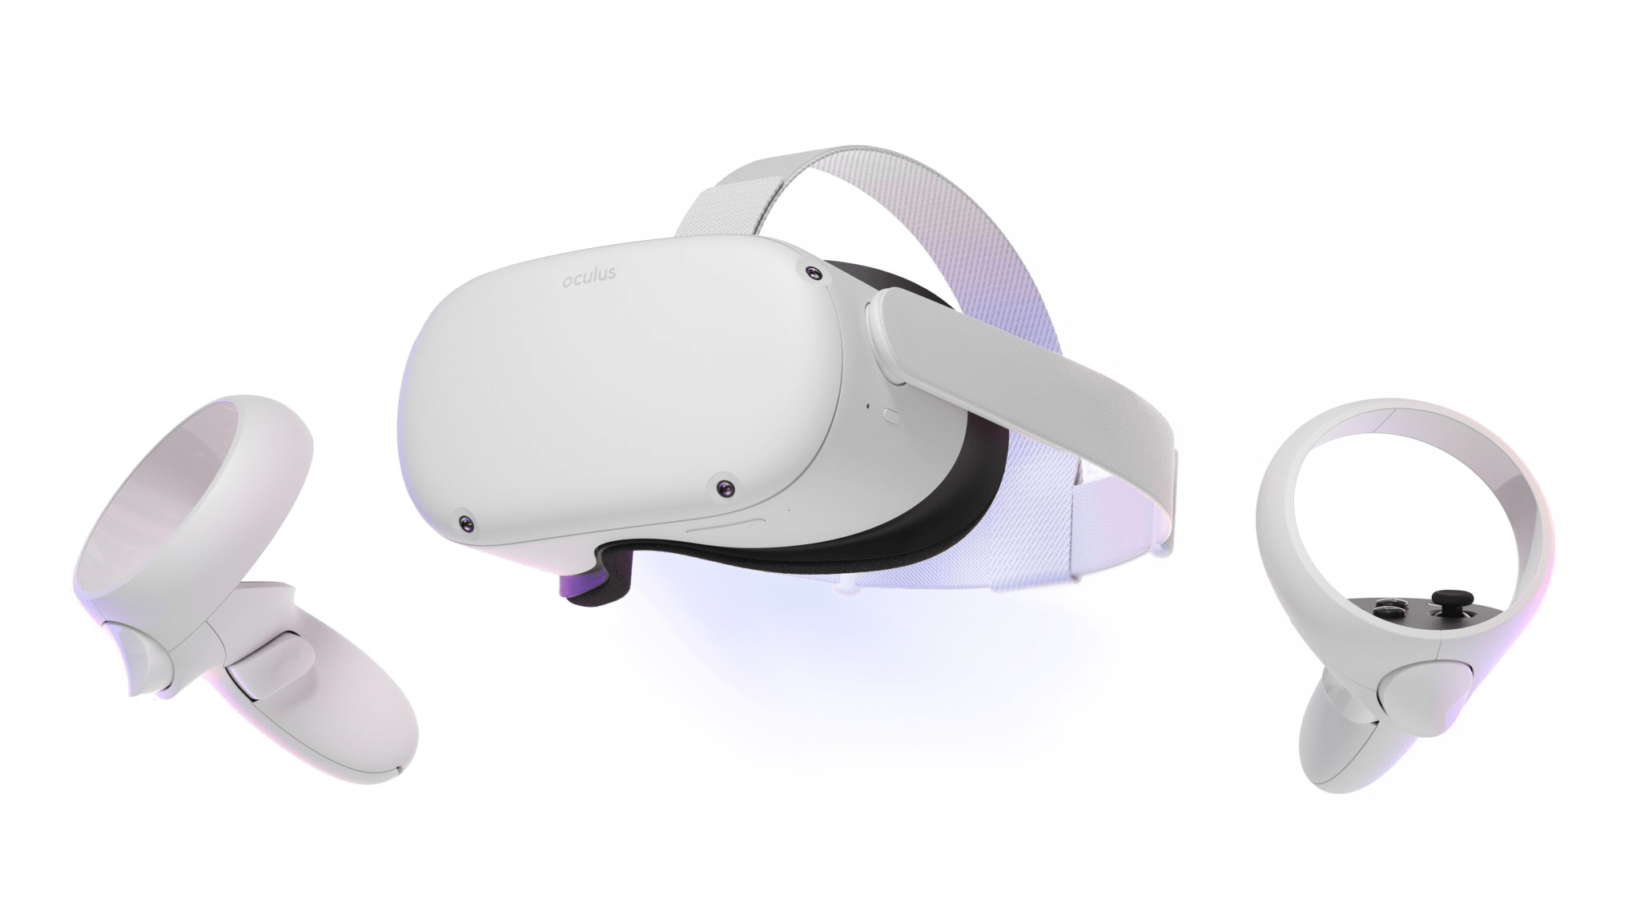

Slide 5
“
The Virtual Reality training tool provided me with an experience I have not felt during any of my 21 years [working in this area]
The ability to see through the eyes of a survivor really challenged my extensive experience in dealing with cases of domestic abuse
[It could be] very useful in challenging practitioners who may have lost empathy and become desensitized to the experience of victims
”

