Slide 1
Using Virtual Reality Headsets in Education
Dr stephen atherton
School of education
Aberystwyth university

Slide 2
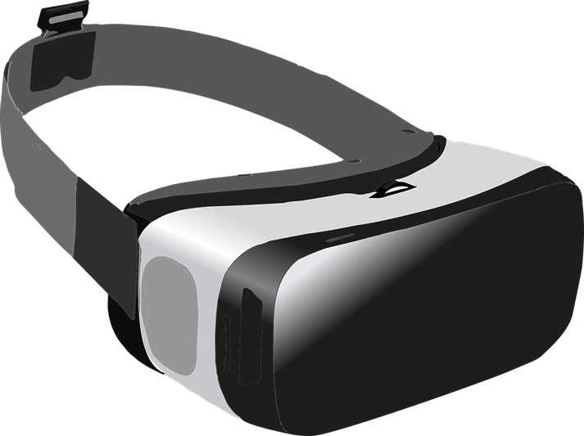
Outline
Using VR for learning and teaching
Future plans
Interaction

Slide 3
Cardboard Camera
Google Cardboard Camera
360 pictures that can be taken from most mobile phones and then viewed on pc, tablet, mobile or VR headset.
Potential to develop further content for academic purposes.

Slide 4
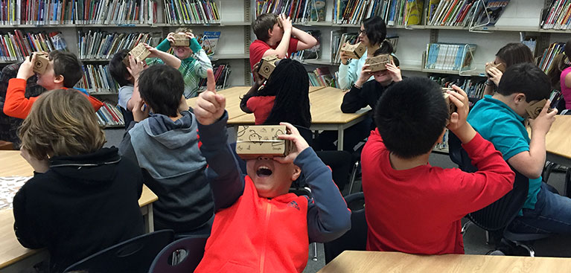
Google Expeditions

Slide 6
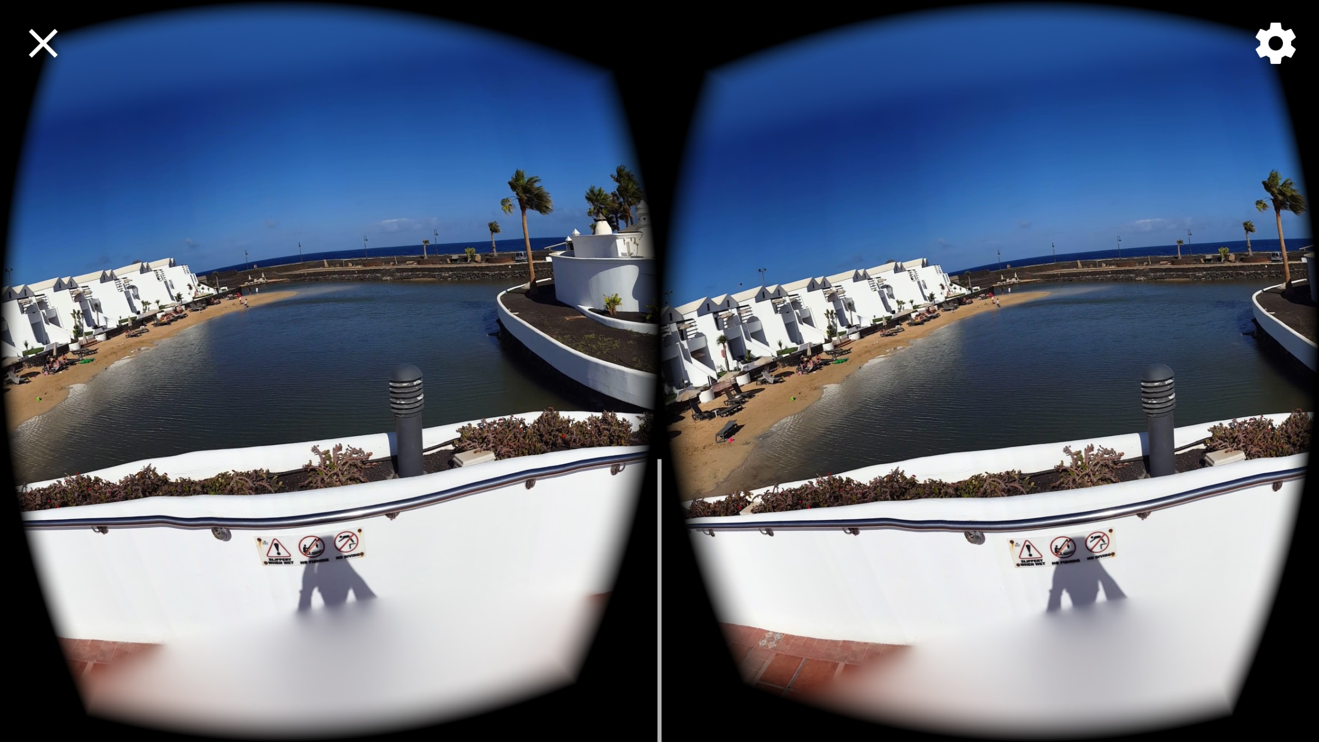

Slide 7
Using VR in Teaching
ED12820- Gender, International Development and Education
ED13720- Play and learning
ED13820- Learner and Learning Environment
ED33020- Communicating Science
Bring Your Own Device (BYOD)

Slide 8
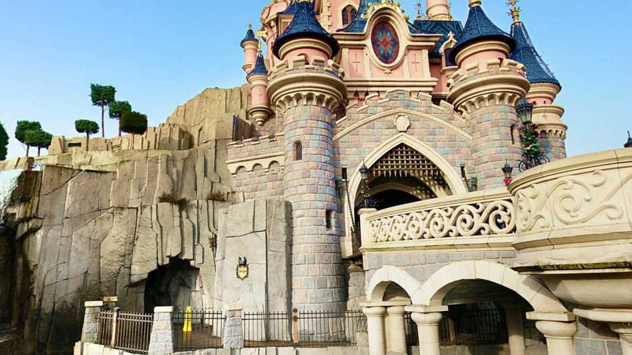
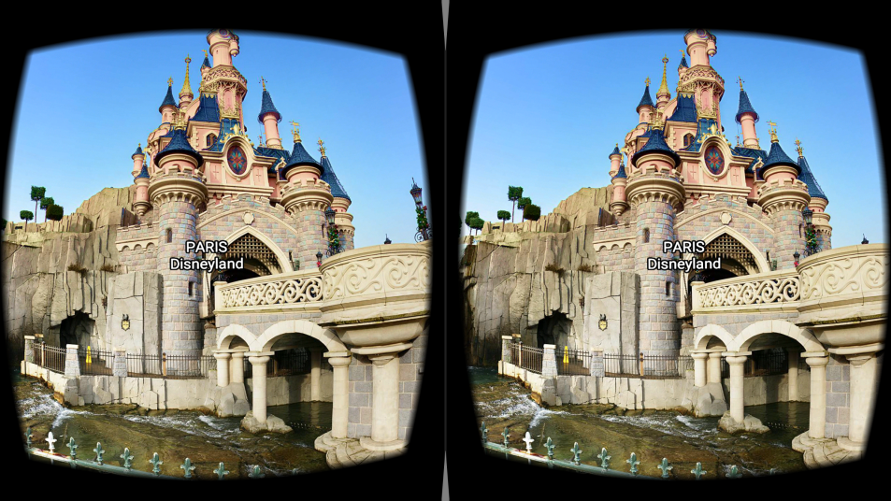
Sites in VR

Slide 9
ED12820- Gender, International Development and Education

Slide 10
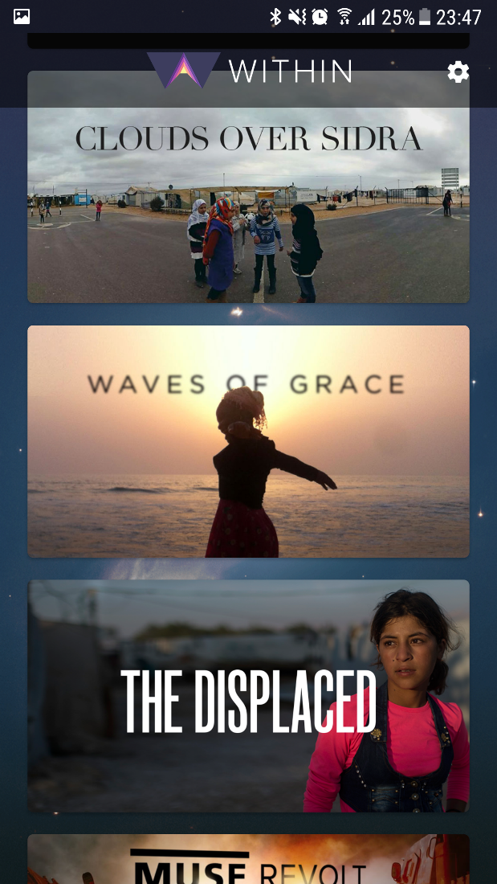
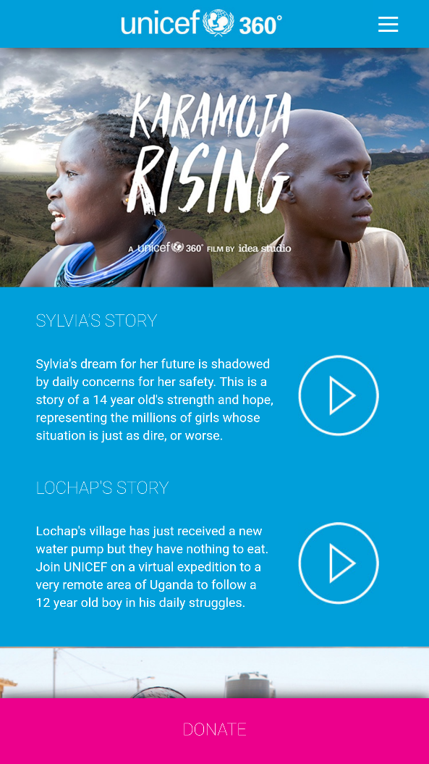
Resources used
UNICEF 360
Clouds over Sidra (short version)
Karamoja Rising
Within
Clouds over Sidra (full version)
The Displaced
The Source

Slide 11
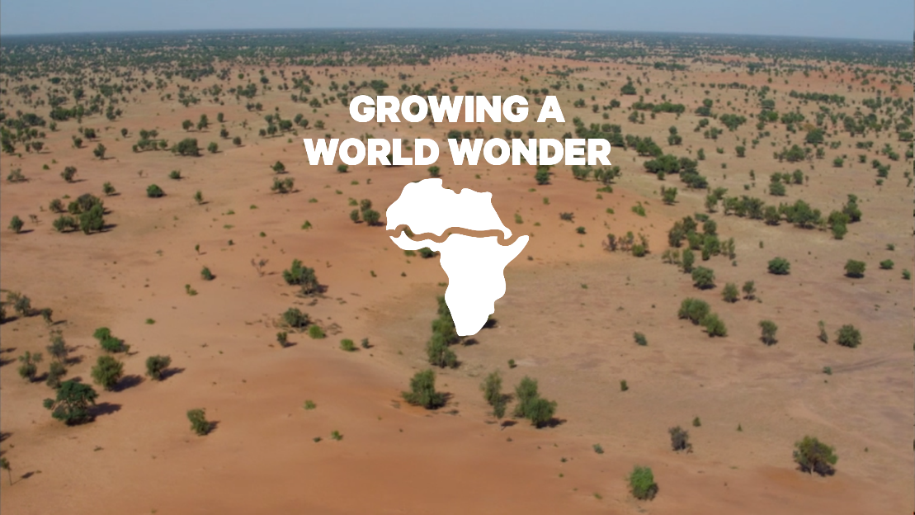
Resources used
Growing a World Wonder
Discovery VR
Women Triumph over HIV in Africa
Under the Net
Youtube 360

Slide 12
Clouds over Sidra

Slide 13
ED33020 Communicating Science

Slide 14
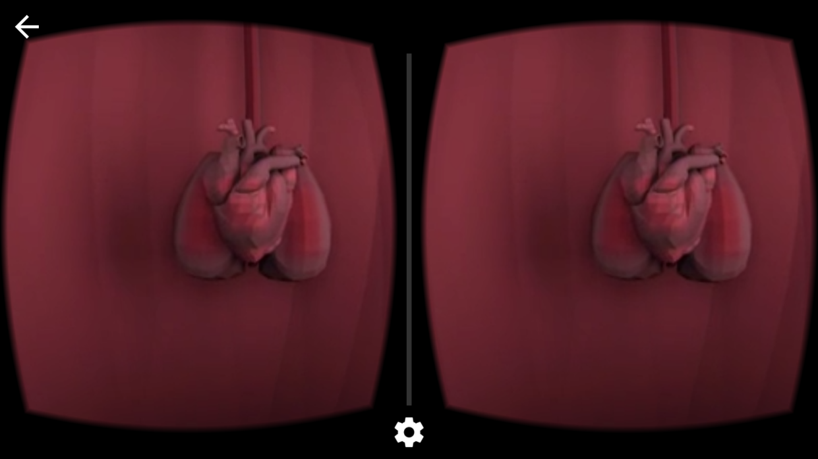
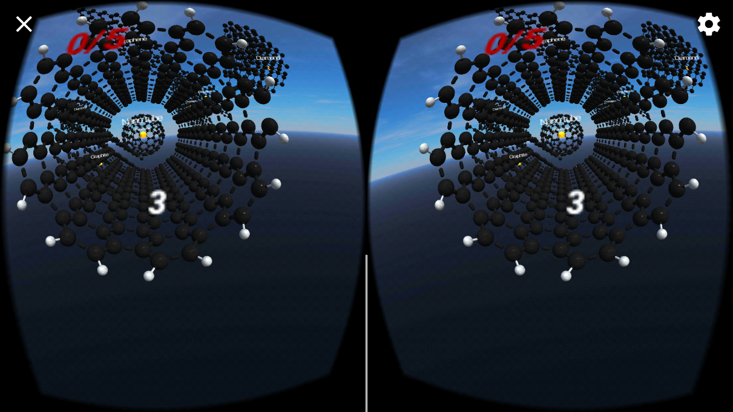
Resources Used
Google Expeditions
In Body VR
Carbons VR

Slide 15
ED13720 Play and Learning

Slide 16
Student Perspectives
I found that using the virtual reality headsets were really interesting. At the beginning I was concerned that I wouldn't enjoy it at all as I'm not the biggest fan of learning through technology, however it was so easy to use and it put you in an entirely new world within seconds! I'm glad we had the chance to use it as it was very different to anything else myself or my friends had ever done in university.

Slide 17
Student Perspectives
I found the utilisation of VR headsets really useful as it provides a much more immersive experience with regards to situations affecting people in other parts of the world. Being able to see conditions that people are living in and how their daily lives are constructed from more of a first-hand perspective leads to a deeper understanding of the issues faced.

Slide 18
Student Perspectives
VR lessons are very exciting. Your visually able to see what life is like for children and adults in third world areas. Being able to hear their stories is also very factual and engaging. The VR sessions have consisted of different topics. Including girl’s rights to education as well as education for girls in Syria. This highlights the various factors to education e.g. conflict famine and social and cultural issues. Overall the VR sessions has been a great experience. The technology allows you to see first-hand the barriers.

Slide 19
Problems
Not all students had a smartphone Older smartphones, or budget models, did not have the necessary hardware.
Some students felt motion sickness from the headsets.
Some students felt discomfort wearing the headsets for more than 15 minutes.
Google Expeditions requires peer to peer network connection and did not work on Eduroam
Youtube 360 no longer available on iOS

Slide 20
Future Plans

Slide 21
Key Aims
Develop Learning Technology Labs [LTL] in Welsh HEIs to allow ideas developed by teachers / lecturers to feed into high tech outcomes.
Develop Learning Labs in Welsh HEIs to facilitate discussions and promotion of ideas around 360-degree video and green screen technology.
Draw on international expertise in the development of VR/ green screen technologies

Slide 22
High- tech/ low- tech models
A central aspect of the project development throughout the 2022-23 period has focused on providing practitioners with ‘low-tech’ solutions that can be used in their day-to-day learning design at a low cost. This complements the ‘high-tech’ equipment and resources that can be developed using the WCLD equipment.

