Slide 1
Global Opportunities: Department of International Politics

Slide 2
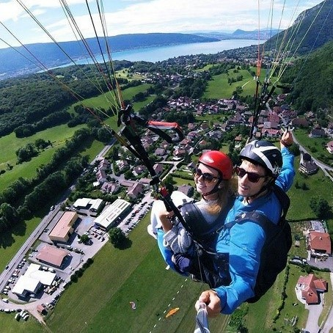
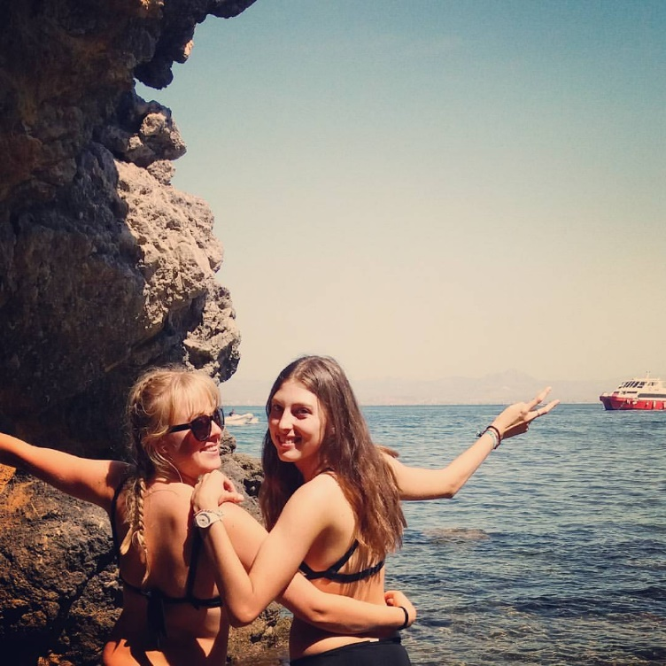
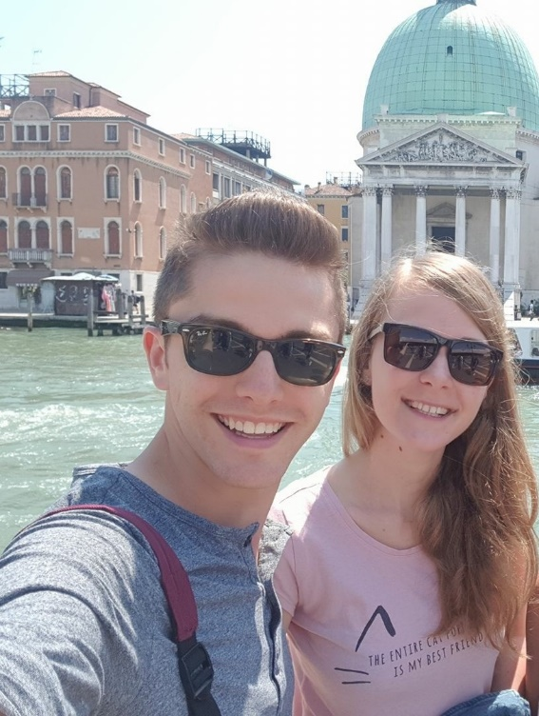
Why go abroad?
Studying, working, or volunteering abroad gives you the opportunity to:
Deepen and supplement your studies at Aberystwyth
Experience another culture
Gain life skills
Learn a foreign language
Add to your CV

Slide 3
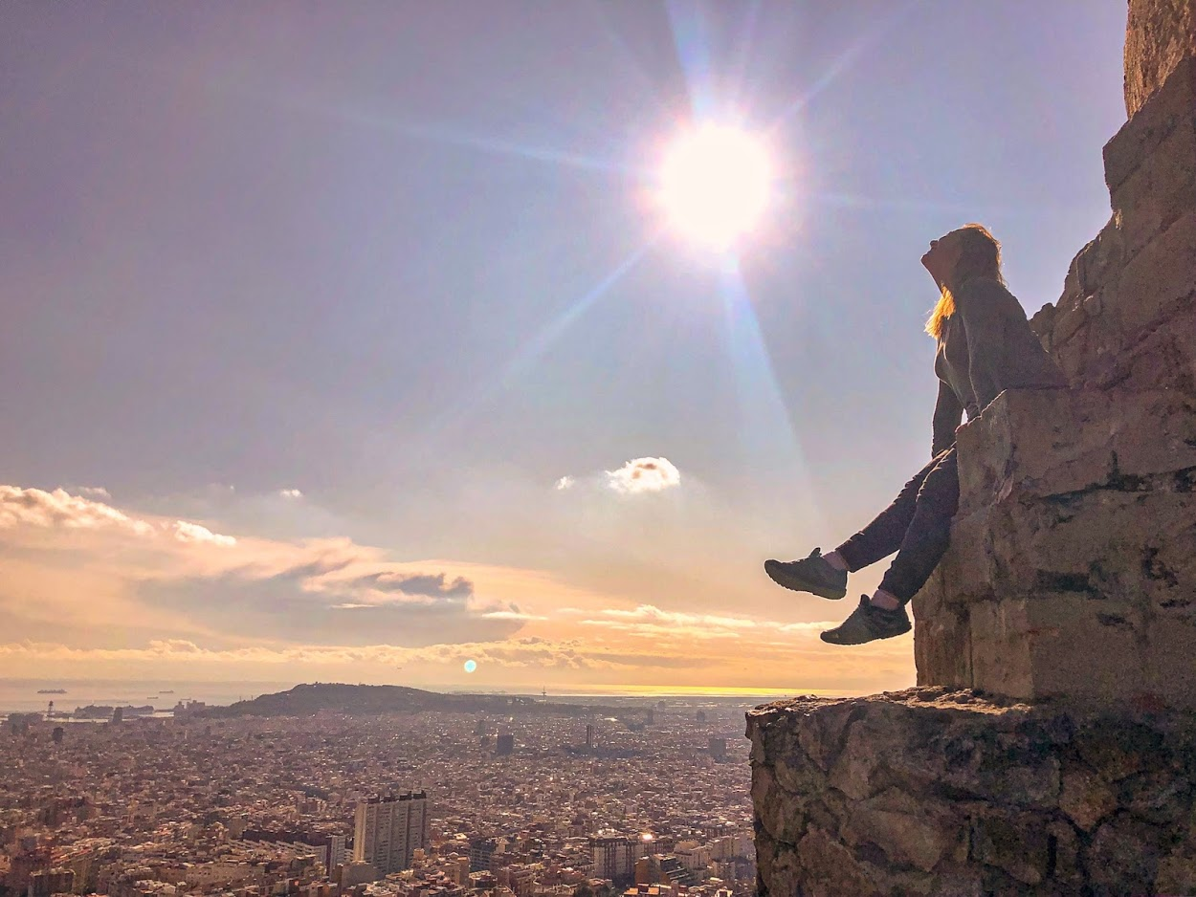
Who can go?
For a semester:
Students on many 3 year degrees (including joint honours) can study abroad for a semester in their 2nd year
For a full year:
Students on degrees with Integrated Year Abroad
Students with integrated Year in Industry

Slide 4
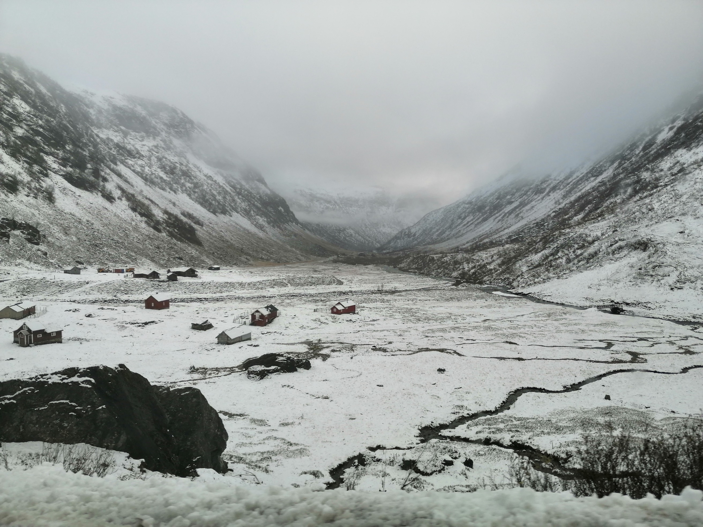
Where can I go?
Study Abroad, Semester or Year
Partner universities worldwide
Full list by department and country on our website
Things to consider:
Modules offered
Cost (travel, visa, housing)
Experience you want
Choose at least 3

Slide 5
How does it work academically?
Single semester
your modules abroad replace Aber modules
Choose 30 ECTS credits
Agree module choice with AU department and host
Your credits transfer, but the marks don’t affect your AU average
Integrated Year Abroad
Do not replace AU modules
Choose 60 ECTS credits
Flexibility in module choice
Must pass enough credits, but the marks don’t affect your average
Your department may require you to complete some assessed work during your time abroad
Year in Industry
Check with your Industrial Year coordinator about how your year will be assessed
Great addition to your CV

Slide 6
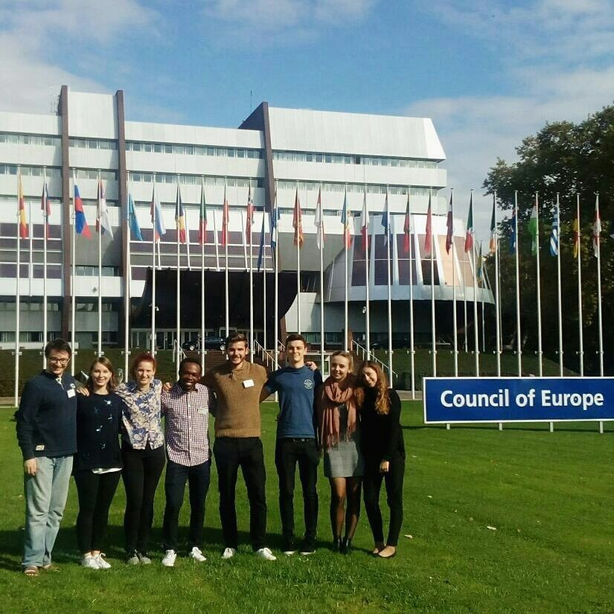
How much does it cost?
Study Abroad, Semester or Year:
No tuition due to host
Don’t pay for AU accommodation while abroad
Apply for your Student Finance as normal
Student Loan Companies offer travel grants
Budget for:
Travel expenses
Visa fee
Health insurance
Accommodation
Living costs

Slide 7
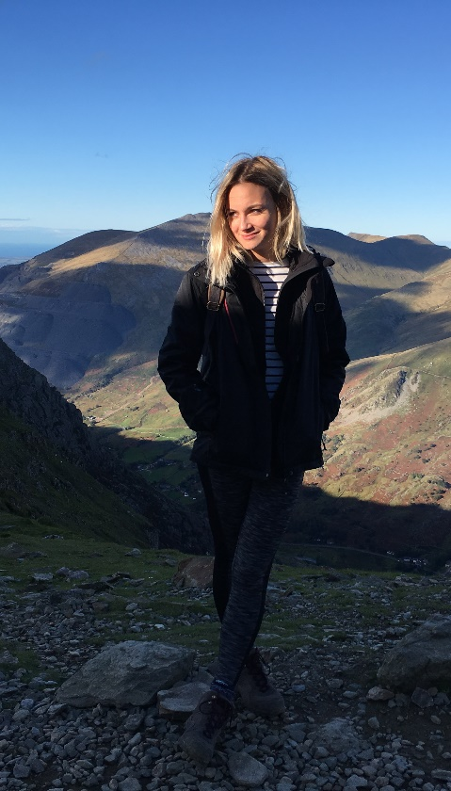
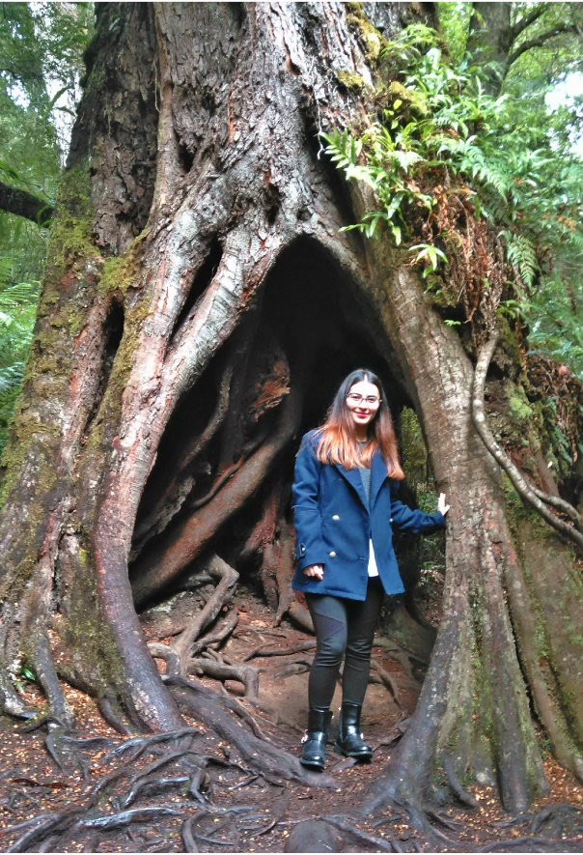
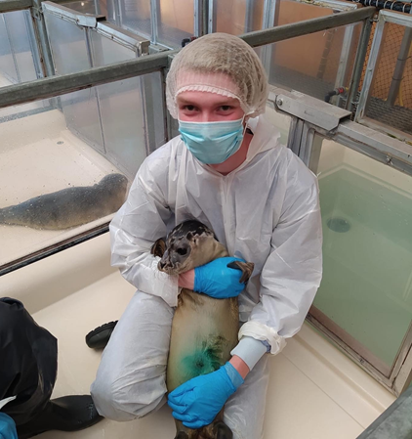
How do I apply?
Study Abroad, Semester or Year:
Check with your departmental coordinator (Aviva Guttmann, avg2@aber.ac.uk) whether you can go abroad during term time
Choose your top 3 universities and send them to him for approval

Slide 8
Next Steps
Study abroad, Semester or Year:
I allocate nominated students places
You fill in Global Opportunities application
I nominate you to your host university and they send you application instructions
We help you apply for any available funding

Slide 9
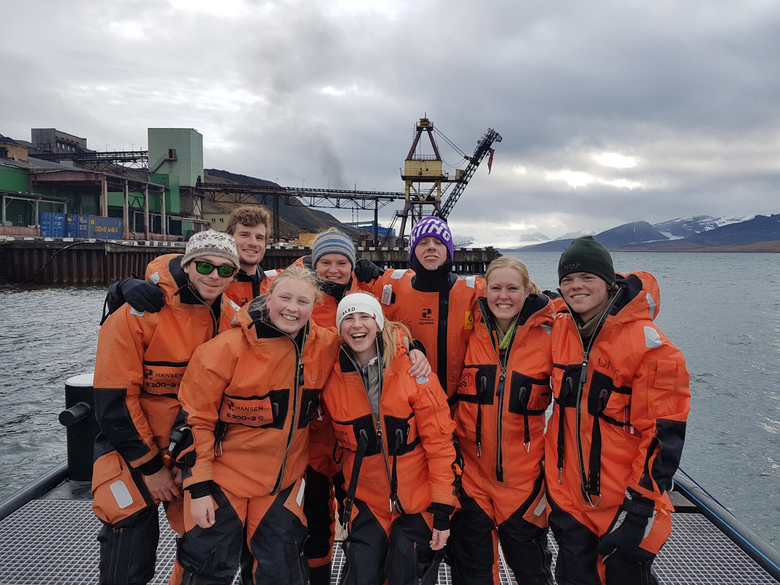
Who can go?
What if I can’t go during term time?
Summer or short placements
Graduate placements
These don’t require departmental approval and don’t earn AU credit, but are still a great, affordable opportunity to travel the world!

Slide 10
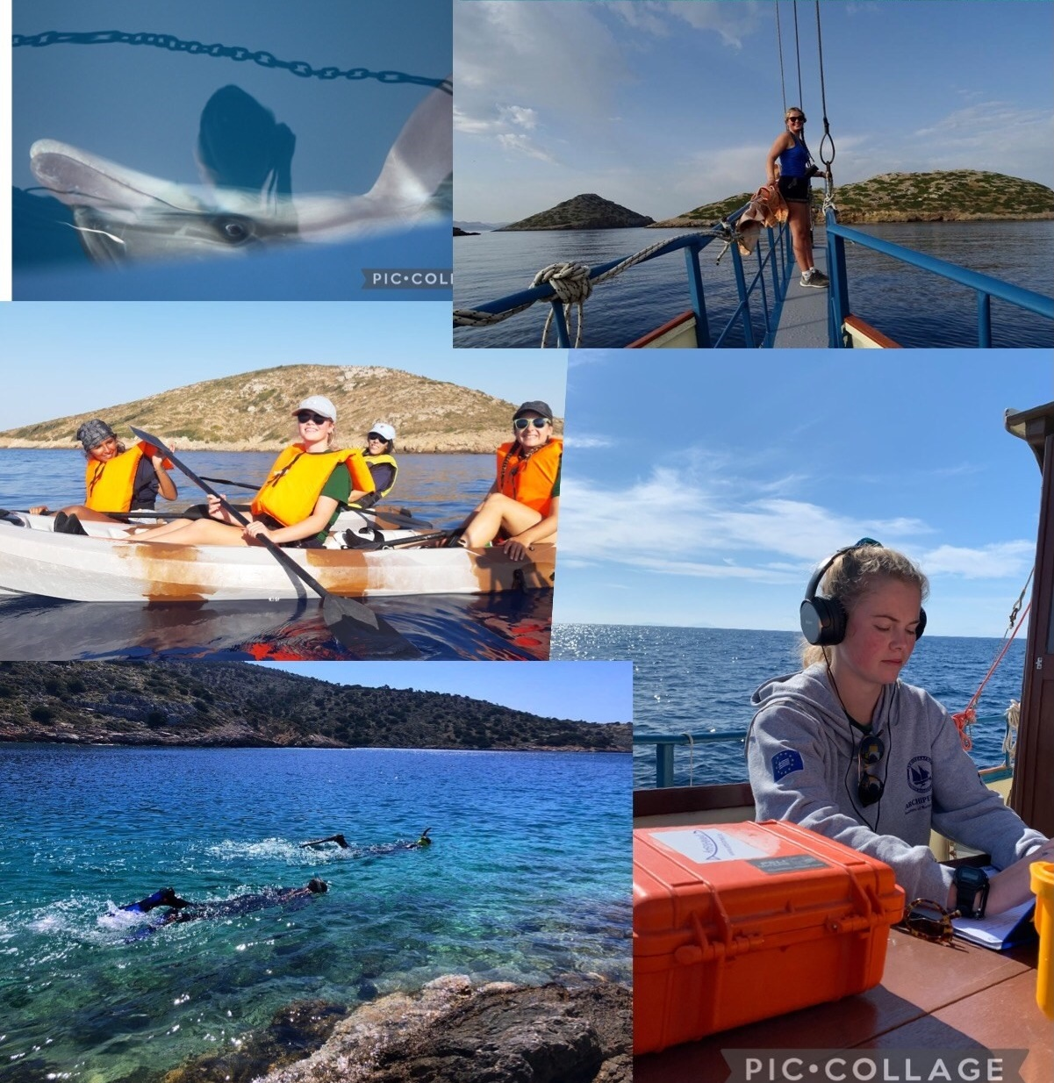
How do I apply?
Summer/Short Programmes and Graduate Placements:
Find a placement
Email global@aber.ac.uk to make an appointment to discuss
Apply directly to the placement and then to us for funding
Short programmes have rolling deadlines, Graduate Placements must be applied for before graduation
Funding is first come/first served

Slide 11
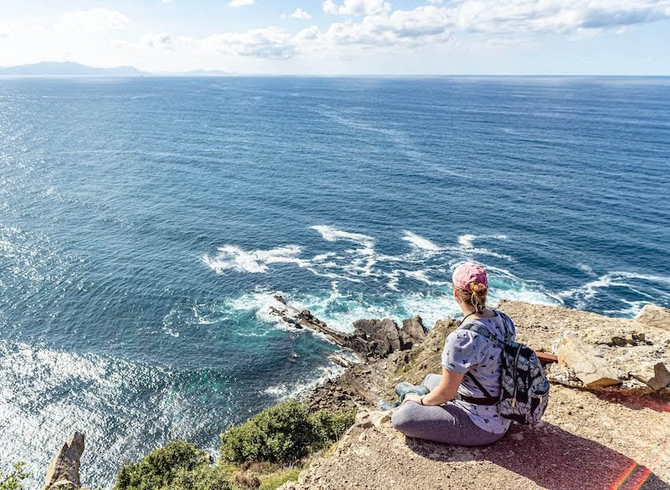
Grant Funding
You don’t need to worry about applying for Grant Funding.
Global Opportunities will take care of this and allocate you to a scheme and arrange the funding and will discuss with you further down the line.

Slide 12
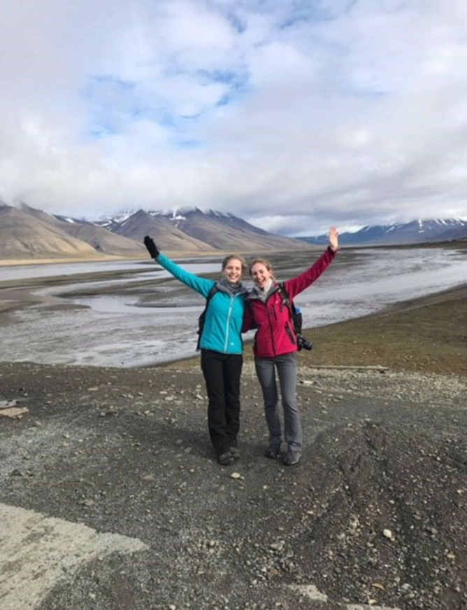
How do I find out more?
Contact the Global Opportunities Team!
Visit our website: https://www.aber.ac.uk/en/global-opportunities/
Email us: global@aber.ac.uk
Drop In: Wednesdays and Thursdays, 1-4pm, Cledwyn Building
Book an appointment with Kirsten Foerster (Outbound Officer)
Speak to your Departmental Coordinator!
Aviva Guttmann, avg2@aber.ac.uk

