Slide 1
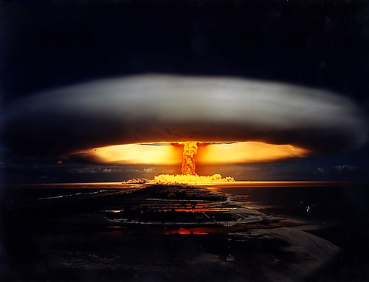
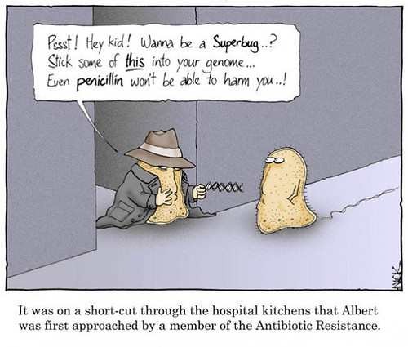
Microbiology and the antibiotic apocalypse
What are antibiotics ?
What is antimicrobial resistance (AMR) ?
Consequences of AMR
What can we do ?
Notes:
"The spread of antimicrobial resistance" by DES Daughter is licensed under CC BY-NC-SA 2.0
"nuke.jpg" by neilhinchley is licensed under CC BY-NC-ND 2.0

Slide 2
Microbiology and the antibiotic apocalypse
Dr Dave Whitworth
dew@aber.ac.uk
Reader in Biochemistry

Slide 3
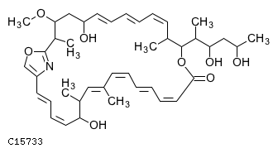
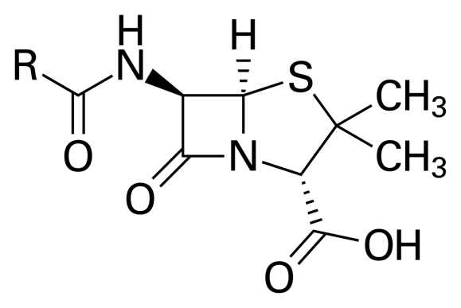
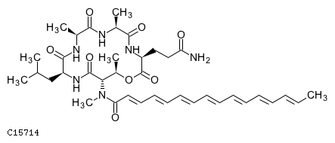
What are antibiotics ?
Chivosazole
Penicillin
Myxochromide
Amoxicillin, Streptomycin, Tetracycline, Methicillin , ...
Notes:
Compound structures available from KEGG

Slide 4
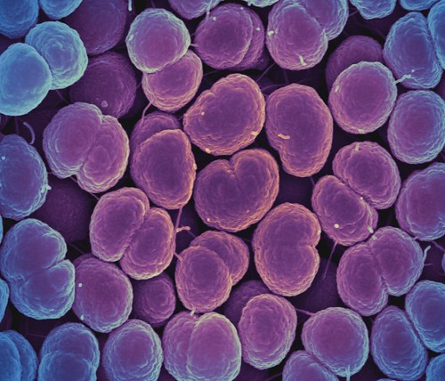
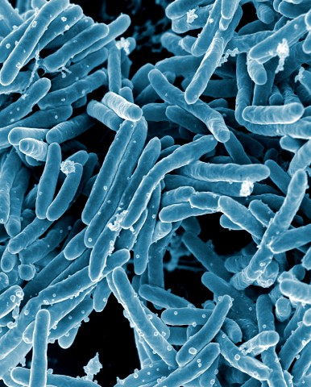
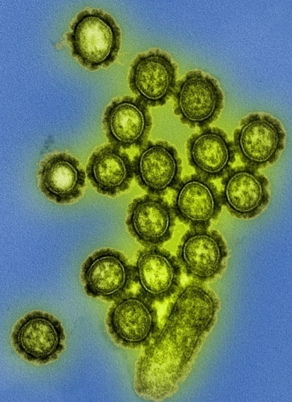
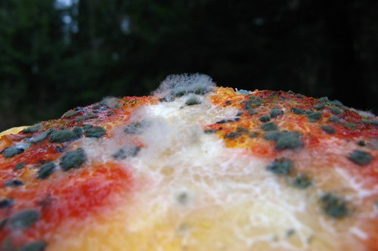
Bacterium
Virus
Infectious diseases
Fungus
Notes:
"Neisseria gonorrhoeae Bacteria" by NIAID is licensed under CC BY 2.0. "Mycobacterium tuberculosis Bacteria" by NIAID is licensed under CC BY 2.0
"mold on the pumpkin" by Cornell Fungi is licensed under CC BY-NC-SA 2.0
"H1N1 Influenza Virus Particles" by National Institutes of Health (NIH) is licensed under CC BY-NC 2.0

Slide 5
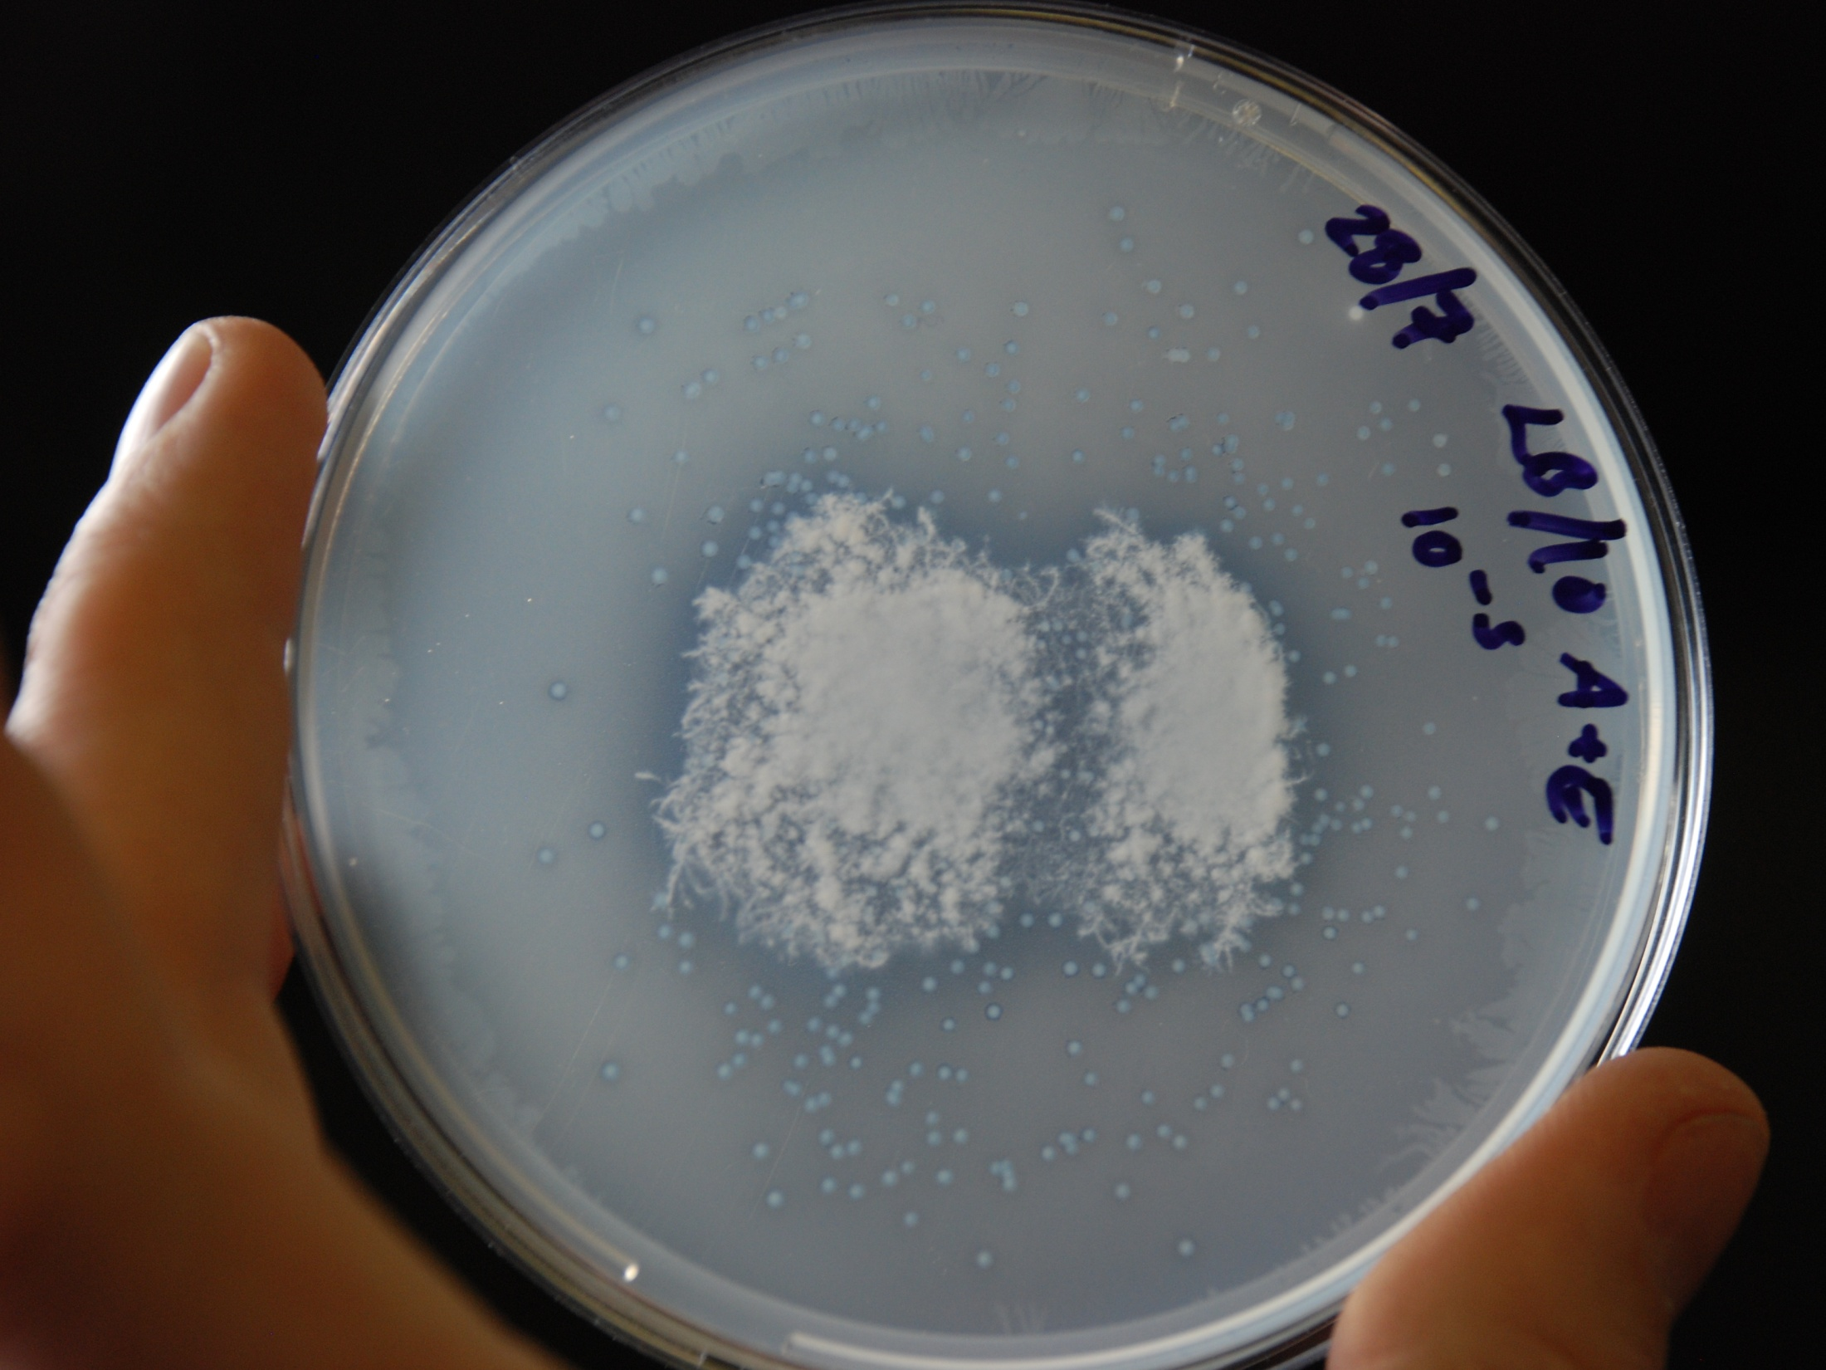
Swab a surface
Spread over agar plate
Incubate overnight
Each cell becomes
a visible colony

Slide 6
Antimicrobial Resistance (AMR)
Evolutionary process – mutation and selection:

Slide 7
Antimicrobial Resistance (AMR)
Evolutionary process – mutation and selection:
AM
Hospital Superbugs – MRSA, C. difficile

Slide 8
Antimicrobial Resistance (AMR)
Evolutionary process – mutation and selection:
Probiotics

Slide 9
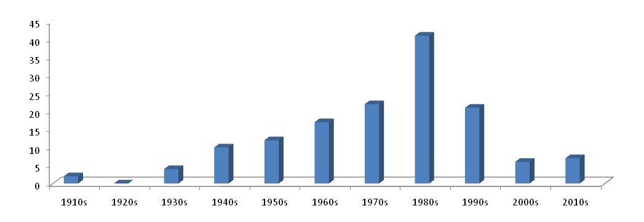
The timeline of antibiotic drug development and resistance
Gentamicin
Linezolid
Carbapenem
Methicillin
Cefixime
Streptomycin
Tetracyclin

Slide 10
The timeline of antibiotic drug development and resistance
Gentamicin
Linezolid
Carbapenem
Methicillin
Cefixime
Streptomycin
Tetracyclin
AM1
AM2

Slide 11
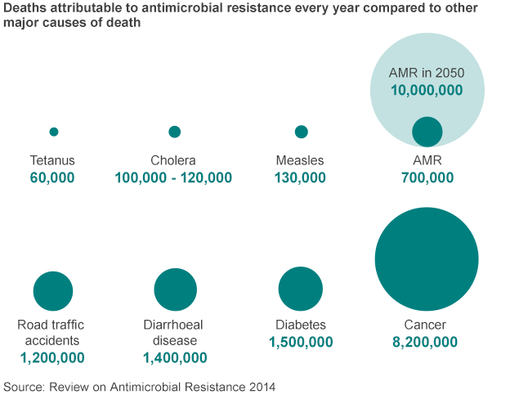

Slide 12
What does it mean in reality?
Data from Wales 2008
1-2% of hospitalisations due to sepsis (septicemia)
Sepsis kills more hospitalised people than any other cause.
200,000 deaths per year in the USA

Slide 13
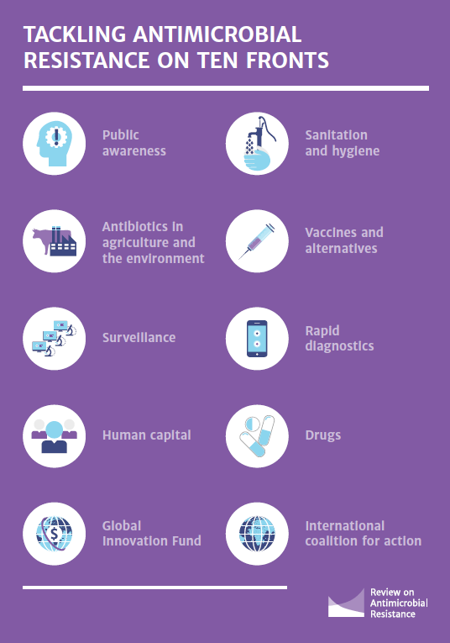
O’Neill Report
Global public awareness
Improve hygiene – prevent spread of disease
Reduce use of antibiotics in agriculture
Increased monitoring of AM use and AMR
New rapid diagnostics to prevent unnecessary AM use
Increase vaccination and other alternatives to AMs
Support more jobs in infectious disease *
A global fund to support un-commercial research
Incentives to develop new and improved AMs

Slide 14
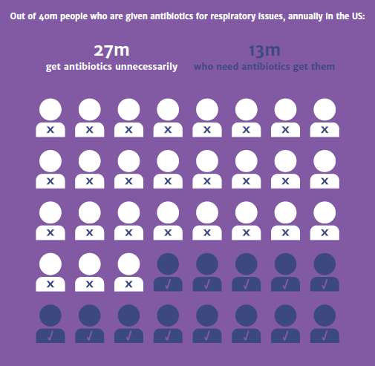
Public awareness:
Antibiotics only work against bacteria
Most infections are resolved by immune system
Nearly ¾ of antibiotics prescribed unnecessarily

Slide 15
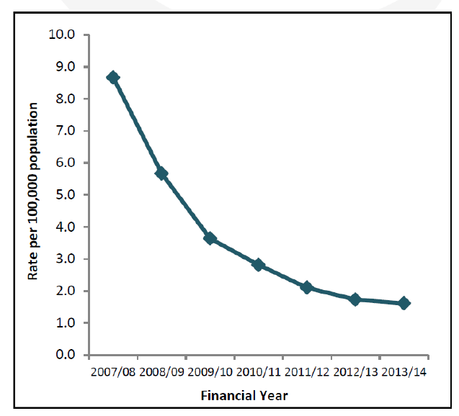
Carriage of MRSA
Hygiene:
Stop spread of drug-resistant bacteria.
Hand washing key – not just alcohol wipes

Slide 16
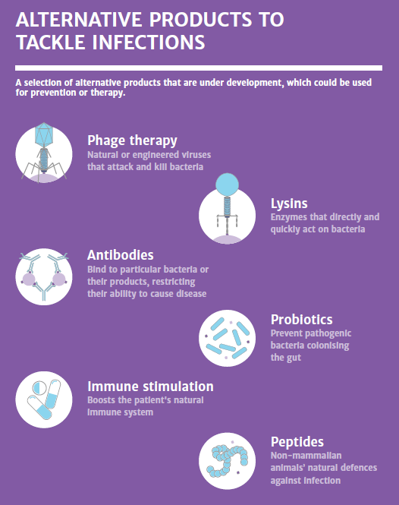
No new antibiotics approved since 2015
Alternatives to Antibiotics:
Vaccination
Bacteriophage Therapy
Other approaches...

Slide 17
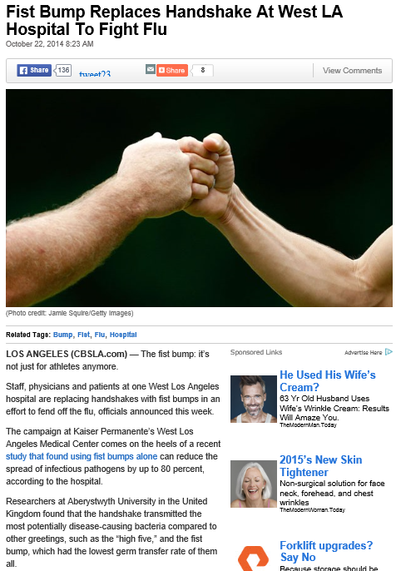
Hand Hygiene and disease transmission

Slide 18
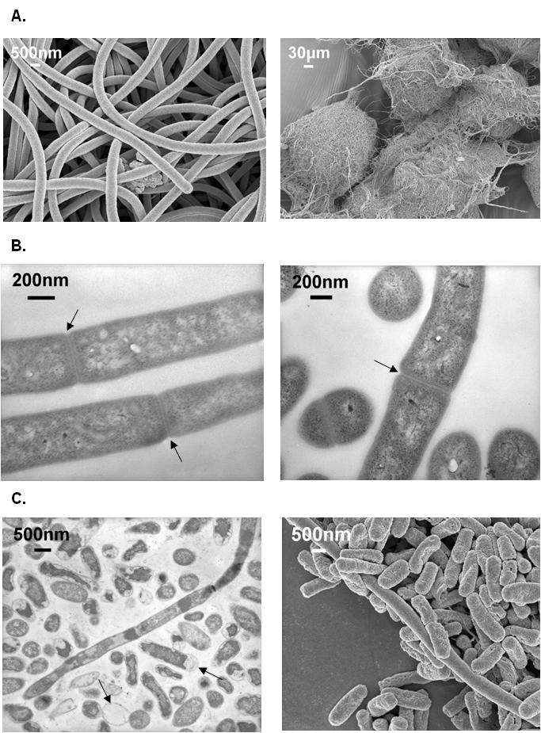
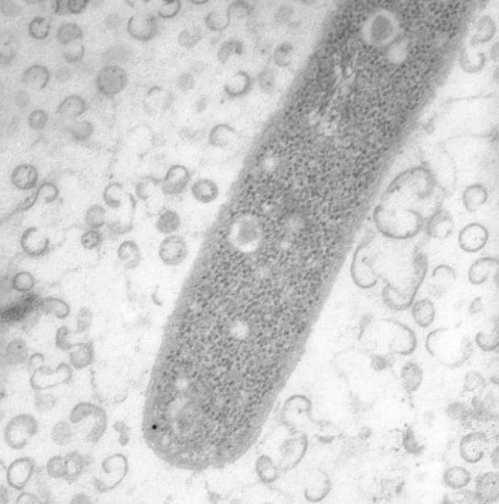
Bacterial Social Predators
Potential source of new AMs and alternatives to AMs
Kill and eat other bacteria
AMs make prey ‘sick’ and vulnerable to attack by OMVs
OMV = Outer Membrane Vesicle
A

Slide 19
Microbiology and the antibiotic apocalypse
What are antibiotics ? What is antimicrobial resistance (AMR) ?
Consequences of AMR What can we do ?
Notes:
"The spread of antimicrobial resistance" by DES Daughter is licensed under CC BY-NC-SA 2.0
"nuke.jpg" by neilhinchley is licensed under CC BY-NC-ND 2.0

