Slide 1
The Effect of Exercise on Blood Pressure
Rhys Thatcher
Reader in Exercise Physiology

Slide 2
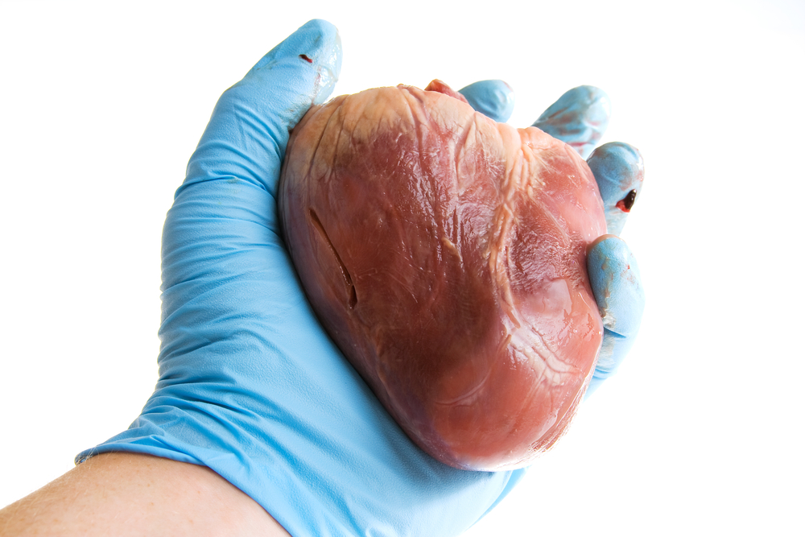
The Heart
Is the pump which propels blood around the body via the blood vessels
Can be considered a muscle sac
It is situated centrally in the thorax, slightly to the left
Weighs less than a pound and is the size of a fist
Surrounded by a double walled sac called the pericardium

Slide 3
The Heart Wall
The heart comprises of a series of chambers and walls
The walls are composed of three layers
the epicardium - the inner layer of the serous pericardium
the myocardium - the muscle of the heart comprising of cardiac muscle forms the bulk of the heart
the endocardium - inner layer of the heart continuous with the inner layer of the great blood vessels

Slide 4
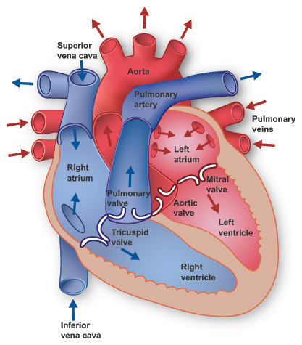
Heart Chambers
Four chambers
two atria - receive blood
two ventricles - discharge blood
Right side
receives blood from the body
sends blood to the lungs
Left side
receives blood from the lungs
sends blood to the body

Slide 5
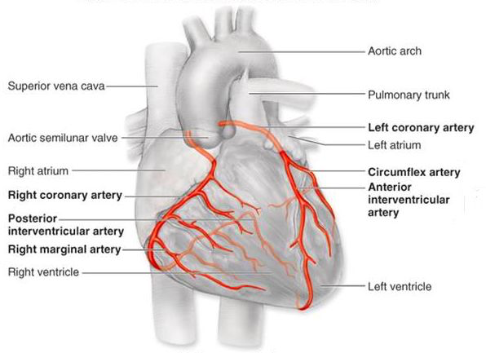
Blood Supply
The heart has its own blood supply
Coronary circulation
Right and left coronary arteries
Fed by the aorta
Atherosclerotic plaques fur up the walls of the arteries
Angina pectoris - “choked chest”
Myocardial infarction (MI) - heart attack

Slide 6
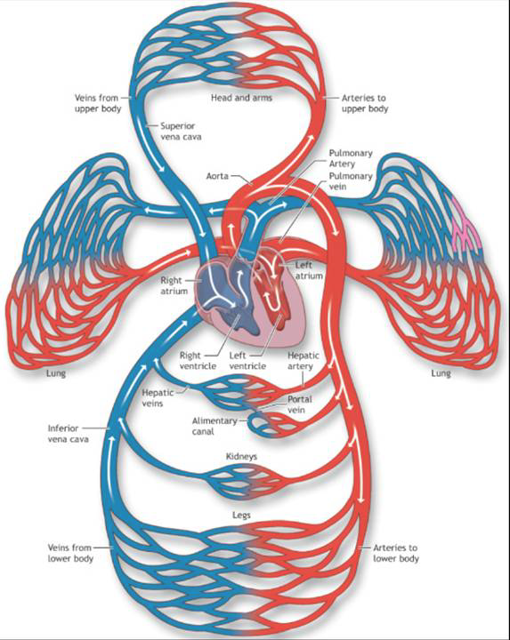
Blood Vessels
Blood leaves the heart under pressure via arteries
Blood returns to the heart, under very little pressure via the veins
Drops off and picks up materials on route via capillaries
Closed loop delivery system
Starts and ends at the heart
100000 km of blood vessels in the human body

Slide 7
Blood Pressure
As the ventricles of the heart contract blood is forced out, under pressure into the large arteries
The pressure under which the blood is forced is transferred to the arterial walls
This is termed blood pressure and is expressed in millimeters of mercury (mmHg)
Two values are generally reported systolic, the active phase of the heart beat and diastolic when the heart is relaxed, during filling
Healthy value at rest 120 / 80

Slide 8
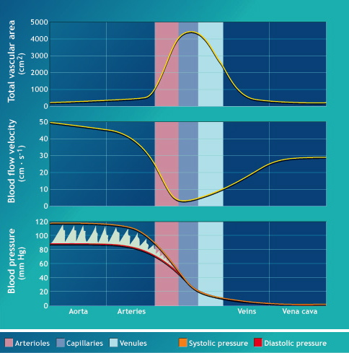
Blood pressure at different positions within the vascular system

Slide 9
Hypotension and Hypertension
Hypotension
Low blood pressure
Hypertension
High blood pressure
Linked to cardiovascular disease (CVD)

Slide 10
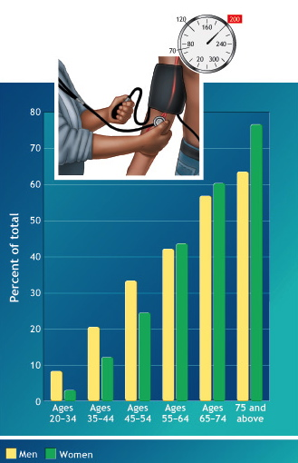
Percentage of Americans with high blood pressure by age

Slide 11
Blood Pressure During Exercise
When we exercise the heart has to work harder to pump more blood to the active muscle, delivering oxygen and nutrients and removing by-products
To increase the the blood pumped the heart will beat more rapidly and more forcefully
This increases blood pressure

Slide 12
Blood pressure during different activities

Slide 13
Blood Pressure Following Training
For people with high blood pressure exercise can result in

Slide 14
Blood pressure changes in people with high BP following a nine-month training programme
Following the training programme there was a one month detraining period
Stable BP during three months before exercise programme
BP dropped within three months of starting the programme
Stayed low for the nine months of the programme
Within one month of stopping BP had gone back up

