Slide 1
New Product Introduction:
Part one Overview
Content to support Level 3 Business Specifications
Dr Ian Harris – ihh@aber.ac.uk
Notes:
Title page

Slide 2
New Product Introduction: Overview
Dr Ian Harris
Degree Scheme Co-Ordinator: Marketing/Digital Marketing

Slide 3
Content
Product Introduction Overview
Linkage to strategic direction
Alignment to Ansoff and Boston Consulting Group Matrix
Product Line and Mix
Red and Blue Ocean strategy

Slide 4
Learning Outcomes
TSSBAT:
  Explain the challenges a company needs to address to introduce a new product
  Outline and critically describe the main stages in developing new market offerings
  Describe the best way of managing the process of developing new market offerings

Slide 5
Examiners might expect to see…
That you can integrate several elements together
Whilst the NPI for Level 3 is fairly uncomplicated, it can be aligned with other models and concepts
It is also dependent upon finance, resources, capabilities

Slide 6
Revenue may be
Made by organic growth and/or developing new products that are attractive to the market, e.g. The launch of the new iPhone SE (2) by mid 2020
Or
Bought via acquisition of existing companies, e.g. when iTunes was nearing the end of its product lifecycle, Apple chose to buy “beats music” for $3billion and rebrand it Apple Music

Slide 7
This is part of Strategic Direction
… typically covered holistically via a discussion of the Ansoff Matrix in his paper
“a joint statement of a product line and the corresponding set of missions which the products are designed to fulfil”, 1957
Basically a very early understanding of the product-market strategy

Slide 9
Peter Drucker, 2006
“if the prime purpose is to create a customer, the business has two, and only two, functions: marketing and innovation. Marketing and innovation produce results. Everything else is a cost”

Slide 10
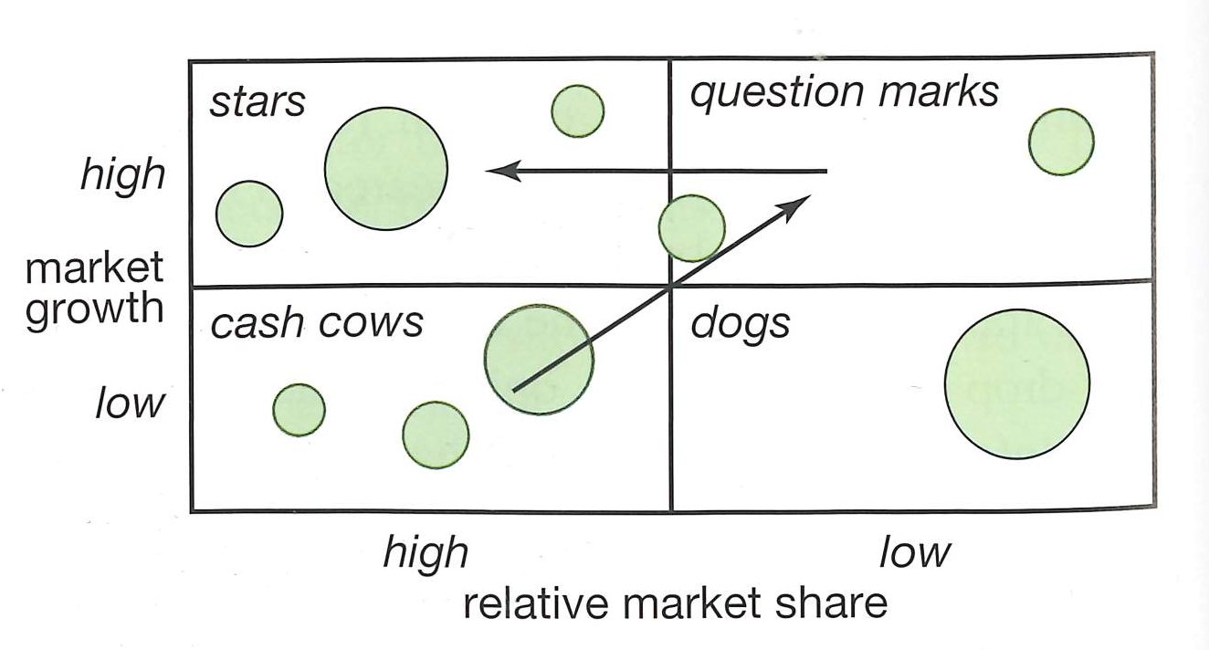
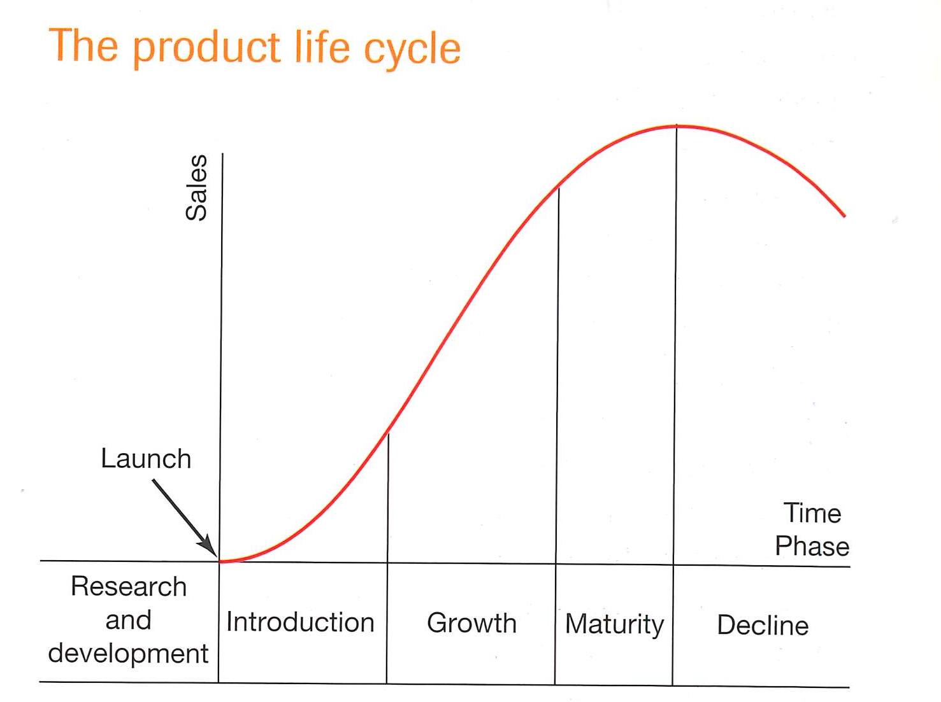
New Product Introductions
Corporations introduce new products regularly
Typically, these New Product Introductions (NPI’s) follow a very structured development
Products that make “cash cow” status fund the development of NPI’s
  Or in technology rich environments this is achieved through direct investment (Angels/Corporate Financers)
  Or, perhaps now, Kickstarter and the like…

Slide 11
Product Line/Product Mix
A typical way established brands introduce new products to market
  Product Line
    Aims to increase market-share by extending a range of established products
    Only if research shows potential to capture further market without cannibalising existing market share
  Product Mix
    Diversification by the company into new/existing markets with different offers
      Colgate make Toothpaste, Mouth wash, Toothbrushes etc.

Slide 12
Academic perspective
There is considerable and easily accessible materials that support this topic. Below is an example from the Harvard Business Review, April 2011 edition
Why Most Product Launches Fail
  Schneider, J. and Hall, J.

Slide 13
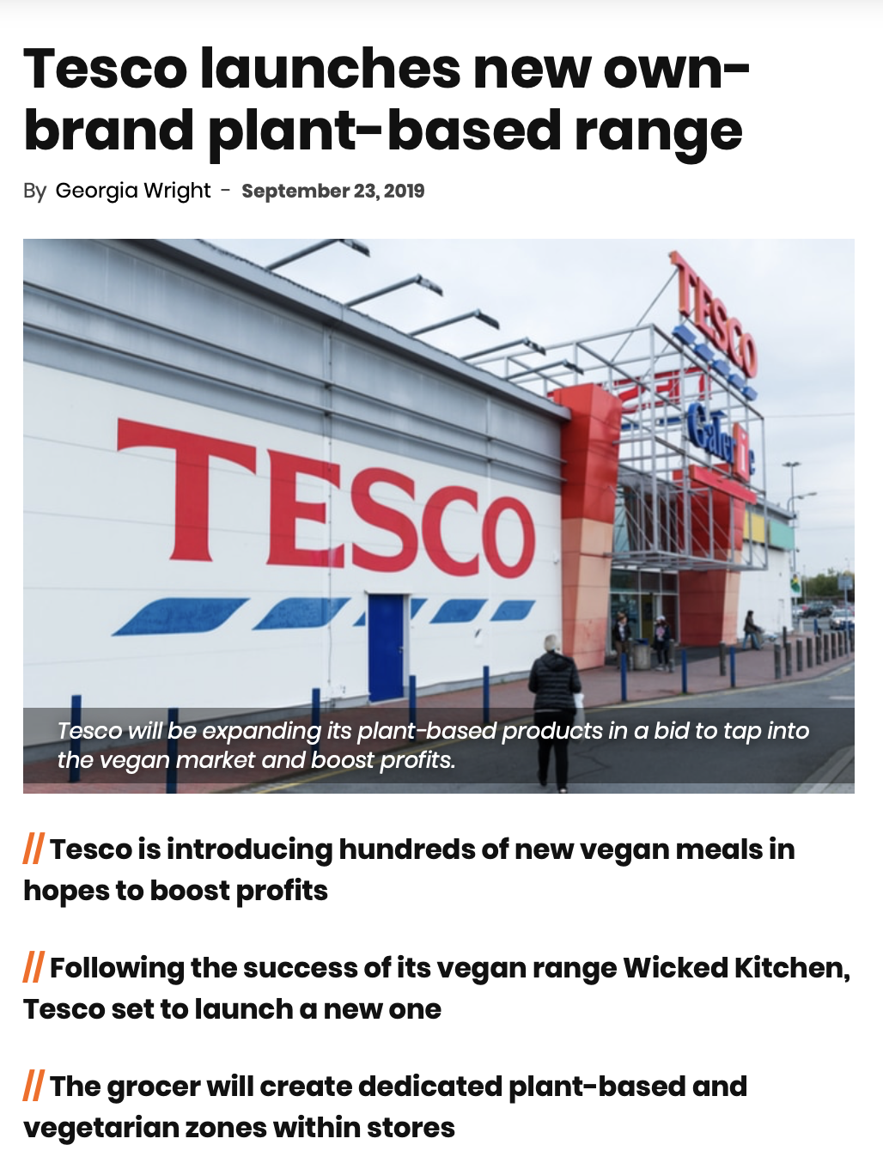
Launching “completely new products”
In dynamic environments, these are some of the typical problems
  Technological uncertainty
  Market uncertainty
  Competitive volatility
  High investment costs
  Short product lifecycles
  Finding the funding
It’s not easy
Think about how long it’s taken for Apple to establish the Apple Watch (it’s currently at Series 5)
Completely innovative new products are fairly rare
No real reproducible basis for estimating “Market” insights
  Price/Benefits/Offer (think Segment, Target, Position (STP))

Slide 14
Why don’t New Products constantly cannibalise the market..?
Reason
Shortage of ideas…
(think of one or two)
Fragmented markets
Social and governmental constraints
Cost of development
Capital shortages
Faster required development time
Shorter product life cycles
Shortage of ideas

Slide 15
Have you considered taking the…
Aberystwyth University Entrance Exam
Successfully complete an exam (there are multiple exam points in the year and you can take it in the subject/s you are best at) and earn yourself an unconditional or reduced offer for Aberystwyth Business School (and some large financial awards)
  More details here:
    Voice search Aber Uni Entrance Exam
Notes:
Bullet point list (animated)

Slide 16
New Product Success
Incremental Innovation:
  Occurs where firms gradually improve the core benefits, or where they “port” the product/service to a new environmental need
  Beneficial because:
    Already have a good understanding of the market dynamics
    Have an understanding of competitor response
    Consumer insights should be available (primary data)

Slide 17
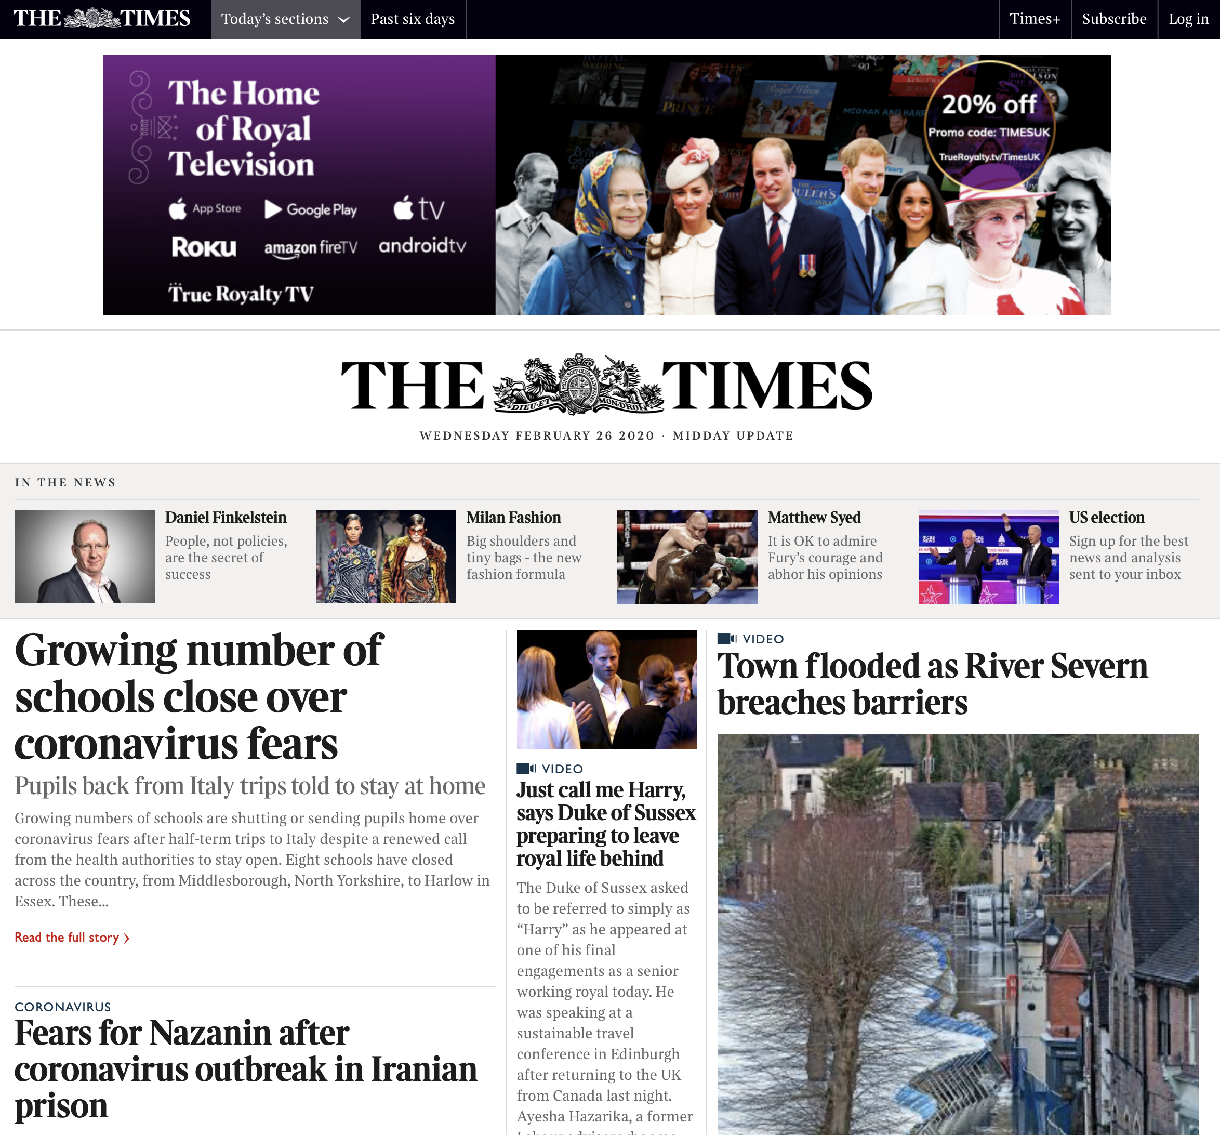
Red Ocean
Some corporations have significant cash reserves
  typically used these to dominate existing markets
  They can introduce “New Products” that are better than established and win by leveraging overarching brand awareness and recognition
  Ultimately, they have “more financial reserves” (deeper pockets)
To “head-on” compete often competitors will create disruptive innovations that are cheaper to produce but offer the same core benefits
  Mobile Internet vs. Fixed Line Internet (5G)
  Tablets vs. Laptop/Notebook Computers
Often a unique, superior product will win a category; other times better marketing/better environments may be sufficient

Slide 18
Blue Ocean Strategy
Chan Kim, W. and Mauborgne, R. (2004)
Provided a set of tools that allows organisations to ”systematically create and capture “blue oceans”: unexplored new market areas”.
The Nintendo Wii is an example of Blue Ocean Thinking (and to a lesser extent the Switch)
Instead of entering the computational speed (processing) arms race with Xbox and PlayStation, they changed the core target from “young people, predominantly male” to family members “young and old”
And the games supplied (where they make ALL of their money) from heavy graphics intensive immersive, hyper-real environments, to environments akin to 20 year old 16 bit games console

Slide 19
Time to think…
Can you identify other examples of Blue Ocean Strategy..?
Netflix and video/film distribution
  1999 Introduces “Monthly Subscription Concept” for DVD’s delivered through the postal service
  2003 Reaches 1 million subscribers
  2007 Delivers 1 billion DVD’s
  2008 “instant streaming service” introduced
  2013 becomes a content producer with the introduction of “House of Cards”
  …the rest is history – it is squarely a media production company now…

Slide 20
Some causes of NPI Failure
What do you think..?
Marketing
  Not sufficient to reach mass market
  No fundamental differentiation
  Not meeting customer needs
Financial support
  Company runs out of money
  Insufficient ROI
Timing
  Too late or too early (Nike Fuel Band)
Technical issues
  Bad design/did not work
Organisational issues
  Poor fit with culture
  Lack of organisational support
  No integrated Venture Team
Environmental failure
  Regulations
  Macro-economic

Slide 21
Diolch | Thank you
Notes:
Title page

