Slide 1
The not dead – witnessing war
Dr. Natasha Alden, English & Creative Writing Department, Aberystwyth University

Slide 2
adynaton
“The impossibility of addressing oneself adequately to the topic” (Vickers, In Defence of Rhetoric (Oxford: Oxford University Press, 1988), 491)
“The mother of all diversionary tactics, adynaton not-writes about war by making not-writing its very subject.” Kate McLoughlin, Authoring War (Cambridge: Cambridge University Press, 2011)
“I was always embarrassed by the words sacred, glorious, and sacrifice and the expression in vain … I had seen nothing sacred, and the things that were glorious had no glory and the sacrifices were like the stockyards of Chicago if nothing was done with the meat but to bury it. There were many words that you could not stand to hear and finally only the names of places had dignity … Abstract words such as glory, honor, courage, or hallow were obscene beside the concrete names of villages.” Ernest Hemingway, A Farewell to Arms, 165.

Slide 3
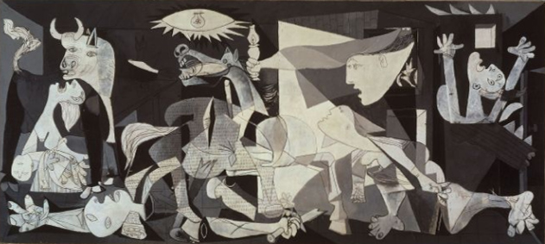
So who gets to write about war?
The importance of presence/personal experience
Picasso painted Guernica in Paris

Slide 4
… secondhand experience, from the newspapers, the news-reel, the wireless, is one of the dominating realities of our time. The many people who are not in direct contact with the disasters falling on civilization live in a waking nightmare of secondhand experiences which in a way are more terrible than real experiences because the person overtaken by a disaster has at least a more limited vision than the camera’s wide, cold, recording eye, and at least has no opportunity to imagine horrors worse than what he is seeing and experiencing. — Stephen Spender, Guernica

Slide 5
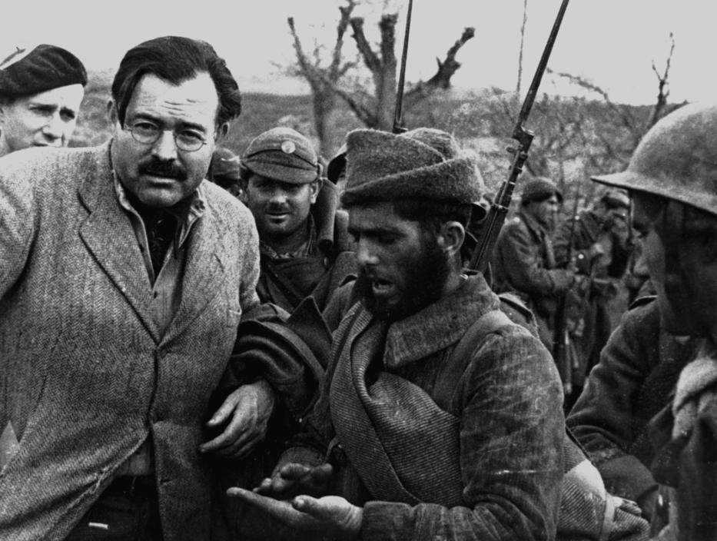
The power of the imagination
“A writer’s job is to tell the truth. His statement of fidelity to the truth should be so high that his invention, out of his experience, should produce a truer account than anything factual can be.”
(Ernest Hemingway, Men At War (1942))

Slide 6
Collaborative documentary poetry & the ethics of witnessing
Unusual form
Why appropriate here?
Whose poems are these?
What does their relation to the veterans’ testimony mean – are they more powerful than a purely imagined response, or could something like that have a stronger impact and if so why?
What is the purpose of witnessing what we see in The Not Dead?
Does the quality of the poems matter?
Why does Armitage use the form he does here – think about the type of rhyme scheme and language he uses.
Armitage is not alone in using simple language and rhythm in a politicised poem – compare W H Auden’s poem ‘Miss Gee’ (next slide)

Slide 7
Miss Gee
Let me tell you a little story About Miss Edith Gee; She lived in Clevedon Terrace At number 83.
She’d a slight squint in her left eye, Her lips they were thin and small, She had narrow sloping shoulders And she had no bust at all.
She’d a velvet hat with trimmings, And a dark grey serge costume; She lived in Clevedon Terrace In a small bed-sitting room.
She’d a purple mac for wet days, A green umbrella too to take, She’d a bicycle with shopping basket And a harsh back-pedal break.
The Church of Saint Aloysius Was not so very far; She did a lot of knitting, Knitting for the Church Bazaar.
Miss Gee looked up at the starlight And said, ‘Does anyone care That I live on Clevedon Terrace On one hundred pounds a year?’
She dreamed a dream one evening That she was the Queen of France And the Vicar of Saint Aloysius Asked Her Majesty to dance.
But a storm blew down the palace, She was biking through a field of corn, And a bull with the face of the Vicar Was charging with lowered horn.
She could feel his hot breath behind her, He was going to overtake; And the bicycle went slower and slower Because of that back-pedal break.
Summer made the trees a picture, Winter made them a wreck; She bicycled to the evening service With her clothes buttoned up to her neck.
She passed by the loving couples, She turned her head away; She passed by the loving couples, And they didn’t ask her to stay.
Miss Gee sat in the side-aisle, She heard the organ play; And the choir sang so sweetly At the ending of the day,
Miss Gee knelt down in the side-aisle, She knelt down on her knees; ‘Lead me not into temptation But make me a good girl, please.’

Slide 8
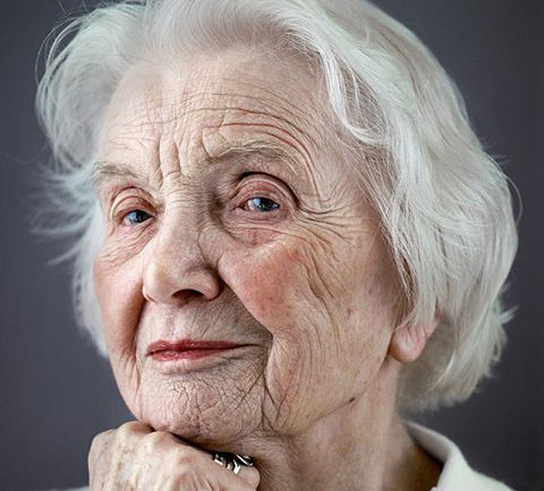
'Nobody knows what the cause is, Though some pretend they do; It’s like some hidden assassin Waiting to strike at you.
'Childless women get it. And men when they retire; It’s as if there had to be some outlet For their foiled creative fire.‘
His wife she rang for the servant, Said, 'Don’t be so morbid, dear’; He said: 'I saw Miss Gee this evening And she’s a goner, I fear.‘
They took Miss Gee to the hospital, She lay there a total wreck, Lay in the ward for women With her bedclothes right up to her neck.
They lay her on the table, The students began to laugh; And Mr. Rose the surgeon He cut Miss Gee in half.
Mr. Rose he turned to his students, Said, ‘Gentlemen if you please, We seldom see a sarcoma As far advanced as this.’
They took her off the table, They wheeled away Miss Gee Down to another department Where they study Anatomy.
They hung her from the ceiling Yes, they hung up Miss Gee; And a couple of Oxford Groupers Carefully dissected her knee.
The days and nights went by her Like waves round a Cornish wreck; She bicycled down to the doctor With her clothes buttoned up to her neck.
She bicycled down to the doctor, And rang the surgery bell; 'O, doctor, I’ve a pain inside me, And I don’t feel very well.‘
Doctor Thomas looked her over, And then he looked some more; Walked over to his wash-basin, Said,'Why didn’t you come before?‘
Doctor Thomas sat over his dinner, Though his wife was waiting to ring, Rolling his bread into pellets; Said, 'Cancer’s a funny thing.

Slide 9
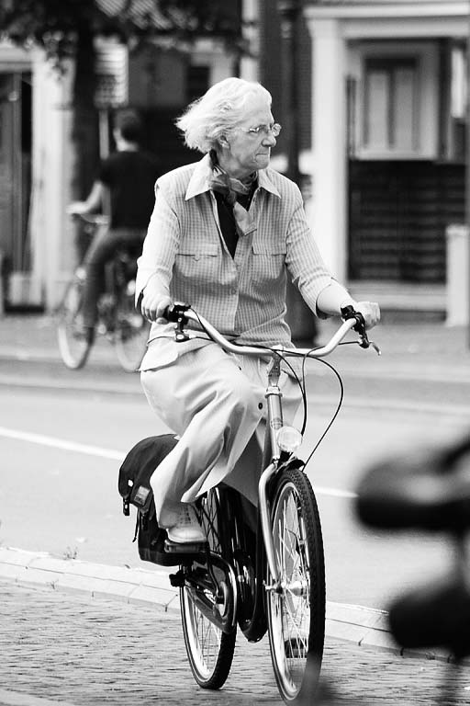
Auden uses his simple, music-hall style rhyme scheme to lull us into a false sense of security.
Think about how he presents Miss gee in the first half of the poem. What sort of figure is she?
What happens to her?
Where does it happen?
Answer – she dies. But it happens between stanzas, un-remarked on, because no-one cares about Miss Gee, or sees her as anything other than an insignificant old lady. Including us, because in the first part of the poem,, Auden has encouraged us not to.
Auden uses a simple form to deceive us as to the type of poem this is – one that wants to make us think and feel differently. What parallels, and differences, can you see between what he is doing here and what Armitage is doing with his use of internal rhyme, simple rhyme schemes, & simple every day language?

Slide 10
Witnessing
Like ‘Miss Gee’, Armitage’s poems demand that we LOOK at people who are often ignored, people who it is easier to turn away from.
But witnessing brings up all sorts of ethical questions. When does witnessing someone’s trauma cross the line into intruding on their pain, for example?
In this text, it can be hard to witness the veterans’ pain and distress. How do we feel – are we intruding? Think especially about Eddie and Laura’s relationship and Cliff’s pain, and the way the film shows this to us.
These poems do not only witness the horror of war, but also post-war trauma (and in this respect they are similar to My Boy Jack).
How is this war poetry different from other war writing you’ve looked at?
Not written by a participant
Focussed on something other than the actual fighting
Collaborative and documentary

Slide 11
how successful is this poetry, and on whose terms?
“The soldier's own memories, and the language in which he couched them, were astonishing, and so much more real and involving than Armitage's poeticising of the same images and narrative tropes. Armitage's poem rests on a borrowed authenticity that will of course look shabby in comparison to the brutal authenticity upon which it is based.” (http://gistsandpiths.blogspot.co.uk/2012/04/simon-turner-resurrecting-hyphen-notes.html)
Is this true? Can poetry by non-combatants ever avoid this fate?

Slide 12
Group work
“What makes their television performances so compelling is the role played by someone who is not seen on screen. Huddersfield poet Simon Armitage listened to the men's unedited accounts and extracted from them particular modes of expression and turns of phrase which he re-fashioned as poems. The former soldiers speak these to the camera with such fluency and conviction, they appear spontaneous, their own words.” (http://www.yorkshirepost.co.uk/news/analysis/finding-words-for-hidden-wounds-1-2475323 Yorkshire Post, 7th November 2007)

Slide 13
Group work
First, does it matters if the poem sounds spontaneous/”has conviction”? What does this mean? And second, evaluate if it does. What is the difference between poetry and real speech? Do they seem “their own words?
‘The Malaya Emergency’ and ‘The Parting Shot’ (Cliff’s story; 16.20-23, 37-44)
What differences can you find between the testimony and the poem? Which do you think is more powerful and why?
‘The Black Swans’ (32-3) Look at the footage, then read the poem. Again, what has Armitage done to Eddie’s testimony, and why? Does it work? Why/why not?
‘Man Hunt’ (Eddie’s discussion of the uselessness of his medical treatment 1.07-).
How do you feel, watching this? Why have they filmed it with them together – what effect does this have?

