Slide 1
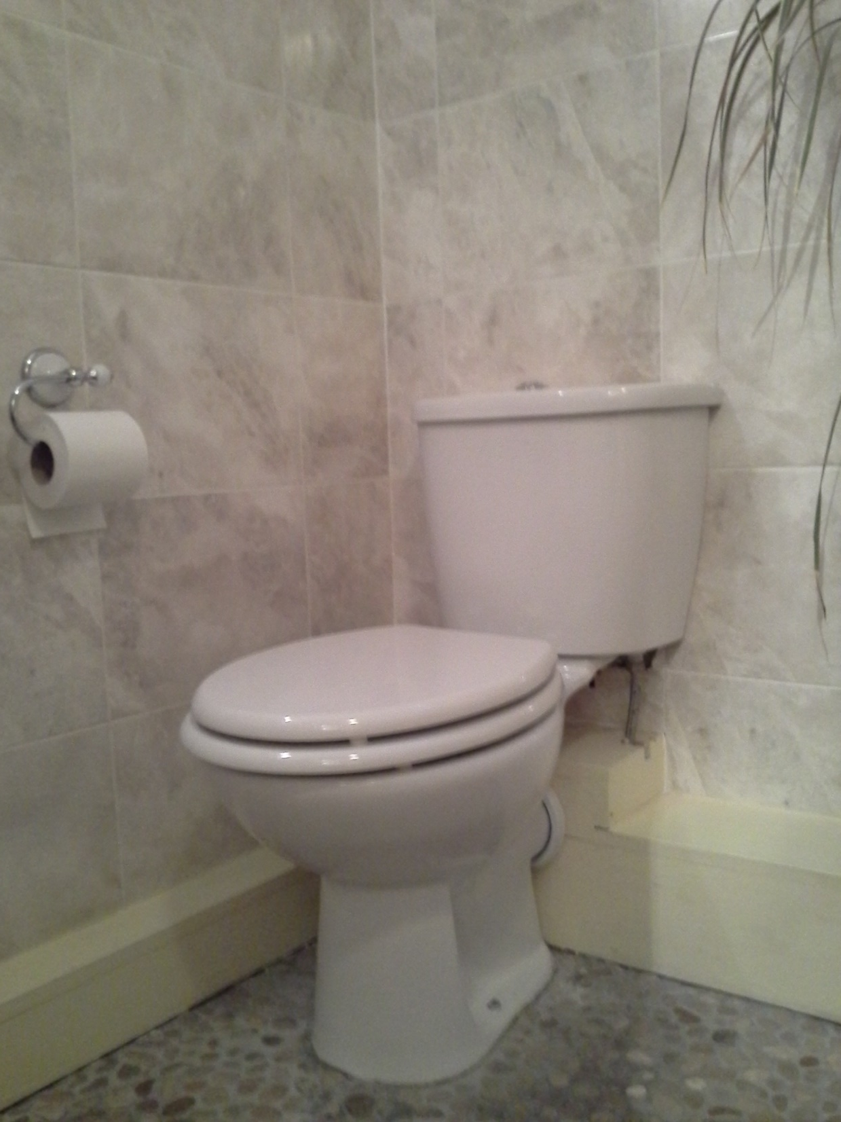

Slide 2
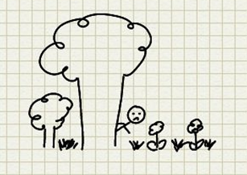
The fortunate…
68% world’s population use at least a basic sanitation service (WHO, 2017).
The rest…
2.4 billion people do not have basic sanitation (WHO & UNICEF, 2017).
The poorest…
Open defaecation for 892 million people (WHO, 2017).

Slide 3
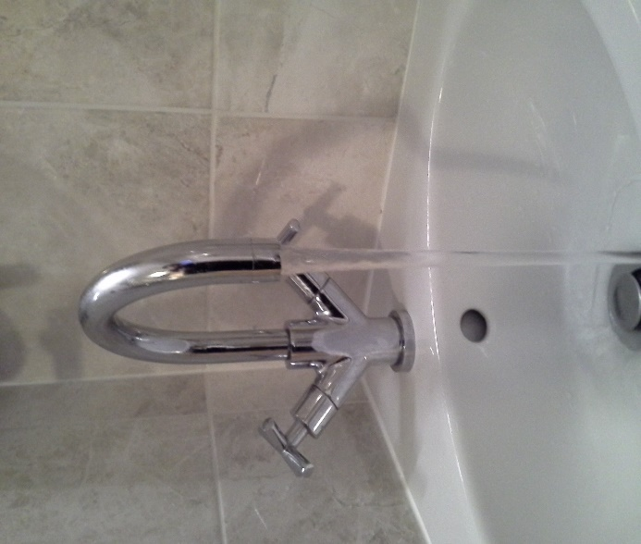
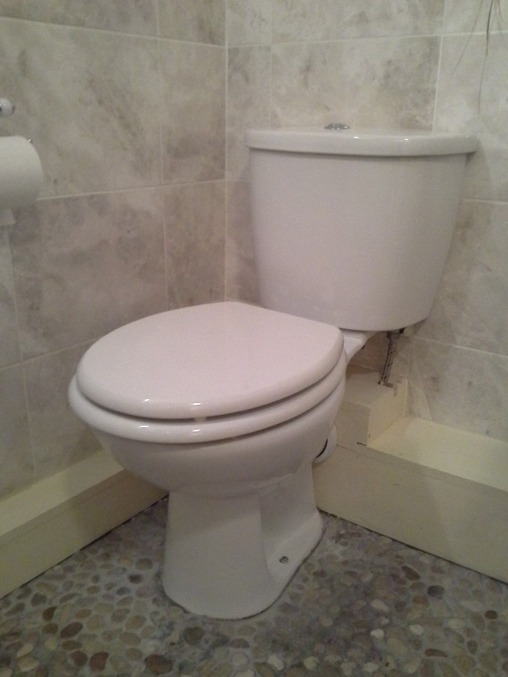
We turn on our taps, but…
2.1 billion lack safe water at home (Unicef & WHO, 2017).
~10% world’s population consume food irrigated by wastewater (WHO, 2017).
We flush our loos, but…
Poor sanitation: diarrhoea, dysentery, typhoid, intestinal parasitic worms, schistosomiasis (WHO, 2017).

Slide 4
Why are parasites a problem in developing countries?
Access to sustainable clean water & sanitation.
Daily activities = risk.
Access to education?
Access to sustainable health care?
Geography & climate.
Poverty, malnutrition, conflict & unrest.

Slide 5
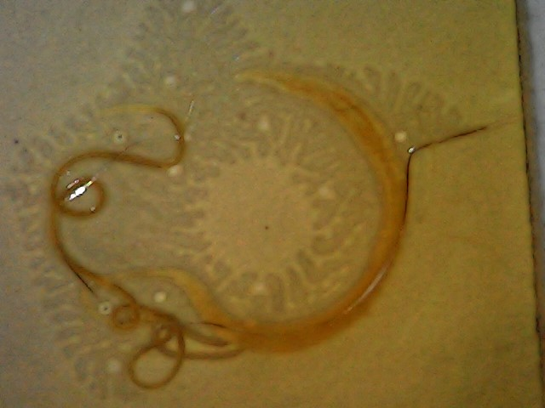
On our planet…
~1.5 billion infected with soil-transmitted helminths (STHs, WHO, 2017).
Roundworms: Ascaris lumbricoides
Whipworm:Trichuris trichura
Hookworms: Ancylostoma duodenale & Necator americanus.

Slide 6
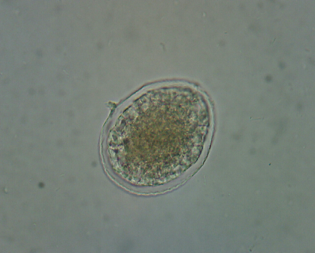
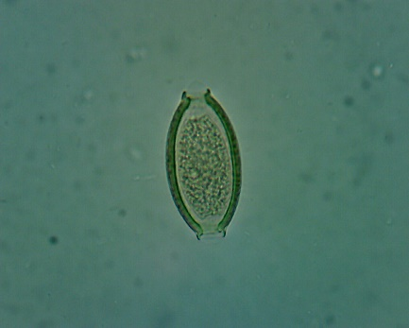
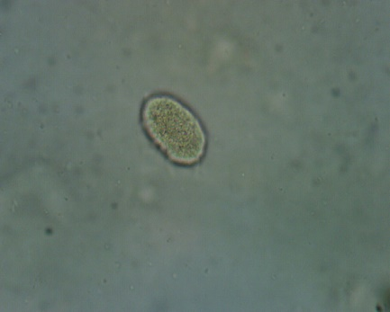
Soil-transmitted helminths: “Do what they say on the tin”…
Contact with infective parasite eggs/larvae in soil contaminated by human faeces…
Eggs on unwashed vegetables
Eggs ingested from contaminated water sources
Eggs ingested from contaminated soil (children, occupational exposure, etc)
Hookworm larvae penetrate skin.

Slide 7

Eggs in faeces
Ingested
Eventually adult worms in intestine
Eggs infective 18 days+ later
Hookworms different. Eggs hatch in soil & larvae penetrate host skin.

Slide 8
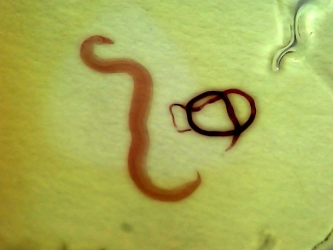
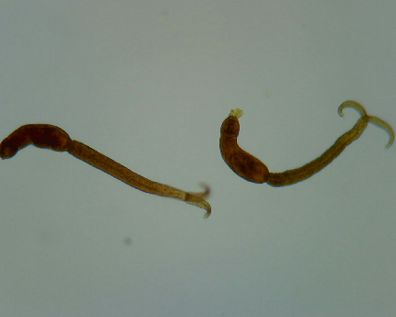
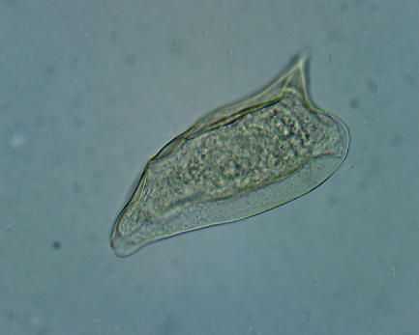
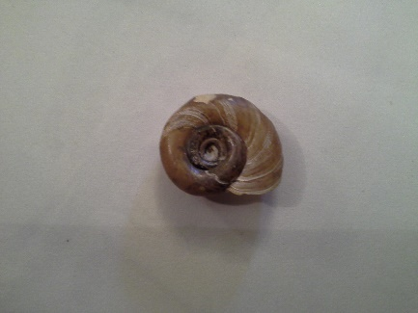
206.5 million people required preventative treatment for schistosomiasis (WHO, 2016)…
Contact with infective cercariae in contaminated water sources…
5 important species in humans

Slide 9
What can we do?
Education?
Provision of safe water & sanitation?
Address lifestyles?
Address attitudes?
Tackle poverty?
Research neglected diseases?
Funding?
Integrated approach.
Inequality…
Poorest children 1.9 times more likely to die before age 5.
800 children die each day from preventable diseases caused by poor water, sanitation & hygiene.

Slide 10
De-worm…
Large-scale programmes…
29/09/17 WHO published recommendations for large-scale de-worming…
Work…
2016 >385 million school-age children treated. 68% of those at risk.
Goal…
75% children by 2020.

Slide 11
Improve sanitation & water…
Reduces spread of STH & schistosomiasis.
Promotes dignity & safety.
Promotes school attendance.
Reduces malnutrition.
Faeces: valuable source of nutrients, renewable energy & water.

Slide 12
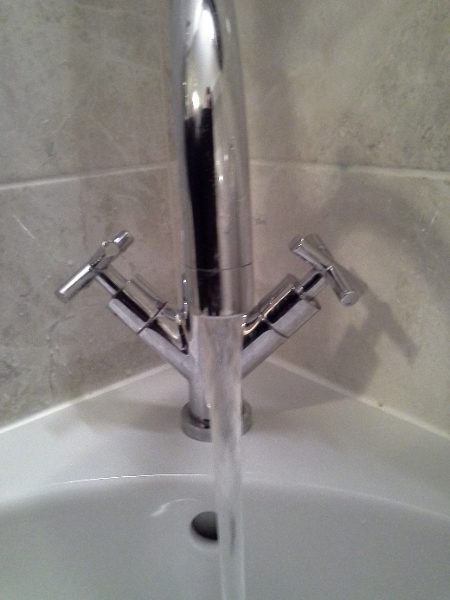
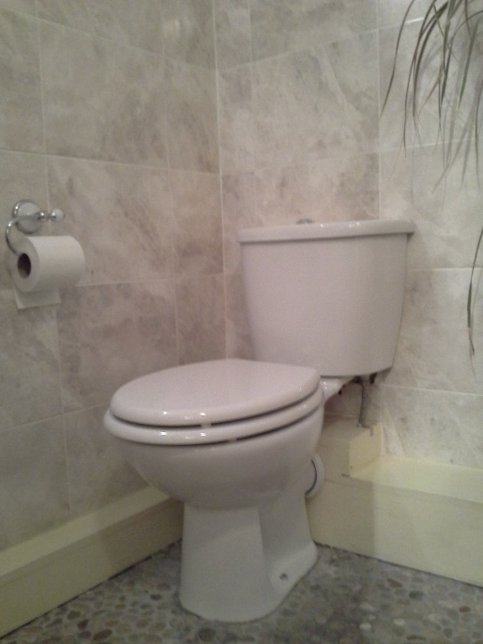
What can we do?
“Not my problem”?
Information & involvement?
Water Sanitation and Health (WASH)
  End open defaecation
  Universal access to basic services

Slide 13
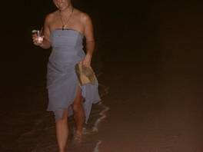
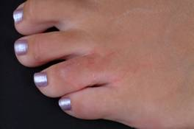
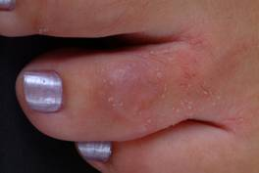
Parasites do not discriminate!
Travel & tourism
Honeymoon, St. Lucia.
Cutaneous larva migrans
  Hookworm larvae
Ivermectin.
https://www.aber.ac.uk/en/ibers/research-and-enterprise/research-groups/parasitology_epidemiology_group/

