Slide 1

Croeso | Welcome to ABS Level 3 Business Lecture Series
Notes:
Title page

Slide 2
Branding
Content to support Level 3 Business Qualifications
Dr Ian Harris – ihh@aber.ac.uk
Notes:
Everyday you are surrounded by brands
They are on your clothes
Your transport
Your lunchtime sandwiches
And articulated by promotion just about everywhere

Slide 3
Learning Outcomes
Outline Brand Definition
Explain the Historical Development of Brands
Discuss why marketers love brands
Compare brand image and brand identity
Discuss how brands align to “personality”
Describe the difference between Functional and Symbolic Brands
Compare and Contrast Emotional Selling Proposition with Emotional Selling Proposition
Notes:
Defining a brand
Why did brands historically develop
What is it about brands that is so essential

Slide 4
What is a Brand
A brand is:
“a name, term, sign, symbol or design or a combination, intended to identify the goods, or services of one seller or group of sellers, and to differentiate them from those of competitors”.
Kotler and Keller (2006)

Slide 5
History of Brands
2700 BC – Egypt, owners ”branded” cattle
  The brand outlined the owner – theft happened regularly in those days
A result of a fundamental need to identify property if it is traded – remember most were illiterate thus “symbols” were used rather than words
Large urban environments (towns) (2500 BC) needed brands to distinguish provenance of commodities
Since then, and particularly in the previous 30 years the sophistication of brands has matured to include broadly the following realms of influence
Components
Brand Identity
Brand Communication
Brand Awareness
Brand Loyalty
Brand Management Strategy

Slide 6
Why do Marketers Love Brands?
There are many advantages to having a strong brand:
  Competitive edge in marketplace
  Allows simple line extensions
  Promotes customer loyalty
  Improves customer recognition
  Enhances credibility and ease of purchase

Slide 7


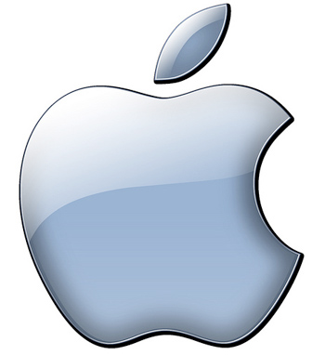


Branding
Successful brands create strong, positive and lasting impressions:
  through their communications and associated psychological feelings and emotions,
  not just their functionality through use.
Notes:
Symbol, but also:
Emotion – happiness, satisfaction, envy, nausea, inspiration
Associations – money, value, health

Slide 8
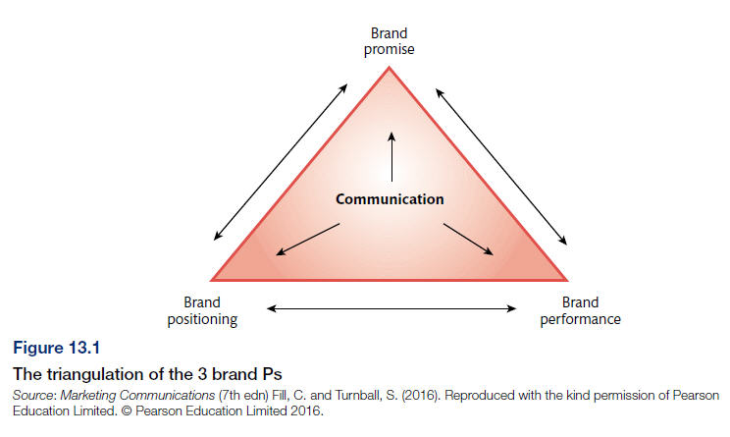

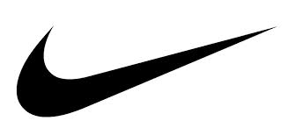
The Triangulation of the 3 Brand Ps
https://www.theguardian.com/news/2017/nov/06/nike-tax-paradise-papers

Slide 9


Manufacturers and Retailers enjoy brands because it…
Enables premium pricing.
Helps differentiate the product from competitive offerings.
Encourages cross-selling to other brands owned by the manufacturer.
Develops customer loyalty/retention and repeat-purchase buyer behaviour.

Slide 10
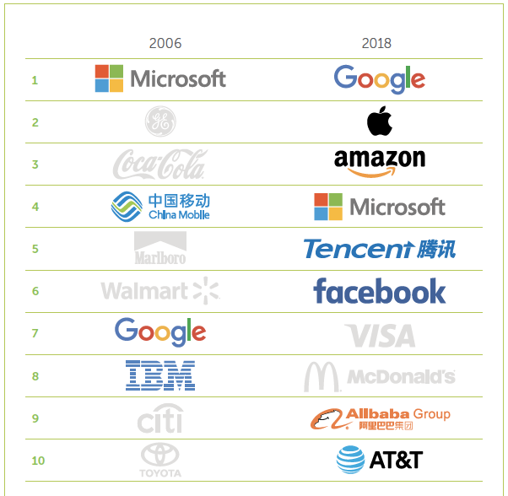
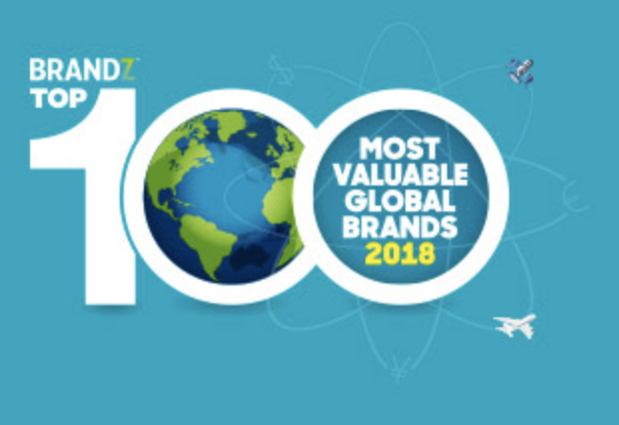
Tech Impact 2006 v 2018
FULL REPORT CAN BE DOWNLOADED HERE:
http://www.millwardbrown.com/brandz/rankings-and-reports/top-global-brands

Slide 11
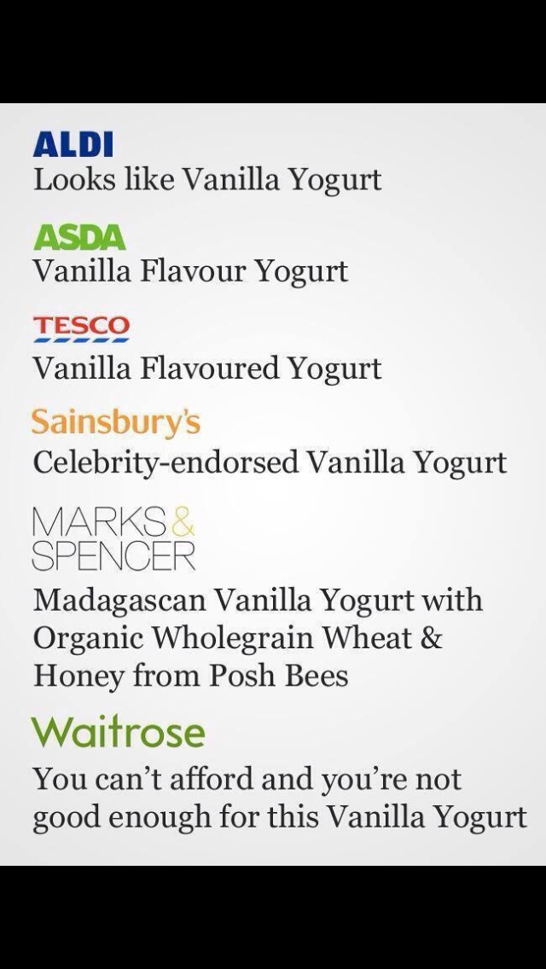
Consumers help co-create brand meaning

Slide 12
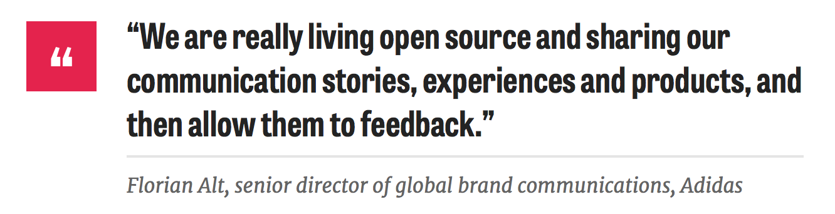
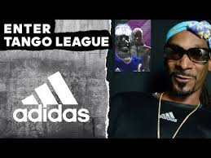
Brand Community:
Adidas Tango Squad
https://www.youtube.com/watch?v=STUbsydO0Ik
Currently 70% of global brand referrals happen on dark social not via Twitter or Facebook.

Slide 13
Brand Names
Simply something that can be spoken or written and through this identifies the brand, and differentiates it against any competition
Brand names may include
  Words
  Phrases
  Signs
  Symbols
  Designs
  Or combinations of the above

Slide 14
Brand Image
Probably better known as Brand Identity is
  The name, trademark, communications, and visual appearance
  It is what the brand owner wishes the customer to perceive the brand to be
  Image/Identify is a fundamental component for Brand Recognition and Brand Recall
  Recognition separates it from other brands in the same category, recall measures what benefits/message the consumer’s remember
Notes:
Brand Image, really is just what a brand Looks Like

Slide 15
Corporate Brand Identity
Kotler et al (2009) – Four levels of meaning for brand identity:
  Attributes
    A set of labels with which the company seeks association with
  Benefits
    Emotional translations for these labels
  Values
    What does a company seek to be in the eyes of the consumer
  Personality
    Associating a brand as a person
Notes:
Toothpaste:
A – strengthens teeth, fights decay
B – Less pain/time in dentists chair
V – Number ONE dentist recommended toothpaste
P – Someone attractive in a white coat

Slide 16
This is content that we test in the…
Aberystwyth University Entrance Exam
Successfully complete an exam (there are multiple points in the year and you can take it in the subject you are best at) and earn yourself an unconditional or reduced offer for the Business School
  More details here (use short link): https://www.aber.ac.uk/en/undergrad/before-you-apply/scholarships/entrance-scholarships-merit-awards/
Notes:
Bullet point list (animated)

Slide 17
Brand Personality
When consumers consume it is considered that they associate the psychological aspect (feelings, perceptions, experiences, beliefs) with the “actual function of consumption” to create a ”brand experience”
In simple English. If I decant prosecco into a champagne bottle the consumer will project what they feel about the symbolism of champagne to a very inferior wine and believe it is FANTASTIC
Kapferer (2003)
  “the set of human personality traits that are both applicable to and relevant for brands”
To imbue the brand with “human-like” characteristics
  The personality traits allow the brand to become “unique” symbolically (in the mind of the consumer)
Personalities have been “categorised” (Aaker, 1997)
  Sincere; exciting; competent; sophisticated; rugged
Notes:
Aaker conceptualised brand personality as consisting of five broad dimensions, namely: sincerity (down-to-earth, honest, wholesome, and cheerful), excitement (daring, spirited, imaginative, and up to date), competence (reliable, intelligent, and successful), sophistication (glamorous, upper class, charming), and ruggedness (outdoorsy and tough).

Slide 18
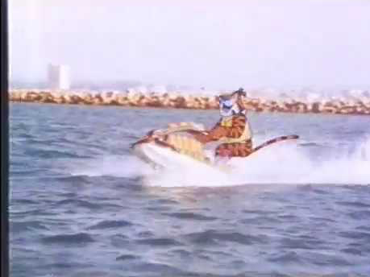

Slide 19
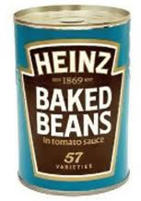
Brand Types
Manufacturer brands
Manufacturers try to create brand recognition and name recall through their marketing communications activities with end users.
The goal is to help customers identify the producer of a particular brand at the point of purchase. For example, Persil, Heinz, Cadbury’s and Coca-Cola.

Slide 20
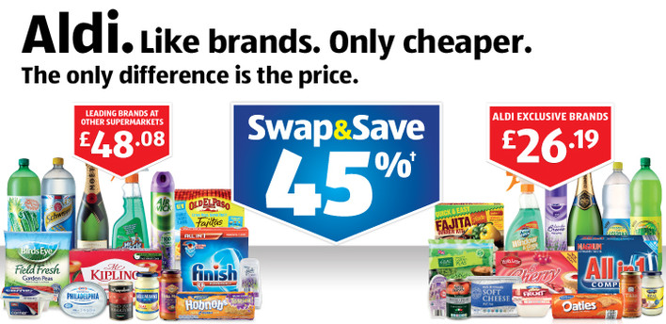

Brand Types
Distributor brands
refers to the identities and images developed by the wholesalers, distributors, dealers and retailers who make up the marketing channel. Also known as ‘own label’ brands.
Generic brands
are sold without any promotional materials or any means of identifying the company. The only form of identification is the relevant product category, for example, plain flour.

Slide 21
Functional Brands
Every brand has a functional element; the things that deliver the core benefits
  E.g. The functional element of toothpaste is that it cleans your teeth
But there are other toothpastes that clean teeth equally as well (it’s not a magic substance)
Supply certainly exceeds demand; therefore the functional component has no intrinsic value
To maintain sales consumers need to believe something symbolic about the brand/something other than functional benefit
Notes:
Colgate: 1873, sold in pots – 1896 collapsible tube

Slide 22
Symbolic Brands
To overcome market oversupply issues, brands typically try to deliver an emotional (symbolic) benefit
Even toothpaste shows evidence of the need of this emotional bond
  Do your parents/guardians typically buy the same brand/type..?
But why might an emotional bond exist?
  Familiarity, family well-being, safety
Symbolism works because other brands find it difficult to replicate (mimic)

Slide 23
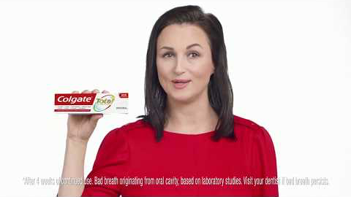

Slide 24
Symbolic Brands
Symbol-intensive brands are able to maintain a relationship with their customers that typically surpasses brand loyalty
Symbolic brands may be further sub-divided:
  Authority Brands
  Solution Brands
  Icon Brands
  Cult Brands
  Lifestyle Brands

Slide 25
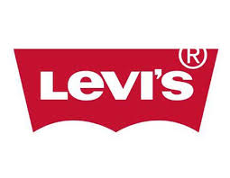
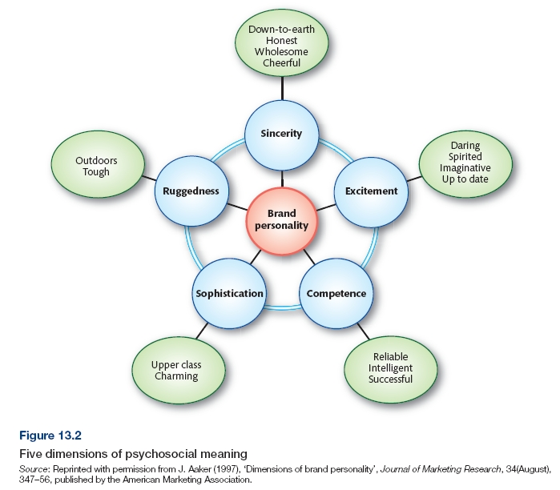
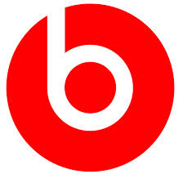

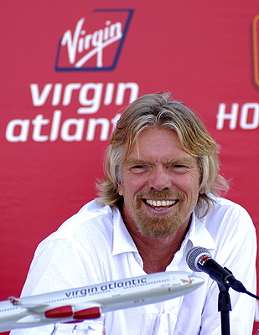


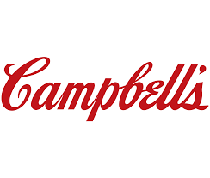


Five Dimensions of Psychosocial Meaning
https://www.youtube.com/watch?v=EgU-RWQ4J7o

Slide 26
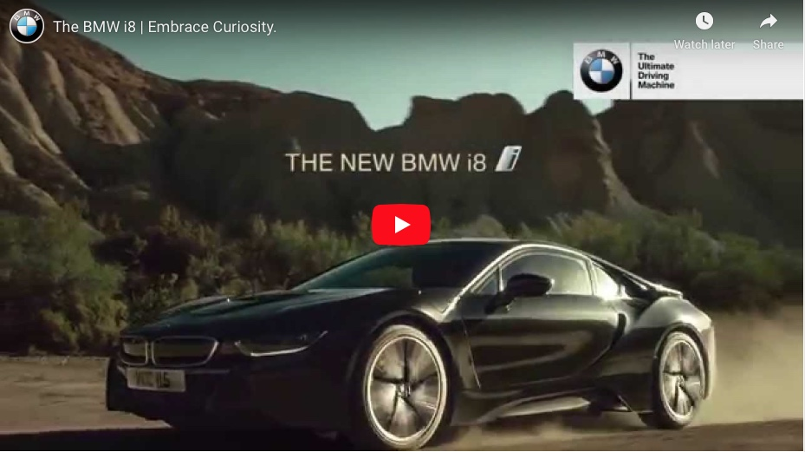
Unique Selling Proposition (USP)
Thus a USP differentiates a product/service/brand because it possesses a unique benefit
“one feature (attribute) of the product that stands out as being different from the competition” (Blythe, 2005)
A “clear” USP helps consumers understand differences between brands, and leads to positive attitude and intention towards the brand
To find this USP requires a great deal of research
To promote this USP requires a great deal of promotion
To secure this USP requires considerable focus
It has taken BMW decades to reinforce “The Ultimate Driving Machine” most recently rolling it out to challenge Tesla (Electric vs Hybrid)
This hair product positioned it’s USP as
“Clinically proven to reduce dandruff”
Can you guess who it is..?
Head and Shoulders – now think about how the name of the product (dandruff is mostly found on your shoulders) reinforces the efficacy of Pyrithione Zinc – thankfully they did not call the product this…
Term was created to try to understand the basis of successful advertising in the 1940s
Unique propositions aimed at the centre of the mass market
Such propositions quickly persuaded consumers to switch supply. Was the precursor to
  “Differentiation is one of the most important strategic and tactical activities in which companies must constantly engage” (Levitt, 86)

Slide 27
Emotional Selling Proposition (ESP)
Whilst USP deals with “logical benefits” or functions of a product
Emotional Selling Proposition seeks to “differentiate” against emotional responses
In a marketing degree you’d be aware of the Tricomponent Model which simply translates to:
  Think – Feel – Act
USP maps to “thinking” or cognition
ESP maps to “feeling” something or affective
Some ways in which promotion targets you via ESP
  That you feel important
  That you feel remembered
  That you feel attractive
  That you feel trendy
It’s about “feeling something about the brand”

Slide 28
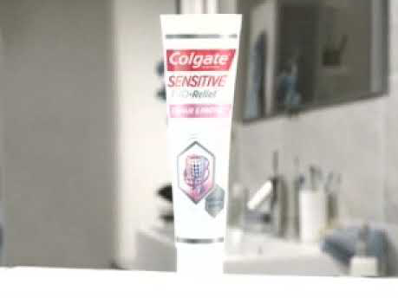
Notes:
Banned advert

Slide 29
Branding, brand personality, brand image, unique selling point (USP), implications of business size for marketing activity, budgetary constraints, availability of specialist staff

Slide 30
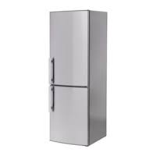
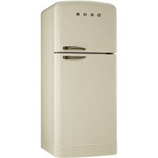
Why are brands important?
Brand can account for 10% change in stock price.
The value of the BrandZTM Top 100 Most Valuable Global Brands 2018 is $4.4bn, 21% up on 2017.
Important to differentiate between ‘product’ and ‘brand’….“products are created in the factory, but brands are created in the mind.” Walter Landor.

Slide 31
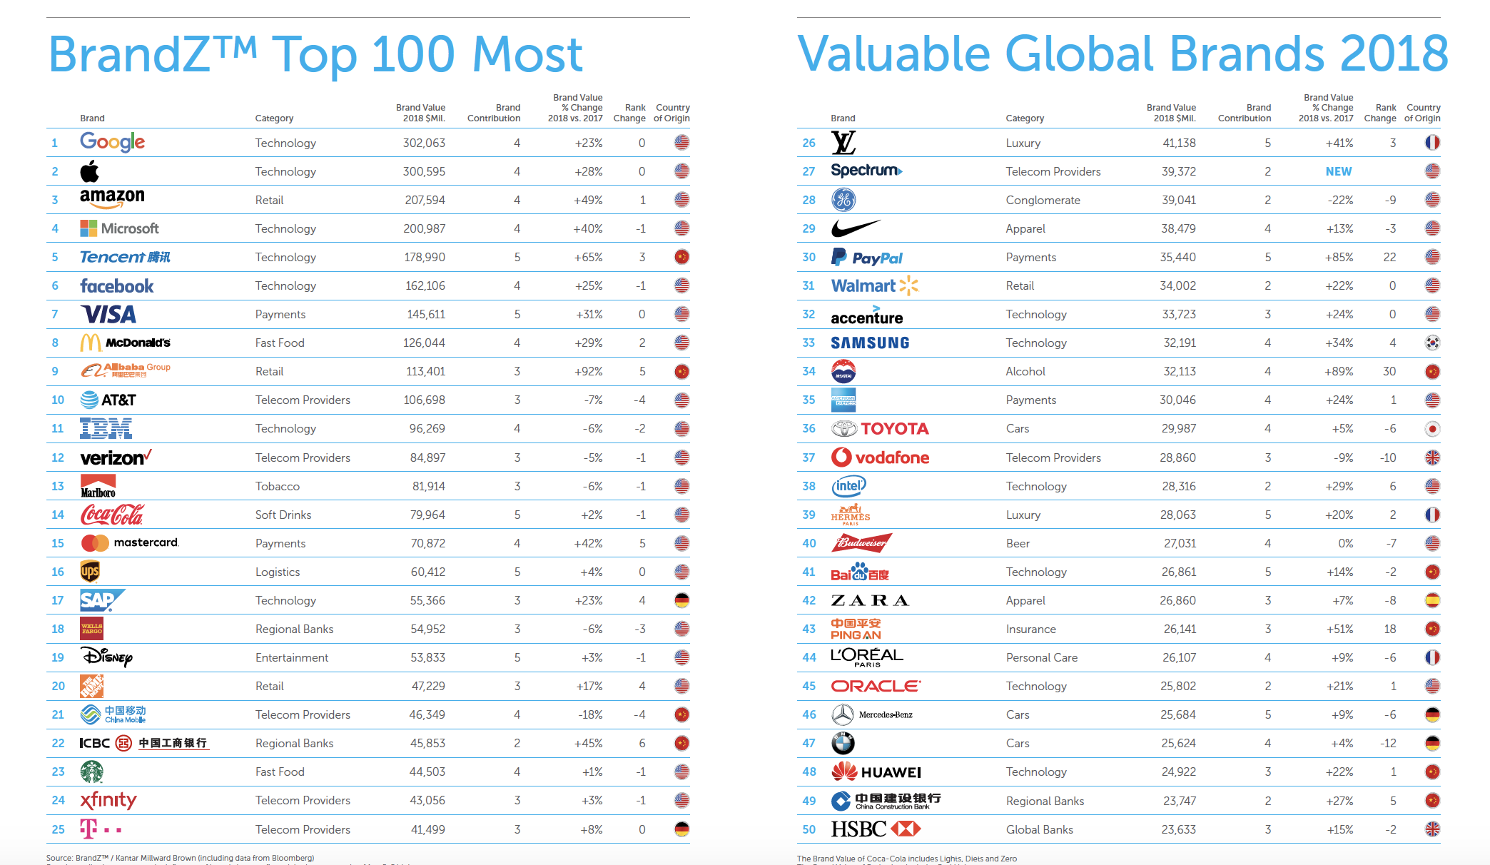

Most Valuable Global brands 2018

Slide 32
Consumers like brands because?

Slide 33
Consumers like brands because it…
Helps us to identify our preferred products.
Reduce levels of perceived risk and in doing so improve the quality of the shopping experience.
Helps people to gauge the level of product quality.

Slide 34
Consumers like brands because it…
Reduces the amount of time spent making product-based decisions and in turn decrease the time spent shopping.
Provides psychological reassurance or reward, especially for products bought on an occasional basis.
Informs consumers about the source of a product (country or company).

Slide 35
Relationship orientated buyers
Crosby (2012) Relationship orientated buyers appreciate and seek:
Information sharing
Recognition
Customisation
Appreciation
Exceptional customer service
Personalisation
Reciprocity
Fairness
Harmonious interactions
Cooperative problem solving

Slide 36
Companies like brands because?

Slide 37

Manufacturers and Retailers enjoy brands because it…
Assists the development and use of integrated marketing communications.
Can deter competitors from entering the market
Provides some legal protection.

Slide 38
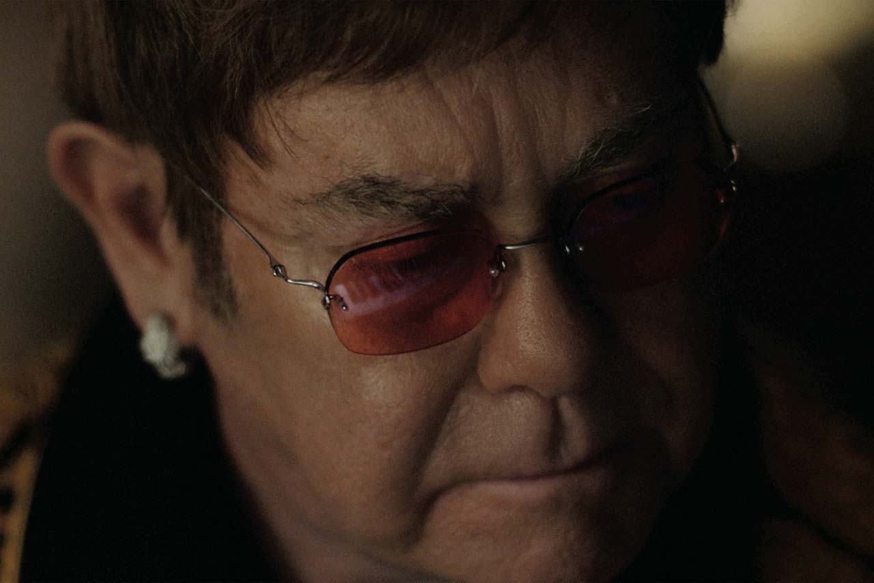
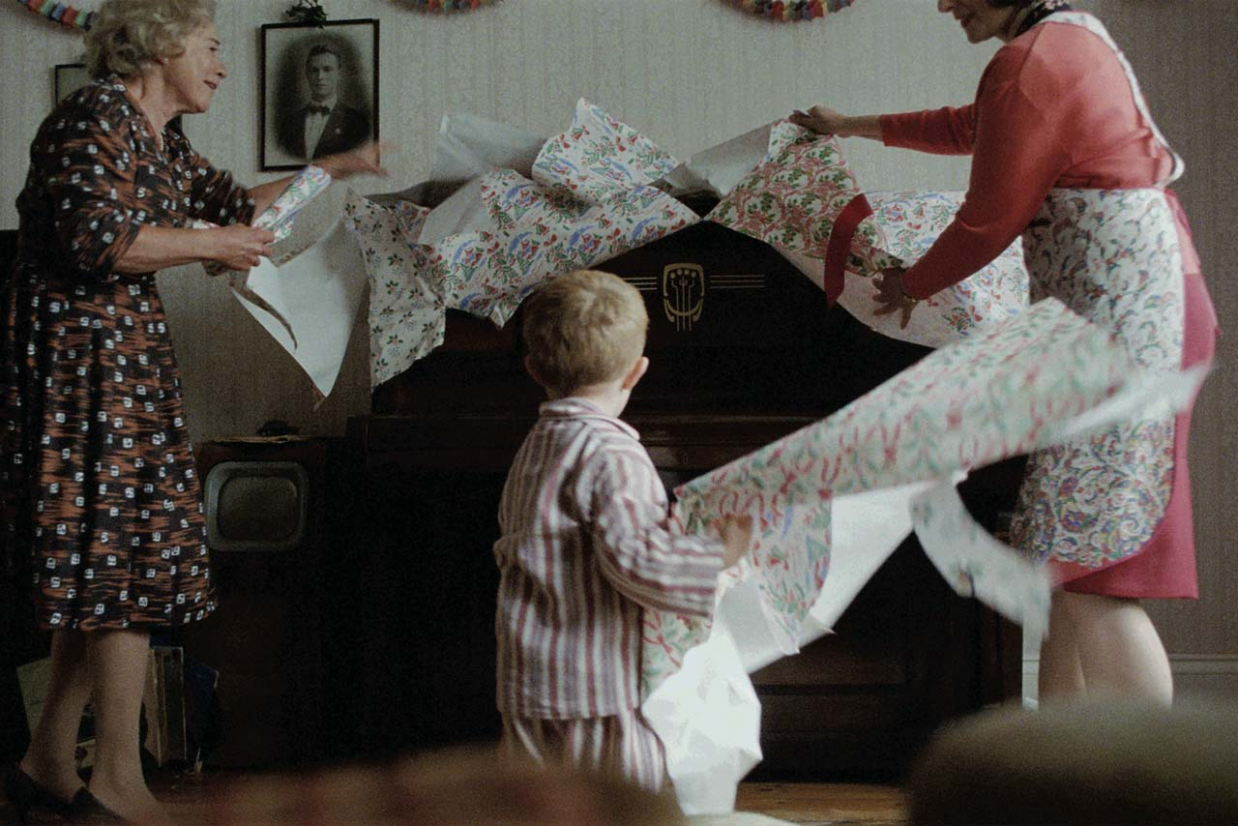
John Lewis Christmas 2016:
https://www.youtube.com/watch?time_continue=1&v=mNbSgMEZ_Tw
Exercise in pairs/groups:
What is the message communicated?
  Functional benefit?
  Emotional benefit?
Who is the target audience?
Does it DRIP?

Slide 39

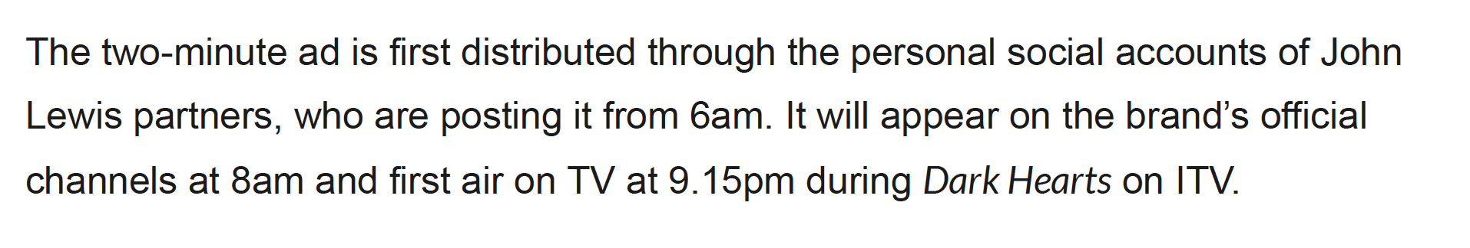
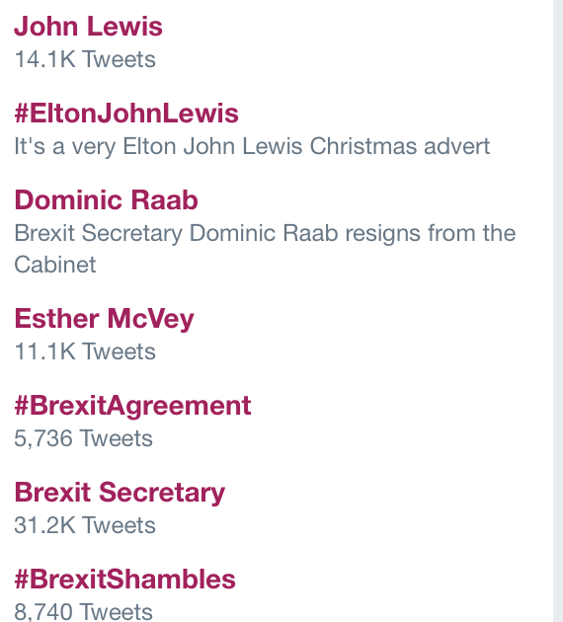
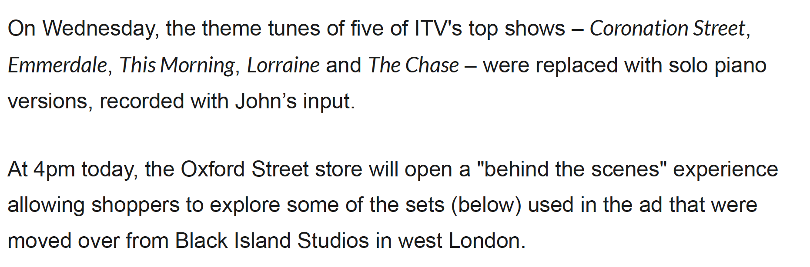
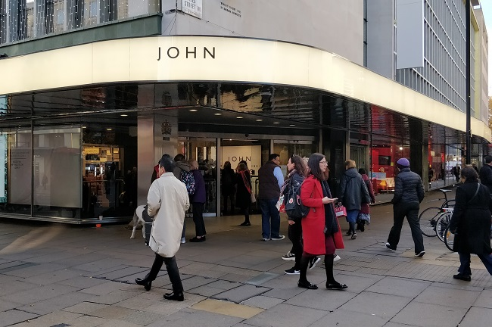

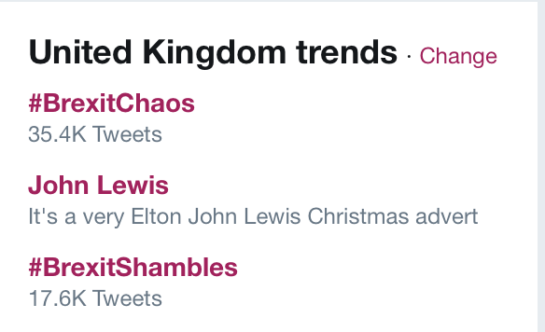
Impact and some nice touches:
9.,30 a.m.
1.00 p.m.

Slide 40
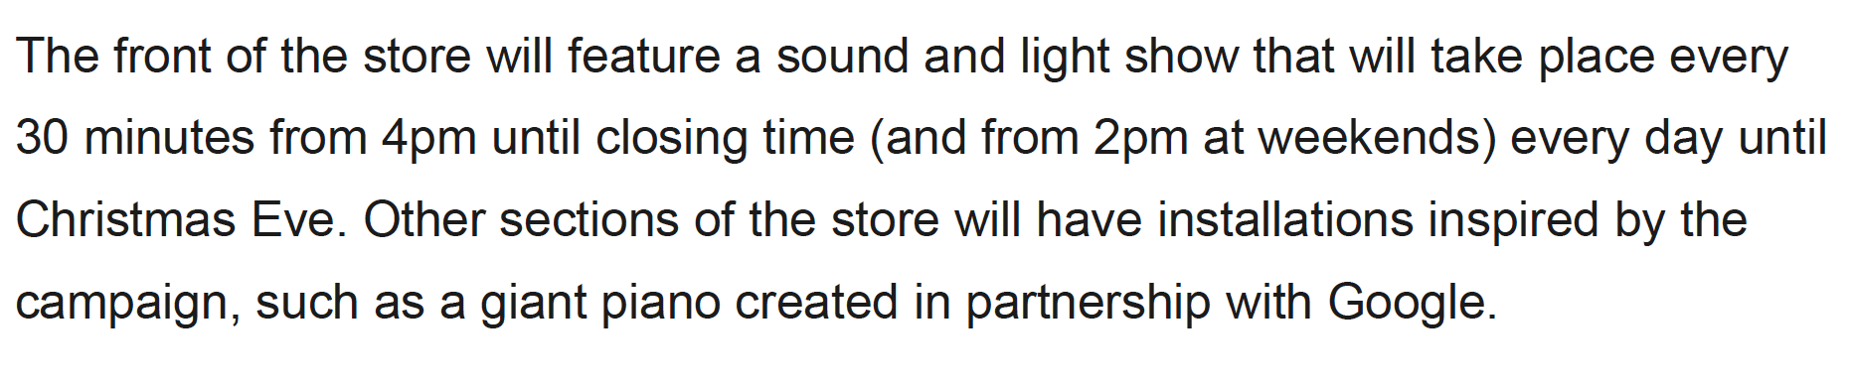
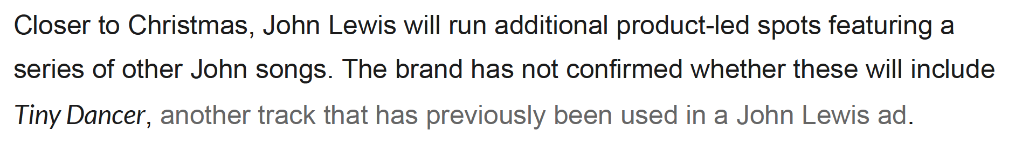
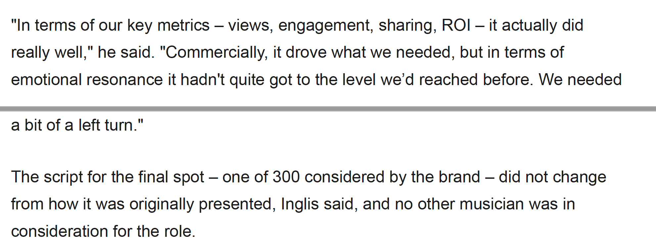
More to come & Why the change?
Why change? Needed to improve on Moz

Slide 41
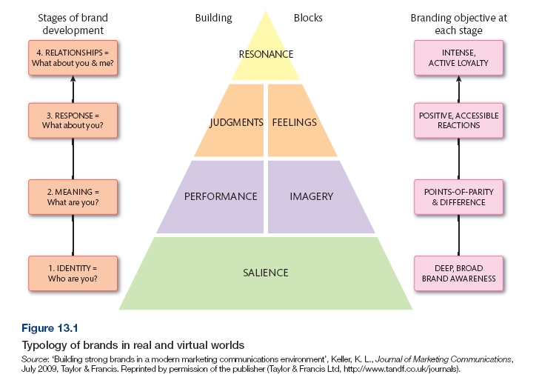
How to Build a Brand – Keller’s Customer Based Brand Equity Model

Slide 42
Elements of Keller’s Brand Pyramid
Brand salience - how easily and often do customers think of a particular brand?
Brand performance - how well do customers believe a particular brand performs?
Brand imagery - describes the extrinsic properties of a brand (the colour, the
packaging, the product consistency, associations) and level to which these satisfy
customers’ psychological or social needs.
Brand judgements – a customers’ own personal opinions and evaluations
about a brand.
Brand feelings - customers’ emotional responses and reactions with respect to
the brand when prompted by communications or by friends.
Brand resonance - the nature of the relationship customers have with the
brand and the extent to which they feel loyal to the brand.

Slide 43
Brand Associations
Brands can be used to trigger associations in the minds of customers. These associations may enable customers to construe a psychosocial meaning which they learn to associate with a particular brand.
Aaker (1997) developed a Brand Personality Scale to reflect the main human characteristics that she found people associate with brands.

Slide 44
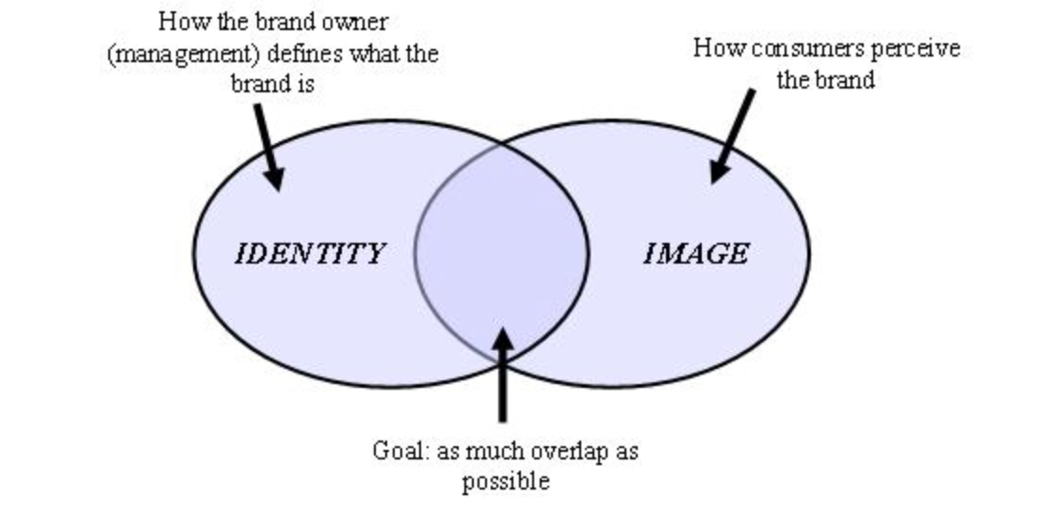
Brand building exercise
In groups, pairs or individually
List meanings of your favourite brand
Repeat the exercise with your least favourite brand

Slide 45
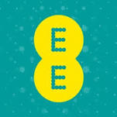
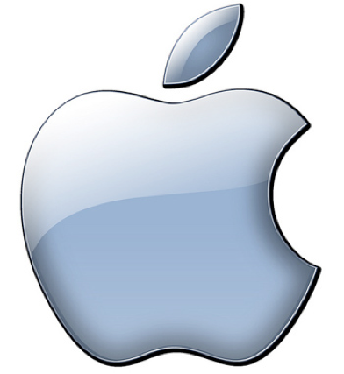
Example
Apple ($302 billion)
  Innovative
  Reliable
  Supportive
  Easy to Use
  Generous
  Happy to be part of the family.
  Solid
EE
  Nags
  Unhelpful
  Annoying
  Unreliable
  A hassle to pronounce
  Website is poor poor poor

Slide 46
Brand Policies
Individual Branding – requires that each product offered by an organization is branded independently of all the others.
  Unilever (e.g. Knorr, CiF and Dove)
  Procter and Gamble (e.g. Pampers, Head and Shoulders)
‘Used to’ typify this approach, but both are cutting back on their brand portfolio.

Slide 47


Brand Policies
Moving towards ‘family branding’
Corporate branding for CSR purposes

Slide 48
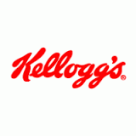

Brand Policies
Family Branding
Products use the organisation’s name, either entirely or in part.
Microsoft, Heinz and Kellogg’s all incorporate the company name as it is hoped that customer trust will develop across all brands.
Corporate Brands
Single umbrella brand, based on the name of the organization.
Brand name used at all locations and is a way of identifying the brand and providing a form consistent differentiation, whether on the high street or online. For example, Tesco, IBM and Caterpillar.

Slide 49
Question 1
Cadbury brand is a good example of:
a) distributor brand.
b) manufacturer brand.
c) generic brand.
d) niche brand.

Slide 50
Question 2
_________ is a strategic activity and is used to differentiate and distinguish a brand, so that a consumer understands the brand, not just remembers it.
a) Brand heritage
b) Brand anatomy
c) Brand positioning
d) Brand extension

Slide 51
Brand Relationships & Co-Creation
Fournier (1998) stresses the importance of understanding how brands add value to peoples’ lives, including the personification of brands.
Increased use of user generated content enables consumers to redefine what brands mean to them.
Customers attach a name, term, or other feature that enables them to identify one seller’s good or service as distinct from those of other sellers ( AMA 2012 ). This is commonly referred to as co-creation.

Slide 52

Brand co-creation through UGC
User generated content allows for greater consumer contribution to creation of brand associations.
Paddy Power ‘mischief makers’ .Random items shared across the internet.

Slide 53
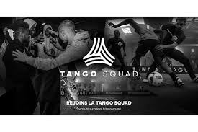
https://www.marketingweek.com/2016/10/06/adidas-on-redefining-influencer-marketing-through-dark-social/
Groups of socially savvy 16-19-year-old football content creators in 15 key cities
Each group is managed by an Adidas in-house team,
All content is mobile optimised and shot in portrait selfie-style to add to the authenticity.
squad members are invited to to take part in experiences like meeting players.
Currently 70% of global brand referrals happen on dark social not via Twitter or Facebook.

Slide 54
Brand Community:
Adidas Tango Squad
https://www.youtube.com/watch?v=STUbsydO0Ik
Currently 70% of global brand referrals happen on dark social not via Twitter or Facebook.

Slide 55

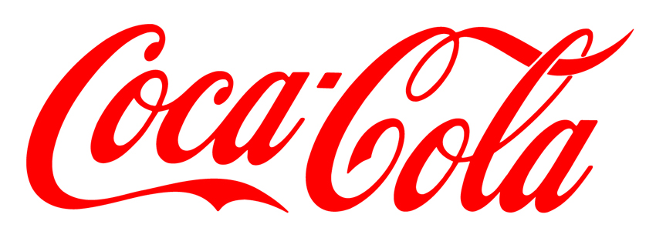

Sector Branding
Service Brands
Global Brands
B2B
Brands
Internal Brands

Slide 56

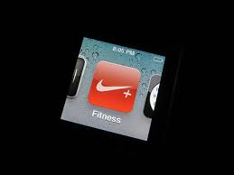
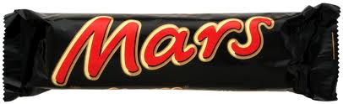
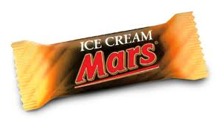
Brand Strategies
Rebranding
Brand extensions
Co-branding
Hem, de Chernatony and Iversen, (2003)

Slide 57

Brand Equity
A brand with a strong equity is more likely to preserve its customer loyalty and fend off competitors
Feldwick suggests there are three elements associated with brand equity:
Brand Value – a financial base
Brand Strength – a consumer’s attachment to a brand
Brand Description – specific attitudes consumers have towards a brand.

Slide 58
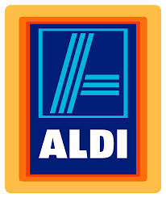


Brand Values
Best brands in the world built on distinctive but solid values.
Values guide our decisions and behaviour – fundamental to business.
A combination of distinctiveness, authenticity and a compelling story.
Don’t be too obvious or bland e.g. honest, innovative.
(source: Simon Middleton, Build a Brand in 30 days)
Notes:
58

Slide 59

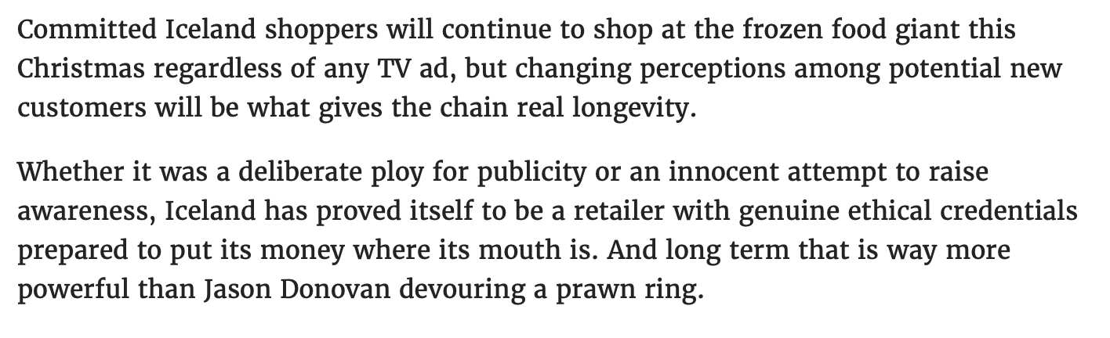
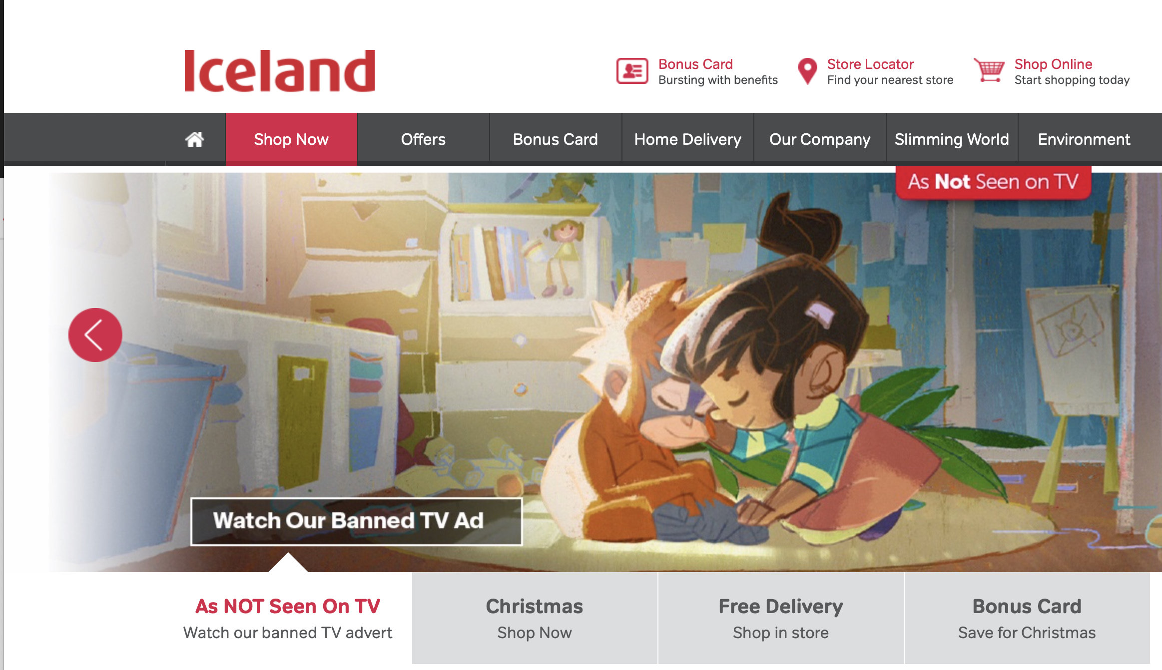
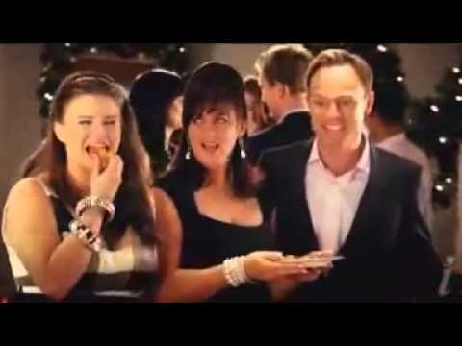
Marketing Week 13 November 2018
https://www.youtube.com/watch?time_continue=1&v=JdpspllWI2o
https://www.youtube.com/watch?v=qYktaaEPXXo&list=PL25FB0FCD42ED3E91

Slide 60
Question 3
A measure of the value and strength of a brand, including an assessment of a brand's wealth is known as:
a) brand stretching.
b) brand heritage.
c) brand name.
d) brand equity.

Slide 61
Diolch | Thank you
Notes:
Title page

Slide 62
Notes:
Title page

Slide 63
Notes:
Title page

Slide 64
Notes:
Title page

Slide 65
Notes:
Title page

Slide 66
Notes:
Title page

Slide 67
Notes:
Title page

Slide 68
Notes:
Title page

Slide 69
Notes:
Title page

Slide 70
Notes:
Title page

Slide 71
Notes:
Title page

Slide 72
Notes:
Title page

Slide 73
Notes:
Title page

Slide 74
Notes:
Title page

Slide 75
Notes:
Title page

Slide 76
Notes:
Title page

Slide 77
Notes:
Title page

Slide 78
Notes:
Title page

Slide 79
Notes:
Title page

Slide 80
Notes:
Title page

